Slide 1
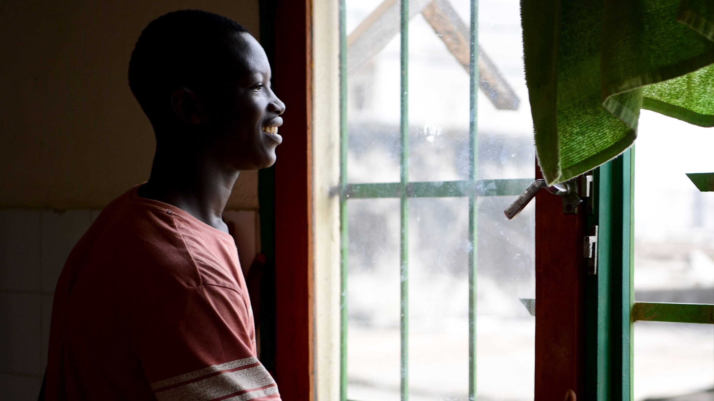


© UNICEF/Dejongh
Activity 4
UNICEF UK, registered charity England & Wales (1072612) Scotland (SC043677).
What affects our mental health?

Slide 2
MENTAL HEALTH MYTHS AND MISCONCEPTIONS
What do you know about the facts of mental health, now and in the past?
Notes:
Part 1
Explain that throughout history and up until the present day, what we know about mental health has been built on many misunderstandings, myths and misconceptions. If we want to move our society forward in how we see mental health, we need to know what’s fact about mental health (both now and in the past), and what is false.
Explain to the young people that they will be shown a series of different statements. The first half of these are statements about mental health and wellbeing and treatment in the past, and the second half of these are statements about the state of mental health currently in the UK and around the world.
Review each statement, asking one young person to read it to the group. Ask young people to vote on whether they think the statement is a fact or a false statement (a mental health myth or misconception).
As each statement is completed, give the young people opportunities to discuss their reaction to the information shared, and to give their thoughts on what made them think that some statements were myths or misconceptions.

Slide 3

1. The first laws in the UK around mental health were regulations for ‘madhouses’ where people with mental health conditions were detained and often abused.
TRUE
Notes:
TRUE
The Madhouses Act 1774 was the first legislation in the United Kingdom addressing mental health. Madhouses were private homes where the owner was paid to detain the residents, with little or no medical involvement.
Two forms of abuse were common in madhouses. The first was keeping people with mental health conditions in atrocious conditions with no care, and second was the detention of people who did not have a mental health condition – in effect, private imprisonment.

Slide 4
2. An order in the UK in the late 1800s called the ‘Lunacy Act’ required local authorities to create and maintain institutions called ‘Insane Asylums’ or ‘Mental Hospitals’ to treat people who had mental health conditions away from their families.
TRUE
Notes:
TRUE
The UK’s 1890s Lunacy act placed an obligation on local authorities to maintain institutions for people who had mental health conditions. By 1938 131,000 patients were in local authority ‘mental hospitals’ in England and Wales, and 13,000 in district asylums in Scotland, where there were also seven ‘Royal Mental Asylums’.

Slide 5
3. The UK appointed its first minister for mental health and suicide prevention during World War II to help treat soldiers returning from war.
MYTH
Notes:
MYTH
The impacts of WWII on the mental health of people in the UK were great and lasted long after the war. However, at the time of WWII, the UK Government did not have a Minister in charge of mental health.
On World Mental Health Day in 2018, the UK Government hosted the first ever global Mental Health Summit, reflecting the growing importance of this issue for the Government’s priorities. So much so, that on the same day, the Prime Minister announced the creation of a new minister in charge of suicide prevention and mental health. The creation of new ministers is decided by the Prime Minister and since the creation of the role in 2018, it has remained a continuous priority for each successive administration and Prime Minister. Indeed, the current role has been broadened and the Minister of State is now in charge of patient safety, suicide prevention and mental health, reflecting the importance of mental health as a policy priority within the Department for Health and Social Care.
In Scotland, Wales, and Northern Ireland health policy, and mental health policy, is largely devolved, which means the respective governments in each nation are responsible for their own nation’s policies and actions. The governments of Scotland and Wales are also taking wide action to support children’s and adult mental health. For example, in Scotland, the First Minister has appointed a Minister in charge of Mental Wellbeing and Social Care. In Wales, the First Minister has also appointed a Deputy Minister in charge of Mental Health and Wellbeing, and in Northern Ireland, the Health Minister holds the remit for the mental health portfolio.

Slide 6
4. Mental health treatment significantly changed when the NHS was established in 1948.
MYTH
Notes:
MYTH
When the NHS was established in 1948, mental health services were not integrated or prioritised with physical health services.
Currently, the majority of mental health care in the UK is now provided by the NHS, assisted by the private and the voluntary sectors.
In 2018/2019 the NHS reported it was struggling to cope with rising demand for mental health care and one big area of concern was depression, anxiety and suicidal thoughts in school-age children and young people.

Slide 7
5. The UK was one of the first countries to create asylums as a way to treat people who had mental health conditions, but it was also one of the first countries to turn away from mental institutions as the primary mode of treatment and shift to a community care model.
TRUE
Notes:
TRUE
The UK was one of the first countries to establish asylums as a way to treat mental health patients, and it was also one of the first countries to move away from them.
In the 1960s the UK began to shift its treatment of mental health away from institutions and asylums towards providing care in the community.

Slide 8
6. Today, mental health problems are very rare in children and young people because modern care is much more advanced.
MYTH
Notes:
MYTH
Adolescence is a time of significant psychological, physical and social change, and this can heighten the risk of mental health problems. Plus, socio-economic factors including trauma, stress and life events have the greatest effects on mental health and wellbeing during the developmentally sensitive phases of early life and adolescence.
Around the world, diagnosable mental health conditions affect about one in seven (14 per cent) of children and young people aged six to 18; and 20 per cent of young people aged 12-18 have a mental health condition.
Source: Unicef Global Advocacy Priority, Strategy 2021-2025

Slide 9
7. Race, gender and sexual identity can play a role in determining your mental health and put some children and young people at greater risk of mental health conditions.
TRUE
Notes:
TRUE
Some young people, depending on their race, gender and sexual identity, are at greater risk of mental health conditions.
Young people who are denied the ability to express themselves and be accepted for that (often due to cultural norms or laws where they live) are more likely to be depressed and/or die by suicide if they cannot access support.
Many LGBTQ+ people experience mental health problems. The bisexual and transgender communities have the highest rates of mental health concerns within the LGBTQ+ population. Younger members of the LGBTQ+ community struggle the most with mental health concerns of all the age groups.
Personal, family, and social acceptance of sexual orientation and gender identity can affect the mental health and personal safety of LGBTQ+ individuals.
Source: mhanational.org/issues/lgbtq-communities-and-mental-health

Slide 10
8. If mental health was better addressed in children and young people, fewer young people would become adults with mental health problems.
TRUE
Notes:
TRUE
50 per cent of those with lifetime mental health problems first experience symptoms by the age of 14.
The consequences of not addressing mental health conditions in young people extend to adulthood, impairing both physical and mental health and limiting opportunities to lead fulfilling lives as adults.
Source: who.int/news-room/fact-sheets/detail/adolescent-mental-health

Slide 11
9. People with mental health problems can’t recover and will not ever lead full, independent lives.
MYTH
Notes:
MYTH
People can and do recover from mental health conditions and recovery means being able to live, work, learn and participate in the community. There is lots of different support and help available to help people recover.

Slide 12
10. Globally, depression is one of the leading causes of illness and disability among young people and suicide is the third leading cause of death in 15 to 19-year-olds, and is preventable.
TRUE
Notes:
TRUE
50 per cent of those with lifetime mental health problems first experience symptoms by the age of 14. Globally, depression is one of the leading causes of illness and disability among young people, and suicide is the third leading cause of death in 15 to 19-year-olds, and is preventable. Suicide claims the lives of up to 800,000 people every year (1 person every 40 seconds)
Source: who.int/news-room/fact-sheets/detail/adolescent-mental-health
If mental health trends carry on without change, depression will be the leading disease in the next 10 years. Source: UNICEF Global Advocacy Priority, Strategy 2021-2025

Slide 13
How does the history and culture of silence around mental health affect how people today feel about talking about their mental health?
How did the way that people were treated in institutions or ‘lunatic’ asylums affect their rights?
How does this history impact your rights today?
Notes:
Ask young people to split into small groups to reflect on the myths and misconceptions activity using the discussion questions.

Slide 14
-
+
!
Plus
Minus
Interesting
Notes:
For the final question ask:
+ PLUS
What did you like?
What did you learn that was positive?
- MINUS
What didn’t you like?
What did you learn that was negative?
! INTERESTING
What surprised you?
What did you learn that was interesting?

Slide 15
WHAT FACTORS OR EVENTS AFFECT OUR MENTAL HEALTH?
Notes:
Introduce the activity, explaining that on each table there is a card that is face down. On the card there is a topic written. Once the time starts, the group will turn over their card and have 10-15 minutes to discuss how they think that the topic listed on the card affects the mental health of young people and why. Encourage each group to think about both positive and negative effects. If time and resources permit, allow young people to use the internet to research the topic, looking at reports like UNICEF’s State of the World’s Children 2021 report to search for current facts.
At the end of the time, give each group five minutes to report back on their topic. When each group has reported back ask the whole class what might be the impact on mental health if a person experienced two or more of these factors? For example what might be the impact on mental health of race AND technology or gender and sexuality AND culture/country?
Allow young people to guide the conversations, using the discussion prompts in the facilitator notes as necessary.

Slide 16
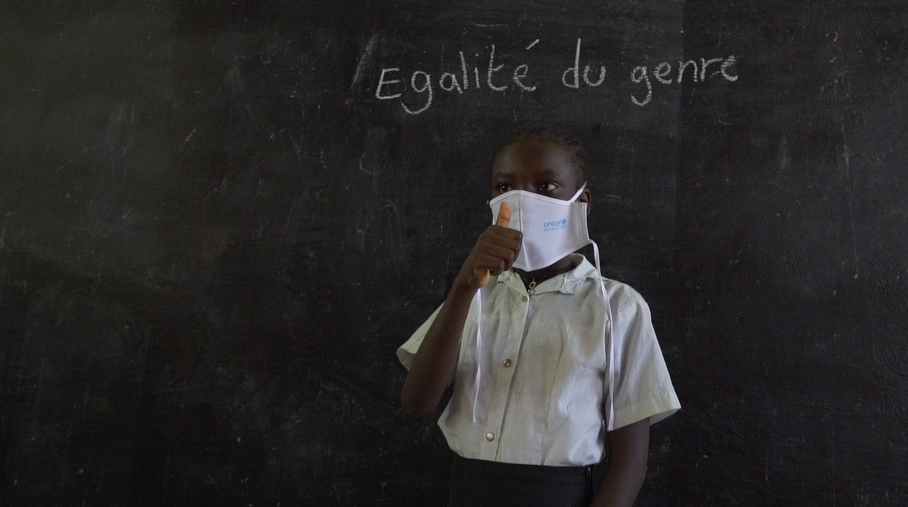
© UNICEF/Mulala
GENDER AND
SEXUAL IDENTITY
Notes:
Discussion prompts:
Society discriminates against many children and young people because of their gender or sexual identity. Prolonged stress around expressing sexual identity can lead to mental health conditions including depression.
Young people who are denied the ability to express themselves and be accepted for that (often due to cultural norms laws where they live) are more likely to be depressed and/or die by suicide if they cannot access support.
Many LGBTQ+ people experience mental health problems. The bisexual and transgender communities have the highest rates of mental health concerns within the LGBTQ+ population. Younger members of the LGBTQ+ community struggle the most with mental health concerns of all the age groups.
Personal, family, and social acceptance of sexual orientation and gender identity can affect the mental health and personal safety of LGBTQ+ individuals.
Source: mhanational.org/issues/lgbtq-communities-and-mental-health

Slide 17

RACE
© UNICEF/Dawe
Notes:
Discussion prompts:
Racism is a mental health issue because experiencing racism causes trauma and long-term trauma has a direct link to mental health problems.
Prolonged fear and anxiety associated with experiencing racism.
Young people from minoritised communities including those of black and ethnic backgrounds may struggle with long-term feelings of isolation and not fitting in, affecting mental wellbeing.
Young people who are living as refugees or asylum seekers in another country may experience long-term mental health conditions as they are living somewhere where they may not feel accepted and have not always chosen to be.
In some places people who are minoritized or experience racism may have even less access to mental health care and support than what is available to other people in the same place.
Source: UK Mental Health Foundation

Slide 18
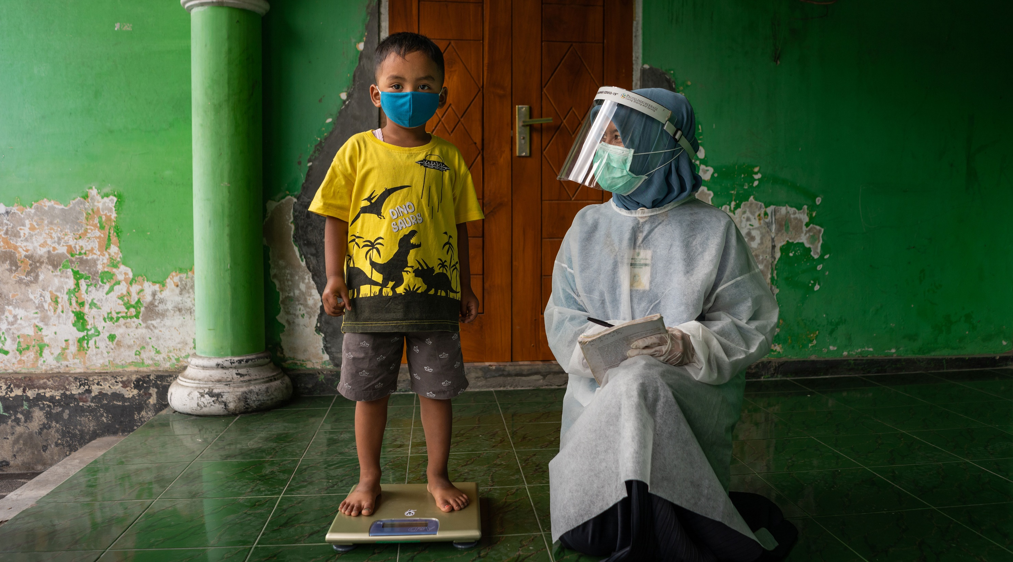
© UNICEF/Ijazah
COVID-19
Notes:
Discussion prompts:
COVID-19 has put the mental health and wellbeing of an entire generation at risk.
The COVID-19 pandemic has disrupted the lives of children, young people, and their parents and caregivers across the globe.
COVID-19 has disrupted many of the foundations that underpin young people’s mental health and wellbeing; like school, activities, and having social interactions with friends and time.
All children and young people have been exposed to prolonged trauma due to the pandemic.
Young people who are already at risk because of other factors have had increased risk without safe social support structure for many months.
Many young people feel worried and anxious about learning and performing on exams after missing many months of school due to lockdowns.
Source: UNICEF UK

Slide 19

SMART PHONES AND SOCIAL MEDIA
© UNICEF/Dawe
Notes:
Discussion prompts:
Our smart phones and social media help us stay connected with our friends, but also have negative implications for the long-term mental health of many young people around the world.
Some young people link their self-esteem and value to their ‘likes’ or social media presence. Young people report social media linking to increased feelings of depression, anxiety, poor body image and loneliness.
Some young people experience online bullying.
Source: Childmind

Slide 20

© UNICEF/Pouget
ADULTS AND CARERS
Notes:
Discussion prompts:
It is estimated that globally 15-23 per cent of children live with a parent who has a mental health condition.
Children facing violence, neglect, and abuse in the home are more likely to develop a mental health condition.
Half of all mental health conditions start by 14 years of age, but most cases, while treatable, go undetected and untreated. Mental health problems in adults would be lower if young people had early access to treatment for mental health conditions when the conditions first surfaced in childhood or adolescence.
Some parents or carers may find it hard to talk about emotions and mental health because these issues were ‘taboo’ or hidden when they were growing up. Children who do not feel safe to talk about mental health with parents or carers at home may have more challenges staying in a healthy place on the continuum.
Children talking about mental health with their parents may make it easier to normalise the topic and therefore make it easier for adults to help.
Children and young people who live in households where they are not looked after well by their parents or carers, may need to look outside the home for safe people to talk to.
Source: https://www.rcpsych.ac.uk/mental-health/parents-and-young-people/information-for-parents-and-carers/parental-mental-illness-the-impact-on-children-and-adolescents-for-parents-and-carers

Slide 21

© UNICEF/Matas
CULTURE AND COUNTRY
Notes:
Discussion prompts:
Mental health services are an under-funded area in all countries, both rich and poor.
In many countries there is low political will and commitment to address mental health, lack of awareness around mental health, and low public demand for services due to stigma and discrimination.
Young people who live in humanitarian emergencies and in poorer countries around the world are at higher risk, and likely have less access to care for both their physical and mental wellbeing.
In some cultures, topics that are considered to be private, such as mental health, are not discussed. Since mental health has a history of being taboo, this is often considered one of these private topics.
In some cultures where there are strong religious or supernatural beliefs, some people believe that people with mental health conditions are cursed.
Source: Rethink Mental Illness

Slide 22
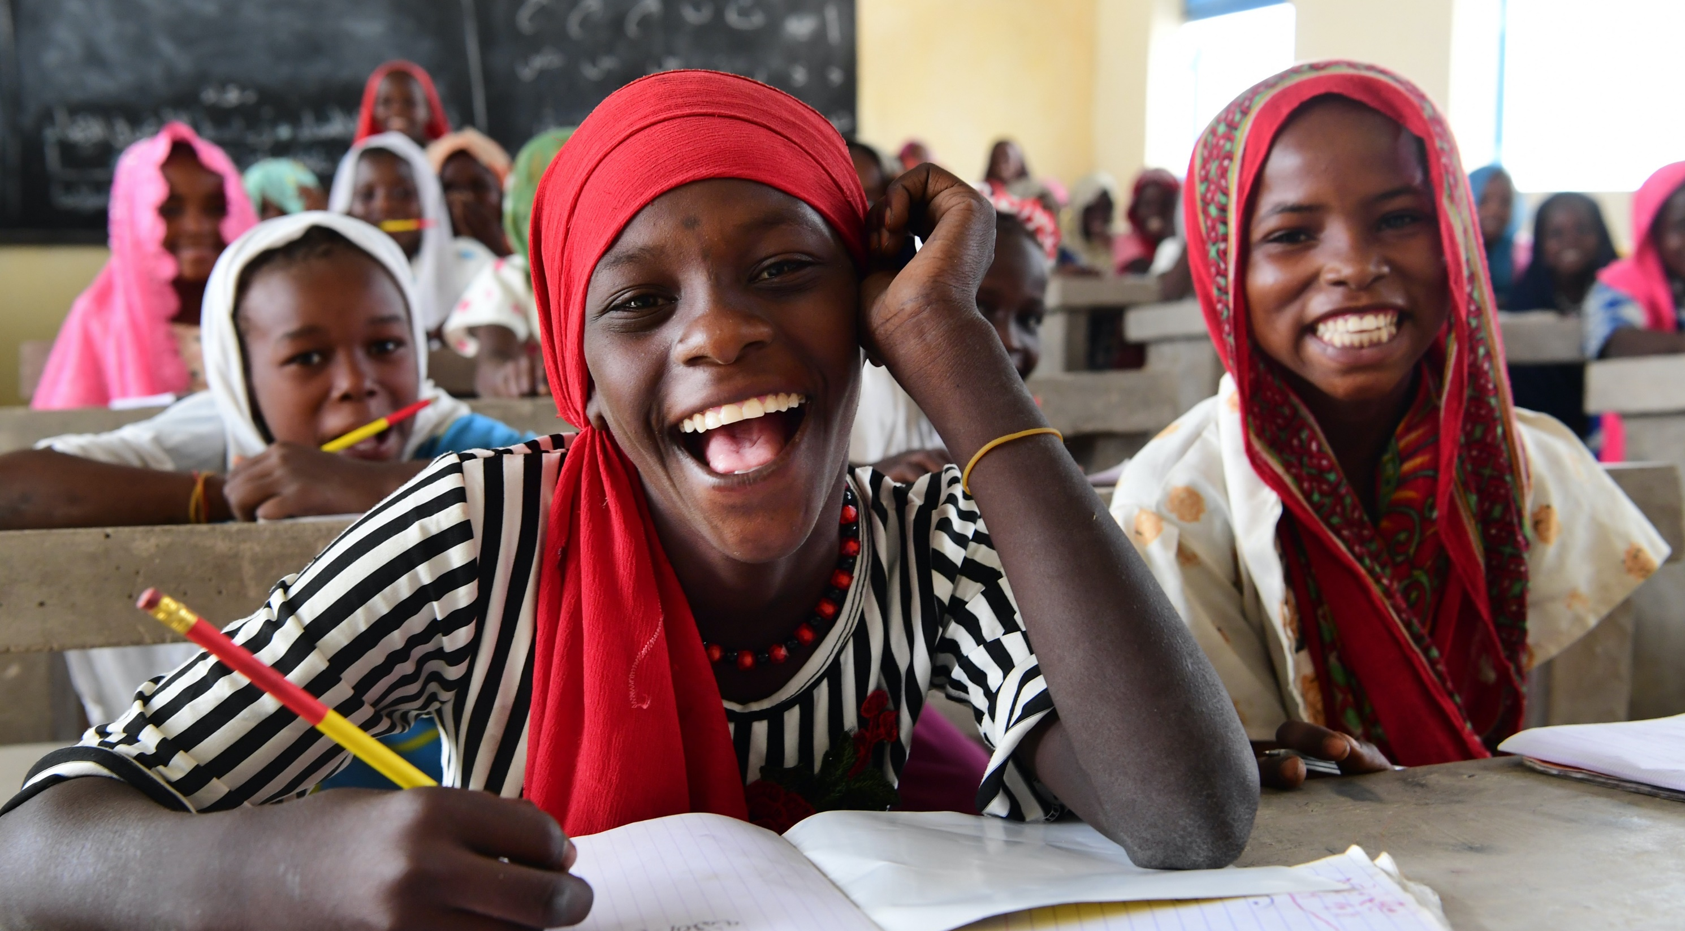
© UNICEF/Dejongh
QUALIFICATIONS AND EXAMS
Notes:
Discussion prompts:
Exam stress or pressure can lead to many different mental health conditions, like depression and anxiety, panic attacks, low self-esteem, self-harming and suicidal thoughts and worsening of pre-existing mental health conditions.
Source: BBC School Report
For children and young people who are generally anxious, the experience of taking exams can be very threatening and could lead to unmanageable increases in anxiety levels.
Academic anxiety is likely to increase as children get older. In secondary education, pressure around school exams, vocational qualifications and progression to higher education may cause anxiety in some pupils.
Sources:
Anna Freud
Young Minds

