Slide 1


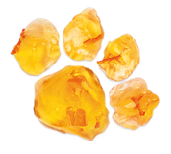

UNICEF UK, registered charity England & Wales (1072612) Scotland (SC043677).

Slide 2
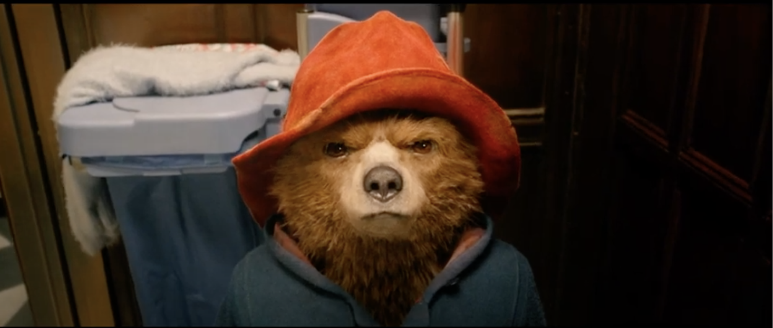

PADDINGTON’S HARD STARE
Click to play video
Notes:
In the story of Paddington, Paddington had a face he would sometimes make when people made him frustrated or angry, especially when other people were not using their manners. Paddington called this face the ‘hard stare’. Can you do Paddington’s hard stare?

Slide 3
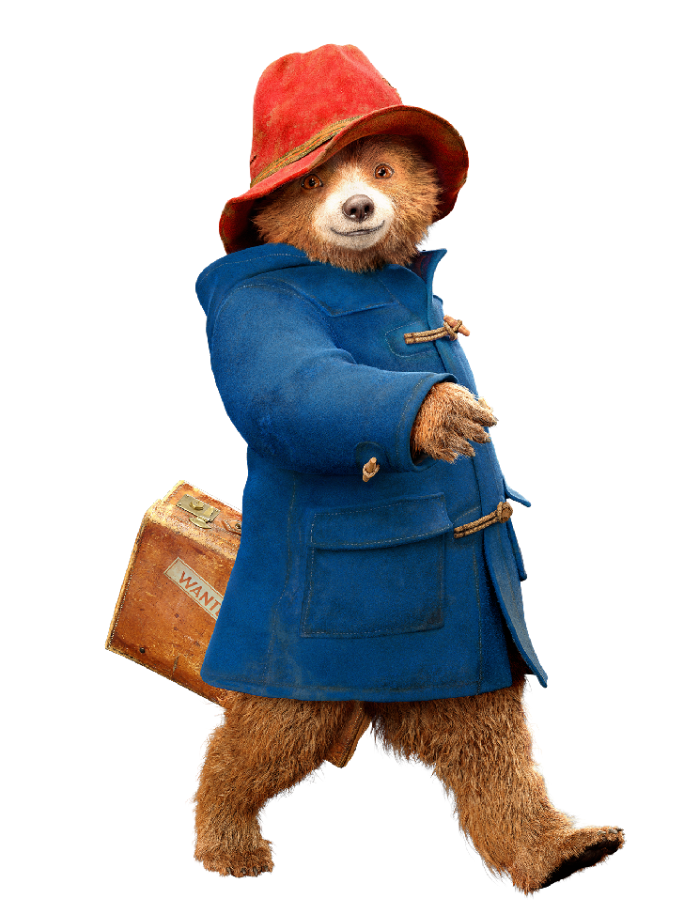
Notes:
Part 2

Slide 4
HOW ARE YOU FEELING?
 | Emotion
 | Angry
Adapted from the following sources: Delphis and Safehouse
Notes:
Beginning with the feelings children identified in creating their wheel of wellbeing (Activity 3), ask the children to write out a list of emotions that they are most likely to feel day to day. Be sure to include a range of different emotions. For example: happy, angry, stressed, surprised, calm, scared, nervous. For older children guide the group to include more complex emotions in their list, for example: rage, anxiety, disgust, grief, acceptance, annoyance, boredom.
On a white board or flip chart create a table with three columns and put the list of feelings in the centre column.

Slide 5
WHAT MAKES YOU FEEL THAT WAY?
The ‘trigger’
Trigger | Emotion
My sister/brother/ friend took one of my things | Angry
Adapted from the following sources: Delphis and Safehouse
Notes:
At the top of the column to the left, write the word ‘trigger’, asking children if they know what this word means. Explain that when we talk about emotions and mental health, a trigger is an action (or lack of action sometimes) that causes us to feel a certain way. For example, in the warm-up activity we learned that when people didn’t use their manners, this was a trigger sometimes for Paddington to feel frustrated or angry.
Ask young people what they think might cause or ‘trigger’ them to feel each of the specific emotions listed in the first column. Write their responses in the second column. For example: “I feel worried when I have a test at school”, or “I feel happy when I think about having a visit from my grandmother”.

Slide 6
HOW DOES YOUR BODY FEEL OR REACT
WHEN YOU FEEL THAT EMOTION?
Trigger | Emotion | Behaviour
My sister/brother/ friend took one of my things | Angry | My face goes red and I feel a lot of energy in my body
Adapted from the following sources: Delphis and Safehouse
Notes:
At the top of the column on the right, write the word ‘behaviour’, asking children how they think that the word behaviour (or how you act) relates to this exercise about their feelings. Referring back to the Paddington example, ask: “When Paddington was triggered to feel frustrated because people were not using their manners, what was his behaviour?” His behaviour was that he gave people the hard stare – like the group practised in the warm-up activity.
Continuing to build on the same list, ask the children to identify any physical feelings or behaviours they might link to the emotion and trigger. Write these in the third column. For example: “When I feel cross, my face gets red and I feel a lot of energy in my body”, or “When I feel anxious my stomach hurts and I lose my appetite for lunch”.

Slide 7

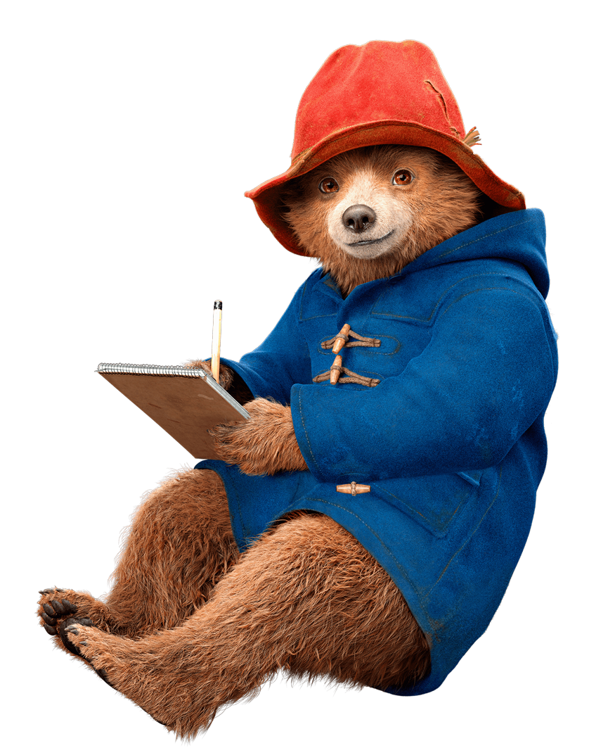
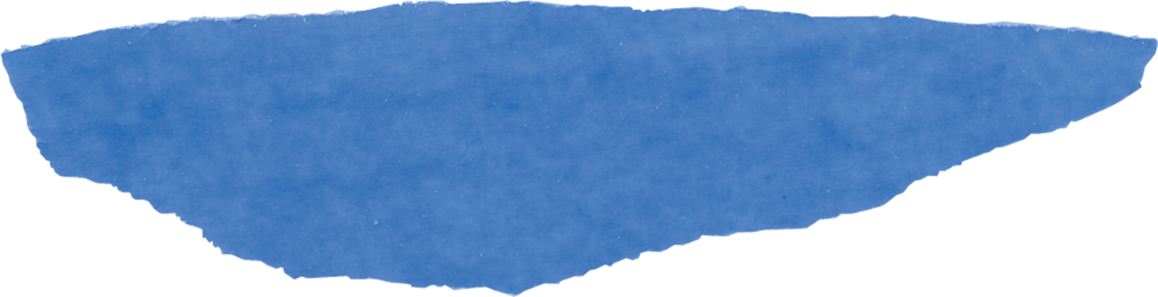
Track you own wellbeing with a DIY mental health journal
Notes:
Part 3

