Slide 1
UNICEF/Panjwani
Notes:
UNICEF/Panjwani
Chattisgarh, India. Manas Foundation Coordinators run activities about mental health and pschyo socio support for adolescents. This program is supported by UNICEF. Location : Dantewada, Chattisgarh, India

Slide 2
Slide 3 – Introducing World Mental Health Day
Slide 4 – Introducing the Article 24
Slide 5 – OutRight 2021/2022
Slide 6&7 – Exploring Article 24
Slides 8&9 – Primary Activities
Slides 10&11 – Secondary Activities
Slide 12 – Reflection

Slide 3
INTRODUCING MENTAL HEALTH DAY – ARTICLE 24
This day is held each year
on October 10th
World Mental Health Day is an international day for global mental health education, awareness and advocacy against social stigma. It was first celebrated in 1992 at the initiative of the World Federation for Mental Health, a global mental health organisation with members and contacts in more than 150 countries.
Each October, thousands of supporters come to celebrate this annual awareness program to bring attention to mental illness and its major effects on peoples' lives worldwide.
Grace introduces Article 24 and World Mental Health Day
Click here to watch on YouTube

Slide 4
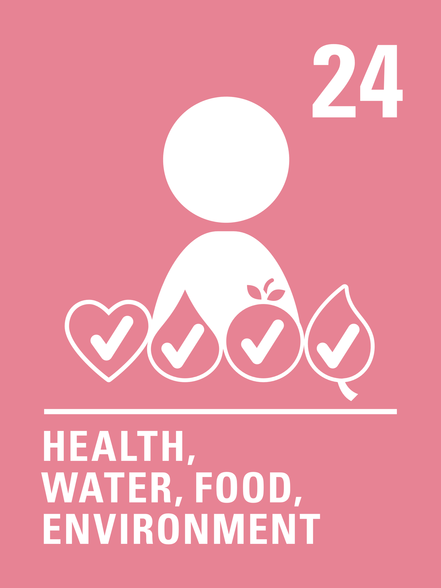
LINKED UNCRC ARTICLES
One article provides a particularly strong link this week:
Article 24 – Every child has the right to the best possible health.
Governments must provide good quality health care, clean water, nutritious food, and a clean environment and education on health and well-being so that children can stay healthy. Richer countries must help poorer countries achieve this.

Slide 5
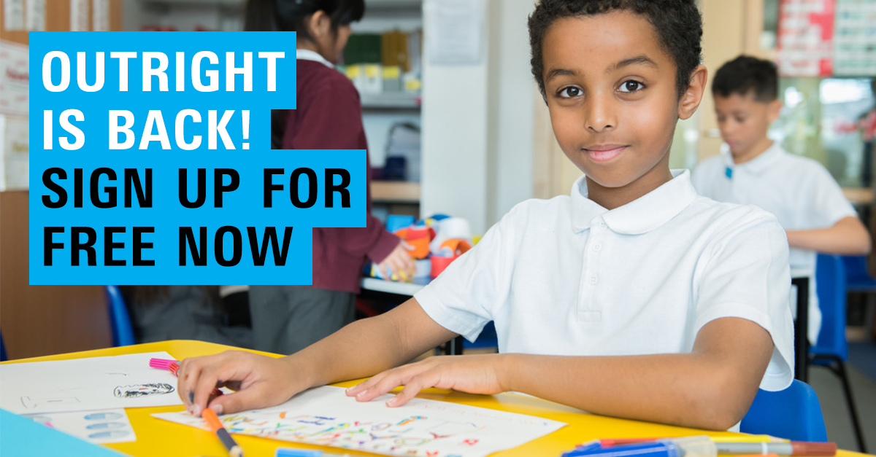
OUTRIGHT 2021/22
OutRight 2021/22 is all about children and young people’s mental health.
Sign up to receive regular sets of learning activities and facilitator resources throughout the 2021/22 campaign.
Share pictures of on social media of what you’ve been doing for OutRight or activities from the Article of the Week pack tagging @UNICEFUK_action on Twitter and using the hashtag #WorldMentalHealthDay2021.
.
Sign up to OutRight here

Slide 6
EXPLORING ARTICLE 24
How do you keep yourself mentally healthy?
UNICEF/Panjwani
UNICEF/UNI390580
Notes:
UNICEF/UNI390580
Bayu, from Indonesia, poses with a sign reading ‘How are you, really?’ as part of a campaign to raise awareness on Mental Health Day.

Slide 7
How many of these did you get?
Understanding the different types of emotions, you have
Knowing that it is usual and ok to have times when you might feel sad or worried
Learning different ways to look after your mental health
Knowing who to talk to if you are feeling unhappy or unsafe
Making sure you exercise regularly
Making sure you have a healthy diet
Spending relaxation and fun time with friends and or family
Taking part in hobbies or activities that you enjoy
Being involved in activities to help others
Limiting time on social media or other online platforms
Health care –being able to see a doctor, nurse or counsellor if you need to
Did you think of anything else?

Slide 8
Helping others and being kind can make us feel happier.
Make a 'thank you' card for someone you know to surprise them with an unexpected thank-you or make a ‘thank you’ chart or ‘tree’ for your class and ask everyone to put messages onto it.
Watch the video here
Talk to a friend or grown up. Write or draw a list of things that make you feel happy or positive.
Think about or talk with a friend or family member about something new you have recently learnt or something you are getting better at…
(for example, at school, or a sport or hobby or a skill you use every day).
What does it feel like when learning is easy and what’s it like when it feels hard? Share your ideas in class.
Watch this video then make a poster by yourself or with others to give people ideas of who they could talk to if they are feeling worried.

Slide 9
Create a list or poster detailing all the people who you can talk to if you are worried about something.
They are the duty bearers for your rights.
How many people can you think of? Display this around your school to remind the other pupils of who they can talk to if they are feeling worried, sad or anxious.
Mindfulness and relaxation can help our mental health. Try this relaxation activity. How did it make you feel? When might it be good or help you to do this activity?
Try it out and see how it helps!
Being physically active can help us to feel and think in a positive way. Watch, and join in with, this video.
What rights does it mention in the video? Can you think of any other children’s rights that link closely with mental health and wellbeing?
Make up your own dance routine to the song in the video.
Design a poster or create a short play or song to show how respect or a lack of it can affect children’s access to their rights and their mental health and well-being.

Slide 10
Either by yourself or with others make an A to Z of words or phrases that you associate with your mental health and wellbeing.
Choose 2 or three to write about in more detail.
Try and match children’s rights to the ideas you have put down. You might choose to make a shared A to Z class poster of mental health and wellbeing.
Find some time to try this body scan meditation (it takes about 15 minutes)
How do you feel after paying attention to yourself in this way? When might it be good for you to use this again?
Discuss it with your friends or as a class.
Anxiety and stress can make your body feel different things. Draw around one member of your group onto big paper.
Think about a time you felt stressed or anxious and draw or write into the outline the different ways this made you make you feel or the physical things that can happen to your body.
Discuss all the ideas that come up.
How could these be addressed or supported?
Keep a chart for a week noting the things that you do to look after your health and wellbeing each day.
Do you do a physical activity every day?
Do you manage to make time to relax?

Slide 11
‘Take care of yourself and you can take on the world’ – Imagine these words to be the opening line of a poem or a song.
Add more lines and verses.
(Try to link appropriate articles in too!)
Consider sharing your finished piece. a teacher.
Research online the different organisations you can reach out to if you are feeling stressed or anxious.
Create a poster or information sheet to distribute to other pupils signposting them to who can help.
UNICEF is marking World Mental Health Day with the launch of a report on mental health. The voices of young people fed into this research, and you can help UNICEF by telling more people about the recommendations.
Have a look at the report and tell five people about the things that you think are most important.
Could you write an article about the report for your school newsletter?
Explore the Voices of Youth site (UNICEF’s digital community For Youth By Youth) and read blogs on mental health
Write your own blog about mental health and consider submitting it to Voices of Youth.

Slide 12
REFLECTION
We are using the ‘reflection space’ this week to share some interesting links to the charity Young Minds.
Please have a look at the sort of advice they give. You may not need it now, but imagine how helpful it would be to know of this site if you or a friend need to seek support in the future:
Reaching out for help
How to speak to your GP about mental health
Understanding Anxiety
Supporting a friend
Who could you share this with?

Slide 13
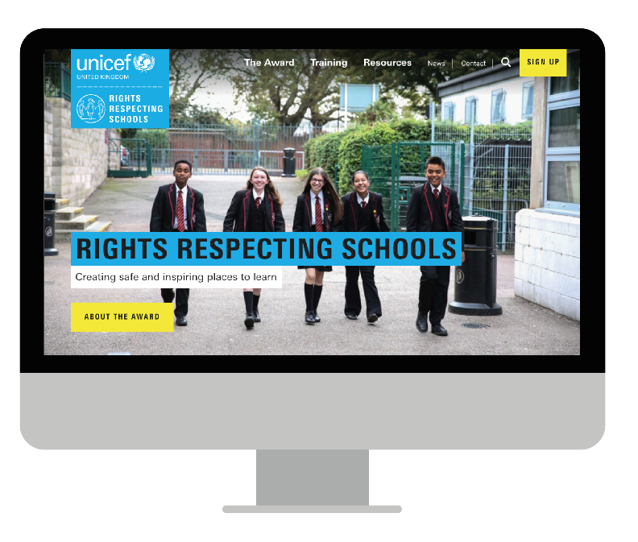
MORE INFO…
RRSA WEBSITE
For more information or to download previous Article of the Week packs please visit the RRSA website by clicking the link below
CLICK HERE
And for more support on any of the issues raised in this week’s pack please contact
ChildLine – 0800 11 11
Frank – 0300 1236600

