Slide 1
UNICEF/Gelman
Notes:
UNICEF/Gelman
Yasmeen, 13, sits in her bedroom in Paris.

Slide 2
Slide 3 – Guess the article
Slide 4 – Introducing article 16
Slide 5 – Question around article 16
Slide 6 – Some possible answers
Slides 7&8 – Primary Activities
Slides 9&10 – Secondary Activities
Slide 11 – Reflection

Slide 3
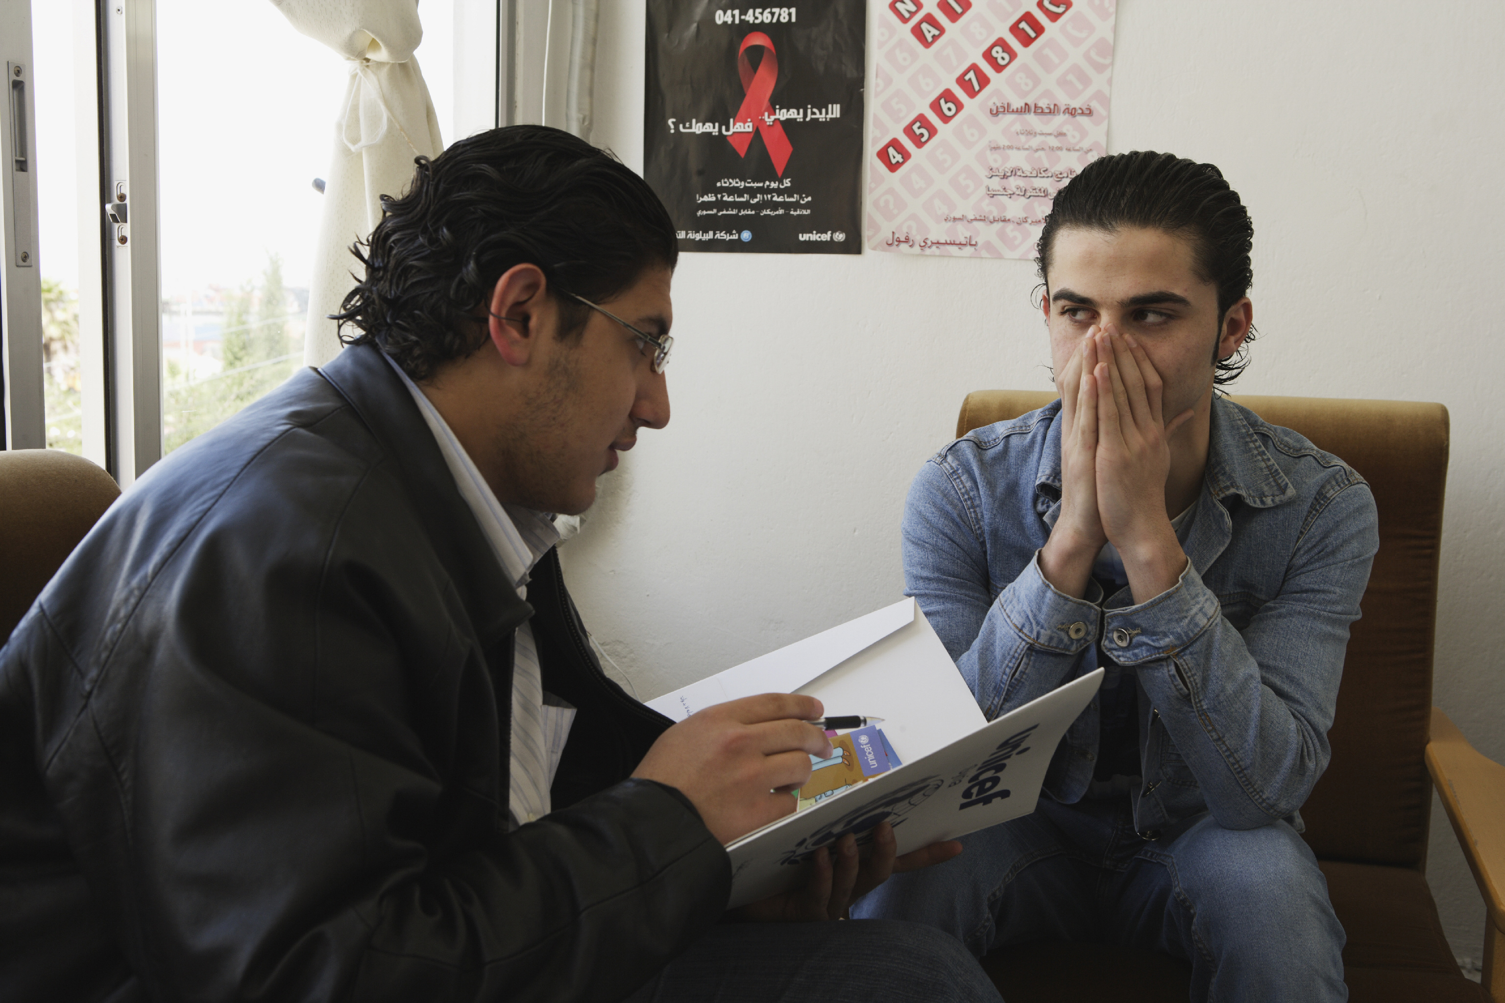
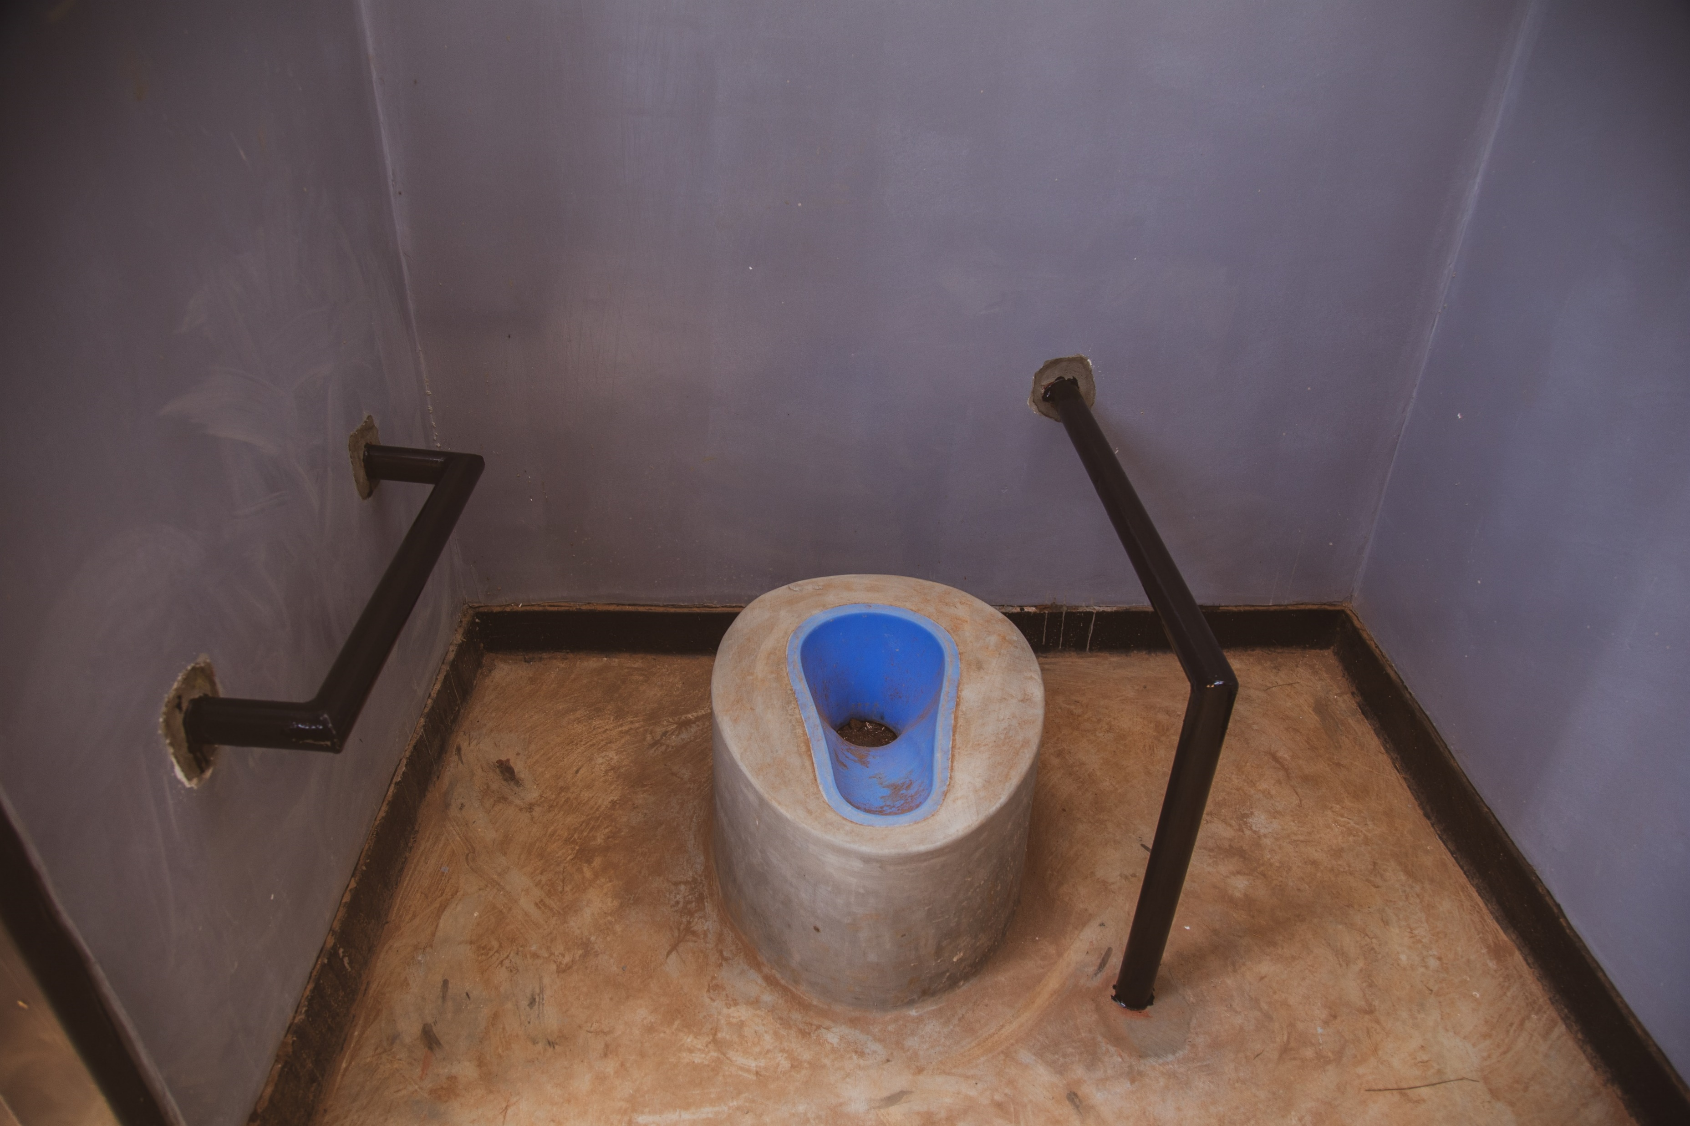
Guess the Article
These pictures provide a clue to this week’s article.
How do these pictures help you? Can you guess how they are linked together?
Write down your thoughts or discuss with someone in your class.
Unicef/Babajanyan
Unicef/Noorani
Unicef/UN0512615
Notes:
From left to right:
Hasmik, 16, sits for a portrait in her bedroom in Yerevan, Armenia. UNICEF/Babajanyan
SHOUT volunteer Majed Safiyeh reviews UNICEF health materials with Amro Alsolabi at a clinic in the port city of Latakia in the western Latakia Governorate. Mr. Alsolabi is receiving counselling before being tested for HIV. UNICEF/Noorani
New toilet facilities at Mpondamwala Primary School in rural Lilongwe. UNICEF/UN0512615

Slide 4
INTRODUCING ARTICLE 16
Martin introduces Article 16
Article 16 – The Right to Privacy
Every child has the right to privacy. The law should protect the child's private, family and home life, including protecting children from unlawful attacks that harm their reputation.
Click here to watch on YouTube

Slide 5
EXPLORING ARTICLE 16
Why is privacy important to you?

Slide 6
How many of these did you get?
It helps to keep you safe on-line and in the real world.
Children are at risk of being harmed if the wrong people know too much about them.
Things about identity, location, health and personal life, are personal to you.
Not everyone should know everything about me.
It helps us to have personal space.
People might judge you or make assumptions about you.
People might not understand me for who I am.
I should be able to choose the right time to share and with whom.
What others did you think of?

Slide 7
What do we do to keep things safe and private? Listen to this story ‘Password Please?’ and then discuss with your class the lessons you have learnt from the story.
Talking about the right to privacy might make you think about ‘personal space’. Discuss with your teacher and class what personal space means and how we respect each other’s personal space. This ‘social story’ in symbol format may help the discussion. Create a set of top tips or design a poster to remind everyone about personal space.
Watch this telling of the book 'Some Secrets Should Never be Kept' by Jayneen Sanders and use as class discussion. *Teachers - this story contains sensitive subjects so please watch it first before sharing with the class.
A few weeks ago, some new rules came into force to help with online privacy and safety. See the Newsround article about internet safety and then talk about the Children’s Code with your class and your teacher.

Slide 8
Think about why privacy is important to you. Have a go at showing your reasons in a way that works for you. It could be a list, a piece of creative writing or a picture.
Watch this video about privacy online. Use this as a starting point for class discussion.
Look at the PANTS lessons from the NSPCC. What can you remember about this? Discuss how these link to your right to privacy?
You have the right to privacy. Think about a 2-year-old, a 10-year-old and a 16-year-old. What are the similarities and differences in the types of privacy that should be respected at these ages?

Slide 9
Watch this film about how information shared on social media is used. What kind of information do you share on social media? Your location? ‘Liked’ posts? Photos of yourself? Items you have bought?
Discuss the risks of sharing this information in relation to a) your Right to Privacy b) Your Right to be Protected from Harm and c) Your future life.
Think of three top tips you would give to someone new to social media to protect them from harm, now and in the future.
Have you ever discussed privacy settings at home? Read this 2018 article from the e-safety organisation Internet Matters. Have a discussion in class (and at home too) about the value of safe settings and parental controls.
Watch the Twisted Toys commercials from 5Rights Discuss as a class how online games impact on your right to privacy using some of the information in the safety warnings.
Children and young people have a right to privacy and yet it’s important that parents and carers monitor their use of the internet to help keep them safe and protected. Write a page for a parenting guide about how to respect a child’s right to privacy as that child grows into an a teenager, ensure that this is balanced with an adult’s responsibility for keeping them safe. Try and find time to have this conversation with the adults in your family.

Slide 10
One way that children are empowered to protect their privacy online is to be given the option to request that their personal data is deleted should they no longer wish to use a website, platform, product or service. Imagine you are an investigative journalist and find out if a company you use provides children with an option to close their accounts and delete all personal data when that account is closed. Share your findings with your class.
Create a short presentation about how the right to privacy is respected in your school – this presentation could be shared in PSHE.
A new law came into force in the UK on the 2nd September 2021. “The children’s internet code” requires companies that run social media platforms such as Instagram and Snapchat to improve their privacy settings for under 18s. Research this code on BBC and the Guardian. What do you think of it? Does it go far enough or too far? Would it be easy for under 18s to get around it?
Discuss with your class if it’s OK if a celebrity includes her child in a ‘reality’ television show. What impact might this have on the child?

Slide 11
REFLECTION
Give yourself some time and space – a moment of privacy!
Have a think about the following questions:
Why is your privacy important to you?
What do you do to respect other people’s right to privacy?
What other rights are connected to the right to privacy?
UNICEF UK/Dawe

Slide 12
MORE INFO…
RRSA WEBSITE
For more information or to download previous Article of the Week packs please visit the RRSA website by clicking the link below
CLICK HERE

Slide 13
THANKYOU
UNICEF UK/Dawe

