Slide 1
UNICEF/UN0382147

Slide 2
TEACHERS INTRODUCTION TO THIS WEEK’S PACK
This Article of the Week pack combines Article 26 – social security, and 27 – Adequate standard of living. We chose to combine these articles to help facilitate discussion and activities around poverty.
As part of your work as a Rights Respecting School you will understand that all the rights in the UNCRC are there for every child and that rights are indivisible from one another. It is important not to ignore some of the articles that may be more challenging to explore in the context of learning.
Please use your professional judgement about the choice of activities from this pack, based on your knowledge of your pupils and their context. In all schools children are likely to be impacted by poverty. We hope your school will help students navigate this conversation and that language based on children’s rights will provide a useful framework for discussion.
In the context of these articles, we would encourage you to review, with pupils, the breadth and accessibility of information and signposting about how your pupils and families can access the support services or help they need, both in and out of school, with regards to all aspects of their safety and wellbeing.
Best wishes,
The Rights Respecting Team
UK Committee for UNICEF (UNICEF UK)

Slide 3
Slide 3 – Guess the article
Slide 4 – Introducing articles 26 & 27
Slide 5 – Exploring articles 26 & 27
Slide 6 – Some possible answers
Slides 7&8 – Primary Activities
Slides 9&10 – Secondary Activities
Slide 11 – Reflection

Slide 4
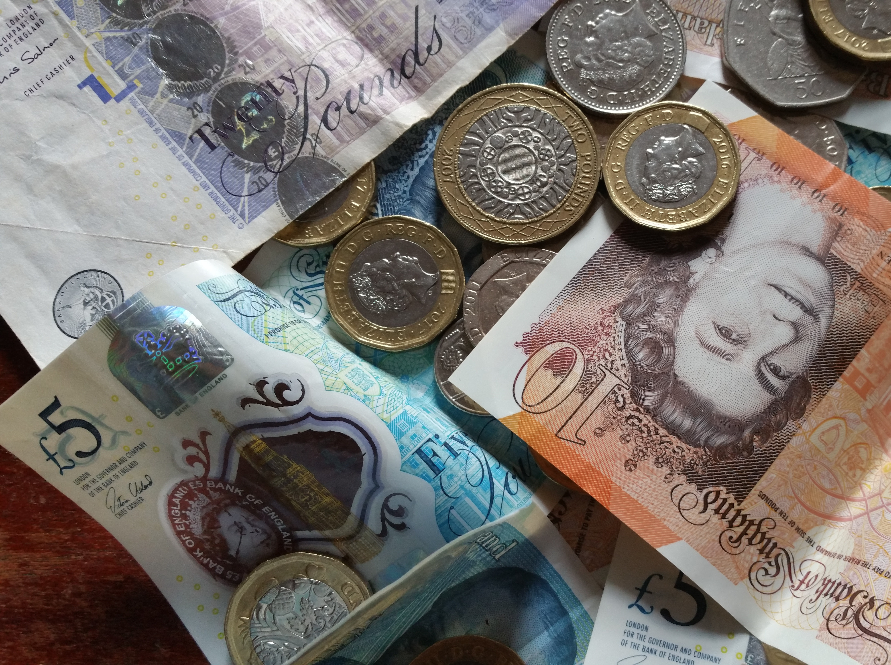
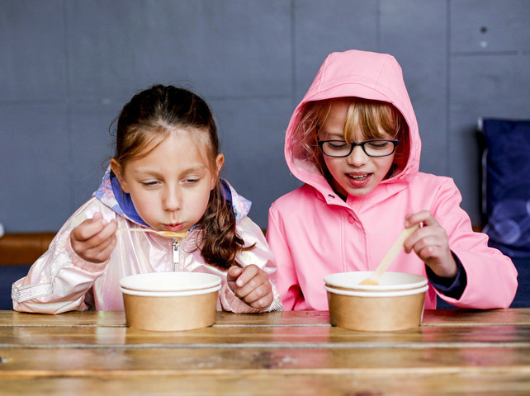
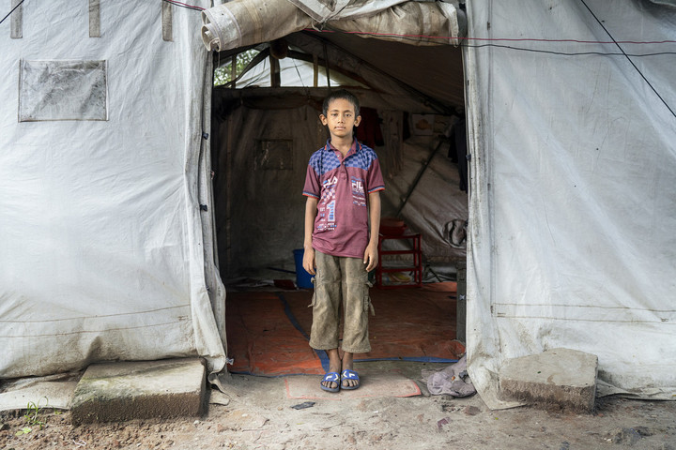
Guess the Article
These pictures provide a clue to this week’s article.
How do these pictures help you? Can you guess how they are linked together?
Write down your thoughts or discuss with someone in your class.
UNICEF UK/Zahn
Photo by Alaur Rahman from Pexels
@Unicef
@Unicef/Fabeha Monir

Slide 5
INTRODUCING ARTICLE 26 & 27
Kathy introduces Article 26 & 27
Article 26– Social Security
Every child has the right to benefit from social security. Governments must provide social security, including financial support and other benefits, to families in need of assistance
Article 27 – Adequate standard of living
Every child has the right to a standard of living that is good enough to meet their physical and social needs and support their development. Governments must help families who cannot afford to provide this.
Click here to watch on YouTube

Slide 6
EXPLORING ARTICLE 26 & 27
Article 26 and 27 are about your right to an adequate standard of living.
What do you think are the most important things you need to grow up healthy and happy?

Slide 7
How many of these did you get?
Healthy food
Healthcare and medical treatment
Clothes
A chance to have friends
A safe home
Education
People to look after us/ a family
Enough money for the essential things in life
Relaxation time
Somewhere safe to play
All our rights
Financial support from the government if the family needs it
What others did you think of?

Slide 8
What do we all need to have a good enough life (article 27)?
Choose a teddy or character and talk about what it needs to enjoy a good enough standard of living. Perhaps discuss ‘Wants’ and ‘Needs’. Draw pictures of all the things your character needs in life.
Around the world, people live in all sorts of different homes.
Research different types of homes and discuss or watch this video. What would your ideal home look like?
Draw a picture and label the important elements.
Explore different food from around the world and research where your favourite food comes from. Share with your class.
Choose a recipe to make yourself (with help from an adult).
Watch this reading of the story Still a Family. Discuss in class reasons why some people may lose their homes. What makes your home and family special to you?

Slide 9
Explore Article 26 & 27 in your class.
Take the opportunity to discuss free school meals and benefits that help some families.
Draw images or find items that represent Article 26 and Article 27 or write a poem or story about why everyone should have a good enough standard of living.
Listen to or read Maddi’s fridge. As a class, discuss the dilemma Sophia had.
Did she do the right thing?
In recent years foodbanks have seen a huge demand for their services and are supporting children and families across the UK who are struggling to afford enough food.
Read or listen to the book ‘It’s a no money day’ by Kate Milner. How can you help families in your community that need support?
Read about these Rights Respecting Schools who have set up a swop shop to support families:
https://www.cardiffnewsroom.co.uk/releases/c25/23094.html
Could your school do something similar?

Slide 10
Read this article about child poverty in the UK from the Children’s Society and take a look at this map to find out about the levels of child poverty where you live.
Using these resources as a starting point, research and present the facts about child poverty in the UK to your class.
Luisa is 11 year old and lives in the popular tourist town of Malaga in Spain. Hear her story here
Many children in the UK live in similar situations.
Write an article or create a poster to highlight the issues. Mention how poverty can affect access to lots of other rights. How could you raise awareness of poverty in your community?
Free School Meals campaigner (and footballer) Marcus Rashford makes a healthy, cheap meal back at his old primary school. Discuss why his campaign was effective. Find out what else he has campaigned about since then.
Thinking of a recent book you read at school, consider whether the main character(s) had an adequate standard of living.
What helped or hindered? Did they/their family receive any Government assistance?

Slide 11
Have you heard of the National Minimum Wage? The Living Wage? The ‘real’ Living Wage?
Do a bit of research on the difference between them (this page might help) and prepare a presentation for your class or year group.
The Child Poverty Action Group encourages schools to think about the real ‘Cost of the School Day’. This video explains one school’s work on uniform. As a class, discuss the pros and cons of uniform. What more could your school do to help families who struggle to afford uniform? Make some suggestions to your School Council.
Have a go at this budgeting game.
Did you manage to make your money stretch? For some families it isn’t a fun game, it’s something they have to work hard at every single day and sometimes it’s pretty much impossible.
Do you think that’s fair? Can your class take action to raise awareness?
In Scotland, young carers aged 11-18 are able to access a special package of treats, funded by the Scottish Government.
What do you think it would important to include?

Slide 12
REFLECTION
Watch this video and then think about these questions:
How might a lack of money affect children’s rights, their dignity and self esteem?
How does your school make sure all children are included no matter what their circumstances?
If you know of somebody whose family is struggling because of poverty how can your words and attitudes show them support?
UNICEF UK/Dawe

Slide 13
MORE INFO…
RRSA WEBSITE
For more information or to download previous Article of the Week packs please visit the RRSA website by clicking the link below
CLICK HERE

