Slide 1
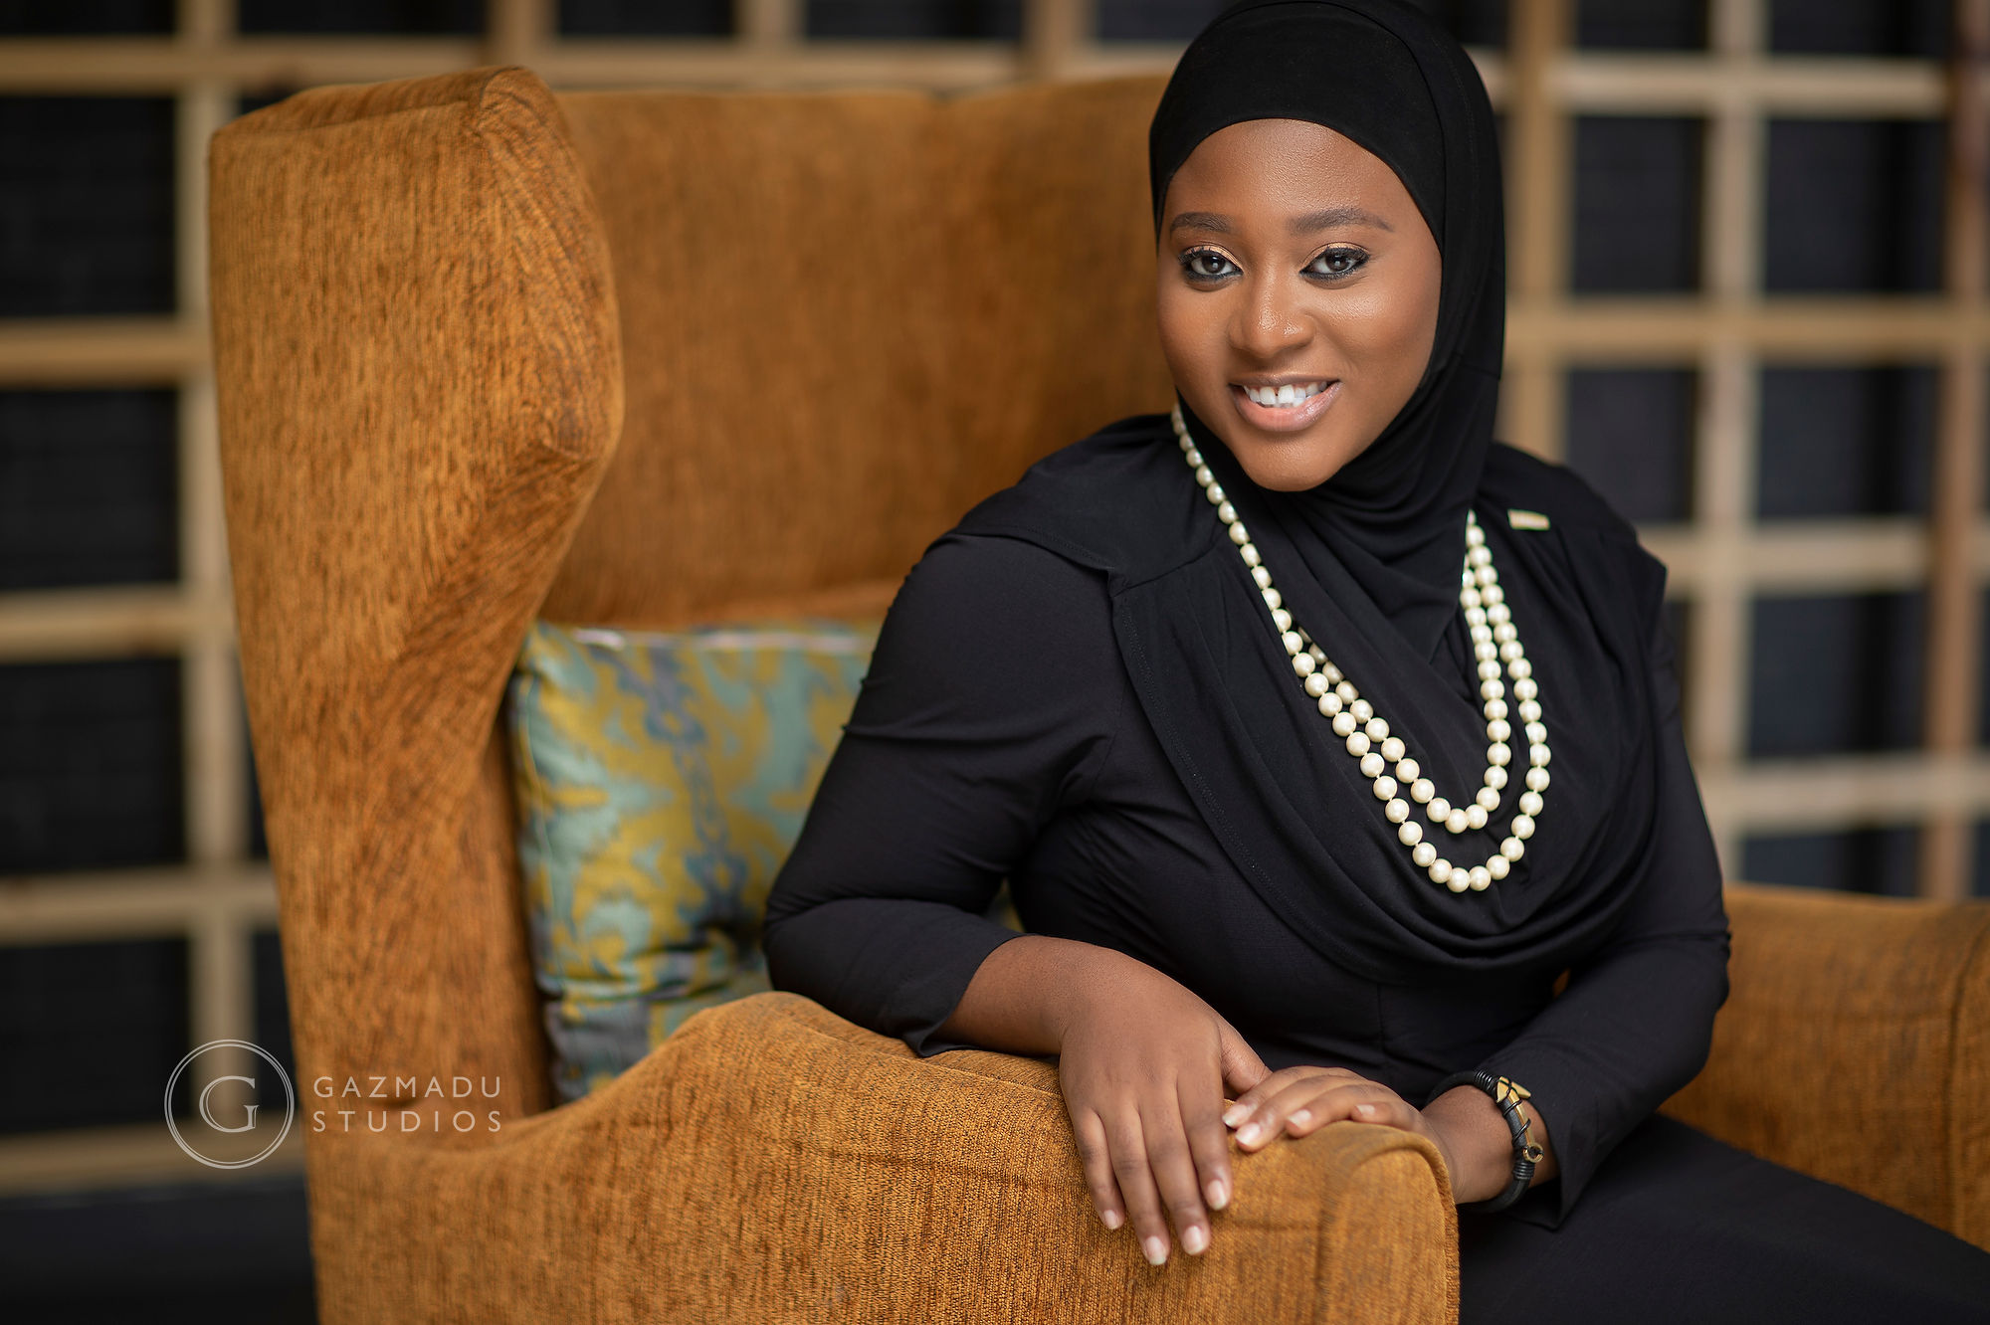
© Hauwa Ojeifo
Activity 6
Youth advocates
for mental health
UNICEF UK, registered charity England & Wales (1072612) Scotland (SC043677).

Slide 2
WHAT IS MINDFULNESS?
Notes:
Part 1
Invite young people to play emotion charades. Write different emotions on slips of paper and put them in a bag or hat. This can be prepared in advance, or young people can create the emotion slips before the activity (leave time to review slips and remove duplicates and any words submitted that do not belong).
Ask young people to take turns to pick an emotion out of the bag or hat, then act out that feeling, without speaking, in front of the group. The rest of the group must guess which emotion is being portrayed. (If playing virtually, let each young person think of an emotion to act out.) Using a timer, give each team two minutes per turn. If you want to keep score, time the groups while guessing. The time elapsed is the score and the team with the lowest score wins!
In wrapping up the activity, ask young people to point out how often the ‘actors’ portrayed a physical feeling or expression to demonstrate the emotion. What does this say about that emotion?

Slide 3
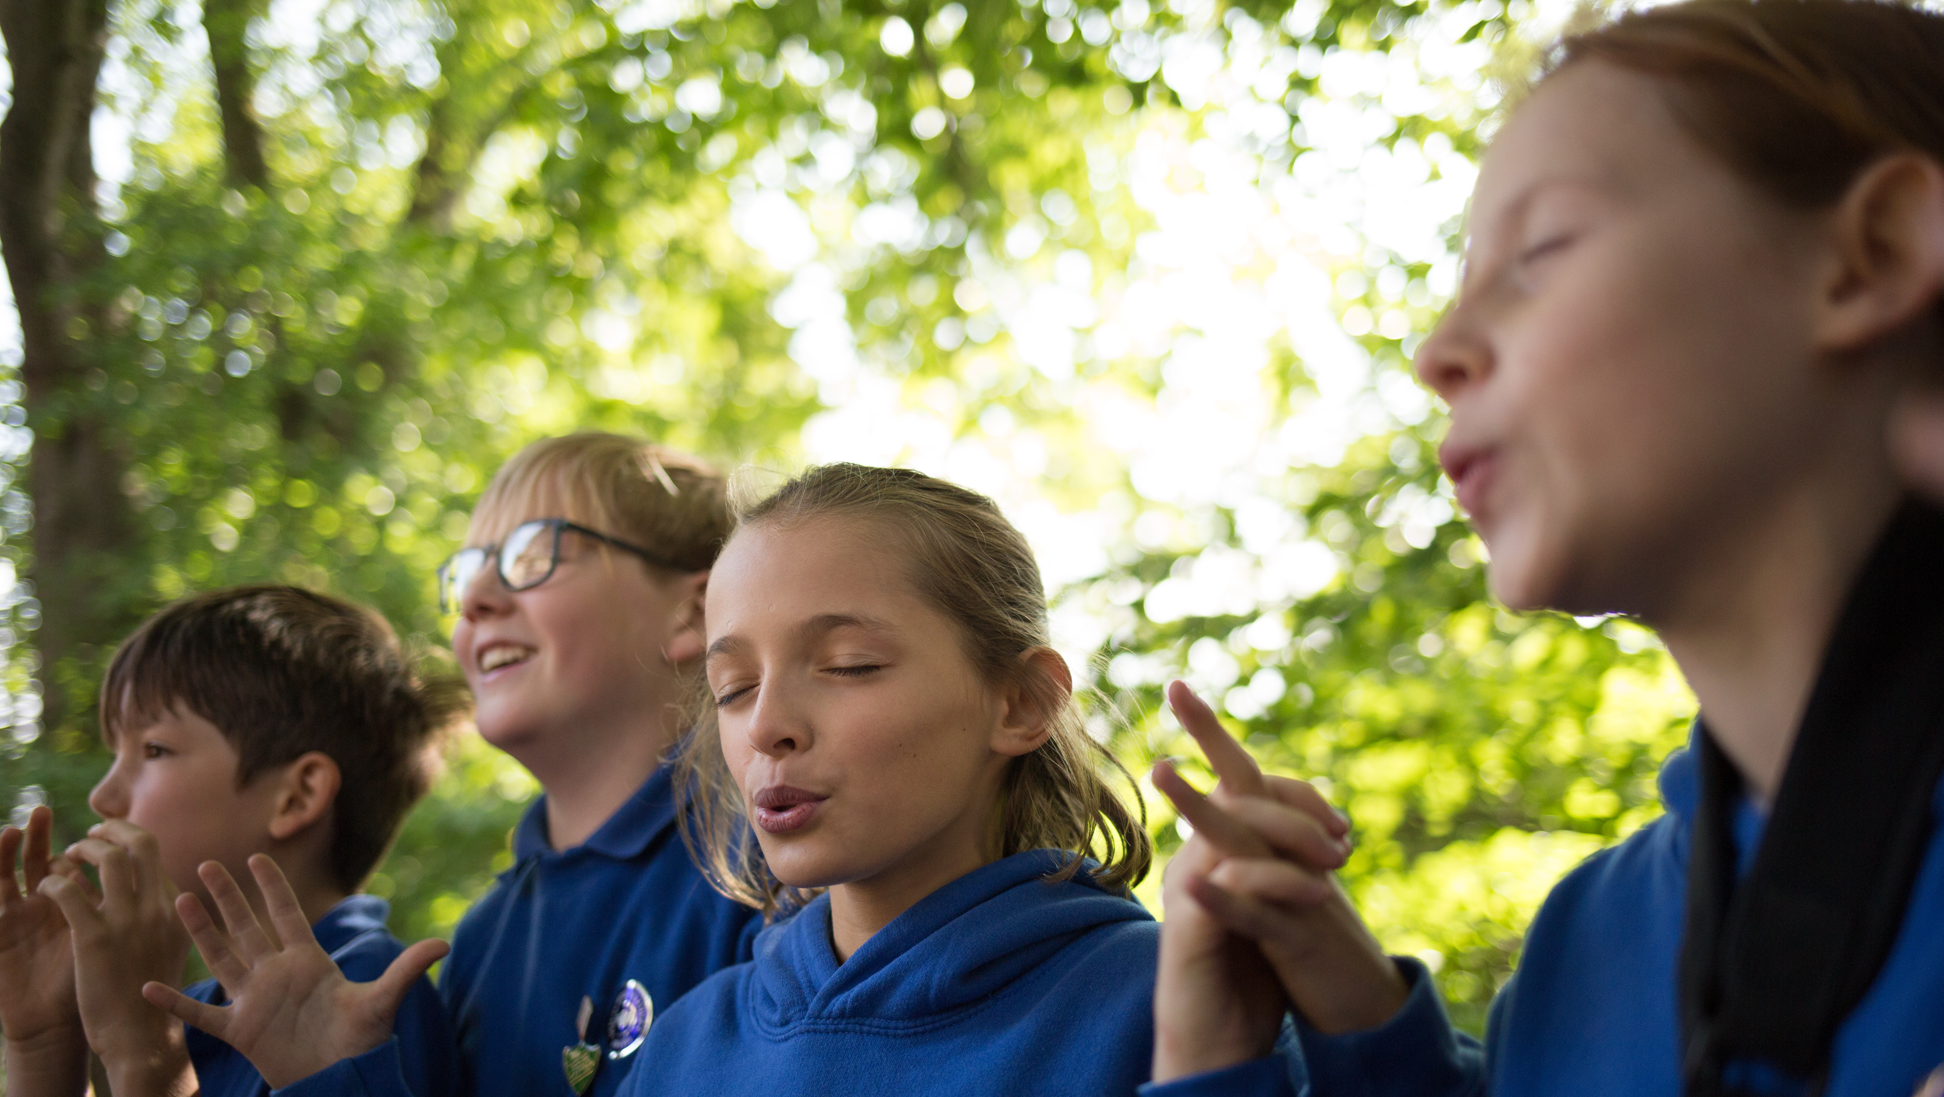
LET’S PRACTICE MINDFULNESS
Name...
5 things you SEE
4 things you FEEL
3 things you HEAR
2 things you SMELL
1 thing you TASTE
Notes:
If you like you can use this video to facilitate this exercise: 5, 4, 3, 2, 1 mindfulness video - https://youtu.be/30VMIEmA114 Take a deep belly breath to begin
5 - SEE: Look around for five things that you can see. Say them out loud. For example: I see the desk, I see the teacher, I see the pencil, I see the water bottle, I see the whiteboard.
4 - FEEL: Pay attention to your body and think of four things that you can feel. Say them out loud. For example: I feel the fan blowing on my face, I feel my feet warm in my socks, I feel the vibration of the ringing of the school bell, I feel the hardness of the chair I am sitting on.
3 - HEAR: Listen quietly for three sounds. Say them out loud.
For example: I hear the birds outside, I hear the raindrops falling on the window, I hear the sound of my breath.
2 - SMELL: Say two things you can smell. If you can’t smell anything from where you’re sitting it is okay to move to another spot and sniff something. If you can’t smell anything at the moment or you can’t move, then name your two favourite smells.
For example: I can smell lunch being cooked in the canteen, I can smell freshly cut grass.
1 - TASTE: Say one thing you can taste. If you can’t taste anything, then say your favourite thing to taste. For example: I can taste the toothpaste from brushing my teeth this morning.
Take another deep belly breath to end.

Slide 4
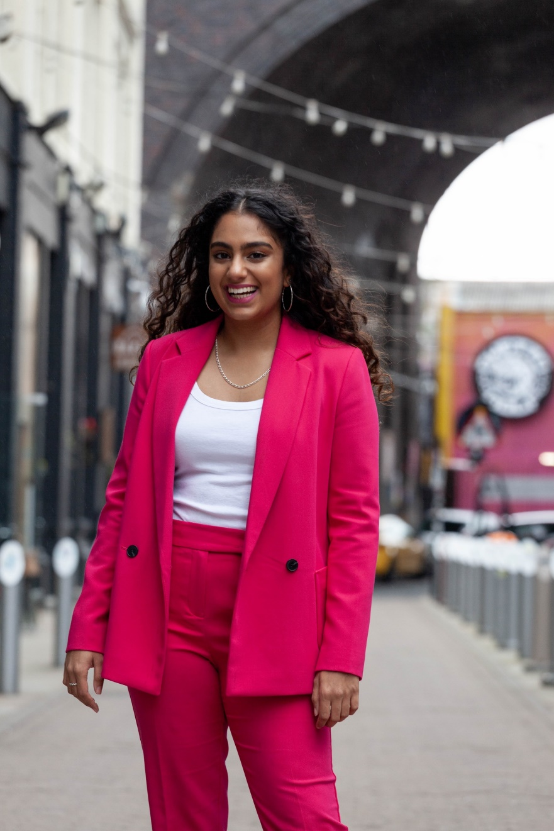
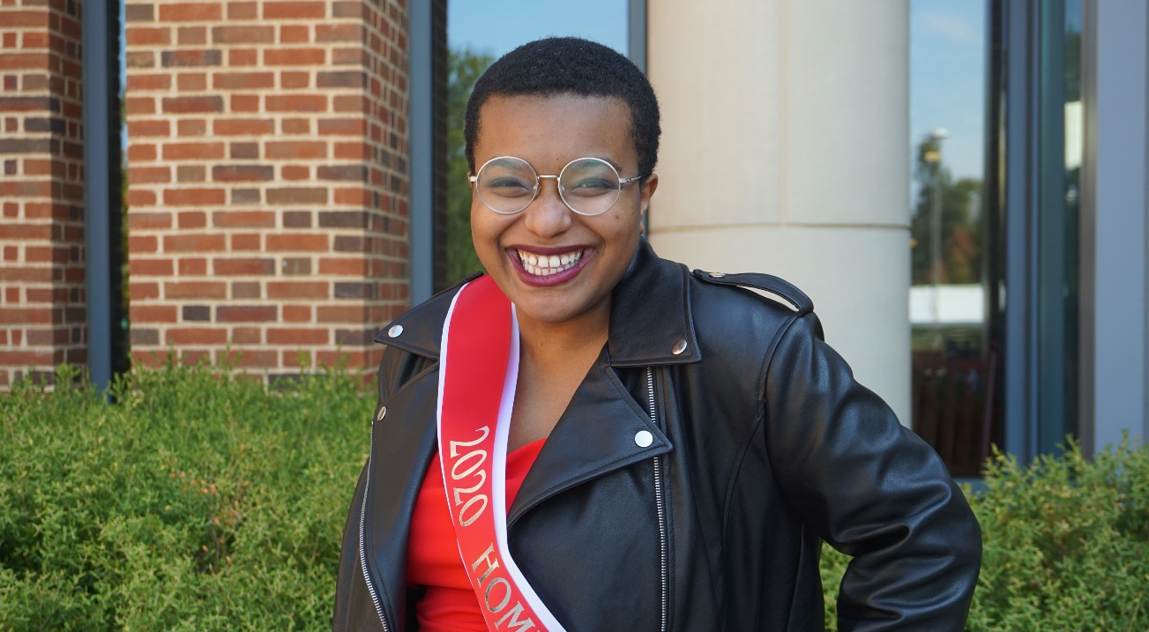
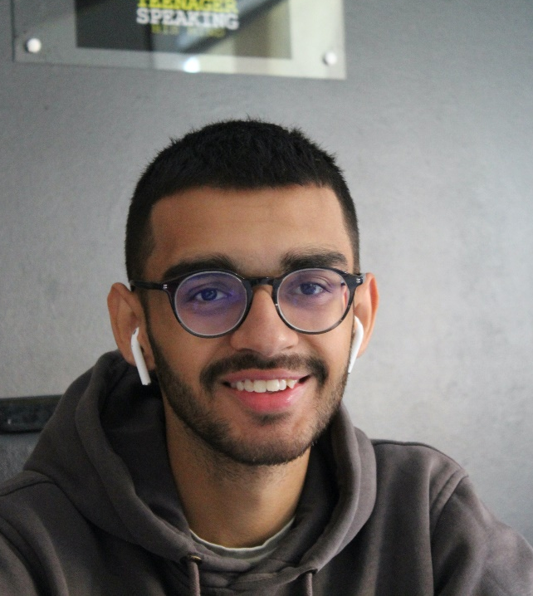
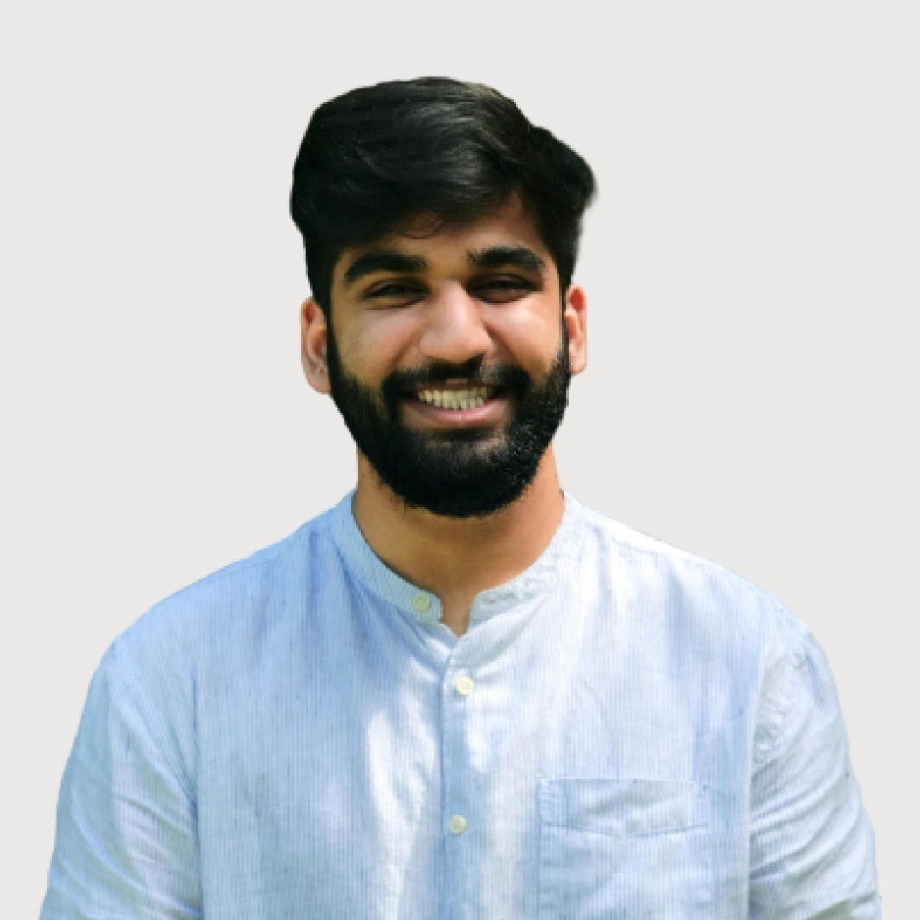
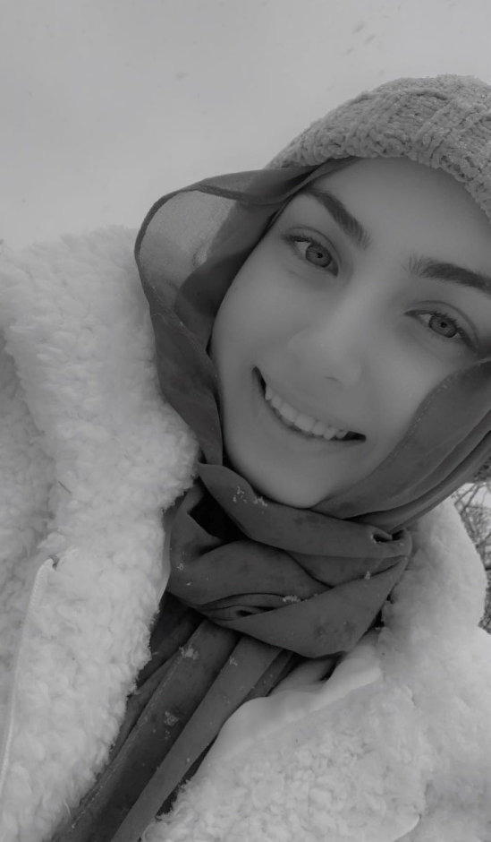
Meet the Youth advocates
for mental health
Notes:
Part 2
In this activity we will meet youth advocates from around the world who are using their voices to break the silence around mental health and wellbeing

Slide 5
ELYSE FOX
Founder, Sad Girls Club, USA
Notes:
In 2017, aged 23, Elyse founded @sadgirlsclub, a non-profit organisation to create a community and destigmatise depression and mental health issues for women of colour. Later she also founded @sadboysclub.
Sad Girls is an online platform and in-real-life community created to bring girls together who are battling mental illnesses to:
remove the negative stigma integrated in mental health conversations;
provide mental health services to girls who do not have access to therapy and treatment; and
create in-real-life safe spaces that build a community for young women to know they are not alone. https://sadgirlsclub.org/

Slide 6
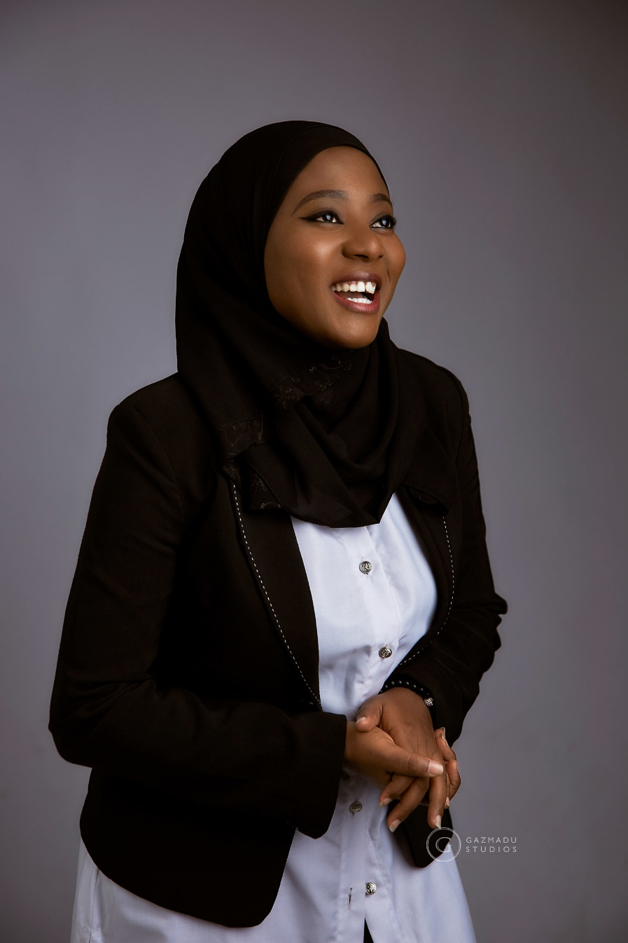
Hauwa Ojeifo
Founder, She Writes Woman, Nigeria
© Hauwa Ojeifo
Notes:
In 2016 Hauwa Ojeifo founded She Writes Woman, a women-led movement helping to break the silence around the issue of mental health in Nigeria and across West Africa.
During her teenage years Hauwa struggled with depression. In 2014 she was sexually abused and in 2016 she attempted suicide. Hauwa was diagnosed with bipolar and post-traumatic stress disorder. To turn her difficult experiences into something positive, she founded She Writes Woman.
The foundation provides a helpline, teletherapy and virtual support groups for survivors of gender-based violence and those living with mental health conditions across West Africa, giving them access to safe and confidential support and counselling.
In 2020, when Nigeria was working to pass its first mental health law, Hauwa defended the rights of people with mental health conditions before the Nigerian parliament, making her the first woman to have done something of this kind.
In 2018, Hauwa received the Queen’s Young Leaders Award in recognition of her work to overcome the stigma around mental health.
http://shewriteswoman.org/
Instagram: @shewriteswoman
Sources
Glamour Magazine Profile
Wikipedia
Queens Young Leaders Awards

Slide 7
© Paul Stringer
SOPHIA BADHAN
Mental health advocate, UK
Notes:
Aged 18, Sophia Badhan, from the West Midlands, received a Diana Award for her work as a mental health advocate and campaigner.
As a teenager Sophia spent time in hospital with mental health conditions including anorexia nervosa, anxiety, depression, and OCD. She made it her mission to make others aware of how mental health issues affect young people and to campaign for young people to be given the treatment they need and deserve.
Through her work, she helps to reassure young people with mental health problems that they are not alone.
https://sophiakaurbadhan.wordpress.com/
Twitter: @sophiakbadhan
Sources:
Diana Awards
Refinery 29

Slide 8
RAMIS
BBC YOUNG REPORTER, UK
Notes:
Ramis is a BBC Young Reporter. When Ramis was 12 his father died and Ramis struggled with his mental health. He was diagnosed with depression.
Ramis is using his own experience to talk about the challenges of mental health and religion, mental health and masculinity, and mental health in the Asian and Muslim community.
Source:
BBC Youth Reporters Hear Me podcast

Slide 9
SANDY IBRAHIM
© Sandy Ibrahim
Member of Welsh Youth Parliament, Wales
Notes:
Sandy Ibrahim became a member of the Welsh Youth Parliament aged 15, with a mission to use her knowledge of multiple languages and her experience of discrimination to help facilitate mental health support for young people who don’t speak English as a first language.
The Welsh Youth Parliament was set up in late 2018 by the National Assembly for Wales to give young people across the country a voice.
Resources:
Welsh Youth Parliament
Refinery 29
Positive.News
https://sophiakaurbadhan.wordpress.com/
Twitter: @sophiakbadhan
Sources:
Diana Awards
Refinery 29

Slide 10
SATVIK SETHI
MENTAL HEALTH ADVOCATE, USA
Notes:
As a young person, Satvik Sethi noticed people in need of support for their mental health posting images of self-harm and expressing their pain on social media, and he wanted to do something. Satvik started reaching out individually to the people making the posts, offering help. As he got older, Satvik decided he wanted to be able to reach more people so he created an app called Runaway and trained volunteers in order to help more people talk about what’s troubling them
In the UK we have an app like this that you could use or tell a friend about if you need someone to talk to. It’s called Mee Too.
Originally from New Delhi, India, Savik has been recognized as one of eight Inspiring Mental Health Youth Activists by Mashable, and one of 15 Students Changing Mental Health by Mental Health America for the impact he has created through his passionate advocacy.
Twitter: @satviksethi
Sources:
WHO
Mental Health America
Mashable

Slide 11
OSE ARHEGHAN
LGBTQ+ mental health advocate, USA
Notes:
As a teenager, Ose Arheghan (they/their) from Ohio, USA, started working as an activist on LGBTQ+ issues. Very quickly, Ose recognised that there was an important link between mental health and a queer identify. For example, Ose explains how a school environment that is hostile to LGBTQ+ young people can negatively affect a young person’s mental and emotional wellbeing.
Their work in mental health awareness and LGBTQ+ advocacy at school has included talking with school administrators about discrimination and bathroom use policies, and focusing on how rules that explicitly protect LGBTQ+ young people can positively influence their mental health.
Ose was selected for the youth ambassador council of the Trevor project, an organisation that provides crisis intervention and suicide prevention services to LGBTQ+ young people.
Twitter: @osearheghan
Sources:
Mashable
Teen Vogue
Bear to Make a Difference Gala Speech
NBC News Profile

Slide 12
EXPRESS YOURSELF ON MENTAL HEALTH
Notes:
Part 3
Ask young people to reflect on the advocate stories they’ve heard. Ask them:
Which message did you connect the most with?
Why did you think it was powerful?
How might you enjoy your own freedom of expression (Article 13) to speak out on mental health?
In wrapping up the activity, ask young people to point out how often the ‘actors’ portrayed a physical feeling or expression to demonstrate the emotion. What does this say about that emotion?

Slide 13
LET’S WRITE A MENTAL HEALTH HAIKU
A haiku is a poem with three lines
5 syllables
7 syllables
5 syllables
Notes:
Ask young people to think about and pick a topic around mental health and write a haiku. These can be written on posters or A4 paper and hung around the school or community area where the group meets, or can be shared on social media (as appropriate for age and resources). Haiku topics might include breaking silence around mental health, a child’s right to mental health, or a haiku around a specific emotions or range of emotions. See how to write a haiku poem.
As an alternative activity, young people could use a different creative medium, suited to their own skills and interests, to share a mental health message. For example, instead of haiku, write a song, create a short play, or make a poster collage with a message.

Slide 14
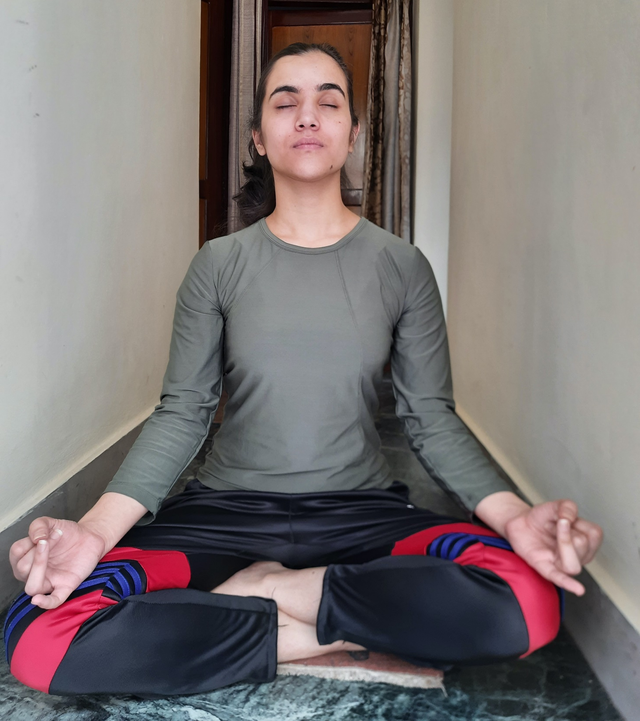
Breathe in and breathe out We all have good and bad days Body and mind health An ocean of thoughts I worry my destiny Is fearing everyday
© UNICEF/Shitanshu Dhakal
- Elsa, 14, USA
Notes:
These are two sample haikus written about emotions, feelings and mental health.

