Slide 1



UNICEF UK, registered charity England & Wales (1072612) Scotland (SC043677).

Slide 2

Notes:
Mindfulness is the practice of paying full attention to something and focusing on being intensely aware of what you're sensing and feeling in the moment in order to relax the body and mind and help reduce stress.

Slide 3
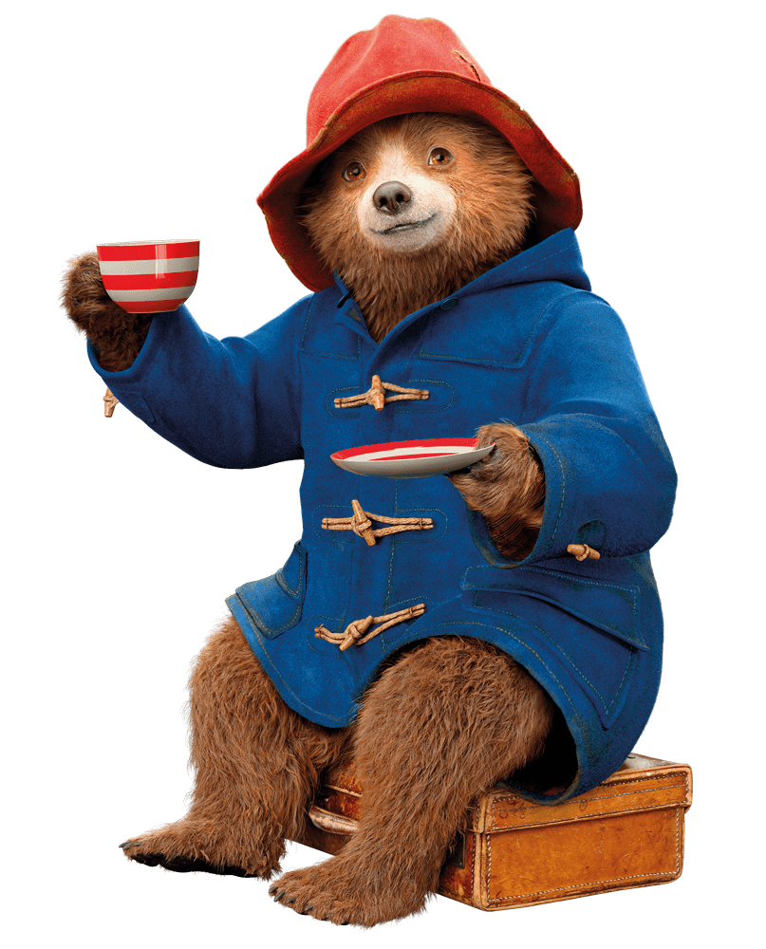
Name...
• 5 things you SEE
• 4 things you FEEL
• 3 things your HEAR
• 2 things you SMELL
• 1 thing you TASTE
Notes:
Take a deep belly breath to begin
5 - SEE:
Look around for five things that you can see. Say them out loud. For example: I see the desk, I see the teacher, I see the pencil, I see the water bottle, I see the whiteboard.
4 - FEEL:
Pay attention to your body and think of four things that you can feel. Say them out loud.
For example: I feel the fan blowing on my face, I feel my feet warm in my socks, I feel the vibration of the ringing of the school bell, I feel the hardness of the chair I am sitting on.
3 - HEAR:
Listen quietly for three sounds. Say them out loud.
For example: I hear the birds outside, I hear the raindrops falling on the window, I hear the sound of my breath.
2 - SMELL:
Say two things you can smell. If you can’t smell anything from where you’re sitting it is okay to move to another spot and sniff something. If you can’t smell anything at the moment or you can’t move, then name your two favourite smells.
For example: I can smell lunch being cooked in the canteen, I can smell freshly cut grass.
1 - TASTE:
Say one thing you can taste. If you can’t taste anything, then say your favourite thing to taste.
For example: I can taste the toothpaste from brushing my teeth this morning.
Take another deep belly breath to end.

Slide 4
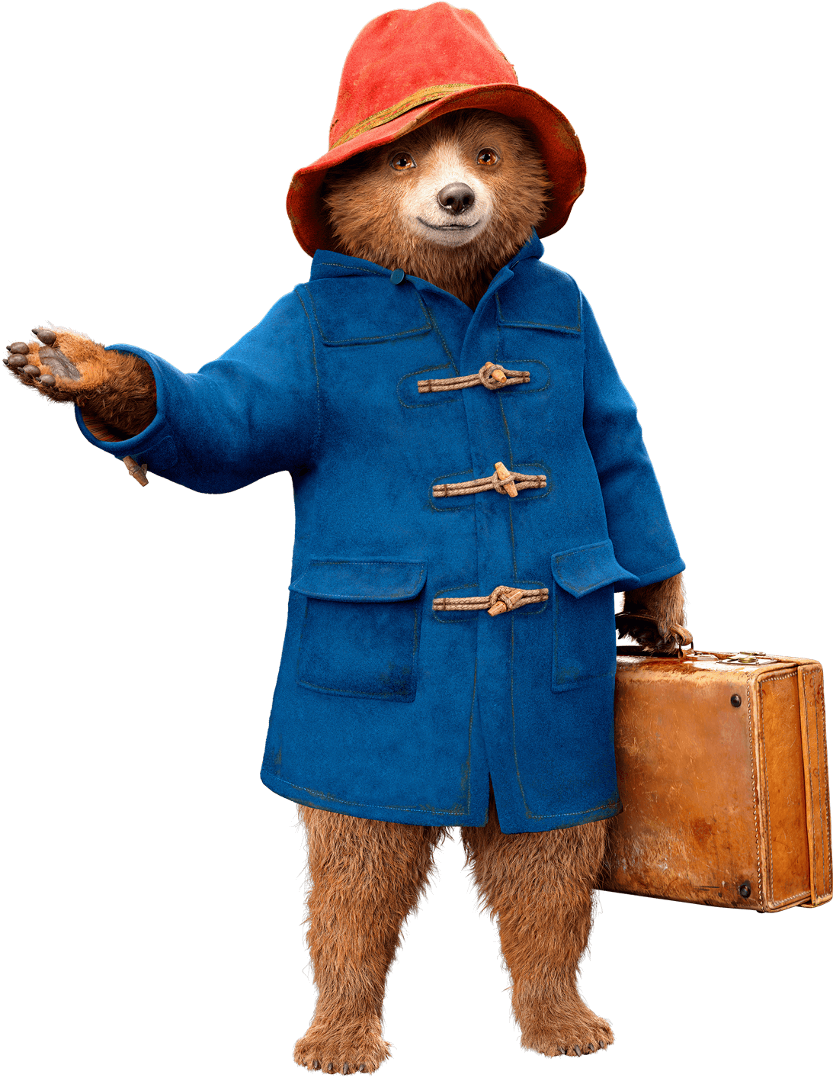

Slide 5
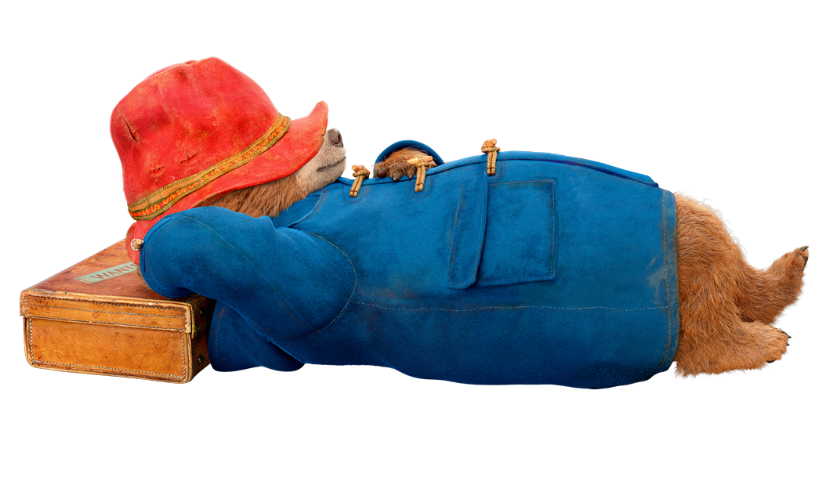
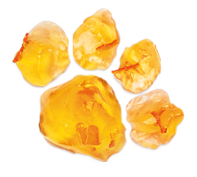
Through mindfulness we can manage and train our brains and bodies to better handle the many different emotions we feel and the behaviours they trigger.
Notes:
Mindfulness actually helps to calm the body – not just the mind. When we practise mindfulness we train our brains to focus on one thing. When we do this, it helps grow new pathways in the way we think. When we are faced with stress and other big emotions, this brain training actually helps us cope better and make different decisions.
Practising mindfulness, like meditation, or making a gratitude list, or doing an act of kindness affects our feeling and our bodies. When we do these things, our brains release different hormones and chemicals in our body-and this can change the way we feel.

Slide 6
What makes you feel better when you are sad or frustrated?
What activities can you do to help you shift your emotions or change the way you feel?
Notes:
Ask children to create a list of all of the ideas of what makes them feel better when they are sad or frustrated, or what activities that they like to do when they want to shift their emotions or change their feelings. Prompt children to include items like meditation, breathing, mindful eating, smiling, running, dancing, keeping a thankful journal. Explain that these activities are mindfulness exercises, and by doing them, our brains and nervous systems are able to help recognise and change how we feel in a specific moment.
Using A4 paper ask each child to trace their hand(s) using non-permanent markers. On each hand ask the children to write the tools that they have access to, to manage their emotions. Then use crayons or markers in the colour of the emotion scale to decorate the hands. Encourage children to hang their hand(s) in a place where they can see them as a reminder of the mindfulness tools they already have in their hands when they need an emotional boost!

Slide 8


How to make a calm-down kit:
1. Find and decorate a box or bag.
2. Fill it with items you can use when you need to manage your mind.
3. Choose an activity from the kit on a day when you need to practise mindfulness.
Notes:
Discuss with the group what tools they might want to put into an activity kit to help them get out energy, practise mindfulness, or process their emotions.
Gather materials, or ask children to bring the materials to create the classroom kit or individual kit(s). As children are working on their kits, encourage discussion and/or class rules or process around when a child should use their activity kit to help regulate their emotions and mental health.

