Slide 1





UNICEF UK, registered charity England & Wales (1072612) Scotland (SC043677).
Notes:
Part 1
It is the responsibility of adults, carers, parents, and governments as duty bearers to make sure that the rights of children are protected. If we need help with our mental health, or want to speak out about our right to mental health who can we safely talk to? Explain to the group that in this activity we are going to map out the different resources available for children who might need someone to talk to or need support for their mental wellbeing. This could be support for them, or support for a friend.

Slide 2
Draw yourself – or another child that might need support – at the centre
1. Me (or another child that might need support)
Notes:
1. In the middle circle draw a picture of yourself or another child or children that might need support to stay healthy.

Slide 3
Who do you live with who you feel safe talking to?
1. Me (or another child that might need support)
2. People at home
I feel safe to talk to
Notes:
2. In the next circle, draw or write: The people you live with who you could feel safe talking to about how you are feeling.
Examples: parents, siblings, grandparents, carers.
Note: Some children may not feel safe talking to family members due to home situations. Use this activity encourage children to identify who are the safe people that they can talk to.

Slide 4
Who are your closest friends and other family members or carers who you could talk to?
1. Me
(or another child that might need support)
2. People at home
I feel safe to talk to
3. Closest friends, family members, carers
Notes:
3. In the next circle, draw or write: Your closest friends, other extended family members, or carers who feel safe talking to about how you are feeling.
Examples: Grandparents, aunts or uncles, cousins, close family friends, other carers.

Slide 5

Who is there at school who you feel safe talking to?
1. Me
(or another child that might need support)
2. People at home
I feel safe to talk to
3. Closest friends, family members, carers
4. People in my school I feel safe to talk to
Notes:
4. In the next circle, draw or write: The people in your school who you feel safe talking to.
Examples: Other pupils, teachers, office staff, librarian, school nurse.

Slide 6
What are the local organisations or people in your community who you feel safe talking to?
1. Me
(or another child that might need support)
2. People at home
I feel safe to talk to
5. Local organisations – neighbourhood or community support
3. Closest friends, family members, carers
4. People in my school I feel safe to talk to
Notes:
5. In the next circle, draw or write: Local organisations or other people in your neighbourhood or community you see outside of school and feel safe talking to
Examples: GP, emergency services, youth workers, youth club friends, people at a sports club, neighbours, religious leaders

Slide 7

What are the organisations in the UK that you could turn to?
1. Me
(or another child that might need support)
6. Organisations in UK offering mental health support for children
2. People at home
I feel safe to talk to
5. Local organisations – neighbourhood or community support
3. Closest friends, family members, carers
4. People in my school I feel safe to talk to
Notes:
6. In the next circle, draw or write: UK organisations or other support systems that would have tools or resources if you or a friend needed help. Examples: ChildLine, Young Minds. For more ideas, see the list of organisations that can help in the background reading [link].

Slide 8

What are the organisations and resources around the world that you could turn to?
7. Organisations that support children’s mental health and protect all children’s right to health around the world
1. Me
(or another child that might need support)
6. Organisations in UK offering mental health support for children
2. People at home
I feel safe to talk to
5. Local organisations – neighbourhood or community support
3. Closest friends, family members, carers
4. People in my school I feel safe to talk to
Notes:
In the last circle, draw or write: Organisations or resources outside of the UK that have resources or tools for helping children around the world and/or work to protect all children’s rights to good mental health.
Examples: UNICEF, some of the international youth advocates from Activity xx

Slide 9

Notes:
Discussion questions
How does it make you feel looking at your support network on paper?
Which relationships are particularly important to you? How do you feel supported by that person/people?
What are the qualities or characteristics of the people or groups on your circles that make you feel supported?
What additional support might you want to advocate for in your school or community that you and other children don’t have access to now?

Slide 10
Your support, your rights
Notes:
How do you think having a support system connects to your rights, specifically Articles 12, 13, 24 and 29?

Slide 11
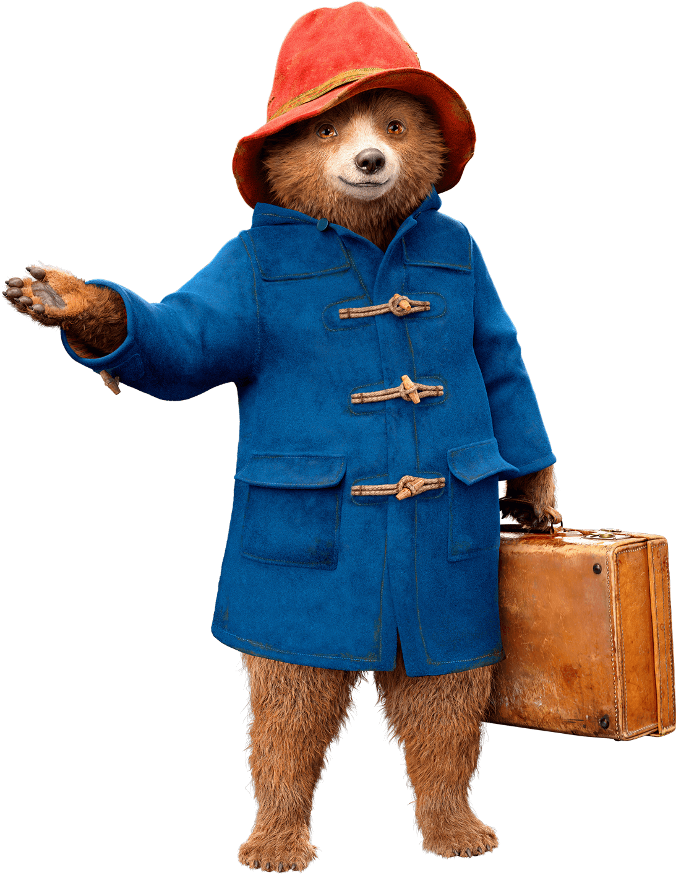
Notes:
Part 2

Slide 12
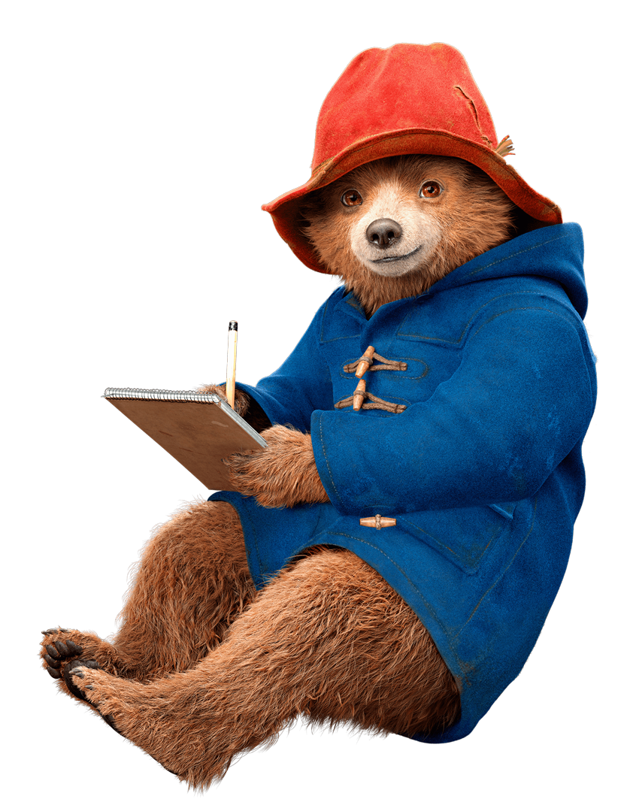
What does it mean to have a group that feels ‘safe’?
Why is it important that we create a classroom or space where everyone feels safe and ready to learn?
How do you want the other children in this group to treat you this year so you can feel safe?
What are some ways we can check in with each other?
Notes:
Ask the children:
How can we commit to be safe support for one another to protect our rights to mental health, no discrimination, freedom of expression, and respect for our views?
Discuss the questions on the slide with them.

Slide 13
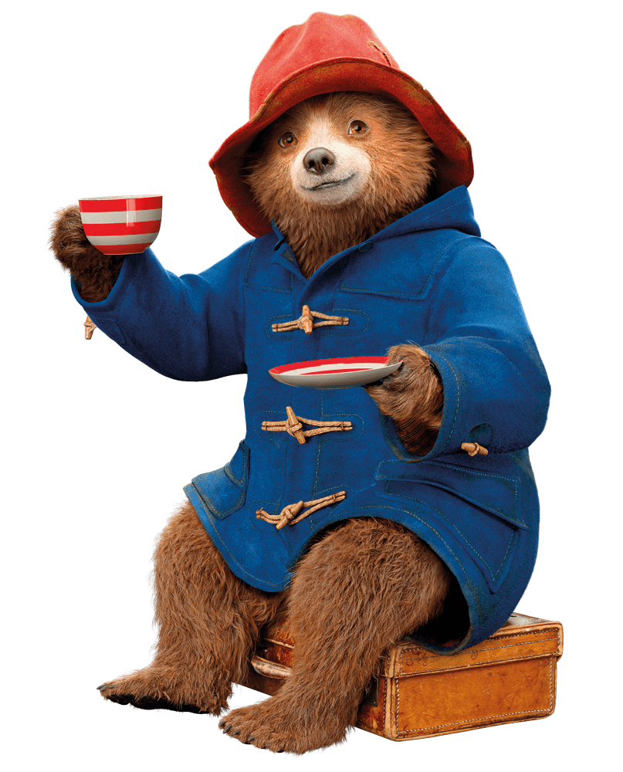
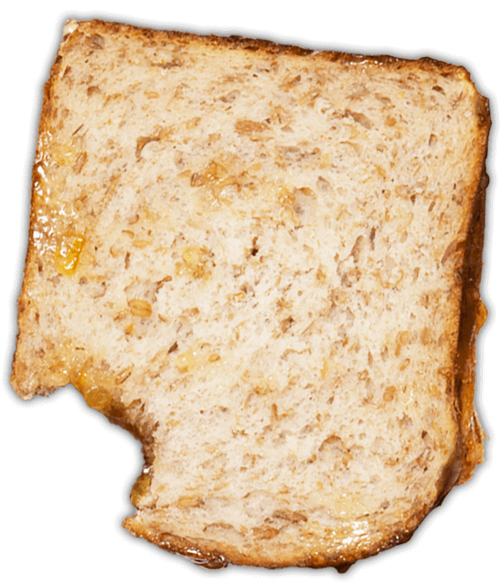
Notes:
Part 3

Slide 14
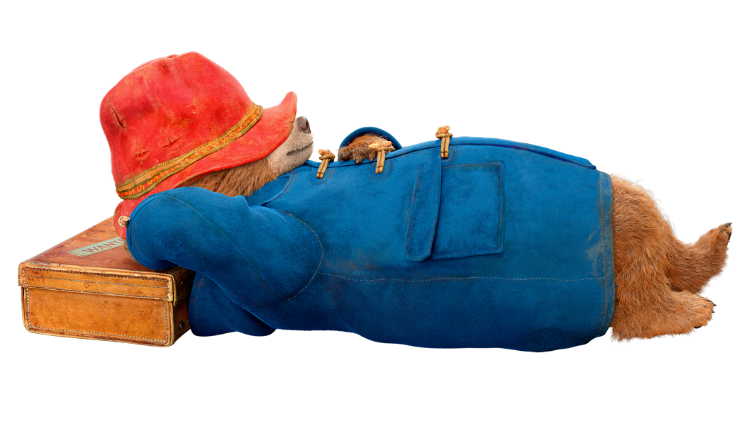
Name...
• 5 things you can SEE
• 4 things you can FEEL
• 3 things you can HEAR
• 2 things you can SMELL
• 1 thing you can TASTE
Notes:
Take a deep belly breath to begin.
5 - SEE:
Look around for five things that you can see. Say them out loud.
For example: I see the desk, I see the teacher, I see the pencil, I see the water bottle, I see the whiteboard.
4 - FEEL:
Pay attention to your body and think of four things that you can feel. Say them out loud.
For example: I feel the fan blowing on my face, I feel my feet warm in my socks, I feel the vibration of the ringing of the school bell, I feel the hardness of the chair I am sitting on.
3 - HEAR:
Listen quietly for three sounds. Say them out loud.
For example: I hear the birds outside, I hear the raindrops falling on the window, I hear the sound of my breath.
2 - SMELL:
Say two things you can smell. If you can’t smell anything from where you’re sitting it is okay to move to another spot and sniff something. If you can’t smell anything at the moment or you can’t move, then name your two favourite smells.
For example: I can smell lunch being cooked in the canteen, I can smell freshly cut grass.
1 - TASTE:
Say one thing you can taste. If you can’t taste anything, then say your favourite thing to taste.
For example: I can taste the toothpaste from brushing my teeth this morning. Take another deep belly breath to end.

