Slide 1
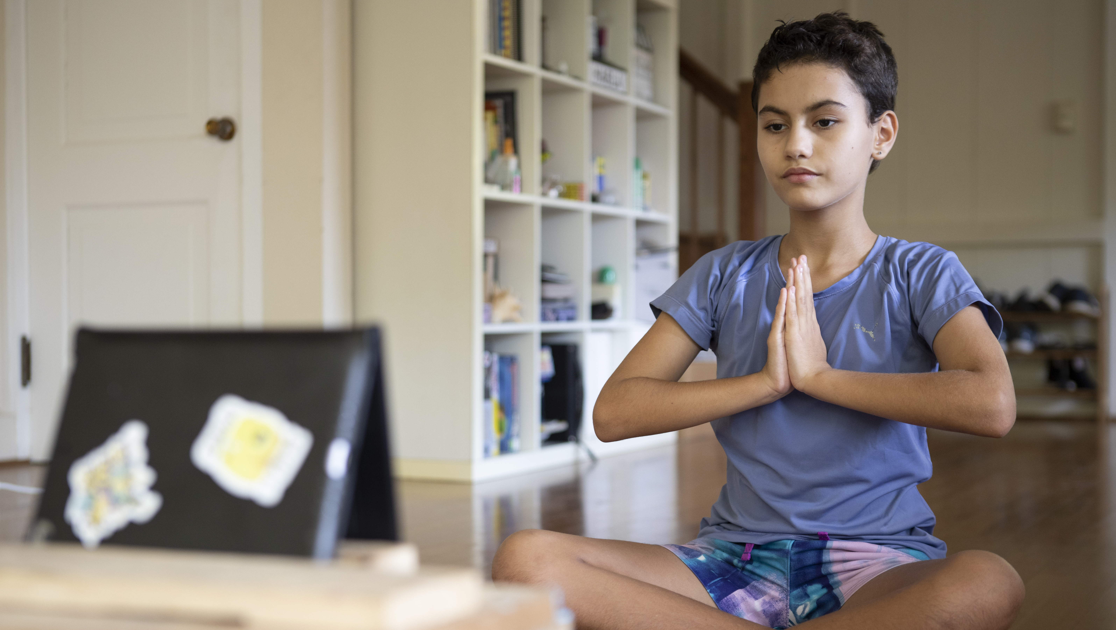
© UNICEF/Schverdfinge
Activity 5
TALKING ABOUT AND MANAGING
YOUR mental health
UNICEF UK, registered charity England & Wales (1072612) Scotland (SC043677).

Slide 2
If you roll a… 1 …Share something that makes you feel anxious. 2 …Share something you like to do when you feel worried or scared that helps you feel better. 3 …Share a feeling that you have a hard time shifting out of. 4 …Share one way the COVID-19 pandemic lockdowns made you feel. 5 …Share something that makes you feel safe. 6 …Share the name of someone you trust to talk to about your feelings.
DICE WARM-UP GAME
Notes:
Part 1
Dice game warm-up
In small groups ask young people to take turns rolling the die, and answering the question for the corresponding number rolled.
Each young person should have enough time to complete at least one roll. They can pass if they prefer not to answer a particular question, or roll again to get a different number.

Slide 3
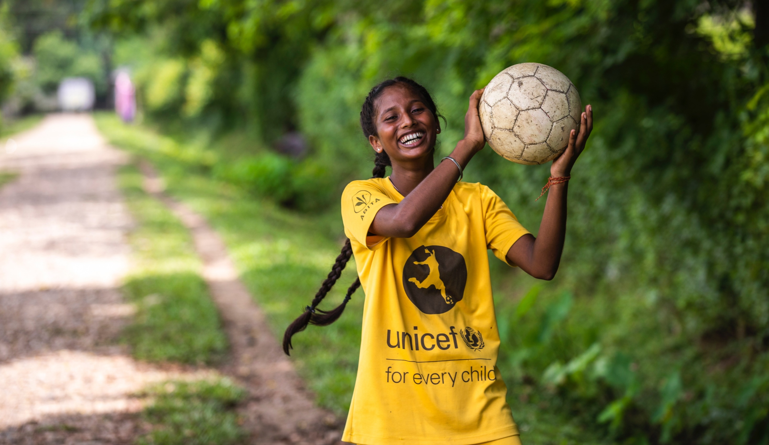
© UNICEF/Vishwanathan
Tools for managing emotions
Notes:
Part 2

Slide 4
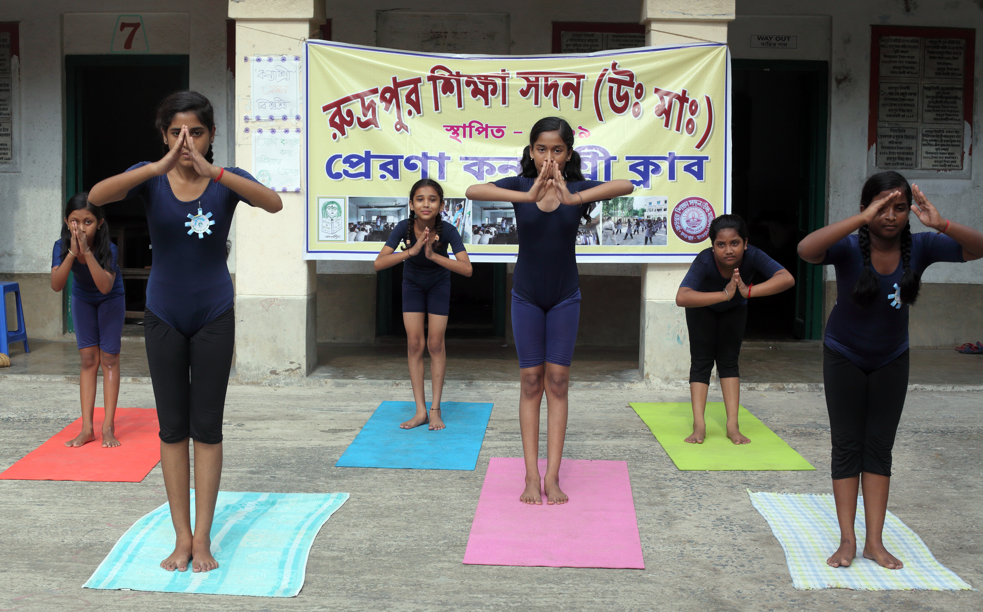
© UNICEF/Das
How does mindfulness work?
Notes:
Through mindfulness we can manage and train our brains and bodies.
Mindfulness actually helps to calm the body, not just the mind. When we practice mindfulness we train our brains to focus on one thing. When we do this, it helps grow new pathways in the way we think, it can be compared to training and building a muscle. When we are faced with stress and other big emotions, this brain training actually helps us cope better and make different decisions.
Practicing mindfulness, like meditation, or making a gratitude list, or doing an act of kindness, affects our feeling and our bodies. When we do these things, our brain releases different hormones and chemicals in our body, and this can change the way we feel.
Further resources for explaining brain science of mindfulness to young people:
Blissfulkids.com

Slide 5
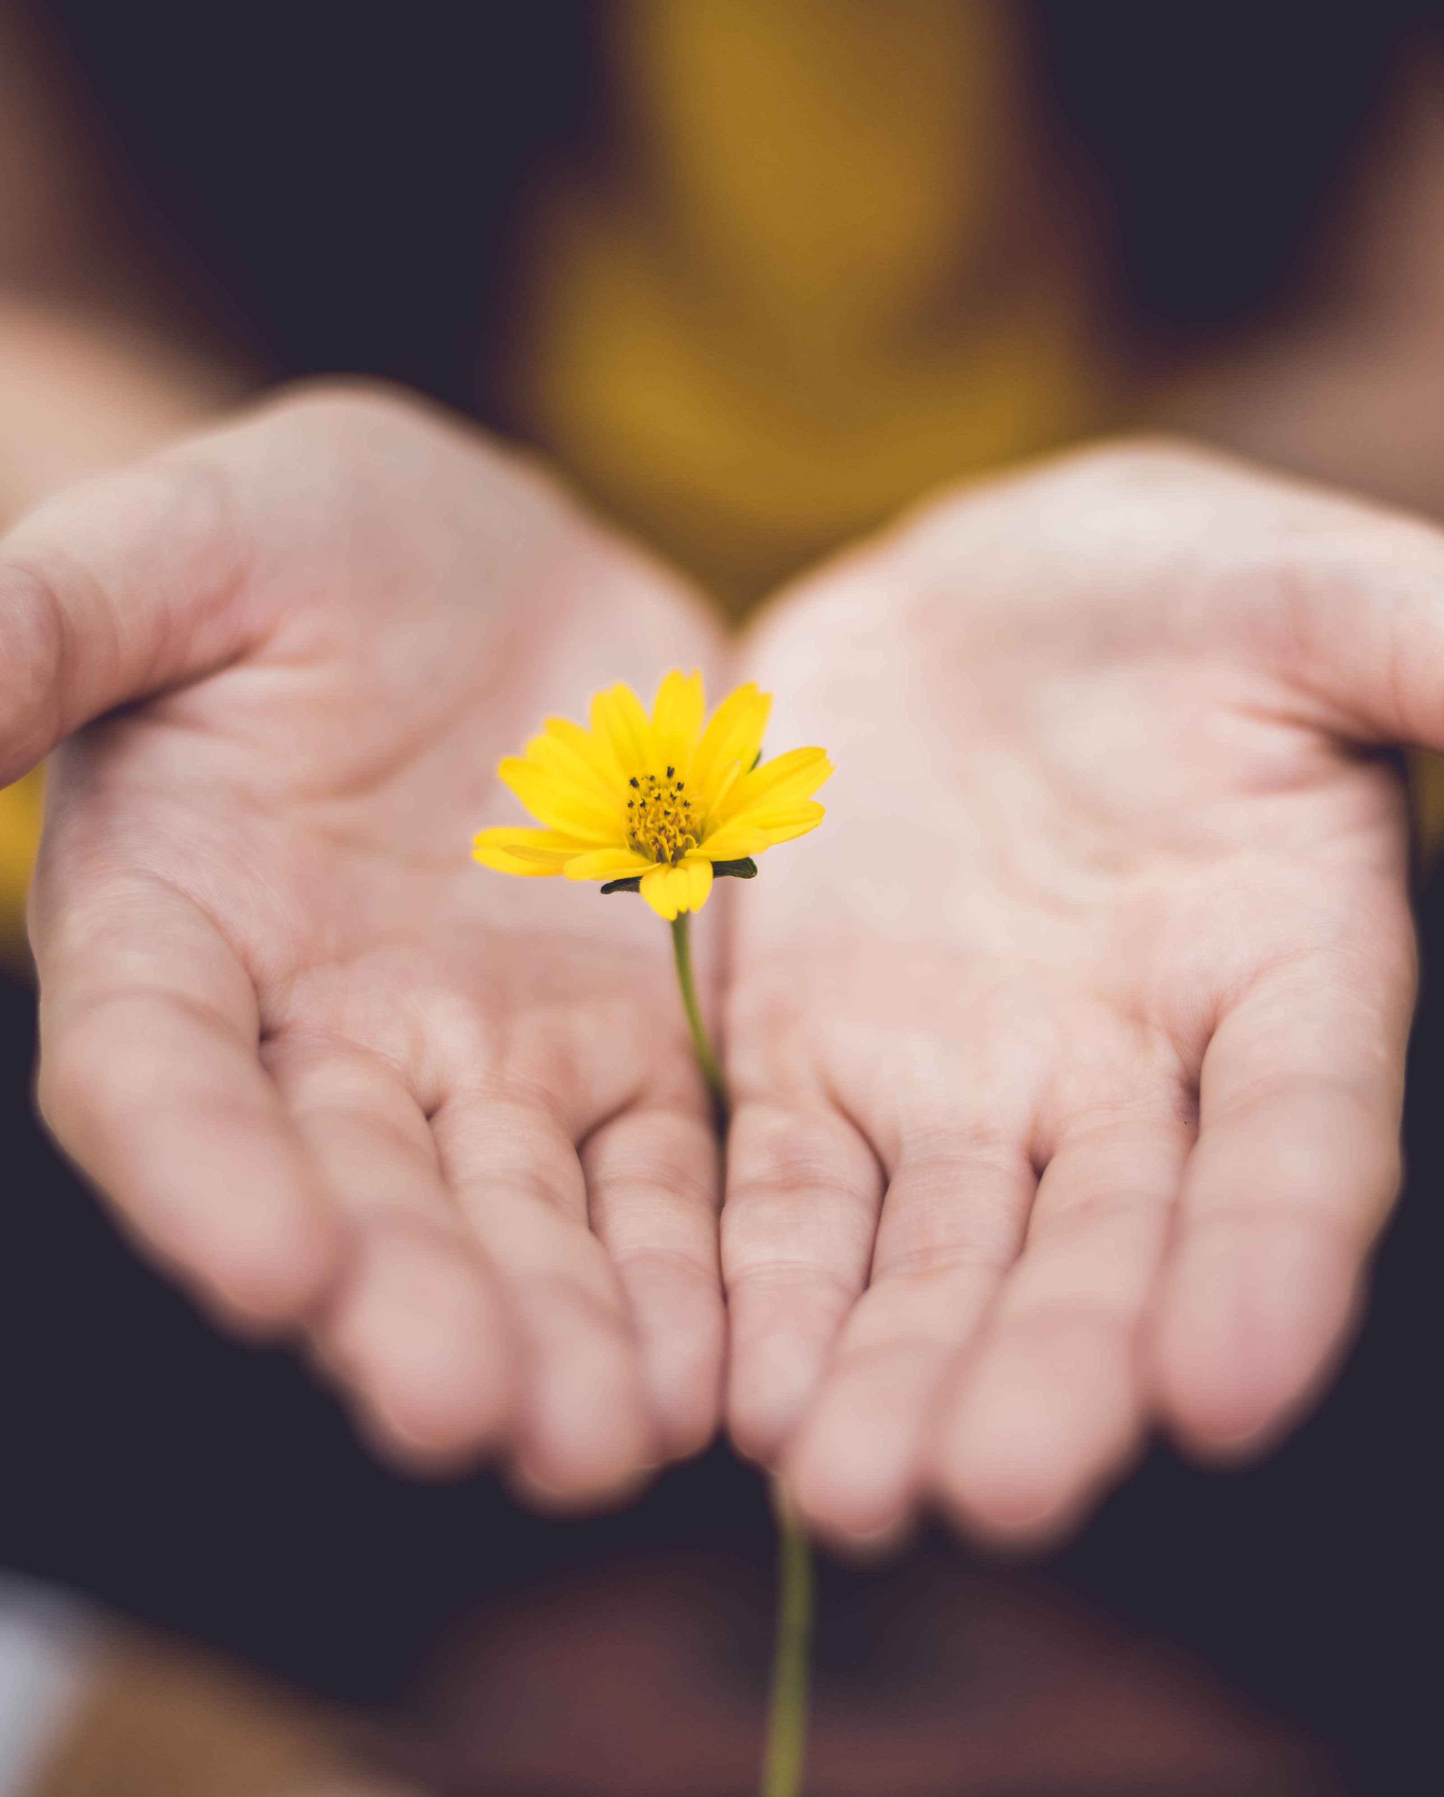
You could... create a self-care package
For young person Paavani Arora, from India, creating a ‘pocket pouch’ of calming items to turn to when she felt overwhelmed, helped her take charge of her mental health.
“The most important thing that I learned was how to focus on the basics. Self-care doesn't mean big changes or tasks.”
© Unsplash/Lina Trochez
Notes:
Share with young people the examples on this slide and the next of ideas on how to manage their mental health.
Read more about the pocket pouch idea here.

Slide 6
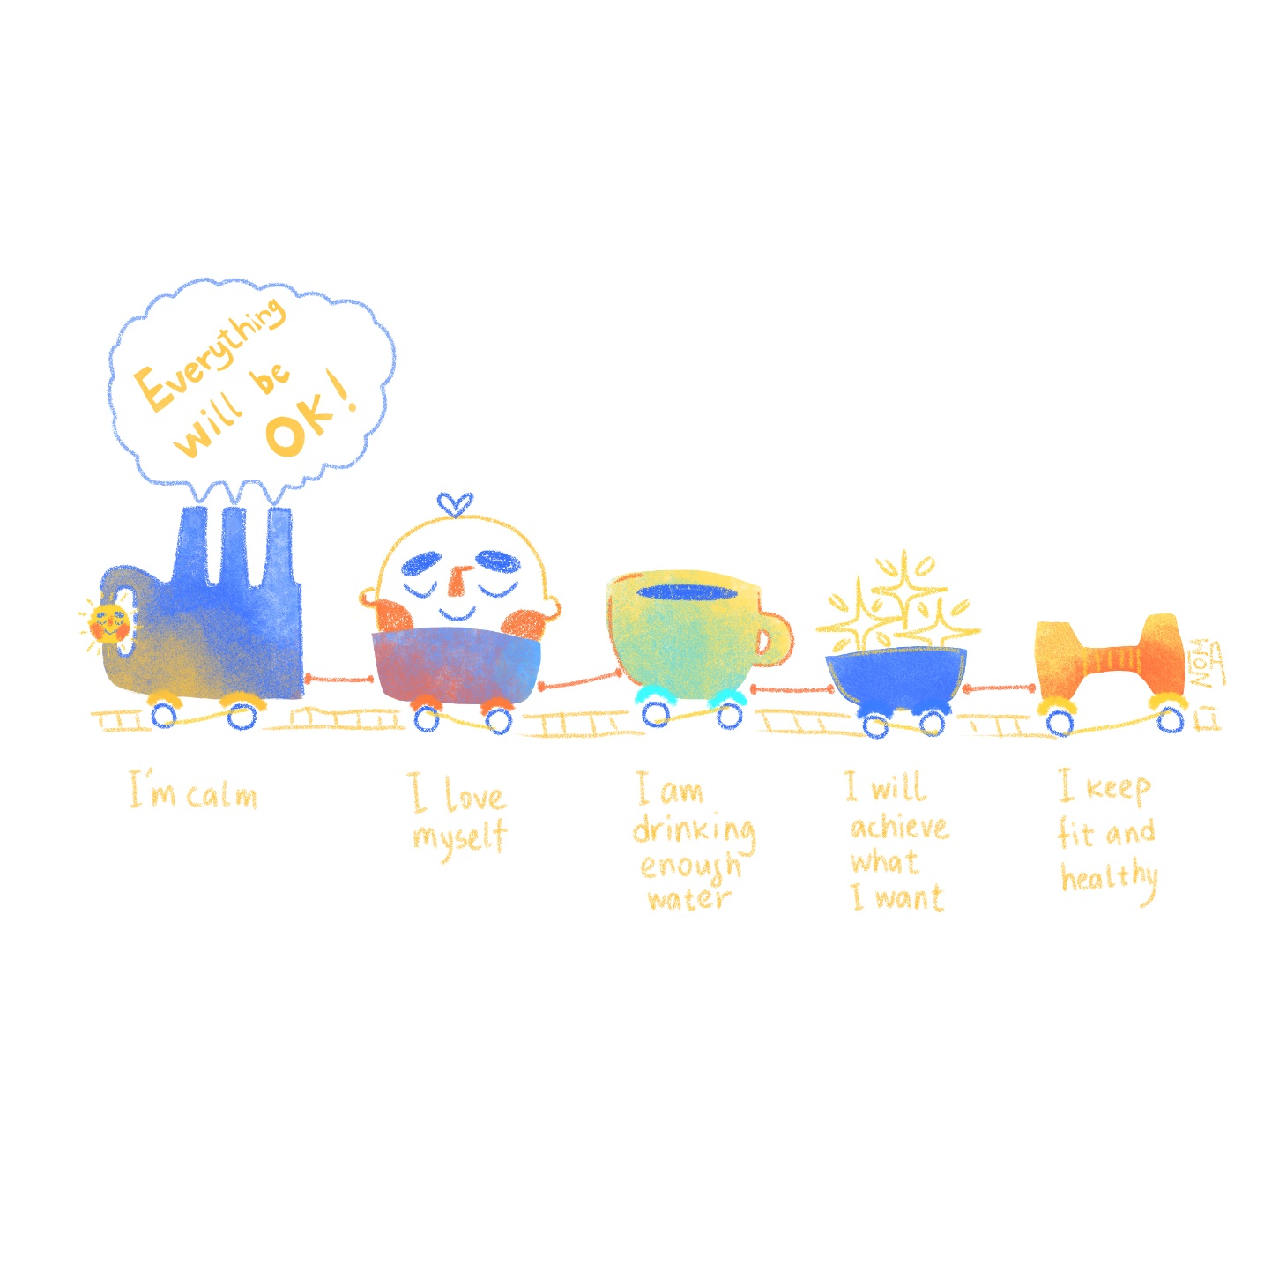
“The most important thing that I learned was how to focus on the basics. Self-care doesn't mean big changes or tasks.”
You could... Climb aboard the train of self-care
Young person Aizat Noma, from Krygyzstan, has an idea to create a ‘train’ of self-care.
“How are you, my friend? Not good? Don't forget that you have a free train ticket in your pocket. Come to the station of mental health and say ‘I am an amazing person!’ Do you hear this loud ‘Everything will be ok!’ sound? That means the train is coming! Get ready!"
“The most important thing that I learned was how to focus on the basics. Self-care doesn't mean big changes or tasks.”
© Aizat_noma
Notes:
Read more about the train of self-care here - https://www.voicesofyouth.org/blog/your-train-good-mood-and-self-care
You could also share this example with young people, if they need further inspiration:
Pratyusha Bhattacharjee, 22, from India, wrote a poem called Silent Screams to express how she was feeling about the COVID-19 pandemic. Read her poem here. https://www.voicesofyouth.org/blog/silent-screams

Slide 7
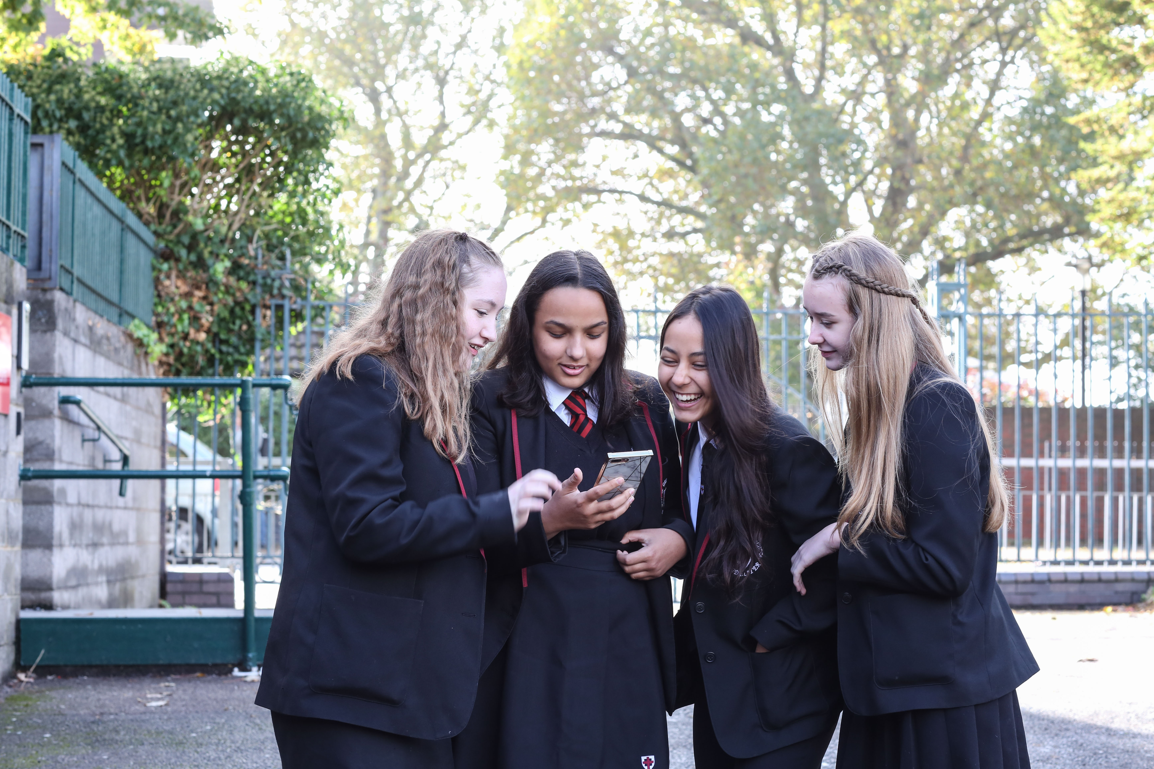
“
What tools do you have to manage your emotions?
© UNICEF/Dawe
Notes:
Ask young people to make a list of the mindfulness tools they know, or activities that they like to do when they want to shift their emotions or change their feelings.
Prompt young people to include items like meditation, breathing, mindful eating, smiling, running, dancing, keeping a thankful journal, and talking about their feelings with someone who is safe.

Slide 8
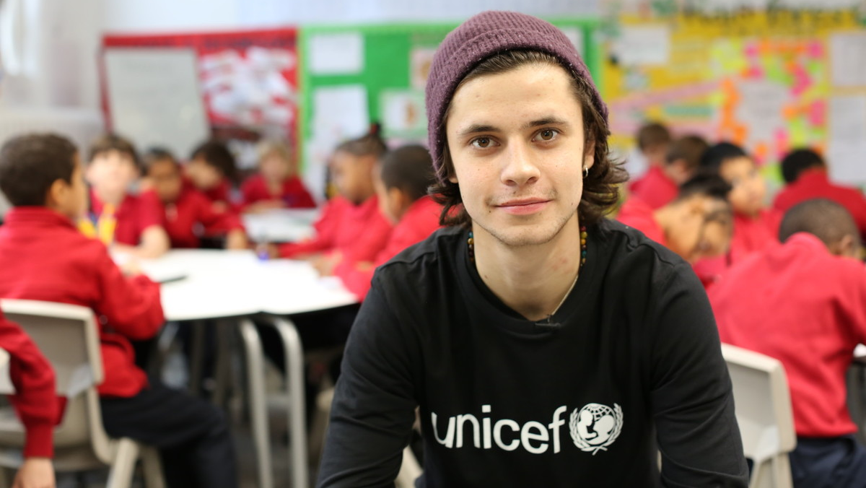
© UNICEF/Dawe
‘Health Uncovered’ – safe conversations with Cel Spellman
Notes:
Part 3
Introduce participants to the Health Uncovered podcast with UNICEF UK High Profile Supporter and OutRight champion Cel Spellman. This is a series of podcasts recorded by Cel about a variety of health issues. In four of the episodes Cel addresses different issues around mental health by talking to health experts and young people who feel safe to talk openly around their mental health challenges and conditions.
As a group, in small groups, or as a take-home activity (as presentation and resources permit) ask young people to listen to one or more of the mental health podcasts.
Season 1/ Episode 3: Mental health, me and my emotions (https://www.stitcher.com/show/health-uncovered-with-cel-spellman/episode/s1-e3-mental-health-me-and-my-emotions-52720926)
Season 1 / Episode 5: Mental health, are you okay?
Season 1 / Episode 7: Mental health, taking control (23 min)
Season 1 / Episode 8: Mental health, asking for help (25 min)

Slide 9
WHAT DID YOU THINK?
Name two things you learned.
Name one thing you would like to learn more about.
What surprised you?
Would you feel comfortable sharing your story on a podcast? Why or why not?
Notes:
Facilitate the group in an open discussion in response to the podcast, asking young people to highlight:
Two things they learned
One thing that the podcast brought up that they would like to learn more about.
Was there anything that surprised them from the podcast topic?
Would they feel safe talking to others so openly about their own mental health and wellbeing challenges?

Slide 10
Top tips 1. Narrow down your topic. What will make it interesting and helpful for listeners? It must be safe for participants to discuss. 2. Choose your interviewee(s): Do you know an expert? Does a friend or peer have an interesting story? Get consent to share.
LET’S MAKE A PODCAST!
3. Choose your podcast style: Q&A interview. Write and share a story. 4. Name your podcast. 5. Find a quiet place to record!
Notes:
Part 4
In small groups, ask young people to design their own podcast topic. Ask them to consider these questions:
What topic might be interesting to cover and help to break stigma, yet be a topic safe for participants to discuss?
Who might you interview for the topic? Would you interview an expert on the topic? Would you interview young people or children to hear their personal stories? If so, how could you ensure the podcast would be a safe place to share their stories or opinions.
What style would your interview be? Make a list of what questions you would ask on the podcast.
What would you call the podcast?
Ask each group to present their podcast topics to the larger group to refine their idea and as a safety check.
As resources permit, ask the wider group to build out one or more of the ideas to record their own mental health podcast using a smart phone or tablet. Where resources are not available, the group could role play using the questions in the format of a panel interview.

