Slide 1
Unicef.com/UN0475685

Slide 2
Slide 3 – Introducing Anti-Bullying Week
Slide 4 – Introducing the articles
Slide 5 – Exploring Anti-Bullying
Week question
Slide 6 – Exploring Anti-Bullying
Week answers
Slides 7&8 – Primary Activities
Slides 9&10 – Secondary Activities
Slide 11 – Reflection

Slide 3
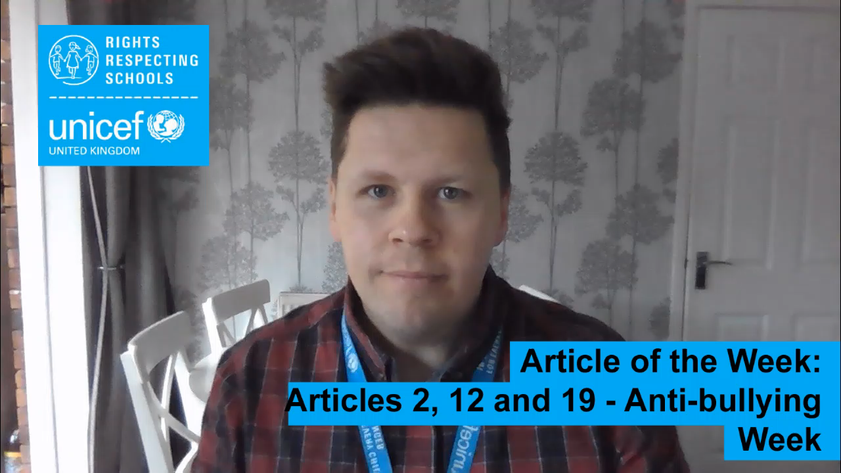

INTRODUCING ANTI-BULLYING WEEK
Stuart introduces Anti-Bullying Week
Anti-Bullying Week 2021: One Kind Word
Anti-Bullying Week takes place across the UK from 15 to 19 November 2021. It's coordinated by the Anti-Bullying Alliance in England and Wales, anti-bullying agency respectme in Scotland and The Northern Ireland Anti-Bullying Forum.
This year has the theme ‘One Kind Word’.
Click here to watch on YouTube

Slide 4



LINKED UNCRC ARTICLES
There are three articles that provide a particularly strong link this week:
Article 2 – Non-discrimination: The Convention applies to every child without discrimination, whatever their ethnicity, gender, religion, language, abilities or any other status, whatever they think or say, whatever their family background.
Article 12 – Respect for the views of the child: Every child has the right to express their views, feelings and wishes in all matters affecting them, and to have their views considered and taken seriously. This right applies at all times, for example during immigration proceedings, housing decisions or the child’s day-to-day home life.
Article 19 – Protection from violence, abuse and neglect: Governments must do all they can to ensure that children are protected from all forms of violence, abuse, neglect and bad treatment by their parents or anyone else who looks after them.

Slide 5
EXPLORING ANTI-BULLYING WEEK
Bullying can take many forms. Can you think of and describe some of the ways someone might be bullied?
Unicef.com/UN0475677

Slide 6
How many of these did you get?
Physical – aggressive or violent action, being pushed, hit, kicked, intimidated
Verbal – name-calling, threatening, being laughed at, teasing, being shouted at
Social – being purposefully excluded from plans with your "friends"
Cyber bullying (online, on social media or gaming forums) – unkind comments, sharing photos with negative comments
Discrimination - against race, nationality, sexuality, faith or another protected characteristic
Sexual bullying – unwanted sexual comments or contact, spreading of sex rumours
Emotional or Psychological – when someone gets what they want by making others feel angry/sad (manipulation) or being told they are not good enough
Did you get any of these? What other answers did you have?

Slide 7

Draw different emotion faces on empty boxes (you can either find some online or drawn them on) e.g. a happy face, crying face, angry face etc. Use scrunched up paper or beanbags and throw them into the box. Wherever the beanbag lands, invite the class to discuss a time they felt this way, or the emotion more generally.
Watch and join in with this Stop Bullying Now song. Discuss as a class why kindness and respect are important.
What does a bully look like?
In your class, work in small groups or on your own, and draw what you think a bully looks like. Then talk about your poster with others. Why do you think your bully looks the way they do? Think about stereotypes.
Types of Bullying – write a list or draw posters of some of the types of bullying we looked at in the start of the pack.
Use this website to help you childline.org.uk/info-advice/bullying-abuse-safety/types-bullying/

Slide 8

Write a letter to an advice column explaining that you are worried about a friend being bullied. You can read an example on Childline website.
Imagine you received the letter. Write a letter back, offering some support and guidance to the person.
What would you say?
Watch this inspiring anti-bullying choir, Class Dynamix, on Britain’s Got Talent.
Write a song or a rap about anti-bullying. Work in groups. If you like, perform it!
Use your drama skills to create a freeze frame of a situation where someone is being bullied.
Take it in turns for each person to ‘un-freeze’ and discuss what is happening and how the person may be feeling. Consider reasons behind why someone might become the bully. Discuss conflict resolutions that may be able to change the situation. Finish with another free frame showing the resolution.
Explore the website respectme.com.
The website provides free campaign resources for anyone involved in influencing the life of a young person to help kick-start meaningful conversations about bullying and the importance of kindness.

Slide 9
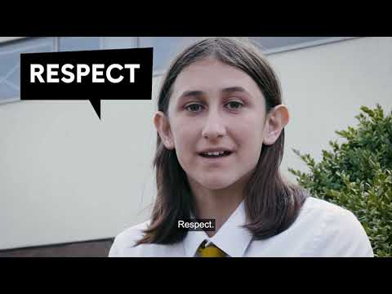
Watch this video from the Anti-Bullying Alliance.
The Alliance is using the hashtag #WhatMadeItBetter? Discuss the different ways you could support a friend who is being bullied, or if you feel confident, discuss a personal experience where you were able to overcome bullying. Perhaps use the # and join the conversation on social media.
Adults are duty bearers for children’s rights – they have a responsibility to promote, protect and respect children's rights. Ask some adults in your school, what they do to respect your right to be protected from the harm that bullying can cause.
Perhaps you could create an anti-bullying charter for your school including articles 2, 12 and 19. with a teacher.
Use a large piece of paper and write the word ‘CYBERBULLYING’ in the middle. As a group, write down everything you know about this and on which platforms it can happen. Think of examples you have seen.
Next, think of and record actions that can be taken to stop or report cyberbullying, such as using an apps report feature, screen capping abusing messages etc.
Explore the website respectme.com.
The website provides free campaign resources for anyone involved in influencing the life of a young person to help kick-start meaningful conversations about bullying and the importance of kindness.

Slide 10

Watch this video of YouTuber Dina Tokio discussing her bullying experiences and her reflections on ‘life after bullying’.
Discuss as a class what you learned from watching this. Use these insights to inspire an anti-bullying ‘manifesto’ for your school.
Signposting – Create leaflets, posters or a page on your school website signposting to charities and organisations who can help you if you are being bullied such as Childline and the NSPCC.
Use your drama skills to create a freeze frame of a situation where someone is being bullied.
Take it in turns for each person to ‘un-freeze’ and discuss what is happening how the person may be feeling. Consider reasons behind why someone might become the bully. Discuss conflict resolutions that may be able to change the situation. Finish with another free frame showing the resolution.
Many schools have an anti-bullying policy. Have you read your school's? Does it mention rights? Create a pupil friendly version to share with the rest of the school community. Think about what needs to be included and how you will make sure all young people have a voice as to what is included.

Slide 11

REFLECTION
This year’s Anti-bullying theme is ‘One Kind Word’
In a world that can sometimes feel like it’s filled with negativity,
one kind word can provide a moment of hope.
It can be a turning point.
It can change someone’s perspective.
It can change their day.
It can change the course of a conversation and break the cycle of bullying. Best of all,
one kind word leads to another.
Kindness fuels kindness.
So, from the playground to Parliament,
and from our phones to our homes,
together,
our actions can fire a chain reaction that powers positivity. It starts with one kind word.
It starts today.
Create some quiet time and find a safe and comfortable space. Read the words on the right-hand side very slowly and think about what they mean to you. (This could be powerful in an assembly with some background music).
At some point this week, choose to say one kind word/sentence to someone in your school, you never know how much impact this might make.
k to add text

Slide 12

MORE INFO…
RRSA WEBSITE
For more information or to download previous Article of the Week packs please visit the RRSA website by clicking the link below
CLICK HERE

Slide 13
Thank you
UNICEF UK/Dawe
Notes:
UNICEF UK/Dawe

