Slide 1
UNICEF/UNI134430

Slide 2
Slide 3 – Guess the article
Slide 4 – Introducing article 14
Slide 5 – Exploring article 14
Slide 6 – Some possible answers
Slides 7&8 – Primary Activities
Slides 9&10 – Secondary Activities
Slide 11 – Reflection

Slide 3
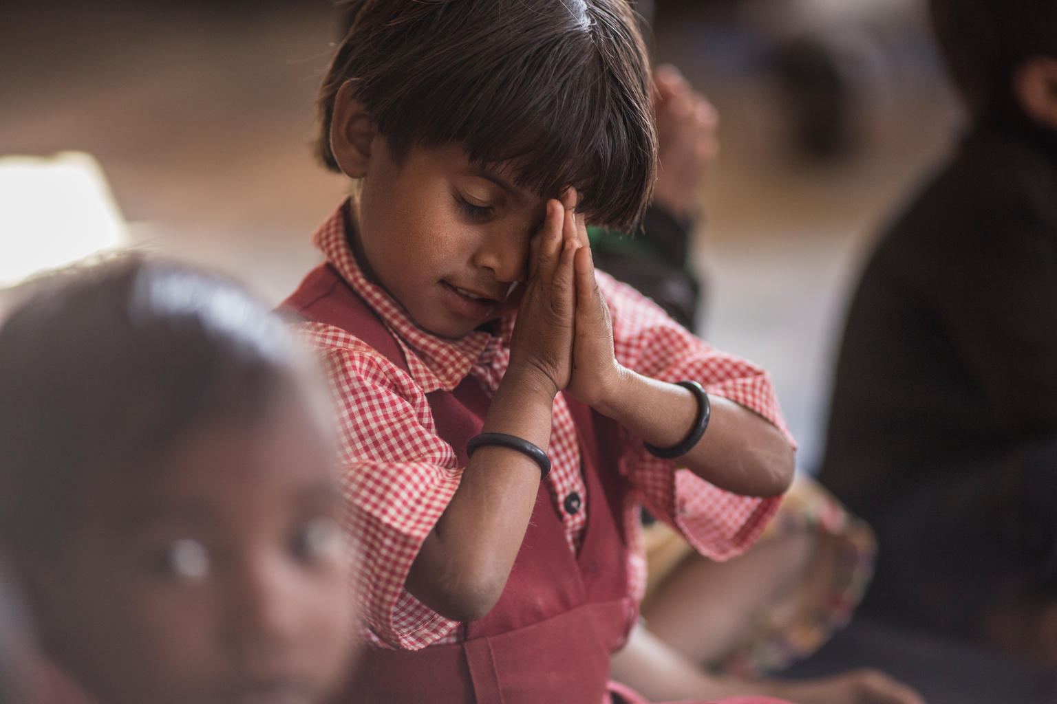
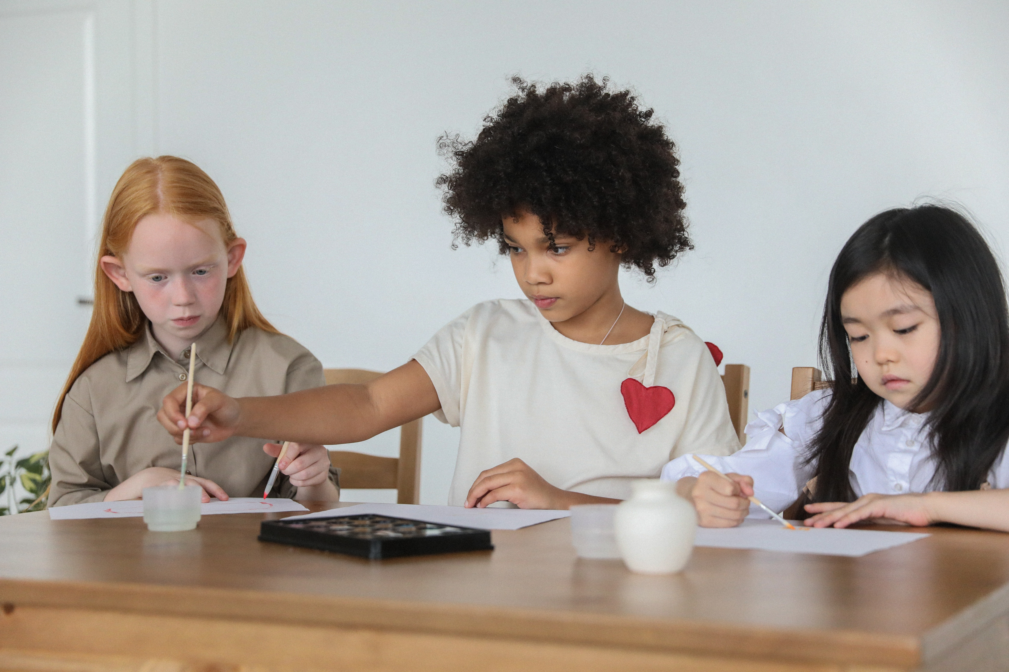
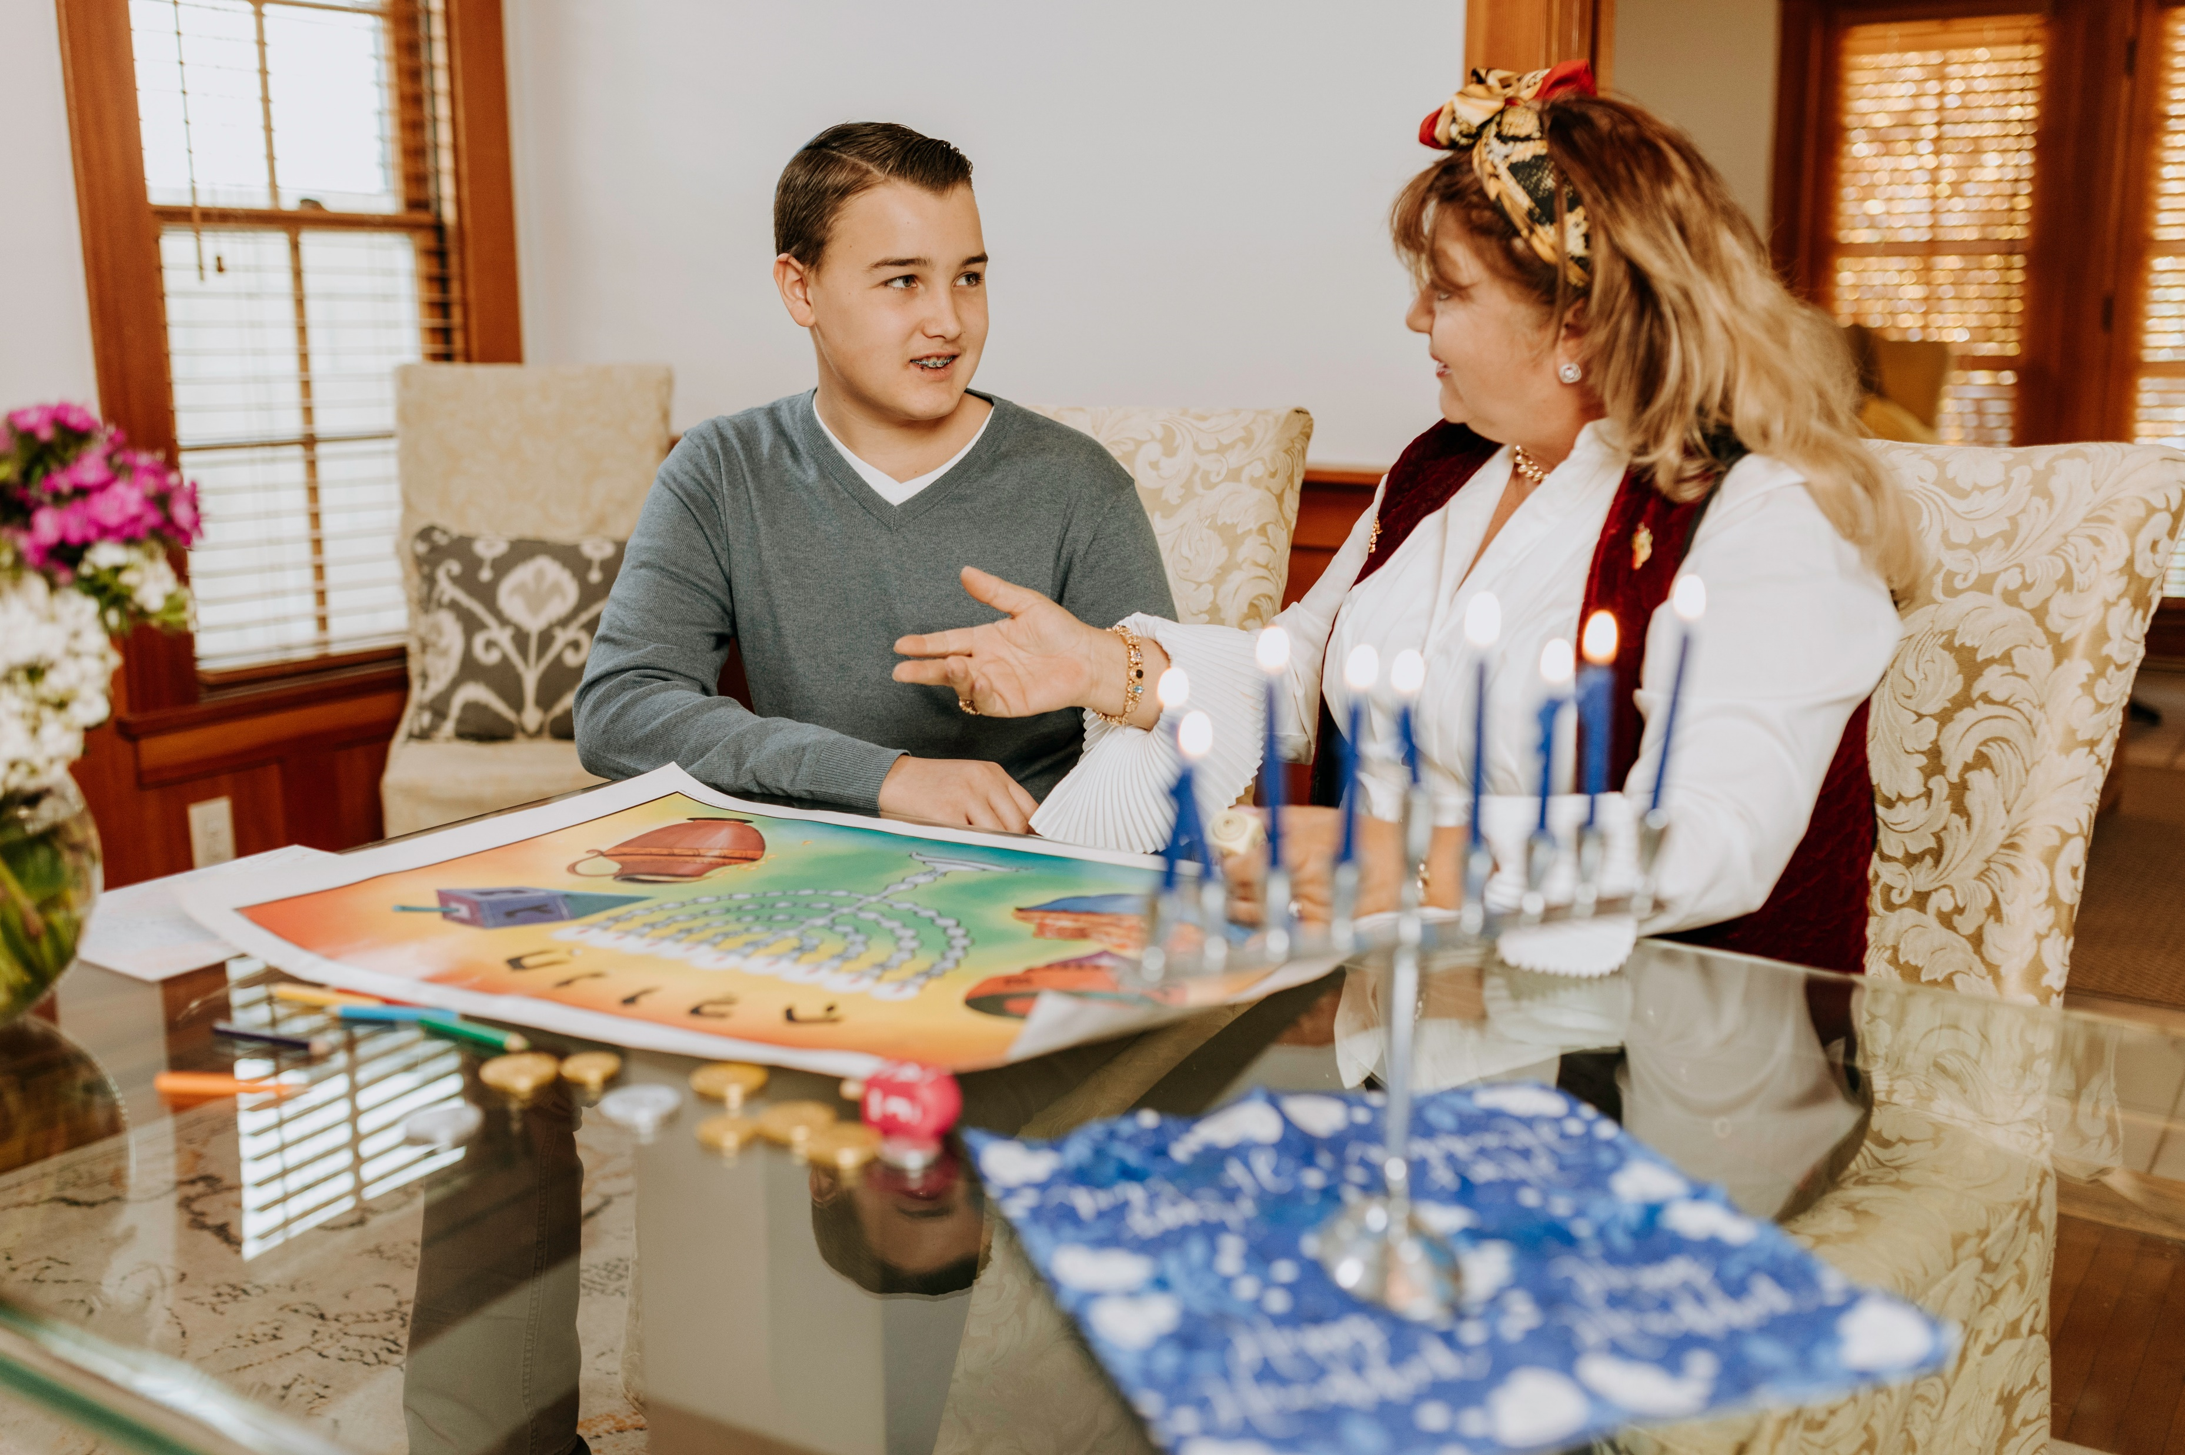
Guess the Article
These pictures provide a clue to this week’s article.
How do these pictures help you? Can you guess how they are linked together?
Write down your thoughts or discuss with someone in your class.
@UNICEF/Dhiraj Singh
Photo by Monstera, Pexels
Photo by RODNAE Productions, Pexels

Slide 4
INTRODUCING ARTICLE 14
Jilly Hillier, Professional Adviser at UNICEF UK, introduces Article 14
Article 14 – Freedom of thought, belief and religion
Every child has the right to think and believe what they choose and also to practise their religion, as long as they are not stopping other people from enjoying their rights.
Governments must respect the rights and responsibilities of parents to guide their children as they grow up.
Click here to watch on YouTube

Slide 5
EXPLORING ARTICLE 14
Every child grows up with their own thoughts and beliefs about the world.
Who or what do you think influences children and young people’s thoughts and beliefs about how they want to live?

Slide 6
How many of these did you get?
Parents and family
Friends
School
Places of worship
Where you live
Holy books or faith stories
Religious leaders or teachers
Social media
Governments
Events in the news
Personal experiences
The welfare of the planet
What others did you think of?

Slide 7
Make a list of 5 things you like and 5 you don’t, then compare it with a friend. Are your lists the same? It’s okay, we’re allowed to have different opinions! Talk about the importance of different views and beliefs.
November and December are important months for many religions. Can you think of some festivals and events that take place at this time? Work with your friends to see how many you can think of. You could research safely online.
You could write a sentence, draw a picture, or write a story about a child celebrating a festival or special day.
Have you seen a mandala? Art has a special place in many religions and cultures and they are one example. Watch this video to learn how to draw a mandala or colour a mandala.
Circle time can be a great opportunity to talk about what you’re thinking – why not make respecting Article 14 the topic for your next group discussion?

Slide 8
Why do you think religious buildings are important for believers? Think of and draw a building that is important to you or make a sculpture of one of these buildings using recycled materials (old cereal boxes, empty toilet roll etc.). This could be a religious building like a church or a temple, or even a school or a library. Write a sentence or two about why this building is important to you.
Food choices are really important to some people. Find out about the food rules of a specific religion. If you have the ingredients at home, why don’t you have a go at making a dish with your family? Watch this video from the BBC and its humorous exploration of food and religion. Discuss what you learnt from it.
Imagine you are part of your School Council. What ideas do you have to make sure your school listens to the thoughts and respects the beliefs of all children?
Could your school do more to celebrate different religions and beliefs?
This video about Dr Martin Luther King Jr explains how his religion and beliefs shaped his work for civil rights. Research and write about another inspirational figure who had strong beliefs – do you agree with them? Share your thoughts about this in a class discussion.

Slide 9
Can you think of an example of when a group of people were stopped from practising their faith? Either in the present day or in history?
Research and write a short newspaper article about this event.
Talk to your grandparents or older members of your community about the importance of religion in their lives growing up. How is it different today?
Report back what you find in a form time discussion or in an RE lesson.
Watch the first minute and a half of this video to find out the percentage of people practicing major religions. You might like to first estimate with a partner how many people you think would be Muslim, Jewish, Hindu, Christian, Sikh and then compare with the video. What influenced your thinking?
Write a ‘for and against’ debate for why people should be allowed to wear a religious item of clothing or accessory in public. You can even do a debate with someone you live with and ask a third person to be the impartial judge, or have a debate in class.

Slide 10
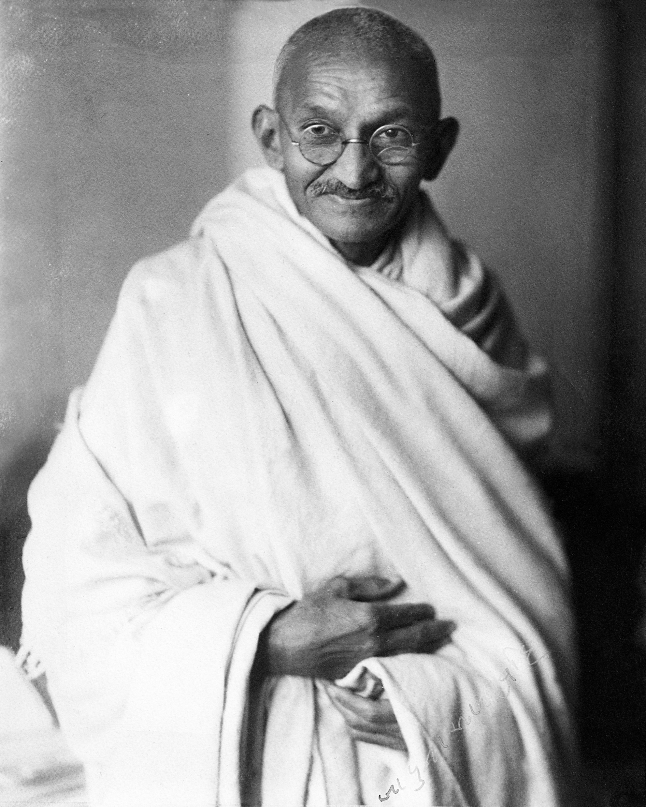
For some non-religious people, humanism is a belief and provides answers to questions about the way to live your life in the same way that religion does for others. Explore what it means to be a humanist and create an information leaflet to show what you have found out.
Every child has the right to think and believe what they choose as long as they are not stopping other people from enjoying their rights. Have you ever heard of views, beliefs and opinions which go against other people’s rights? What role does social media have in this? Take some time to discuss these questions in class.
How do you respond when someone expresses a view different to your own? ‘Respectfully disagreeing’ with someone’s thoughts or beliefs is an important skill. Work with a partner to write some guidelines about the language to use and attitudes to take when having a discussion with someone with different views. Use these guidelines to host a debate on an issue important to you.
Pacifism is the principled opposition to war and violence as means of settling disputes or conflict. Mahatma Gandhi was a famous pacifist. Research his life and beliefs and choose any way you like to present what you have learnt.

Slide 11
REFLECTION
Article 14 is all about your beliefs and how they are shaped. Sometimes it’s nice to stop and take a moment, to be quiet and still and allow yourself to think of bigger questions than what cereal to have or what t-shirt to wear.
Try giving a moment to one or more of these philosophical questions.
What does it mean to live a good life?
Should you forgive others?
Is it better to do what you think is right or to follow the rules?
Is a human life more valuable than a rat’s?
UNICEF UK/Dawe

Slide 12
MORE INFO…
RRSA WEBSITE
For more information or to download previous Article of the Week packs please visit the RRSA website by clicking the link below
CLICK HERE

Slide 13
Thank you
UNICEF UK/Dawe
Notes:
UNICEF UK/Dawe

