Slide 1
UNICEF/UN0413033

Slide 2
Slide 3 – Guess the article
Slide 4 – Introducing article 29
Slide 5 – Exploring article 29
Slide 6 – Some possible answers
Slides 7&8 – Primary Activities
Slides 9&10 – Secondary Activities
Slide 11 – Reflection

Slide 3
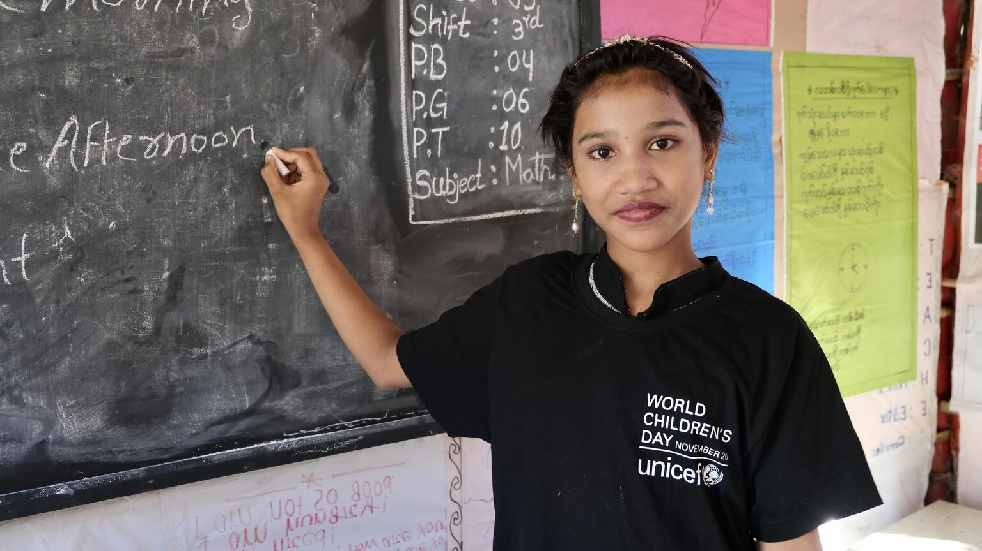
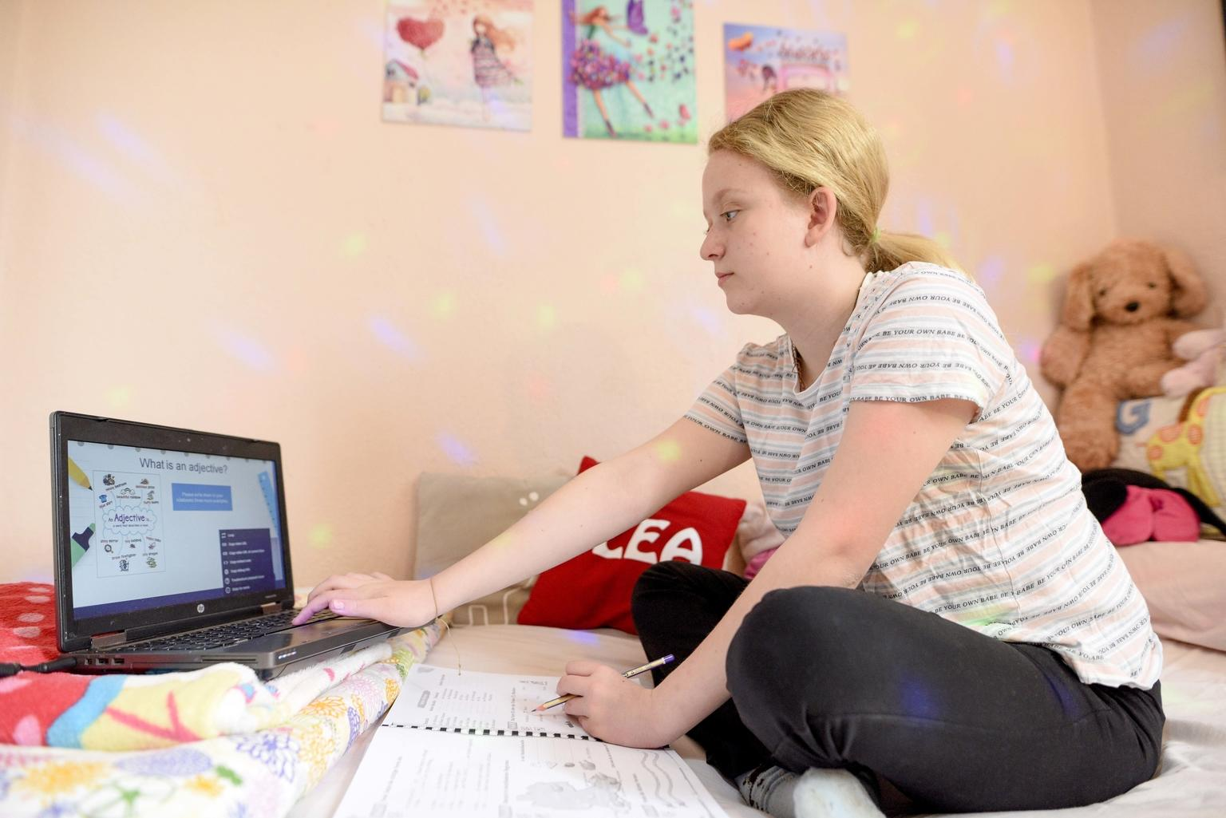
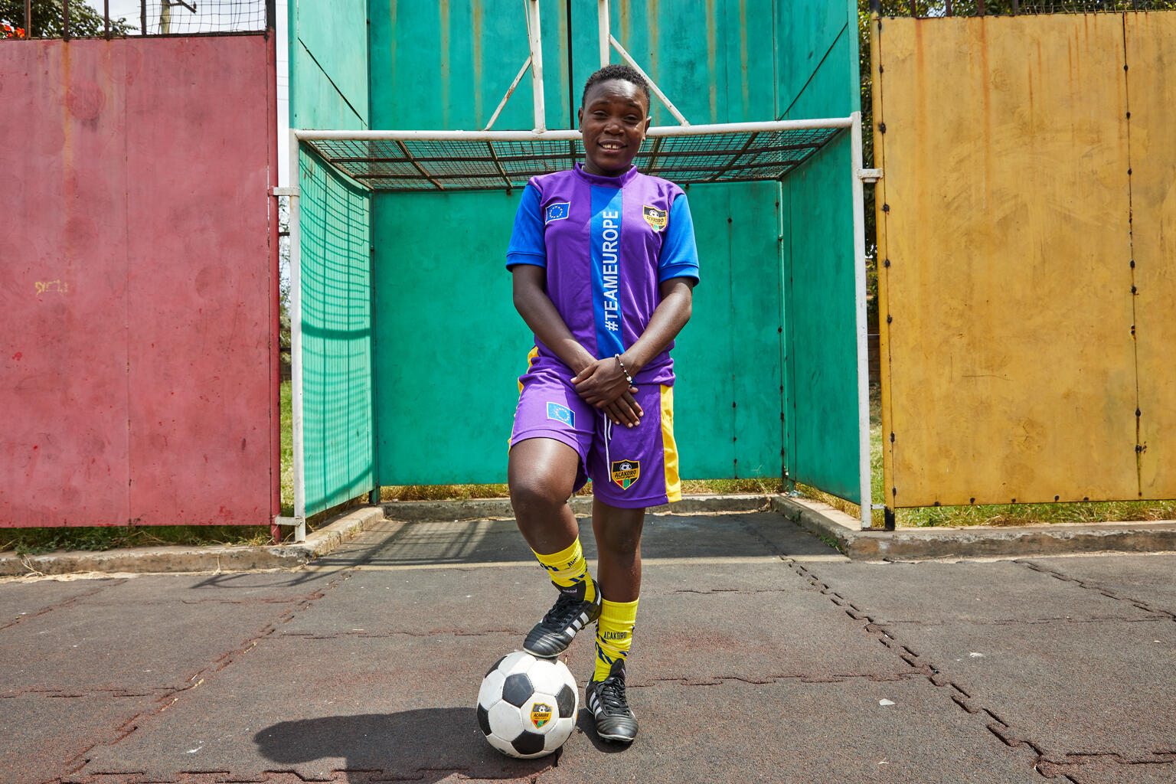
Guess the Article
These pictures provide a clue to this week’s article.
How do these pictures help you? Can you guess how they are linked together?
Write down your thoughts or discuss with someone in your class.
@UNICEF/Maria Spiridonova
@UNICEF/Tomislav Georgiev
@UNICEF/UN0523745

Slide 4
INTRODUCING ARTICLE 29
Steven Kidd, Professional Adviser at UNICEF UK, introduces Article 29
Article 29 – Goals of education
Education must develop every child’s personality, talents and abilities to the full.
It must encourage the child’s respect for human rights, as well as respect for their parents, their own and other cultures, and the environment.
Click here to watch on YouTube

Slide 5
EXPLORING ARTICLE 29
The start of a new year is often a time for looking at our lives and making promises to ourselves. The UN Convention on the Rights of the Child is a list of promises from world leaders to all the children and young people of the world.
Why do you think education is a central part of that promise? Why does it matter so much?
Make a note of your ideas.

Slide 6
Did you think about these areas?
Education matters because it helps children and young people to:
Learn how to be safe and healthy
Be part of a community
Meet people, play and make friends
Develop new ways of learning (such as online learning)
Learn ways to support each other through hard times
Feel included and have a voice
Access healthy food in schools
Prepare for adult life and work
Learn about wellbeing and mental health
Find out more about different cultures and traditions
Learn how to work as part of a team
Develop their personality
Learn how to develop their talents and abilities
Become independent
Learn about the world we live in
Learn about their rights
Learn about school subjects like English, maths and science
What other ideas did you have?

Slide 7
Do you ever make choices about your education, perhaps thinking about what you’d like to learn or setting yourself targets? What do you want to achieve today, this week, this month or this term? Have you heard about the Power of Yet? Here’s a great song from Sesame Street to tell you more. Could you design a poster to spread the word?
Draw a picture of your school showing two of the things you most like doing. Make a display in your classroom showing the things that you enjoy doing as part of your education.
Watch this short ‘Global Goals’ film which shows how lots of children and young people around the world are using their talents to make the world a better place. What are you good at? How could you use your talents to make the world a better place?
Article 29 talks about developing talents, but what is talent? Take a look at this sportscotland video discussing the role of talent in sport and work with a partner to decide on your top tips for how to develop a talent.

Slide 8
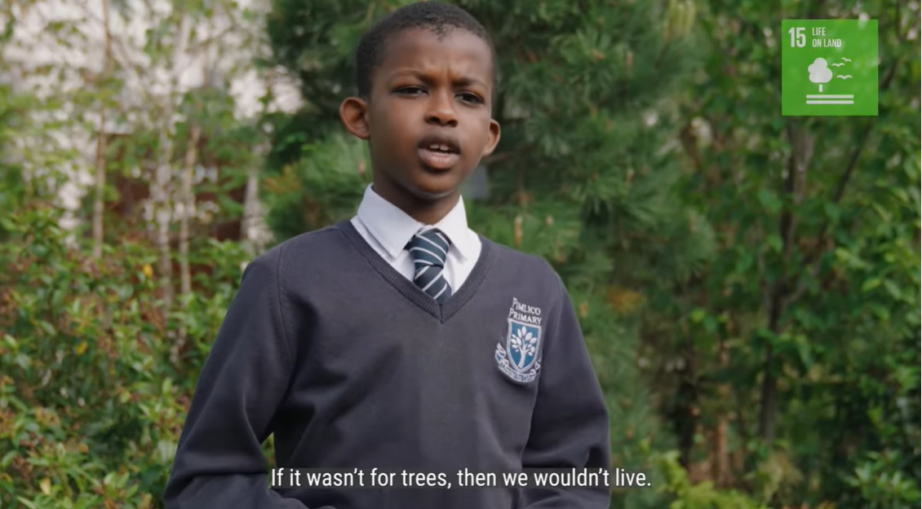
If you have a Class Charter, spend some time revisiting it as a class. How has it been working? Do you need to add a new article? Are there any things to add about respecting other people’s rights?
Article 29 says that education should develop your personality, abilities and talents. Look up these words and discuss their meaning as a class. Create a drawing or write a poem or story to show some of your abilities and talents of an aspect of your personality.
It’s a new year. What are you hoping for in 2022? Imagine you were asked to make a new year’s resolution about your learning and education – think of a few ideas, then decide on your top three and share them. You might like to write them down somewhere and try to stick to them.
Article 29 also says we should learn about how to respect our environment – in this video, children talk about the importance of nature and what they’ve been doing to raise awareness. Upload your own tree picture to the digital forest.

Slide 9
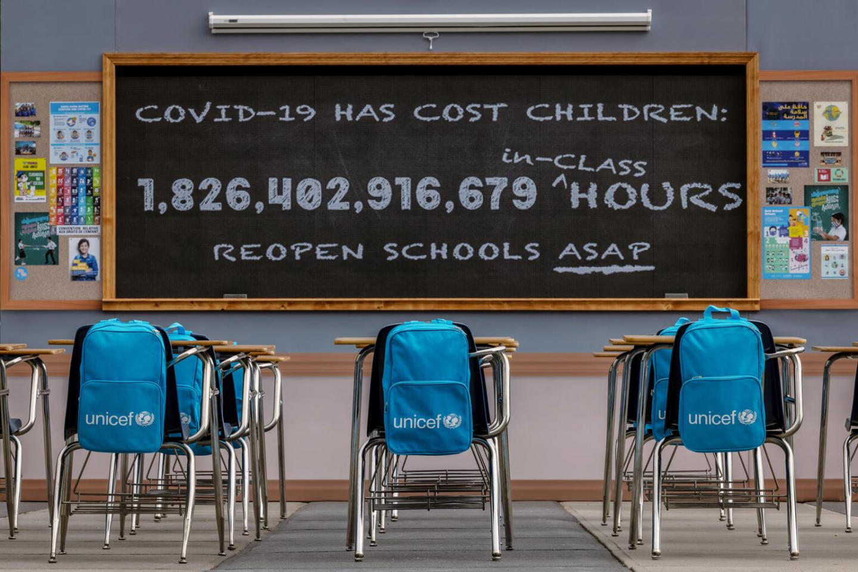
Article 29 describes what education should be and stresses its importance. School closures have disrupted the education of more than 1.57 billion students worldwide. Watch this film of 10-year-old Amanda as she returns to school in Chile. In many countries children have not yet been able to go back to school and home learning is returning. Write a guide to encourage pupils to value and make the most of education – whether at home or in school.
It’s a new year. What are you hoping for in 2022? Imagine you were asked to make a new year’s resolution about your learning and education – think of a few ideas, then decide on your top three and share them. You might like to write them down somewhere and try to stick to them.
As the impact of COVID-19 around the world (and in the UK) continues to affect children’s education, UNICEF encourages all governments to do everything they can to reopen schools as quickly as possible. Watch the videos on this page and then write a newspaper report to show what you have found out.
UNICEF has always supported the right to education around the world. Read and watch the video about a School in a Box. Share what you have learnt with your class or year group. If you can, find out more about UNICEF’s work to support education around the world.

Slide 10
Education and learning has always been at the heart of human progress. What might the future hold? Watch this inspiring video made by UNICEF – “Are we listening to the unstoppable?” and then work with a friend to write your own poetic vision or manifesto for the future of learning for young people.
To get the best possible education it helps to be a great learner! Work with a friend or small group to create a ‘Top Learner Ten’ – a list of tips for all young people to be the best learners they can be. Could you turn this into an assembly linked to your education rights?
The pandemic has meant that education has been interrupted for all children across the world. If you were the Minister of Education, what guidance would you give to headteachers to ensure that all the goals of education are achieved? Think about the ways that school has changed recently, what things will you put in place to ensure all children can reach their full potential?
Read the wording of Article 29 again. Think about how well your school encourages young people to respect: themselves, others, human rights, their parents and the environment. Rate each category out of 5 with 0 as no encouragement and 5 for lots of encouragement. Share your results with a friend from your school or even different schools.
What could your school do to improve its rating?

Slide 11
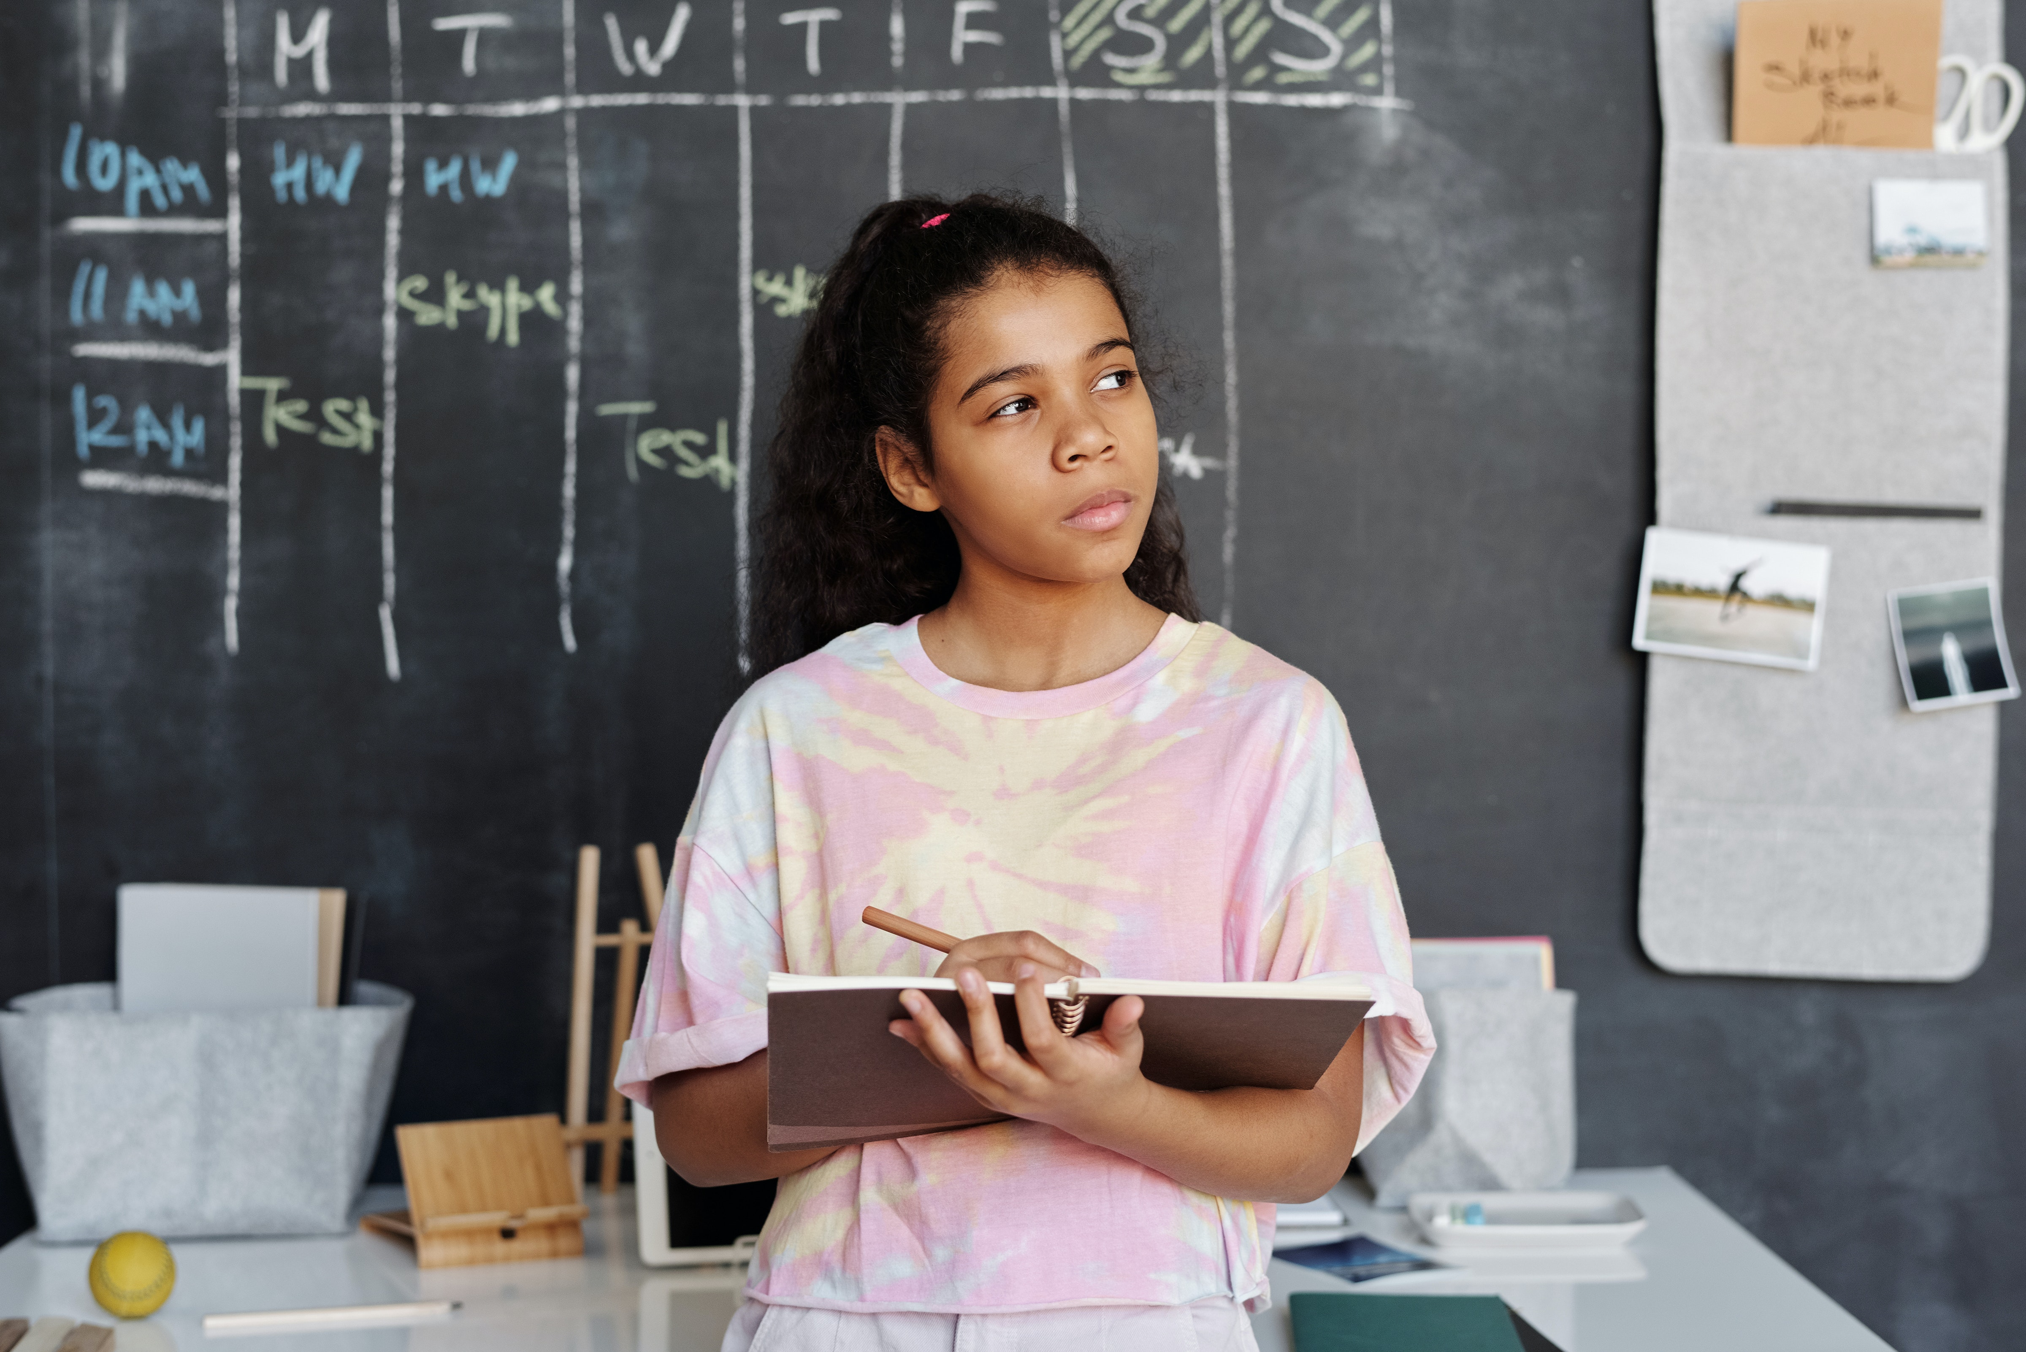
REFLECTION
Try to create some space to think.
Be still and quiet… and then think about the following questions:
It’s a New Year. What are you hoping for or looking forward to?
Article 29 speaks of your talents and abilities. How will you develop these this year?
Who can help you to do that?
How can you help a friend or family member to develop and become the best person they can be?
UNICEF UK/Dawe
Photo by Pexels

Slide 12
MORE INFO…
RRSA WEBSITE
For more information or to download previous Article of the Week packs please visit the RRSA website by clicking the link below
CLICK HERE

Slide 13
Thank you
UNICEF UK/Dawe
Notes:
UNICEF UK/Dawe

