Slide 1
UNICEF/UN0542254

Slide 2
Slide 3 – Guess the article
Slide 4 – Introducing articles 7 & 8
Slide 5 – Exploring articles 7 & 8
Slide 6 – Some possible answers
Slides 7&8 – Primary Activities
Slides 9&10 – Secondary Activities
Slide 11 – Reflection

Slide 3
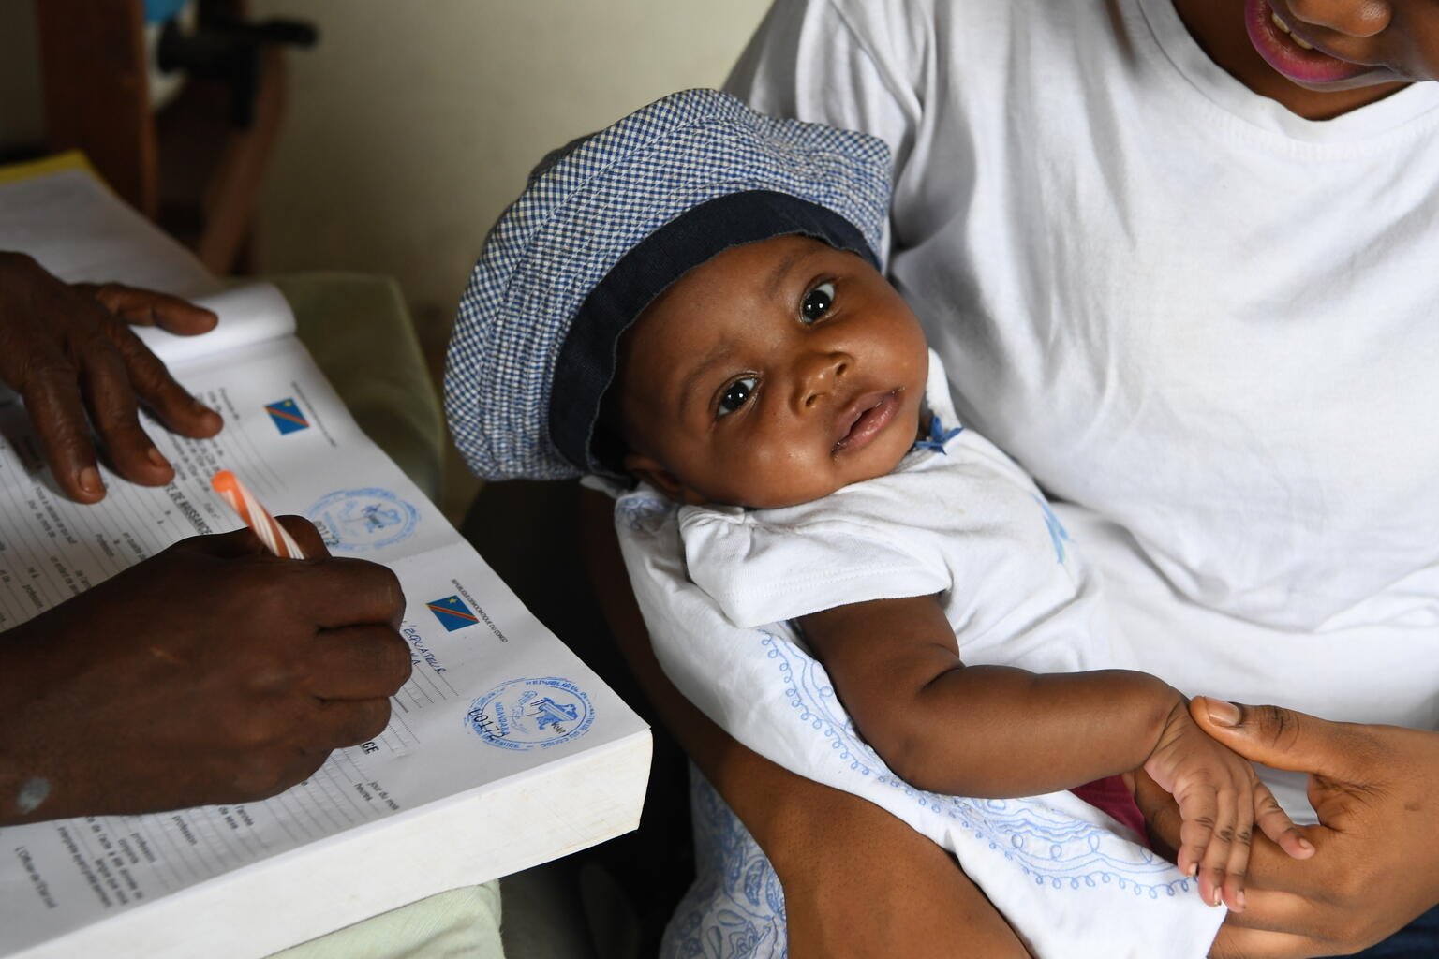
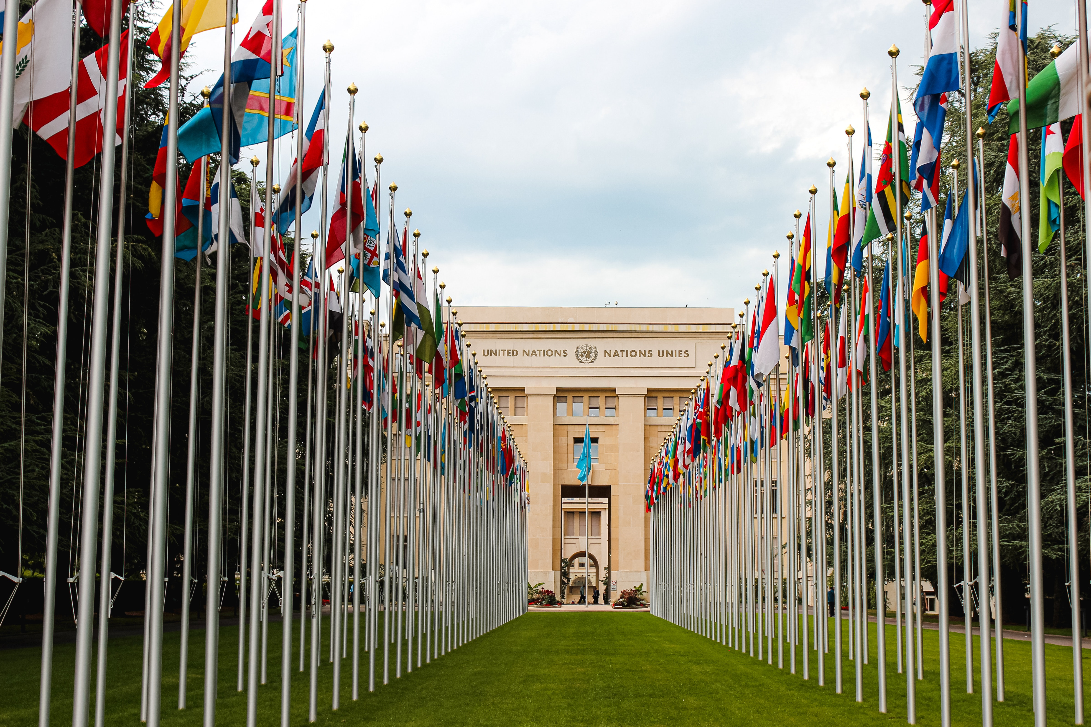
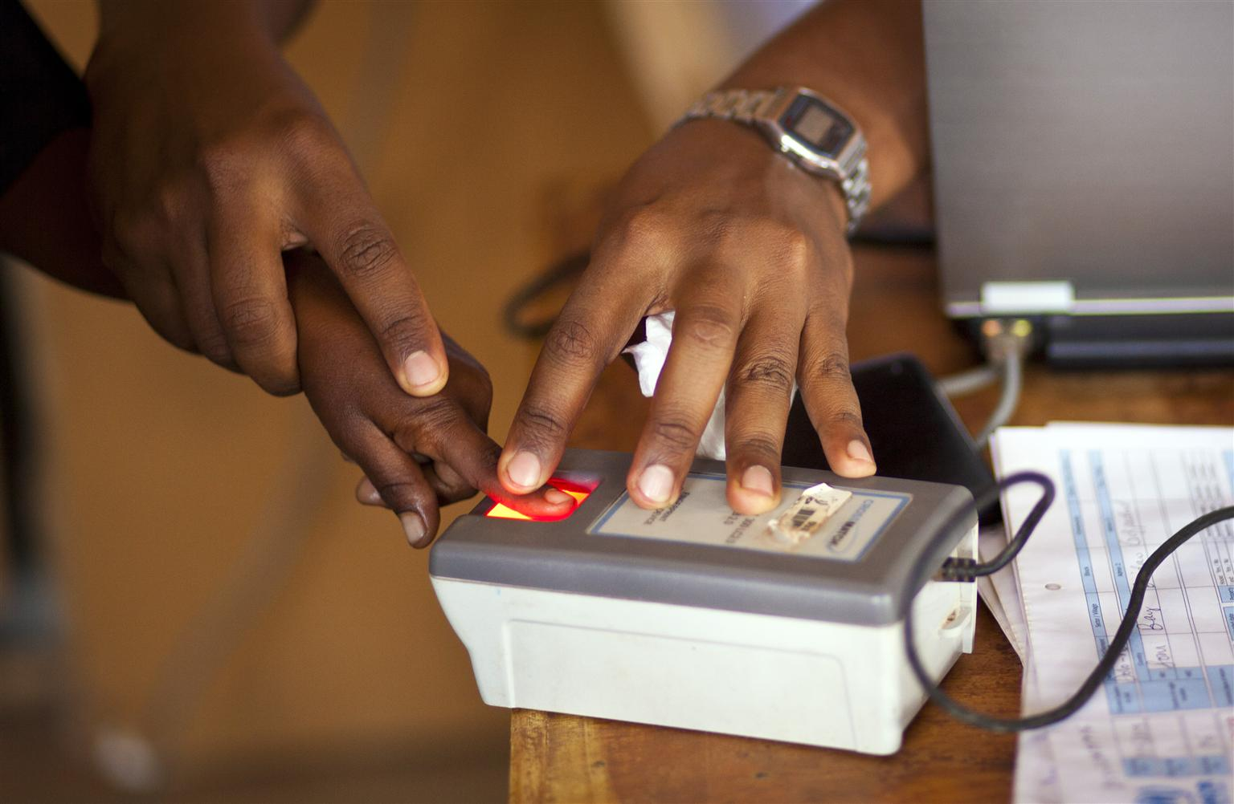
Guess the ArticleS
These pictures provide a clue to this week’s articles.
How do these pictures help you? Can you guess how they are linked together?
Write down your thoughts or discuss with someone in your class.
@UNICEF/Frank Dejongh
Photo by Pexels
@UNICEF/Jiro Ose

Slide 4
INTRODUCING ARTICLES 7 & 8
Article 7 – birth registration, name, nationality, care
Every child has the right to be registered at birth, to have a name and nationality, and, as far as possible, to know and be cared for by their parents.
Article 8 – protection and preservation of Identity
Every child has the right to an identity. Governments must respect and protect that right, and prevent the child’s name, nationality or family relationships from being changed unlawfully.
Kathy Allan, RRSA Professional Adviser, introduces Articles 7 & 8
Click here to watch on YouTube

Slide 5
EXPLORING ARTICLES 7 & 8
List as many things as you can think of that help shape your identity.

Slide 6
Did you think of these?
Nationality
Name
Religion
Gender
Sexual orientation
Family
Interests
Medical conditions
Age
Opportunities
Experiences
Appearance
What others did you think of?

Slide 7
Our names are very important to us. Discuss why names matter and the right to a name, then play a name game in a circle. You could use this song for very young children or play the ‘My name, your name’ clapping game with older children.
It is important to try to pronounce people’s names correctly to respect their right to a name and identity. Read ‘Your Name is a Song’ by Jamilah Thompkins-Bigelow or watch this video. Turn your name into a song or write it phonetically to show how it is pronounced.
What is your nationality? Do you know what the national flag looks like? Look at other flags, pick a favourite and find out which country it belongs to. Talk to your class about how you celebrate your nationality. Perhaps through days like Burns’ Night, St George’s Day or Chinese New Year?
Identity is part of what makes you unique. How would you describe your identity to somebody who does not know you? Try using a mixture of words and pictures.

Slide 8
You might have learnt about protecting your identity as part of online safety. Why is it important not to share information about your name, date of birth, location or other details that might identify you? Design a poster to remind people about this.
A coat of arms of a family, town or organisation is a special design in the form of a shield that they use as a symbol of their identity. Design your own coat of arms with things that represent your family and identity.
What makes you proud about your identity, name and nationality? Imagine if the government decided to ignore individual identity and just give everyone a number. Write a letter to protest about this explaining your opinions and feelings.
Even when people’s identities are different, we can always find characteristics in common. And even when we have similar identities, we will have something that makes us individual. Talk to someone you wouldn’t normally work with. Find one thing you don’t have in common and one thing you do. Create a class display to show these similarities and differences.

Slide 9
Have a conversation with a person who has known you well for much of your life. Explore together how much you have changed and what has remained constant. Which aspects of you feel the most permanent to you? Share what you find out with a trusted friend in your class.
Watch the first few minutes of this TED Talk about identity. Discuss with your friends or in class some of the reasons why we should value our legal identity and not take it for granted.
Learn more about identity theft. Why is this important to know about and how can you protect yourself when you are online? Make some suggestions about how your school could do more to promote awareness of this, linked to rights.
What is your nationality?
Do you know the flag that represents your nationality? Create a display of the flags that represent all of the nationalities in your class or school to celebrate your diversity.

Slide 10
Ask your family why you have the name you have. Did they have another name for you? What does your name mean? Does it suit your personality? Research the most popular names in the UK. What were the most popular names in the year you were born?
Watch this video from the #nonamecampaign run by UNICEF and the African Union.
As a class, discuss how the right to a name and identity link with other rights in the CRC.
Identity and nationality are an important issue in every country. Watch this BBC Panorama programme. Reflect on what you have seen. How does nationality influence a sense of identity? Consider how British immigration policy may be preventing some young people from accessing their right to Articles 7 & 8.
Create a piece of art, a poem, a song, or dance to say something about your identity, such as the things you like, you as a person, what you enjoy and where you are from.… express yourself!

Slide 11
REFLECTION
Take a few quiet moments on your own to think about your identity and how you would answer the following questions…
Our right to a name, a nationality and an identity is something special and should be valued.
Think about what makes you who you are.
What are you proud of about yourself?
How can you respect and appreciate other people’s identity? How might you share this with them?
How does respecting different identities make for a better world?
UNICEF UK/Dawe

Slide 12
MORE INFO…
RRSA WEBSITE
For more information or to download previous Article of the Week packs please visit the RRSA website by clicking the link below
CLICK HERE

Slide 13
Thank you
UNICEF UK/Dawe
Notes:
UNICEF UK/Dawe

