Slide 1
Photo by Pexels

Slide 2
Slide 3 – Introducing LGBT+ History Month
Slide 4 – Introducing the articles
Slide 5 – Exploring LGBT+ History Month question
Slide 6 – Exploring LGBT+ History Month answers
Slides 7&8 – Primary Activities
Slides 9&10 – Secondary Activities
Slide 11 – Reflection

Slide 3
INTRODUCING LGBT+ HISTORY MONTH
LGBT+ History Month takes place in February each year.
LGBT+ History Month is all about promoting fairness, equality and diversity and raising awareness of LGBT+ people and culture, now and in the past. It aims to give voice to LGBT+ experiences, celebrate achievements and highlight the challenges people still face today. It is also about helping everyone to learn more about LGBT+ culture and history.
2022 sees the 50th anniversary of the very first Pride March in the UK in 1972.
You can find more information on LGBT+ History Month website.
Emma Guilfoyle, UNICEF UK Diversity and Inclusion Lead, introduces LGBT+ History Month
Click here to watch on YouTube

Slide 4
LINKED UNCRC ARTICLES
There are many articles that would be relevant to explore when celebrating LGBT+ History Month but we will be focussing on following:
Article 2: (non-discrimination): The Convention applies to every child without discrimination, whatever their ethnicity, gender, religion, language, abilities or any other status, whatever they think or say, whatever their family background.
Article 13: (freedom of expression): Every child must be free to express their thoughts and opinions and to access all kinds of information as long as it is within the law.
Article 17: (access to reliable information): Every child has the right to reliable information from a variety of sources, and governments should encourage the media to provide information that children can understand. Governments must help protect children from materials that could harm them.
And of course, at the heart of the UN Convention on the Rights of the Child are the values of dignity, equality and non-discrimination.

Slide 5
EXPLORING LGBT+ HISTORY MONTH
Why is it important to listen to, learn from and celebrate people’s differences in school and in our community?

Slide 6
How many of these did you get?
It helps to remind us that we are all unique and should all be treated with dignity.
It reminds us that everyone has different experiences and everyone has the right to be listened to and express their opinions.
When our differences are celebrated, we feel valued as people and our health and wellbeing improves.
It helps all people to feel welcome in school.
It reminds us that not all families or relationships look the same.
It helps us to be open and respectful to new ideas about identity.
We are all learning all of the time and by listening to others we continue to grow and learn.
So that we can speak up and challenge unfair comments or actions.
It helps ensure that all children and young people’s opinions are taken into account when making decisions about them.
Did you get any of these? What other answers did you have?

Slide 7
It is important to be proud of who we are. Make a ‘Proud To Be Me’ fact sheet or poster. You might want to include your favourite foods, colours, activities, or places you like to go. Think about what things you've included that make you unique and proud to be you.
Read the story Elmer the Elephant, you can also watch it here. Elmer didn’t feel that he wanted to be the same as the other elephants. Think of ways that we can celebrate our differences like the elephants do on ‘Elmer Day’ – talk about your ideas with an adult.
Watch the video of the story And Tango Makes Three. There are many different types of families. For example, some children may live with a mum and a dad, just a mum, two dads or live with other carers who look after them. Draw pictures of your family. Talk with a friend about why your family is special to you. Finish the sentence with ‘I love my family because...’
We keep using the word ‘different’. In circle time talk about what the word means. What’s its opposite? What would it be like if we were all the same? Work in pairs and find three things that are the same (or very similar) about you both and three differences. Feedback some of your examples to the whole class.

Slide 8
We often hear the phrase, “Treat others as you would like to be treated.” What do you think about this idea? Are there times, when perhaps we should treat people as they would like to be treated? Can we really know what it is like to be in someone else’s shoes when our experiences are often so very different? You might like to discuss this in circle time.
Watch this story about the history of the Pride Flag. The Pride Flag is a symbol of inclusion and diversity. Look up these two words and think about the link with rights such as Article 2 – non-discrimination. Write a poem about all these ideas called Rainbows and Rights or design a rights respecting inclusive flag, explaining what each colour and symbol means to you
Do some research and create a fact file on an inspirational LGBT+ figure that you know. It may be someone famous, a figure in history or somebody you know. What do their actions show us about equality, dignity and rights? Share your fact file with the people you live with or with your class.
Watch this video Love Has No Labels. Discuss with a friend, conversation partner, or family member about how it made you feel.

Slide 9
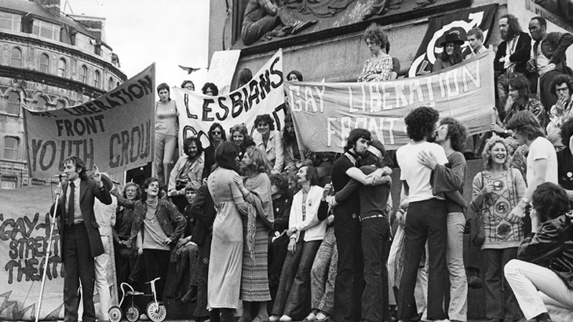
We often hear the phrase, “Treat others as you would like to be treated.” What do you think about this idea? Are there times, when perhaps we should treat people as they would like to be treated? Can we really know what it is like to be in someone else’s shoes when our experiences are often so very different? Discuss this with a friend or suggest it as a theme for tutor time.
What do you understand it means to be an LGBT+ ally? Many people understand an LBGT+ ally to be someone who believes in equality and fair treatment in society for people who identify as LGBT+ and who stands ‘with’ rather than ‘for’ the LGBT+ community. Educating yourself about LGBT+ history is one way to start being an ally. Can you think of other things you can do?
2022 sees the 50th anniversary of the very first official UK Gay Pride Rally, held in London on 1 July 1972. Ask older relatives or friends what they remember/understand about the development of equal rights for LGBT+ people.
There is a global movement that is improving awareness and respect for the rights of LGBT+ people. However, some countries have anti LGBT+ laws and criminalise forms of gender expression and same sex relationships. You might be interested to read different equality global news stories highlighted by Amnesty International on their website.

Slide 10
Do you have a LGBT+ support group in your school? If so, how does it champion Articles 2, 13 and 17? Is there more it could do to raise awareness of LGBT+ issues in school? If you don’t have a group, would it be helpful to start one? Who would you approach? What might be its logo?
There are many terms associated with the LBGT+ community and we are all on a journey of learning. Therefore, having access to reliable information (Article 17) is important. The organisation Stonewall has produced a Glossary of terms that might be helpful – one short, one more detailed. Give yourself some time to quietly read and then discuss with a friend or learning partner.
Watch this YouTube clip about a novel by Dean Atta, The Black Flamingo. Why do you think it is important for people to feel included and valued? What can be the consequences if an individual feels that they are not or that they are discriminated against – whether this is deliberate or not? Discuss with a classmate how can each of us work towards preventing discrimination from happening. You may also like to watch this video of Dean Atta reading more of his novel.
There are many organisations you can reach out to if you feel the need to talk about your gender identity such as Switch Board. Create a database of organisations that can be displayed in your school for pupils who may need their support.

Slide 11
REFLECTION
Give yourself some time and space … to relax… to be quiet…to think…
Have you heard the phrase ‘be your true self’? What does it mean to you?
Where and when do you feel comfortable and free to be yourself?
How can we support others to be their true selves?

Slide 12
MORE INFO…
RRSA WEBSITE
For more information or to download previous Article of the Week packs please visit the RRSA website by clicking the link below
CLICK HERE

Slide 13
Thank you
UNICEF UK/Dawe
Notes:
UNICEF UK/Dawe

