Slide 1
UNICEF/UN0469185

Slide 2
Slide 3 – Guess the article
Slide 4 – Introducing Article 3
Slide 5 – Exploring Article 3
Slide 6 – Some possible answers
Slides 7&8 – Primary Activities
Slides 9&10 – Secondary Activities
Slide 11 – Reflection

Slide 3
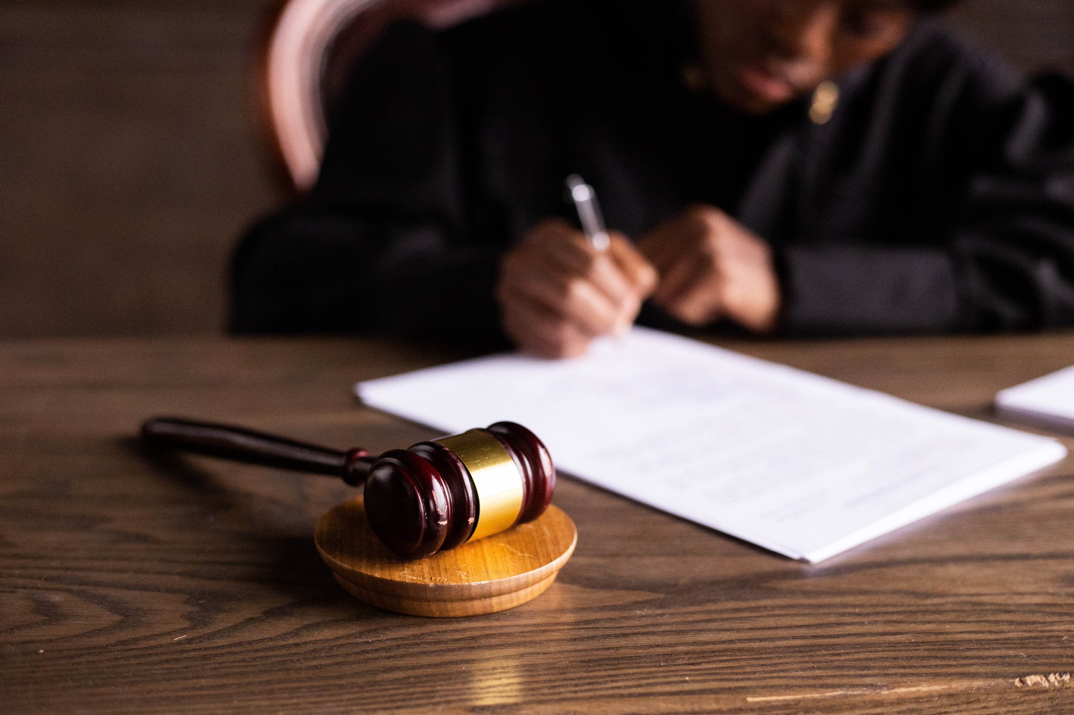
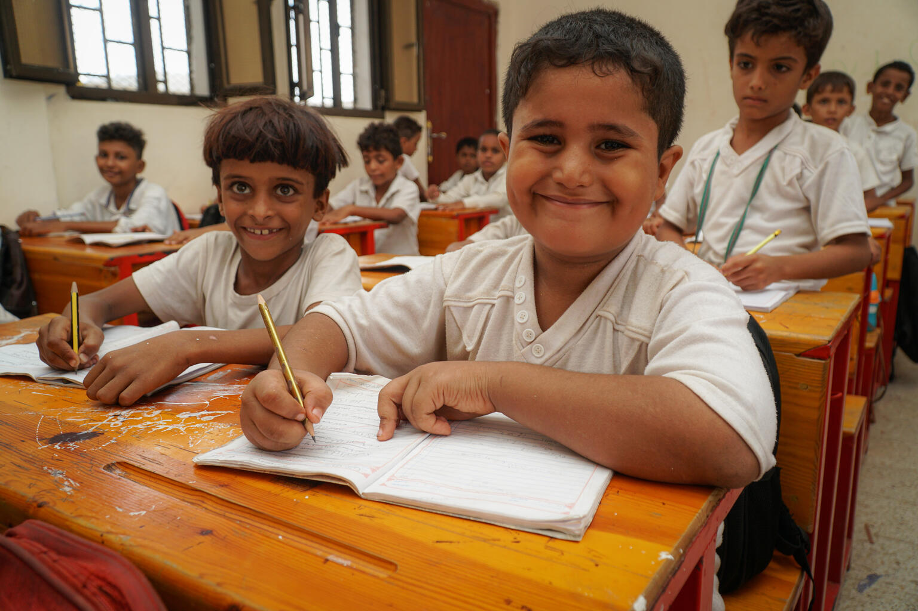
Guess the Article
These pictures provide a clue to this week’s articles.
How do these pictures help you? Can you guess how they are linked together?
Write down your thoughts or discuss with someone in your class.
@UNICEF/Anush Babajanyan/VII Photo
Photo by Pexels
@UNICEFAlaa Noman

Slide 4
INTRODUCING ARTICLE 3
Helen Trivers, RRSA Professional Adviser, introduces Article 3
Article 3 (best interests of the child): The best interests of the child must be a top priority in all decisions and actions that affect children.
Click here to watch on YouTube

Slide 5
EXPLORING ARTICLE 3
Who makes decisions that affect the lives of children and young people?

Slide 6
Did you think of these?
Parents or carers
Other family members
Teachers
Healthcare workers
Social workers
Sports coaches
Youth workers
Police officers
Members of the government
Children’s Commissioners
Courts officials – judges, lawyers
Did you have any others on your list?

Slide 7
Article 3 says that children should be protected and cared for to ensure their wellbeing – how does your school ensure you are protected and safe and that your wellbeing is supported? As a group or class, write a list of all the different things you can think of.
Listen to or read the book You Choose by Pippa Goodhart. Adults make lots of decisions about children’s lives such as where they live, what they eat etc. and when they do, they have to think about what is best for children. When listening to reading the book, how did you feel about making all those decisions?
In your school, there are many adults who look out for your best interests. Draw round your hand and on each finger write the name of a trusted adult you can go to if you feel worried. This could be called your “Trusted 5”. Maybe these could be displayed in your class.
Who are duty bearers and what is their role? Make a thank you card for a duty bearer for always thinking of the best of interests of children when they make decisions.

Slide 8
Think about your day at school and who makes decisions in your best interest. What sorts of things do you get a say in? What sorts of things do adults make decisions on? Is this fair? Discuss in small groups your views on this and prepare to share with the rest of your class in a creative way that suits your skills.
Find out who the Children’s Commissioner is in your country. What role do they play and how do they make sure that children’s best interests are met? Write a letter to your commissioner to find out what children's rights they are focusing on in your area – and anything else that interests you. Maybe they could help you with a particular campaign you have in mind.
Your parents/carers probably make decisions that affect you all the time. What sorts of decisions would you like to be more involved in? Think of why it is in your best interest to be more involved. Discuss in your class or in groups. How could you explain this at home?
Read through the information on this BBC Bitesize page about Article 3 and then do the quiz.

Slide 9
Watch this video by the Children’s Commissioners of the four UK nations about young people’s reaction to recent events. Part of their role is to ensure your best interests are met. Find out who your commissioner is for your country and write to them to express your views and share ideas on how improvements could be made for you personally, for your area or for children and young people globally.
Think about your life at school and in your local community. Who makes decisions in your best interest? What sorts of things do you get a say in? What sorts of things do adults make decisions on? Is this fair? Discuss in small groups your view on this and prepare to share with the rest of your class in a creative way that suits your skills.
Are there decisions being made by the government that affect you, that you feel strongly about? Write a letter to your local MP to explain why – make sure you mention the relevant rights that are being impacted and a suggested action to make a change.
Imagine the adults in your school have suggested a change to something big like the school day or uniform. What kinds of things would they need to consider for the best interests of all young people? For example, gender identity, disabilities etc. Discuss in small groups or with partners what these considerations would be to prepare for a class discussion.

Slide 10
Your school is part of a diverse community. People have different backgrounds, different interests, different skills – do you think you have different ‘best interests’ from each other? Should everyone be treated equally? What is the difference between equality and equity?
Article 3 is about children’s best interests and Article 12 says you have a right to be involved in decisions that affect you – however, in some situations, adults (duty bearers) may make decisions in your best interest, that you may not agree with. Can you think of an example? It may not always feel fair…. Can you see both sides?
Treating children with dignity includes ensuring that children's best interests are met. What does dignity look like or mean to you in school? If there are improvements needed, how could you get your ideas across?
Your parents/carers probably make decisions that affect you all the time. What sorts of decisions would you like to be more involved in? Think of why it is in your best interest to be more involved. Discuss in your class or in groups. How could you start the conversation at home?

Slide 11
REFLECTION
Find a quiet space and take a few moments for some thinking time…
What things matter to you most in your life?
Who are the people who make decisions that affect you?
How do you get your voice heard when decisions are made that affect you?
If this is a struggle sometimes, who could you go to for help?
UNICEF UK/Dawe

Slide 12
MORE INFO…
RRSA WEBSITE
For more information or to download previous Article of the Week packs please visit the RRSA website by clicking the link below
CLICK HERE

Slide 13
Thank you
UNICEF UK/Dawe
Notes:
UNICEF UK/Dawe

