Slide 1
UNICEF/ UN0353544

Slide 2
Slide 3 – Introducing World Book Day
Slide 4 – Introducing the articles
Slide 5 – Exploring World Book Day
Slide 6 – Exploring World Book Day answers
Slides 7&8 – Primary Activities
Slides 9&10 – Secondary Activities
Slide 11 – Reflection

Slide 3
INTRODUCING WORLD BOOK DAY
World Book Day
The 3rd of March 2022 is the 25th anniversary of World Book Day.
World Book Day was created by UNESCO on 23rd April 1995 as a worldwide celebration of books and reading. It is celebrated all over the world on 23rd April but in the UK it always runs on the first Thursday in March. It is marked in over 100 countries.
Spending just 10 minutes a day reading and sharing stories can make a crucial difference to your future success and is fun for all involved. That’s why World Book Day continues to encourage children and young people to read for pleasure through its work with authors, illustrators, publishers, bookshops and libraries.
Stuart Whiffin, RRSA Professional Adviser, introduces World Book Day
Click here to watch on YouTube

Slide 4
LINKED UNCRC ARTICLES
This week’s activities link to the following articles:
Article 17 (access to information from the media): Every child has the right to reliable information from a variety of sources, and governments should encourage the media to provide information that children can understand. Governments must help protect children from materials that could harm them.
Article 29 (goals of education): Education must develop every child’s personality, talents and abilities to the full. It must encourage the child’s respect for human rights, as well as respect for their parents, their own and other cultures and the environment.
Article 31 (leisure, play and culture): Every child has the right to relax, play and take part in a wide range of cultural and artistic activities.

Slide 5
EXPLORING WORLD BOOK DAY
Reading books is an important skill. How can reading help us?
List as many answers as you can
and then compare your thoughts with the next slide.

Slide 6
How many of these did you get?
We can learn new things about the world.
We can enjoy a story that makes us laugh, cry or get excited.
It can help us calm down or get to sleep.
It helps our mental health, makes us feel better or forget about worries we might have.
It inspires us.
It makes us more empathetic towards other people as we learn about their experience.
We can use our imagination.
We can share with friends and family.
We learn new skills.
We learn new words and phrases.
We get ideas for our own writing and stories.
Did you think of other ideas?

Slide 7
Do you have a favourite book? Can you draw a picture of the cover? Talk to a partner and describe what you can see on the cover. Tell your partner what your book is about and why you think they should read it.
Listen to this World Book Day song. How many books and characters did you hear mentioned? Can you create your own song/story or poem about reading or your favourite books?
Can you create a story map of your favourite book? Think about the order of the story, draw or write words to describe the main parts of the story. Can you retell the story to a friend using your map?
Do you have a favourite place to read? Can you think of some words to describe that place? If you have a reading corner in your classroom, have a talk about what makes it special.

Slide 8
Sometimes your reading is part of your learning; sometimes you read just for pleasure and to relax. Discuss how books link to Articles 29 and 31 and create a display to show this or write a short article for your newsletter to help parents and carers understand the links.
Take part in a World Book Day live event. Follow it up by having a discussion in class or creating a piece of art together to represent what you saw and heard.
Libraries are a great place for reading and to find the books you enjoy the most. Where is your nearest library? Find out when it is open and create a poster to advertise its importance. Lots of people use libraries to do research. How does this link to Article 17?
Many books you have in your school will be linked to rights. Choose three books from your classroom or school library and see if you can link them to Articles. How many Articles can your class come up with all together?

Slide 9
World Book Day is about promoting reading for pleasure. What do you enjoy reading most? It might be a fact or fiction book, magazine, or a poem. Create a piece of artwork to represent why this text is important to you. Can you link this to Article 31?
Many books you have in your school will be linked to rights. Choose three books from your school library and see if you can link them to Articles. How many different articles can you find altogether?
If you have a school librarian or library team, work with them to advertise the importance of the library. Try to point out how the school library supports several of your rights.
Design and carry out a survey in your class or at home to find out how many of your friends and family read books and why. Is it mostly for pleasure, for information, to learn a new skill etc.? Share the findings of your survey on your school's social media.

Slide 10
Create a ‘Book Swap’ somewhere in your school. Bring in a book from home that you would like to donate and leave it with a short review. Encourage your peers to do the same. Create posters to put up around the school to advertise the scheme.
In recent years, there’s been an increase in books for children and young people with main characters from diverse backgrounds. For example, “My brother Charlie”, which encourage awareness about disabilities from a young age or “Boy, Everywhere”, about the journey of a 14-year-old refugee boy. Why do you think this is important? Work with your friends to list any other examples you can think of.
Set up a ‘Reading Ambassadors’ pupil group within your school. Create an action plan with a focus on the promotion of the reading for pleasure. Build upon the activities started on World Book Day throughout the next school year – Can you link rights into your ideas?
Explore how World Book Day links to Articles 17 and 29. Have you ever been consulted about the textbooks used in school? Which textbooks and resources set out information most clearly and are best at supporting your learning? Work on this with your friends and discuss your conclusions with subject leaders.

Slide 11
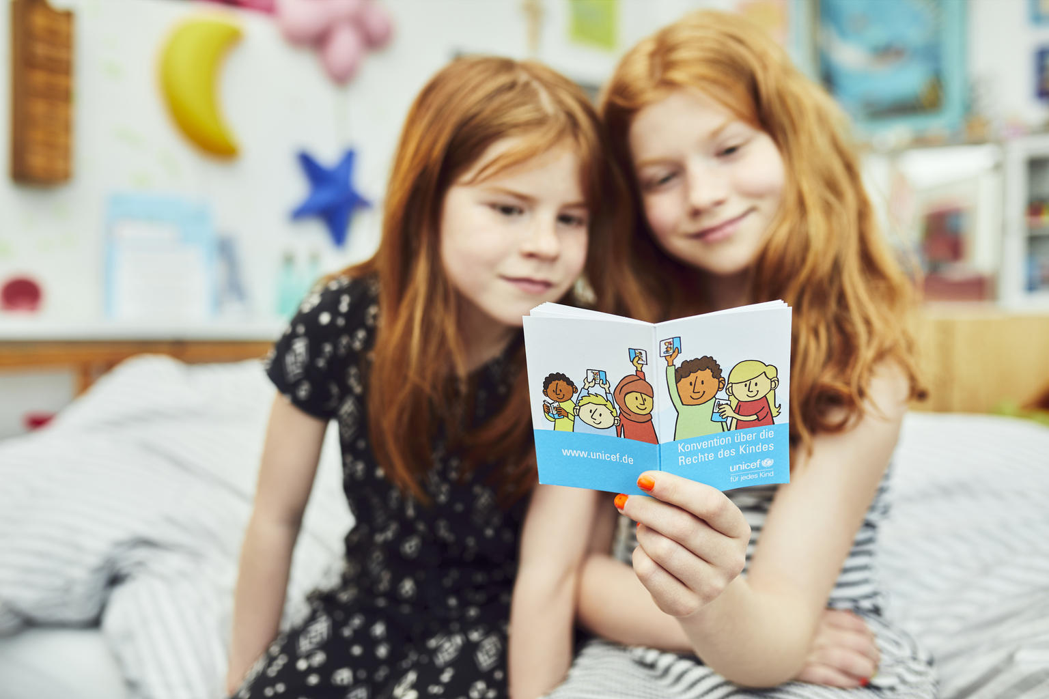
REFLECTION
Find somewhere quiet and allow yourself a few minutes to think about the below.
It has been said that “we don’t need books anymore because we have the internet”.
Do you agree with the statement?
Do books matter to you?
If you could keep only one book from all that you have read, which would it be? What made you choose that one?
Who would you like to tell about this special book?
UNICEF/UNI331934

Slide 12
MORE INFO…
RRSA WEBSITE
For more information or to download previous Article of the Week packs please visit the RRSA website by clicking the link below
CLICK HERE

Slide 13
Thank you
UNICEF UK/Dawe
Notes:
UNICEF UK/Dawe

