Slide 1
UNICEF/UN0364424

Slide 2
Slide 3 – Guess the article
Slide 4 – Introducing Article 12
Slide 5 – Exploring Article 12
Slide 6 – Some possible answers
Slides 7&8 – Primary Activities
Slides 9&10 – Secondary Activities
Slide 11 – Reflection

Slide 3
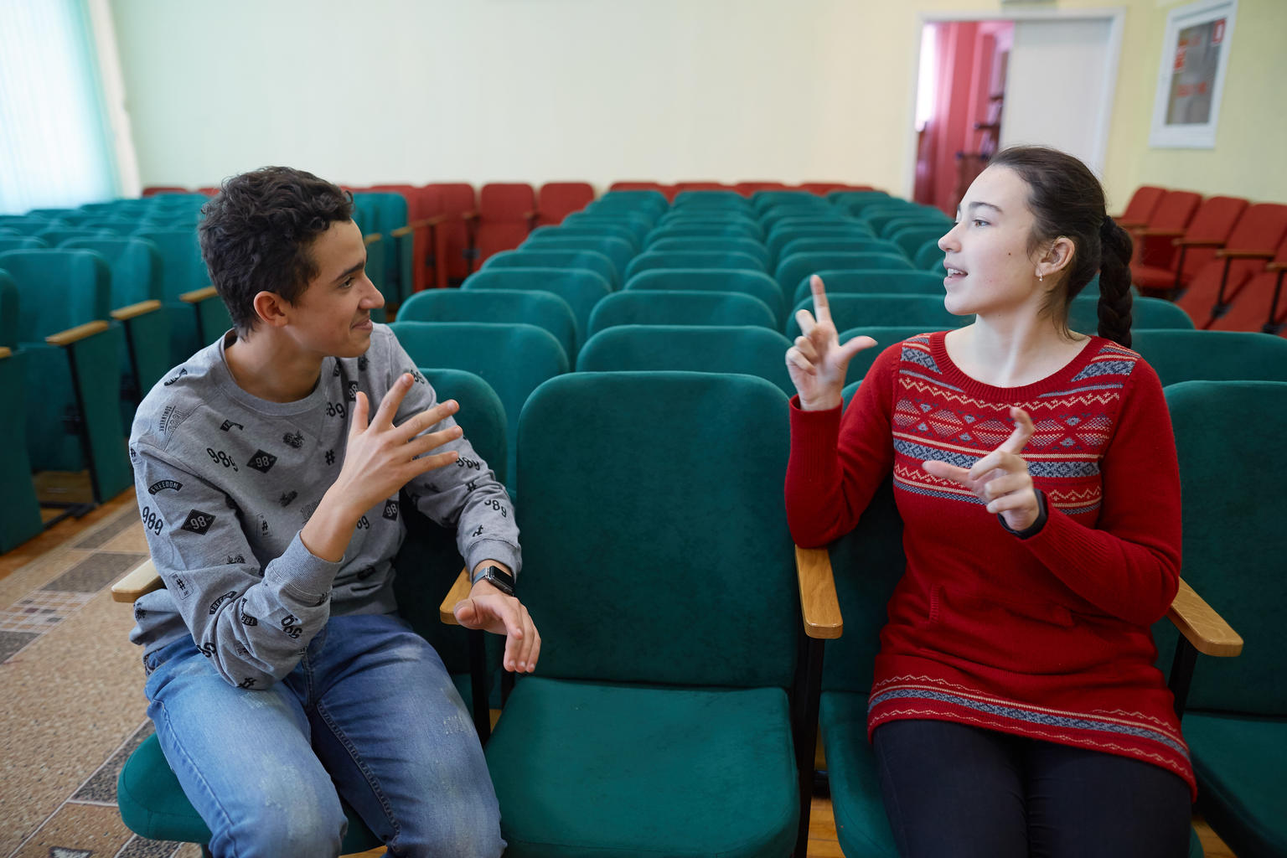
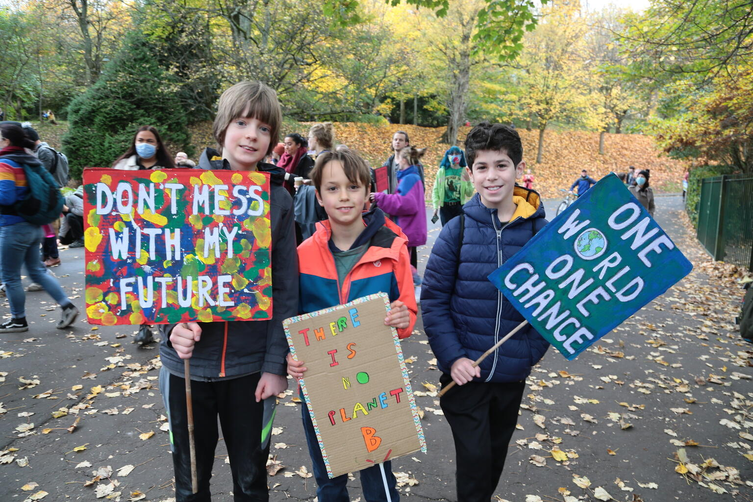
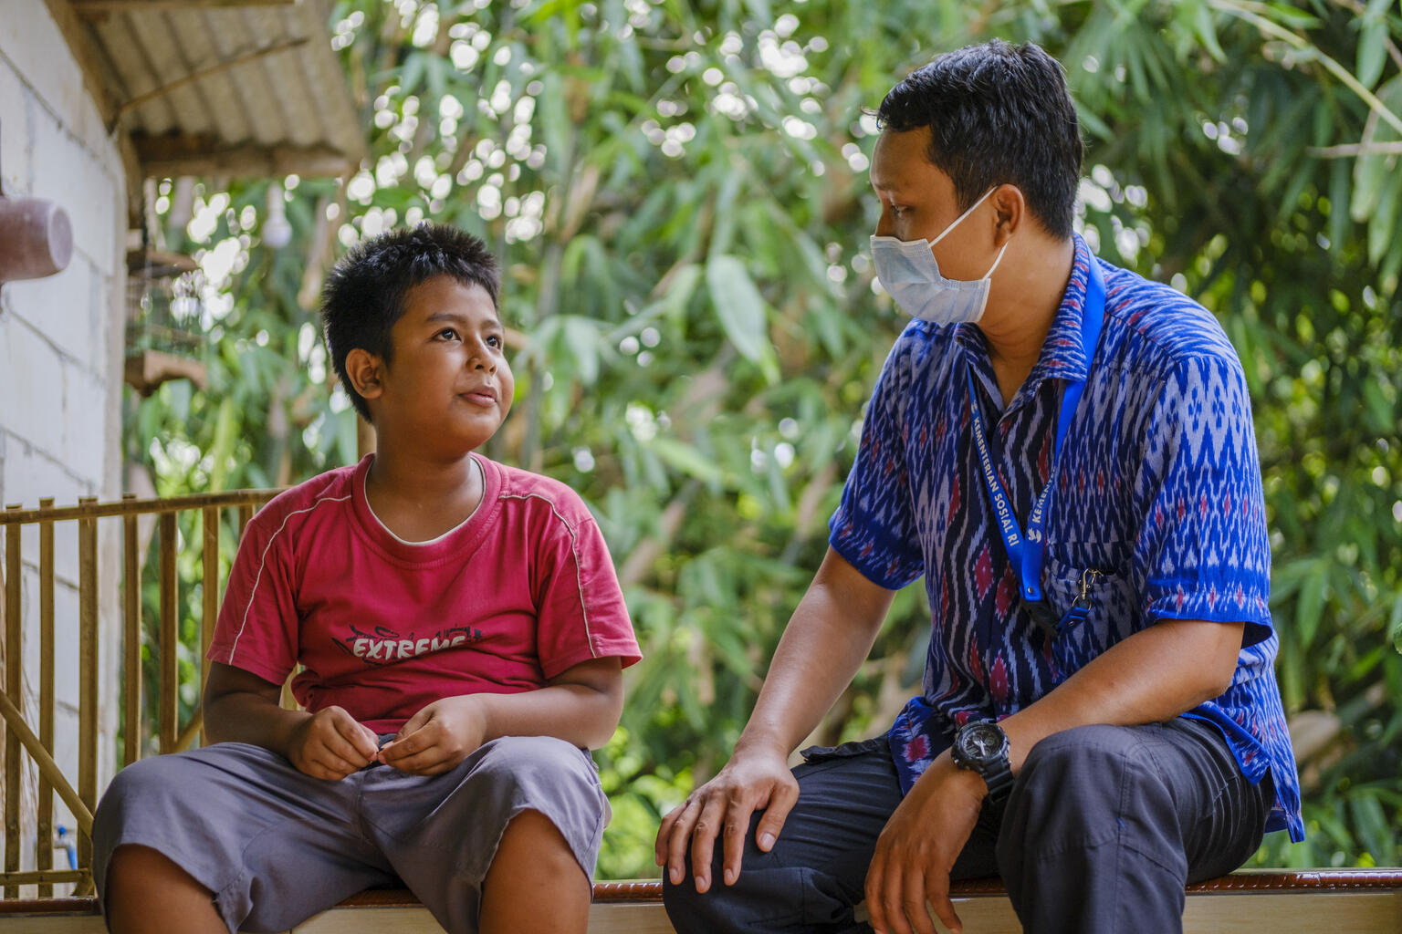
Guess the Article
These pictures provide a clue to this week’s articles.
How do these pictures help you? Can you guess how they are linked together?
Write down your thoughts or discuss with someone in your class.
@UNICEF/UN0285224
@UNICEF/Elwyn-Jones
@UNICEFJiro Ose

Slide 4
INTRODUCING ARTICLE 12
Gold: Rights Respecting Foreland Fields School introduces Article 12
Sarah Thorp from Foreland Fields Special School introduces Article 12, accompanied by two pupils who were recently involved in their RRSA Gold reaccreditation visit. Sarah explains how the school listens to children in different ways, depending on how they communicate and takes their views into consideration in decision-making.
Article 12 (respect for the views of the child): Every child has the right to express their views, feelings and wishes in all matters affecting them, and to have their views considered and taken seriously. This right applies at all times, for example during immigration proceedings, housing decisions or the child’s day-to-day home life.
Click here to watch on YouTube

Slide 5
EXPLORING ARTICLE 12
Article 12 says that every child has the right to express their views freely and that their views should be taken into account when decisions are made.
At your school, how do you ensure that every child can have their voice heard, however they like to communicate?

Slide 6
Did you think of these?
By having a school council that represents pupils' views, with democratically elected representatives
By having issue-led pupil groups such as Eco groups, ICT groups, Equalities groups
Having worry boxes or worry monsters that are regularly checked
Having pupil voice interviews with staff
Pupil surveys/questionnaires
Junior Leadership Teams who are involved in decision-making
Ensuing that everyone receives information about issues so that they can form their own views
By giving some people additional help or time to communicate their ideas if they need it
By asking people to give their views in a way that works for them
By ensuring feedback is given so that you know your views have been heard
Feeling that your voice counts
Trusting that you can speak honestly even if your opinion is different from many others
Believing that your opinion is welcome and respected
Did you think of anything else?

Slide 7
Watch this clip of a story book by Kate Gaynor titled ‘A Birthday for Ben’. Why doesn’t Ben like parties at first? How does Ben make sure that everyone can participate in his party? How can you make sure that everyone feels included and is fully able to participate in your class? (More teacher guidance here)
One way we can communicate our thoughts and ideas is through drawing. Draw a picture of yourself doing your favourite activity and then share these as a class. Ask your teacher to build these activities into their planning over the next few weeks.
Think about what your face looks like when you like something, when you don’t like something, or when you are scared or excited. Can you tell how someone else is feeling by looking at their facial expressions? How can we ‘hear’ people even when they don’t speak so that we can respect their views?
Watch this video about children’s rights. Can you draw the page in the storybook where Viz, Leepa and Zooko explain what Article 12 is all about? (It’s at 6 mins)

Slide 8
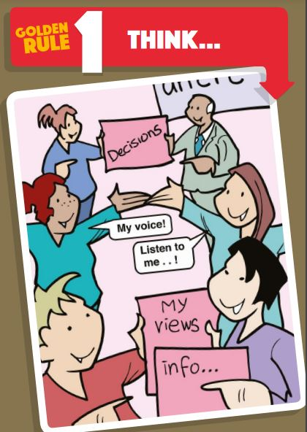
People don’t only share their opinions and thoughts through talking. Write a list of as many ways as you can think through which people share their thoughts and opinions. As a class or a school, how could you make sure children can share their thoughts in different ways?
Use these cards from Scotland’s Commissioner for Children to explore what effective participation looks like. Look at each ‘rule’ in turn and think about whether your school does this well or could improve. Why is it important to remember that Article 12 of the CRC also includes the right not to express a view? As a class, agree on three rules that you need to improve as a school.
Many schools have worry boxes or tell me boxes so that children can share their thoughts in writing. One school has a box labelled, “I wish my teacher knew...” so that children can share any thoughts, ideas, worries or news. Design a class box so that children in your class can share their views through writing.
What pupil leadership groups does your school have to help pupils share their views and opinions on school life? Can you think of any groups you would like to have? Work with a partner to create a plan for a new pupil group. Explain why you think this group is important and what kinds of things they would be involved in. How can you make sure a variety of people can get involved?

Slide 9
How can you tell how someone is feeling? List all of the ways people communicate their views and opinions. Share your list with your class. Discuss the importance of non-verbal communication. What can you do to make sure everyone is listened to and able to participate in decision-making?
Watch this video about the UN Committee on the Rights of the Child. Write a letter to send to your country’s Children’s Commissioner about an issue either within your local community or the wider world that you consider needs improving. Try to include some ideas for how to do this and why you think your ideas would work.
Conduct a survey to look at how diverse your school pupil leadership groups are. What could you do as a school to ensure that a diverse range of voices are heard at your school?
What steps need to be taken to ensure meaningful participation?
After watching this video, spend some time researching organisations which support young people to express their views and concerns to see if they have any helpful guidance that you can share with your class or the school.

Slide 10
Watch this video (2020) showing young people from the UK and Australia expressing their views on climate change. What do you feel passionate about? Visit the UNICEF Voices of Youth home page and find out more about how your voice can join with young people all over the world.
Explore one or more of the questions within this set of ‘Golden Rules for Young People for Participation’ from the Children’s Commissioner for Scotland. Share your responses with others. How can you use what you have discussed to improve participation within your school?
How has your school created space for students to understand, reflect upon and respond to events unfolding in Ukraine and the surrounding countries? Feed back to your teachers what the school is doing well. Do you or your peers need more support to express your opinions about this crisis? Our extra Article of the Week pack about this can be found here.
If you were to stand for election to your School Council or Pupil Parliament next year, what would you say in your speech or manifesto? Start drafting it now!

Slide 11
REFLECTION
Take some time to be still, to be quiet and to have a think...
How does it feel when you know you are being listened to and your views are respected?
When has your voice and your views made a difference?
If adults are not creating a space for your views to be heard, how can you respectfully claim this right? Who could help you?
Are there more things you could speak up about in your own life or in the wider world? How might you do this - on your own or with friends?
UNICEF UK/Dawe

Slide 12
MORE INFO…
RRSA WEBSITE
For more information or to download previous Article of the Week packs please visit the RRSA website by clicking the link below
CLICK HERE

Slide 13
Thank you
UNICEF UK/Dawe
Notes:
UNICEF UK/Dawe

