Slide 1
UNICEF/ UN0368707

Slide 2
Slide 3 – Introducing International Women’s Day
Slide 4 – Introducing the articles
Slide 5 – Exploring International Women’s Day
Slide 6 – Exploring International Women’s Day answers
Slides 7&8 – Primary Activities
Slides 9&10 – Secondary Activities
Slide 11 – Reflection

Slide 3
INTRODUCING INTERNATIONAL WOMEN’S DAY
Jenny Price, RRSA Professional Adviser, introduces International Women’s Day
International Women’s Day
International Women's Day takes place every year on the 8th March to celebrate the social, economic, cultural, and political achievements of women. It is also a day which asks for people to act to speed up gender equality.
This year the focus is on imagining a gender equal world where difference is valued and celebrated. The focus of the day this year asks us all to #BreakTheBias.
Click here to watch on YouTube

Slide 4
LINKED UNCRC ARTICLES
This week’s activities link to the following articles:
Article 2 (non-discrimination): The Convention applies to every child without discrimination, whatever their ethnicity, gender, religion, language, abilities or any other status, whatever they think or say, whatever their family background.
Article 12 (respect for the views of the child): Every child has the right to express their views, feelings and wishes in all matters affecting them, and to have their views considered and taken seriously. This right applies at all times, for example during immigration proceedings, housing decisions or the child’s day-to-day home life.
Article 13 (freedom of expression): Every child must be free to express their thoughts and opinions and to access all kinds of information, as long as it is within the law.

Slide 5
EXPLORING INTERNATIONAL WOMEN’S DAY
What does a gender equal world look like to you?
List as many answers as you can
and then compare your thoughts with the next slide.

Slide 6
How many of these did you get?
All pupils are treated the same in class
A variety of different games are available to all at playtime
Women are shown as role models in assemblies
Reading more books written by women
Equal access to the same jobs such as doctors, nurses, judges, politicians, firefighters, engineers etc.
More art and music by women are studied at school
Sports in PE lessons are equally available to all
Did you think of any more?
Men staying at home to care for children is more common
Sexist and abusive language is never used or heard
Equal pay for women and access to the most senior job roles
All girls globally can access the same education as boys
People learn about and understand bias and discrimination.

Slide 7
Ask children to find four items each around the room that they think girls would like. Ask them to explain their reasons. If you can find objects that are potentially stereotypical (e.g. pink teddy, blue jumper, toy toolkit, a doll) and/or that break the norm (e.g. pink tractor, a book about tractors/dinosaurs) in advance, that may help to strengthen the discussions around gender equality and stereotypes.
Discuss different jobs that people do. Can anyone do any job they like? Share your opinions in class. Watch this video and see if anything surprises you. What are your thoughts after watching the video?
Watch ‘If Cinderella were a guy…’ (the second part of the short video is promoting a book but raises some interesting questions). Write your own fairy tale where ‘traditional’ gender roles are reversed or use other fairy tales that you know and change the characters around.
Draw a picture of a woman or girl that you think is an important role model. This might be a member of your family or someone you have learned about. Annotate your drawing with things you admire about this person.

Slide 8
Article 2 is about non-discrimination. What does discrimination mean? Think about ways in which your school can be made fairer, more equitable for girls. Discuss this in small groups and present your ideas in a mind map and compare with friends. You might want to share the most popular ideas with senior leaders.
Have you heard of the UN Global Goals? One of them is about gender equality. Find out more about Global Goal 5 here. Watch this video and then discuss what inspired you. Have a discussion and express your opinions in class.
Ask a male and a female family member what it was like when they were young. Did they play with different games or have different experiences just because they were a boy or a girl? Prepare a set of questions to ask and then prepare a summary of their answers in another session.
The theme of International Women’s Day 2022 is Break the Bias. Read more about this and then use some of the ideas to create a short piece of mime or dance – try to end with the ‘pose’!

Slide 9
One of the UN Sustainable Development Goals (SDGs) is gender equality (Global Goal 5). Learn more here. Share what you find out with your class. Have a particular look at the ‘Targets’ and the ‘Things to do’.
Watch 2022’s International Women’s Day video ‘Break the Bias’. Create your own writing or poem about bias – you might want to link it to Article 2. If you make a video, you could submit it to IWD.
International Women’s Day describes a gender equal world, a world free of bias, discrimination and prejudice, where there is gender parity. Look up the meaning of the highlighted words. What do they mean in the context of gender? Write a glossary and make sure that everyone in your class understands what the words mean.
Look at UNICEF’s Teen. Girl. Activist. page. Choose an activist that inspires you and find a way of sharing her story with your year group or the wider community.

Slide 10
Does your school have a gender equality policy (or something similar)? If so, read it and review it. Does it include rights? Is it fair? If not, is gender equality mentioned in any other policies? Talk to teachers and senior staff in your school about this.
What do you think of the terms feminist or feminism? Explore what they mean to you. Can boys/men be feminists? Watch this TedX talk by Liam Butler and discuss your thoughts on teaching feminism in schools. Remember Article 13 is your right to an opinion - so long as it is within the law.
The news and media regularly cover concerns relating to the unfair treatment of women. Issues such as equal pay, the Me Too movement, abusive behaviours are often in the headlines. Research some of this coverage and discuss the actions you could take to improve life for girls and women locally and globally. Discuss in small groups or with partners. Before initiating this activity please be mindful of the age of students and the potential impact of exploring these issues.
Article 2 is about non-discrimination. What does discrimination mean? Think about ways in which your life away from school can be made fairer, more equitable for everyone. Discuss this in small groups and present your ideas in a mind map and compare with friends.

Slide 11
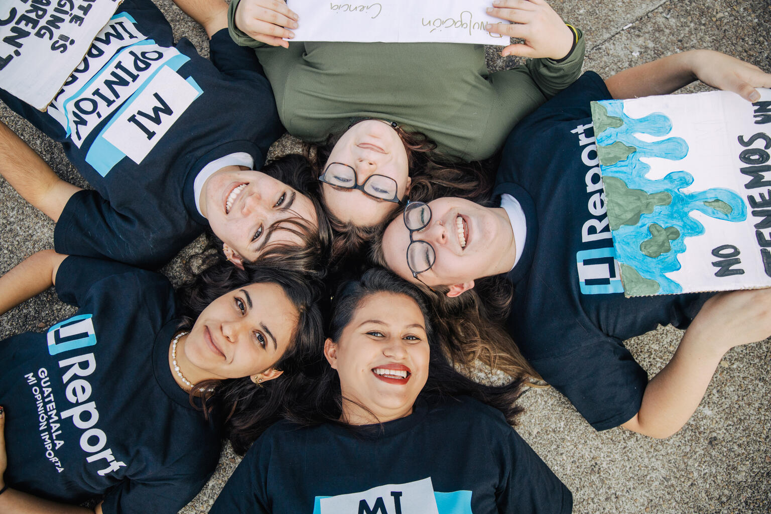
REFLECTION
Find somewhere quiet and allow yourself a few minutes to think about the below.
Think about how you personally can make sure you don’t discriminate against girls – this applies to all genders.
Are you confident to call out stereotypes or discrimination around gender?
What small step could you take towards this?
UNICEF/UN0585537

Slide 12
MORE INFO…
RRSA WEBSITE
For more information or to download previous Article of the Week packs please visit the RRSA website by clicking the link below
CLICK HERE

Slide 13
Thank you
UNICEF UK/Dawe
Notes:
UNICEF UK/Dawe

