Slide 1
UNICEF/ UN0389244

Slide 2
Slide 3 – Introducing World Water Day
Slide 4 – Introducing the articles
Slide 5 – Exploring World Water Day question
Slide 6 – Exploring World Water Day answers
Slides 7&8 – Primary Activities
Slides 9&10 – Secondary Activities
Slide 11 – Reflection

Slide 3
INTRODUCING WORLD WATER DAY
Steven Kidd, RRSA Professional Adviser, introduces World Water Day
World Water Day
World Water Day takes place on 22 March every year. It is an annual United Nations observance, started in 1993, that celebrates water and raises awareness of the 2 billion people currently living without access to safe water.
A core focus of World Water Day is to inspire action towards Sustainable Development Goal (SDG, also known as Global Goal) 6: water and sanitation for all by 2030.
Click here to watch on YouTube

Slide 4
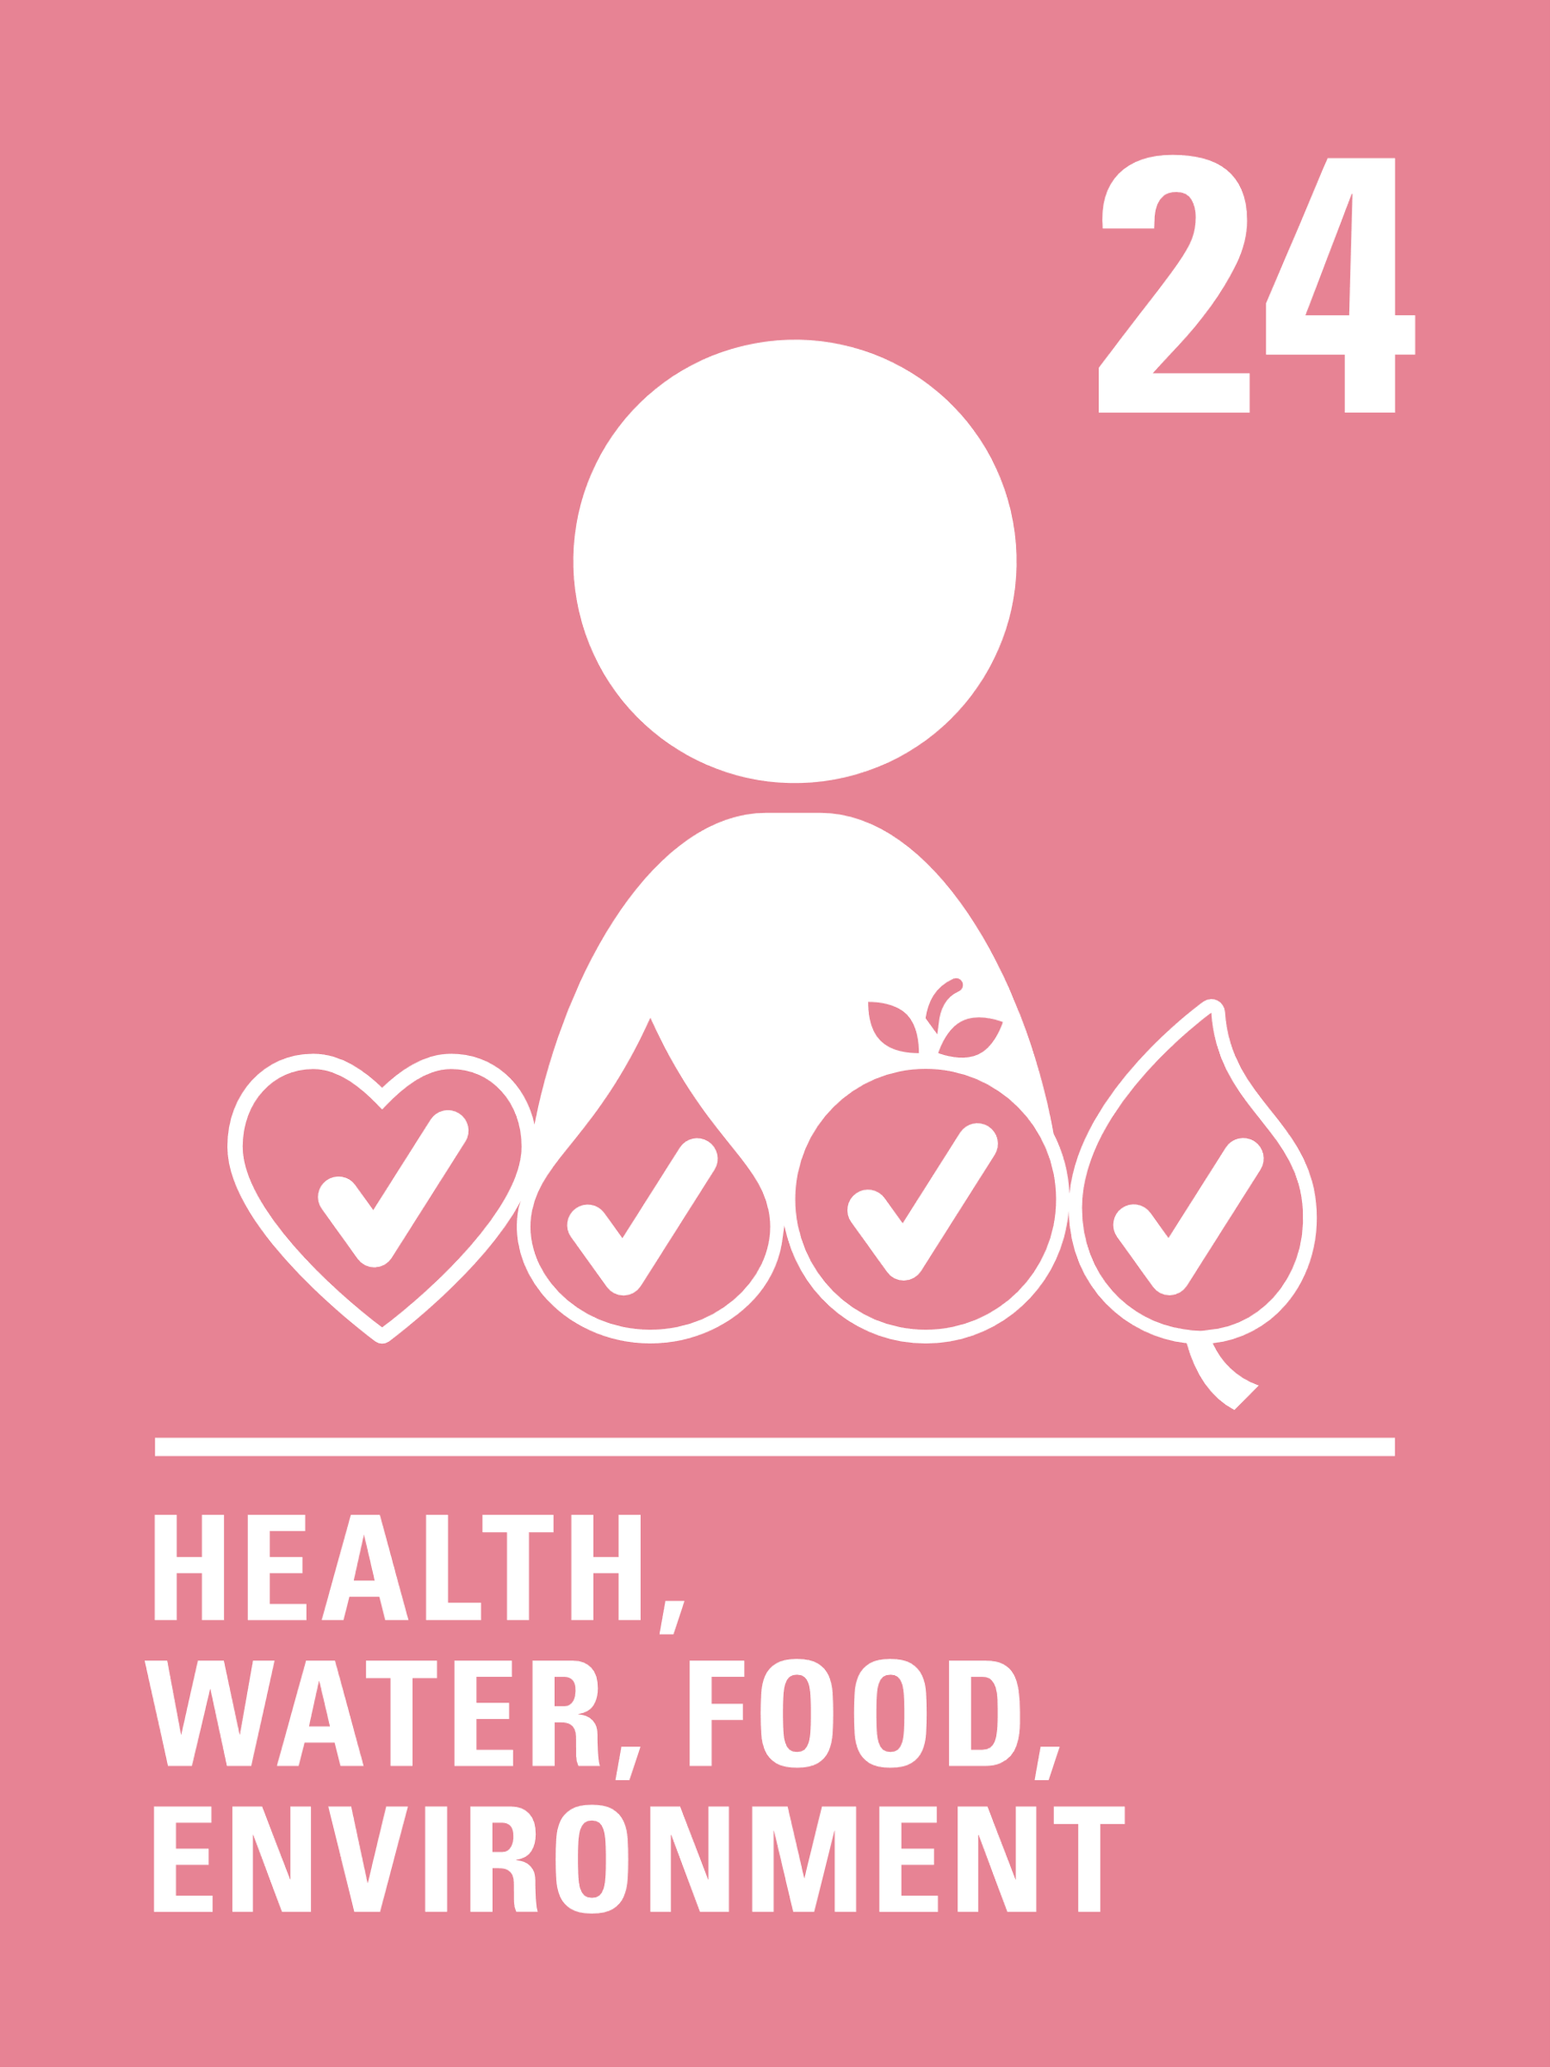
LINKED UNCRC ARTICLES
This week’s activities link to the following articles:
Article 24 (health and health services): Every child has the right to the best possible health. Governments must provide good quality health care, clean water, nutritious food, and a clean environment and education on health and well-being so that children can stay healthy. Richer countries must help poorer countries achieve this.
Article 27 (adequate standard of living): Every child has the right to a standard of living that is good enough to meet their physical and social needs and support their development. Governments must help families who cannot afford to provide this.

Slide 5
EXPLORING WORLD WATER DAY
Why do you think water is such an important and precious resource?
List as many answers as you can
and then compare your thoughts with the next slide.

Slide 6
How many of these did you get?
Everyone needs clean, safe water to drink, to survive and keep healthy.
We need water for washing ourselves and for keeping our clothes and homes clean.
Being well hydrated helps our whole body, including our brain.
We use water to flush our toilets and in sanitation.
We enjoy water for swimming and playing.
Water is important for industry, farming, and agriculture.
Did you think of any more?
Water is important to generate power in some places.
Sometimes we need to travel on water.
In some communities that don’t have access to water, children spend time walking to collect water when they could be at school or playing.
Animals depend on water for life too.
Water and wetlands provide important habitats for plants and animals.
Washing your hands is important to protect yourself and others from some illnesses.

Slide 7
Can you take a photo or draw a picture with a water theme? Perhaps you could have a competition in class, then create a display and include some words that describe water.
Team up with Thomas and Friends to learn more about Global Goal 6: clean water and sanitation for all. Talk about what you have learned with your class.
Make a ‘water diary’ over a day or week, writing down all the times you use water and in what ways. Could you work out roughly how much water you use in litres for drinking and cooking? Work out how heavy it would be if you had to carry that water, say from a pump to your home. You could try carrying a bucket with this amount of water in school.
Washing our hands has been so important during the COVID-19 pandemic. Create your own step-by-step instructions for good handwashing to display in school or at home.

Slide 8
Watch this UNICEF video of a new well being built near a school in Mali and hear children explaining what it means for them. Do you think it’s fair that some children don’t have access to clean water? Write a poem, song or rap to express your views.
This year’s World Water Day focuses on groundwater – making the invisible visible. Watch this video to find out what groundwater is. Work in a group to create a display showing what you have learnt.
Do you ever wonder what happens after you flush the toilet? This video answers your question. Look up the meaning of the word ‘sanitation’ and discuss in class why it is so important. How do Articles 24 and 27 link to sanitation? If you have time look at this UNICEF information.
How do we get clean water? This video from an Australian water company talks you through a great science experiment which will help you to see for yourself.

Slide 9
In January 2022, research by MPs said that no river in England is free from pollution. Read more here and find out what is causing that pollution. Is this a problem in your area? Think about starting a campaign to help clean up our rivers, wherever you live.
Usable water is a limited and diminishing resource and the demand for fresh water is growing. In 2018, Cape Town in South Africa nearly ran out of fresh water.
Find out why and then design a campaign to encourage everyone to be more water conscious.
UNICEF always speaks about water alongside sanitation and hygiene. Why do you think this is? Have a look at this UNICEF information and prepare a short report about the importance of this work for your school newsletter or website.
Water makes the Earth a very special place. It is the only world in our solar system with liquid water on the surface. Think about the role of water and how it makes the Earth unique and write a poem or a reflective piece. Work with a partner to explore the question, ‘Where does our water come from?’

Slide 10
Climate change is making rainfall patterns change. Some places are drier, causing wells and rivers to dry up, in other places, rainfall has increased causing flooding. This video explains the importance of groundwater and a healthy water cycle in helping to keep our climate and planet healthy. Share your learning with others in your class.
Hold a photographic exhibition in your school using photographs taken by students and staff that celebrate water. Raise awareness of Article 24 and 27 and SDG 6 in your exhibition and invite the wider school community to visit.
Find out more about the theme of this year’s World Water Day – groundwater.
Visit https://www.worldwaterday.org/learn and use what you find to prepare a short assembly or organise a discussion in class.
Create a quiz full of water facts to raise awareness of water issues locally and globally. Share this with your local primary schools to celebrate World Water Day.
(Don’t forget to mention rights!)

Slide 11
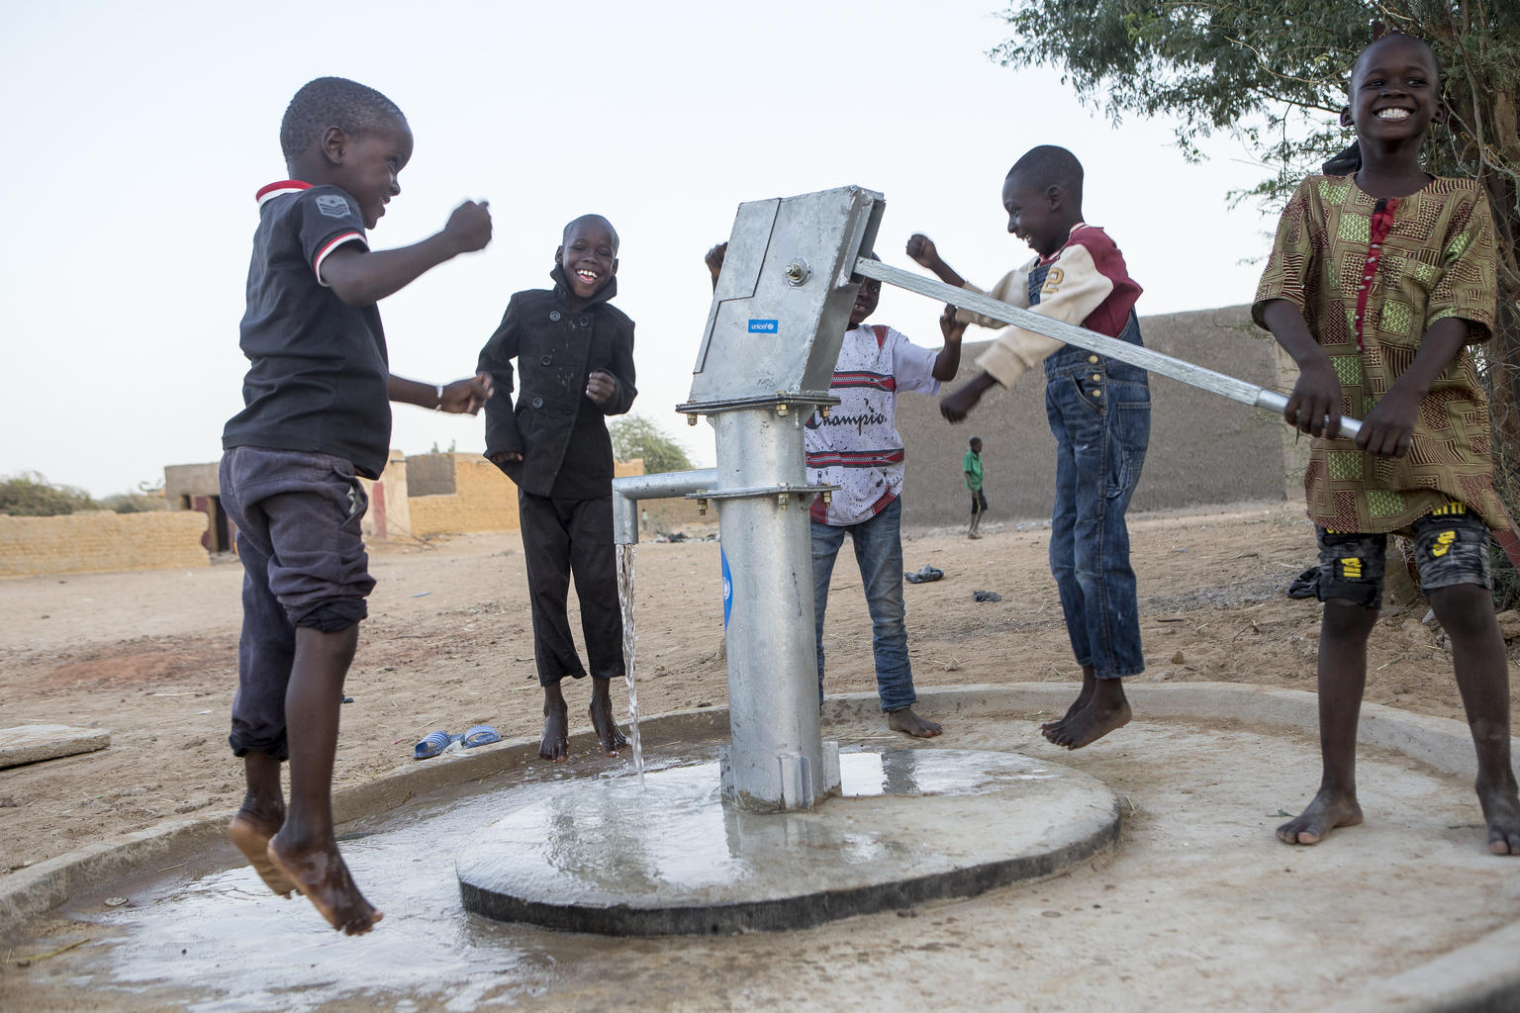
REFLECTION
It you can, have a glass (or a bottle) of water with you for this reflection.
Make some time to think, find somewhere comfortable.
Think about (and look at) water… why is it so special?
Think about cool water on a really hot day.
Think about a really relaxing shower or bath.
Can you think of 3 things that you can do today, to help save and protect water?
How can you encourage others to do the same?
@UNICEF/UNI307697

Slide 12
MORE INFO…
RRSA WEBSITE
For more information or to download previous Article of the Week packs please visit the RRSA website by clicking the link below
CLICK HERE

Slide 13
Thank you
UNICEF UK/Dawe
Notes:
UNICEF UK/Dawe

