Slide 1
©UNICEF/Dawe

Slide 2
Slide 3 – Guess the article
Slide 4 – Introducing Article 31
Slide 5 – Soccer Aid Schools Challenge
Slide 6 – Exploring Article 31
Slide 7 – Some possible answers
Slides 8&9 – Primary Activities
Slides 10&11 – Secondary Activities
Slide 12 – Reflection

Slide 3
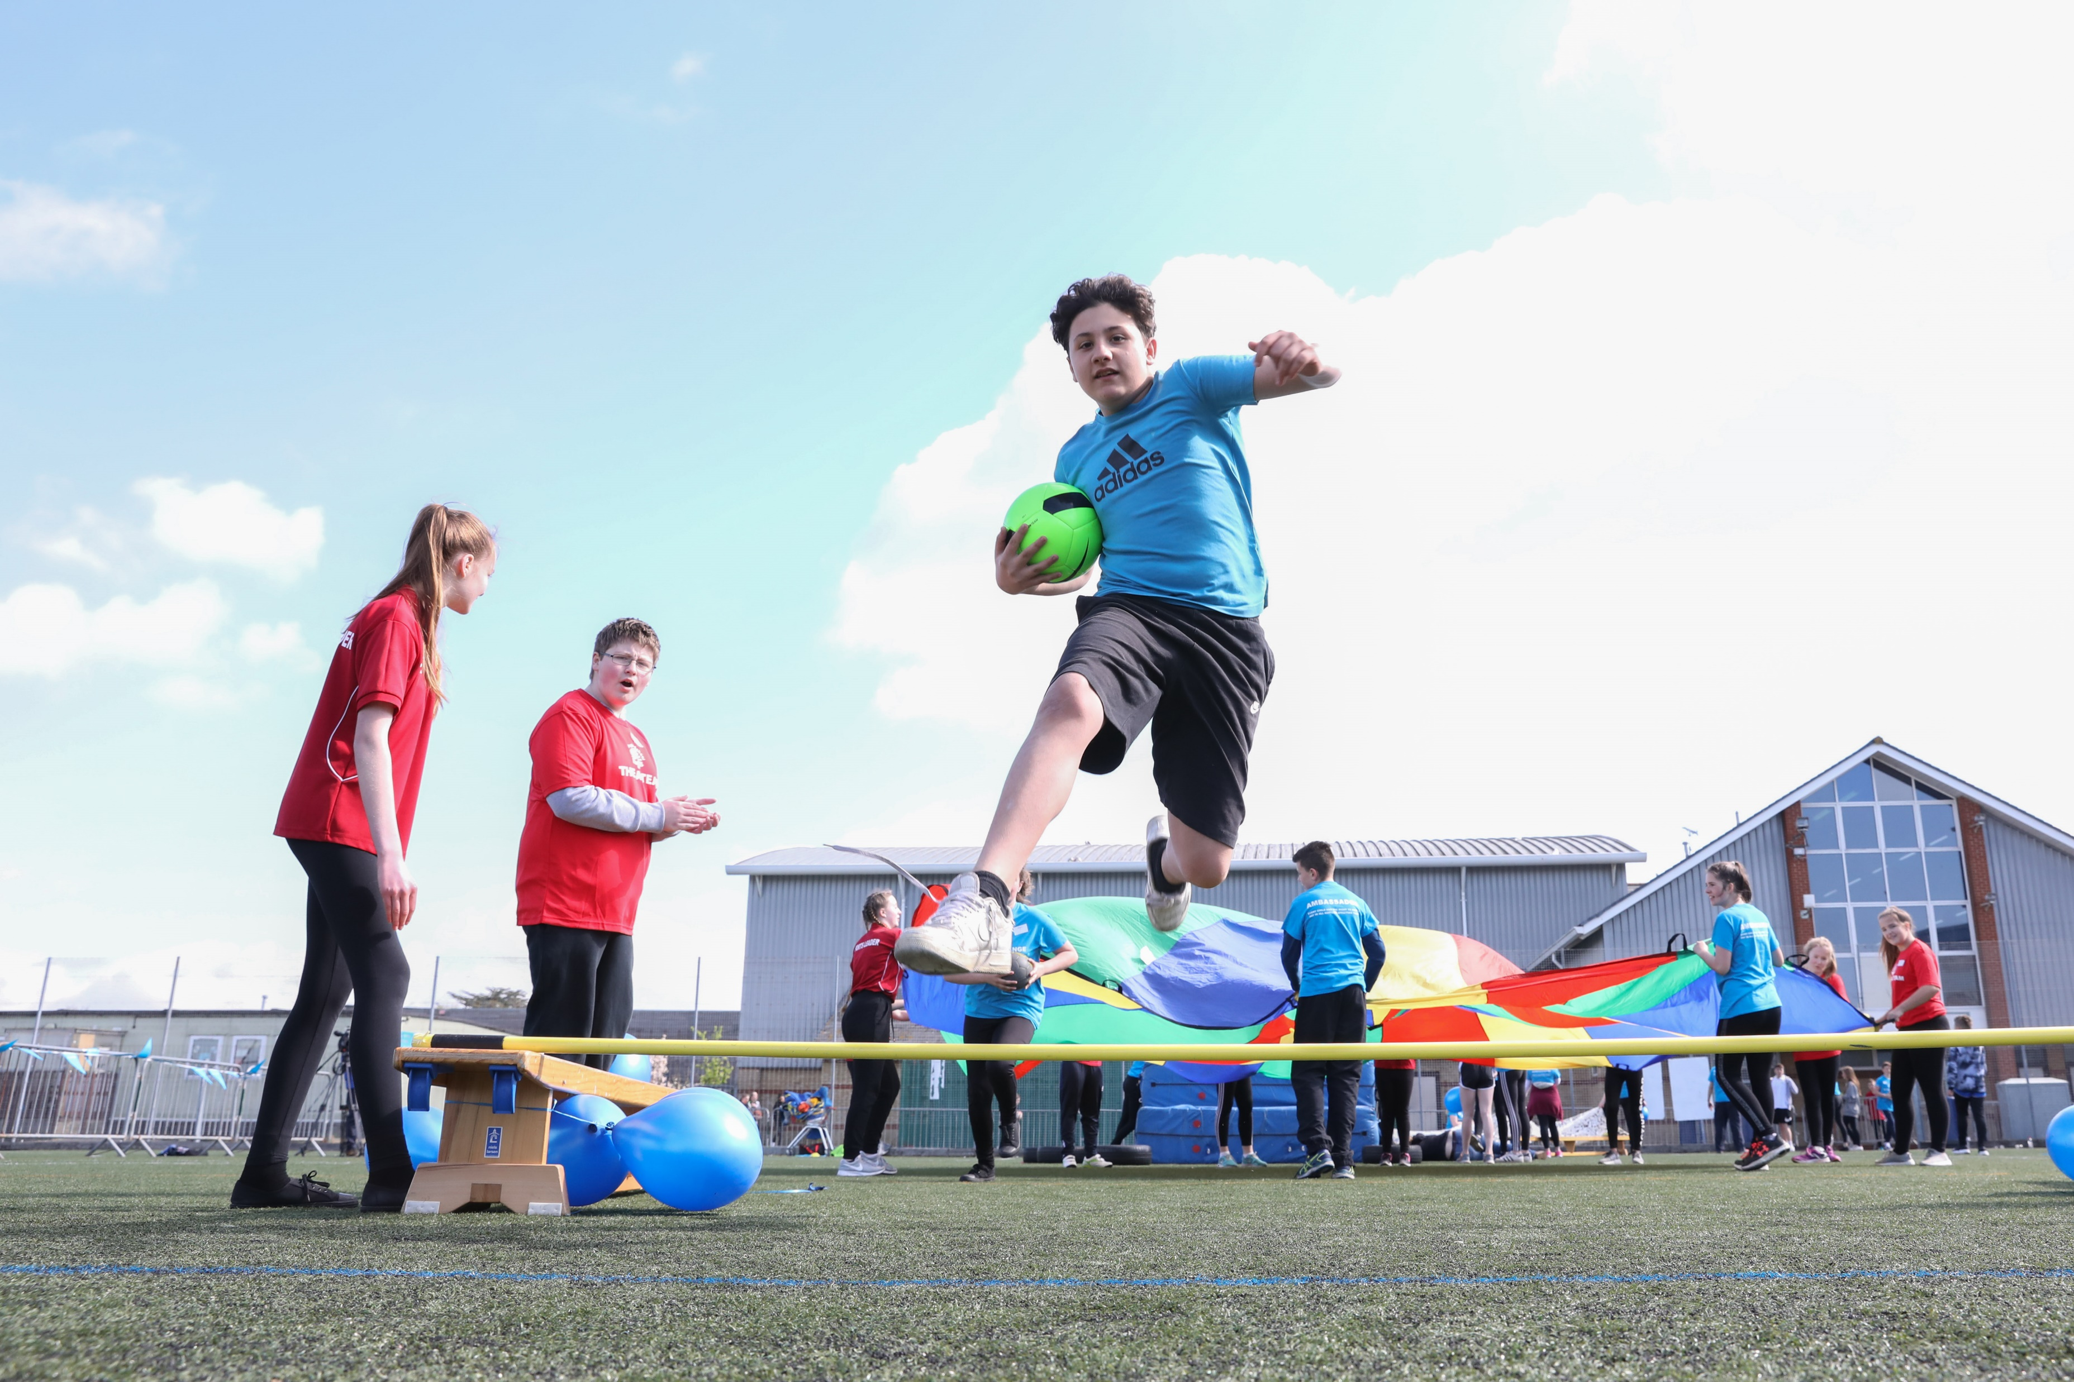
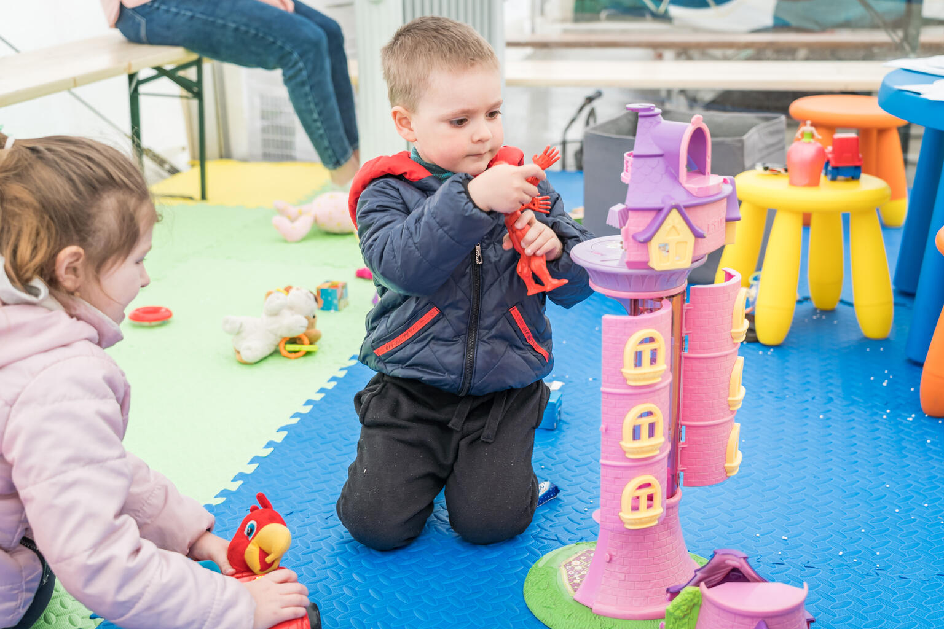
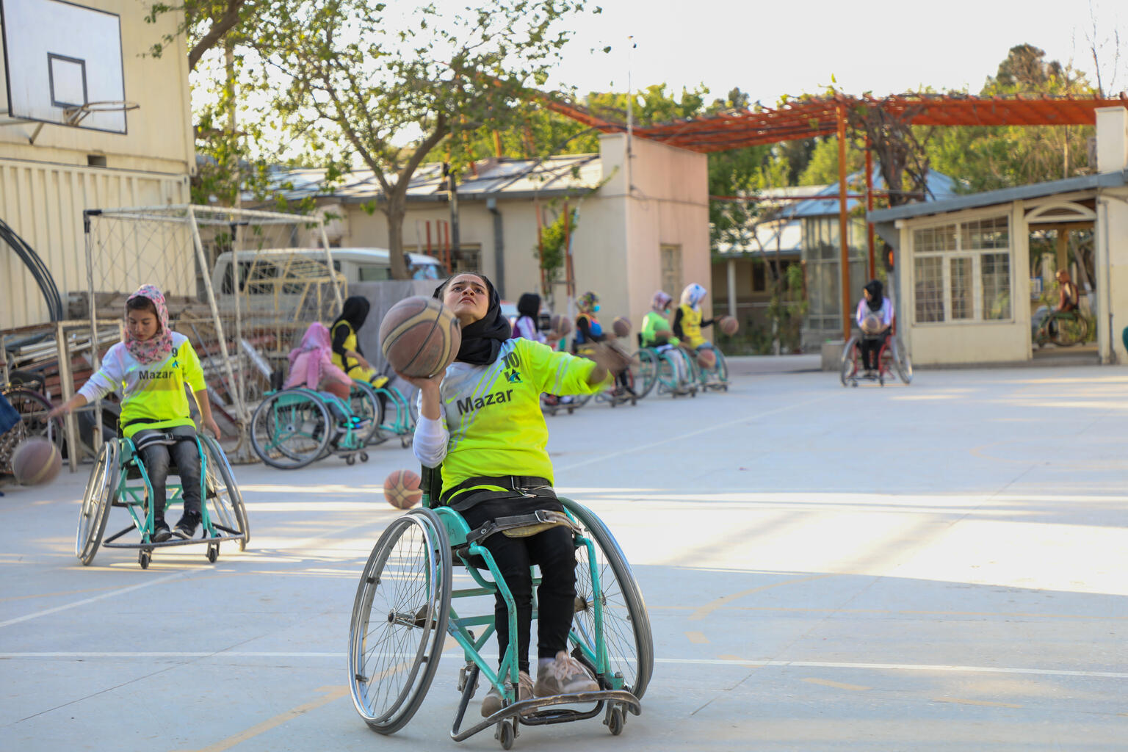
Guess the Article
These pictures provide a clue to this week’s article.
How do these pictures help you? Can you guess how they are linked together?
Write down your thoughts or discuss with someone in your class.
©UNICEF/Dawe
@UNICEF/ Adrian Holerga
@UNICEF/ Azizullah Karimi

Slide 4
INTRODUCING ARTICLE 31
Sam Meegan from Soccer Aid for UNICEF, introduces Article 31
Article 31 (leisure, play and culture): Every child has the right to relax, play and take part in a wide range of cultural and artistic activities.
Click here to watch on YouTube

Slide 5
SOCCER AID SCHOOLS CHALLENGE
Are you looking for fun and meaningful activities to get the school together, celebrate the right to play and promote children’s rights? Join the team this summer and sign up for Soccer Aid Schools Challenge! You can learn more about it here.
The Schools Challenge is part of Soccer Aid for UNICEF, the world's biggest celebrity football match happening on 12 June this year.
By taking part and fundraising, your school can change the lives of children around the world. Watch the video to see some of the work that UNICEF is doing thanks to money raised through Soccer Aid and Soccer Aid Schools Challenge – this was aired during 2021 match.
Olly Murs takes us back to Kenya
SIGN UP NOW
Click here to watch on YouTube

Slide 6
EXPLORING ARTICLE 31
Why is play important to children? Name as many reasons as you can think of.

Slide 7
Did you think of these?
It’s good to have fun and relax.
Some play is good for exercise.
It can help you get on with people and make friends.
You might learn to take turns and to share.
It can help your education and learning.
It can help your mental health.
Play can help you to imagine and be creative.
It’s one of the rights children have.
What other ideas did you have?

Slide 8
Talk to your class about favourite toys/games/sports. Invite the children to draw or paint a picture of themselves playing their favourite game or sport or with their favourite toy.
Read or listen to ‘Giraffe’s Can’t Dance’ by Giles Andreae. Discuss with the class times you have been worried about trying a new sport or activity. What helped you to join in and have fun? Share your ideas and discuss how trying new things can help us with our right to relax and play.
The 2022 Soccer Aid Schools Challenge invites you to design an obstacle course. Look up the word obstacle. Around the world there are many obstacles in the way of children’s rights including their right to relax and play. Find out about some of these and use your creativity to create a display in school to show how your obstacle course will help children overcome obstacles in their lives.
Play a simple game that you know your class enjoys (it could be a word or number game…something they know well), then open up a discussion about play - how we play, what we like about playing, why it matters. Remind everyone that relaxing and playing is a right.

Slide 9
The teams playing in Soccer Aid for UNICEF have male and female players, people from all over the world and this year Alex Brooker will be the first person with a visible disability to play in Soccer Aid. Why do you think this is important? Write an article to share your thoughts or hold a class discussion. If the players were children, which rights would be relevant here?
What do you like to do when you relax? What is your favourite way to play? Do you take part in any cultural activities in school? What about outside of school? Discuss your favourite ways to relax and play. How would you feel if you weren’t able to do any of these things? This activity is part of Global citizenship resources developed by Dreamachine and UNICEF UK. Find more here.
Watch this video with Ramla Ali showing the power of sport in Za’atari refugee camp. Research other UNICEF celebrity supporters who use sport to help ensure all children can enjoy their rights. Create a fact file on your favourite ambassador and their role.
Work in groups to design an advertising campaign to encourage everyone to get involved in the 2022 Soccer Aid Schools Challenge. Try to mention UNICEF’s work and Article 31.

Slide 10
Work in groups to design an advertising campaign to encourage everyone to get involved in the 2022 Soccer Aid Schools Challenge. Try to mention UNICEF’s work and Article 31.
Watch this TED Talk with Molly Wright about the importance of play for a child’s development. As a class, debate whether there should be more time for play as part of secondary education. What rights are linked to the five ideas she mentions?
Talk to friends and family and find out which sports they enjoy. Complete a tally chart and turn this into a graph. Which sport is most popular in your class? Talk to grandparents and/or great grandparents and find out which sports they used to play or watch. How and when has access to sport changed for some women and girls and/or for people with disabilities? Is this the same in all countries?
The 2022 School’s Challenge for Soccer Aid invites you to design an obstacle course. Around the world there are many obstacles in the way of children’s rights including their right to relax and play. Find out about some of these and use your creativity to create a display in school to show how your obstacle course will help children overcome obstacles in their lives.

Slide 11
The teams playing in Soccer Aid for UNICEF have male and female players, people from all over the world and this year Alex Brooker will be the first person with a visible disability to play in Soccer Aid. Why do you think this is important? Write an article to share your thoughts or hold a class discussion. If the players were children, which rights would be relevant here?
Soccer Aid has helped UNICEF make life better for millions of children over the years. Realising the rights of every child requires money to be raised but also voices to be raised in order to change unfair systems and structures. Research the impact of Soccer Aid for UNICEF and, if you would like to, find ways to raise your voice to support UNICEF’s work. You might like to start here.
Think about how Article 19 links to Article 31. Discuss what duty bearers should do to make sure that children and young people are safe when taking part in sporting activities. Create a poster or role play a scenario about this. Discuss with an adult how you can share this information safely with others.
Watch this video with Ramla Ali showing the power of sport in Za’atari refugee camp. Research other UNICEF celebrity supporters who use sport to help ensure all children can enjoy their rights. Create a fact file on your favourite ambassador and their role.

Slide 12
REFLECTION
Here’s a challenge for you…
Next time you play (whether it’s online, around a table with your family or friends or in the park or playground.
Try to stop for a moment and appreciate how good it is to play.
If you are playing with somebody else, remind them that relaxing and playing is one of your rights.
Think about how you can include other people more in your games and in your play.
UNICEF UK/Dawe

Slide 13
MORE INFO…
RRSA WEBSITE
For more information or to download previous Article of the Week packs please visit the RRSA website by clicking the link below
CLICK HERE

Slide 14
Thank you
UNICEF UK/Dawe
Notes:
UNICEF UK/Dawe

