Slide 1
UNICEF/ UN0540783

Slide 2
Slide 3 – Introducing Earth Day
Slide 4 – Introducing the articles
Slide 5 – Exploring Earth Day question
Slide 6 – Exploring Earth Day answers
Slides 7&8 – Primary Activities
Slides 9&10 – Secondary Activities
Slide 11 – Reflection

Slide 3
INTRODUCING EARTH DAY
Meghna Das, Head of International Programmes Engagement at UNICEF UK, introduces Earth Day
Earth Day, 22 April
Earth Day takes place every year on April 22 to show support for the protection of the environment and our planet. It was first held on April 22, 1970, in the United Stated of America. More than 1 billion people around the world now participate in Earth Day activities each year.
This year’s theme is Invest In Our Planet, encouraging everyone to take action and come together in partnership for our planet.
Click here to watch on YouTube

Slide 4
LINKED UNCRC ARTICLES
This week’s activities link to the following articles:
Article 6 (life, survival and development): Every child has the right to life. Governments must do all they can to ensure that children survive and develop to their full potential.
Article 24 (health and health services): Every child has the right to the best possible health. Governments must provide good quality health care, clean water, nutritious food, and a clean environment and education on health and well-being so that children can stay healthy. Richer countries must help poorer countries achieve this.

Slide 5
EXPLORING EARTH DAY
What do you, your school and your family do that helps the environment and the planet?
List as many answers as you can
and then compare your thoughts with the next slide.

Slide 6
How many of these did you get?
Recycle
Litter picking
Buy local to reduce food miles
Turn off lights, TV etc when not in use
Walk to school
Donate clothes and toys that are still in good condition
Use a ‘bag for life’
Don’t waste water
Did you think of anything else?
Use a reusable water bottle
Plant trees in the school grounds
Create space for wildlife
Write to decision makers such as MPs or companies to ask them to protect the environment

Slide 7
Watch this clip of the book The Girl Who Spoke to the Moon by Land Wilson. Discuss the importance of looking after the natural world. What do you value about our environment? How are we going to look after it?
This activity is part of Global citizenship resources developed by Dreamachine and UNICEF UK. Find out more here.
Celebrate all the great things you are already doing in school or at home to protect the environment. Create a display to showcase these things.
Think about your local area. Are there any issues or challenges to the environment – air pollution, litter, lack of green spaces? Vote on which is most important and agree a plan to raise awareness of the issue in school and the community.
Read or listen to George Saves the World by Lunchtime. Discuss what you have learnt and as a class make a pledge to do one good thing for the planet.

Slide 8
“For us, every day is Earth Day.”
Why would people say this? Discuss with your friends. If you feel the same, check out these 52 actions and tips to make a difference. Discuss and choose one to implement in your school and one for home.
The UN Committee on the Rights of the Child is inviting children from around the world to shape the content of the General Comment No. 26 – official UN guidance on what governments must do to uphold children’s rights and protect our planet. Share your views and complete this questionnaire before 30 June.
Take a look at the Earth Day website. Write an article for your school newsletter or create a video to ask as many families as possible to participate in Earth Day 2022. Explain why this is important and how this links to children’s rights and your work as a Rights Respecting School.
Watch this clip from Britains Got Talent. Can your class create a song or assembly to share with your school to show why we need to save the planet?

Slide 9
Some people say:
“For us, every day is Earth Day.”
If you feel the same, check out these 52 actions and tips to make a difference. Discuss and choose one to implement in your school and one for home.
The UN Committee on the Rights of the Child is inviting young people from around the world to shape the content of the General Comment No. 26 – official UN guidance on what governments must do to uphold children’s rights and protect our planet. Share your views and complete this questionnaire before 30 June.
Take a look at the Earth Day website. Write an article for your school newsletter or create a video to ask as many families as possible to participate in Earth Day 2022. Explain why this is important and how this links to children’s rights and your work as a Rights Respecting School.
Look at the Artists for the Earth webpage. Create your own gallery in school or your local library or supermarket to raise awareness of Earth Day and the environment.

Slide 10
Check out this reading list. Have you read any of these or a different book about environmental issues? Talk to a friend and share your thoughts and opinions about these books. Take your ideas to your school library and discuss how reading books about environmental issues could be better promoted.
Watch the One Earth video. Create your own visual representation of the Earth using both positive and negative images. Share on social media using #InvestInOurPlanet.
Reflect on COP26. Read this article about the outcomes for children and young people. Share your ideas and identify your key priorities regarding the planet. Share these with a key local or national decision maker. This could be by letter, video or try inviting them into school to speak to you directly. Try to mention Articles 6 and 24.
Check out the pledge ideas on Earth Day website. Choose one to commit to or make one of your own. Decide how you can share your commitment and encourage others to make their own pledge.

Slide 11
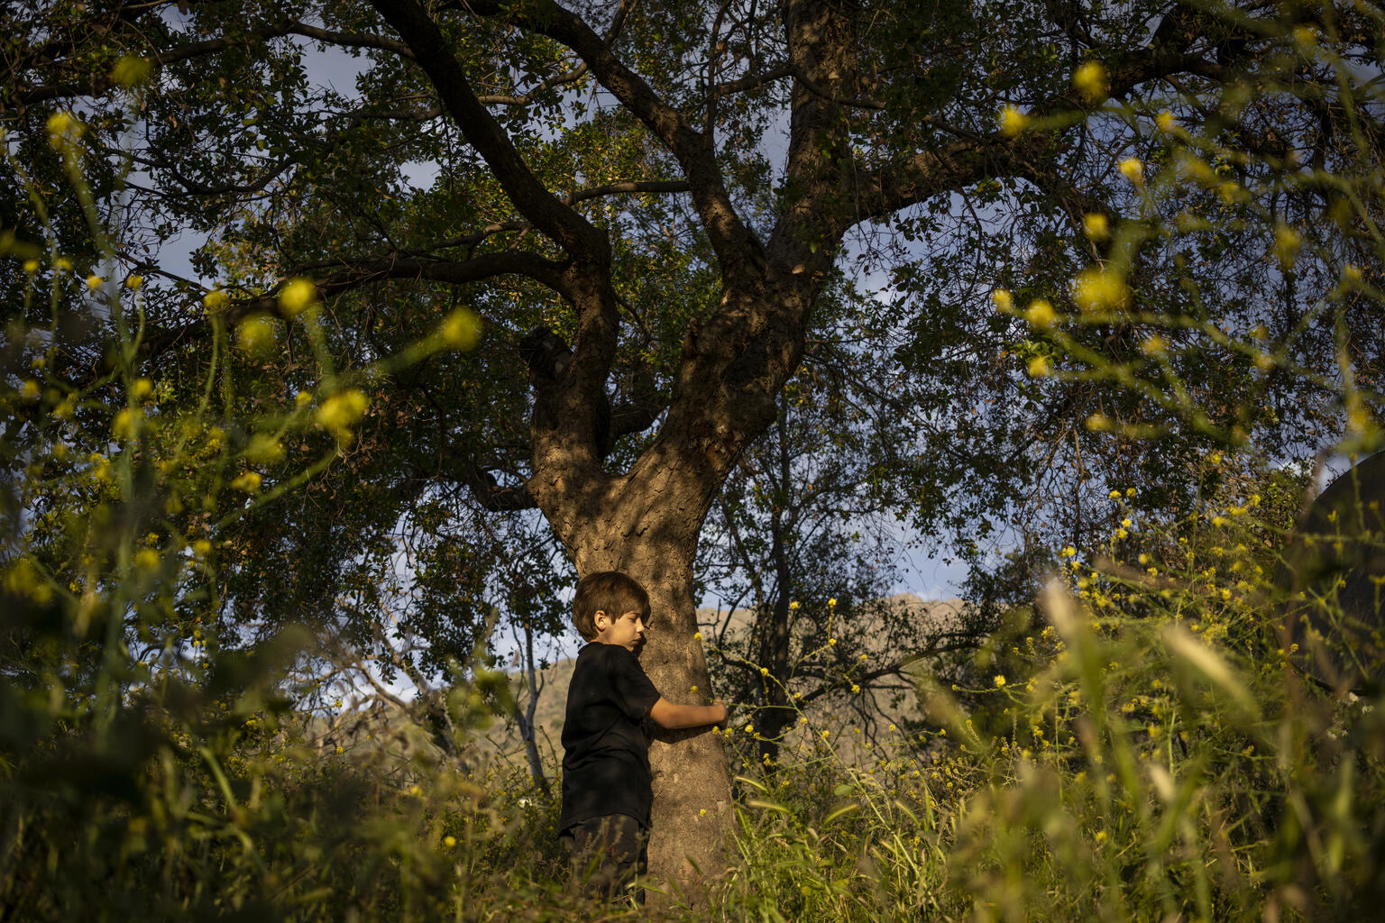
REFLECTION
Take a few minutes and find some space to be quiet and to think... If you can, go outside, look out of a window or put some images of earth and the environment on a screen...
Why is our planet special to you? What do you value most about the environment?
How can upholding everyone’s rights help protect the planet?
How will you ‘celebrate’ Earth Day this year?
How can you encourage positive environmental action with friends, neighbours and family members?
@UNICEF/UN0364082

Slide 12
MORE INFO…
RRSA WEBSITE
For more information or to download previous Article of the Week packs please visit the RRSA website by clicking the link below
CLICK HERE

Slide 13
Thank you
UNICEF UK/Dawe
Notes:
UNICEF UK/Dawe

