Slide 1
UNICEF/UN0517660

Slide 2
Slide 3 – Guess the article
Slide 4 – Introducing Article 6
Slide 5 – Exploring Article 6
Slide 6 – Some possible answers
Slides 7&8 – Primary Activities
Slides 9&10 – Secondary Activities
Slide 11 – Reflection

Slide 3
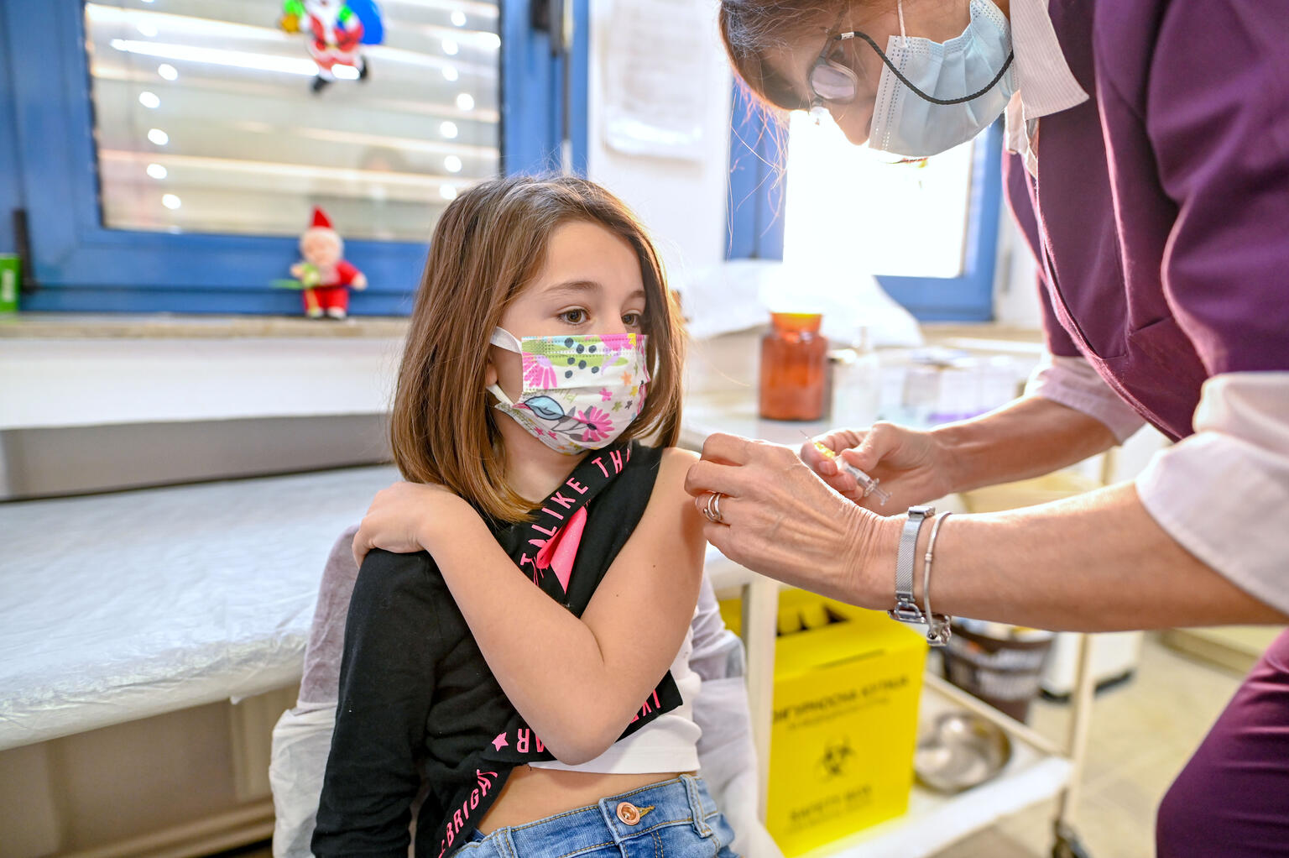
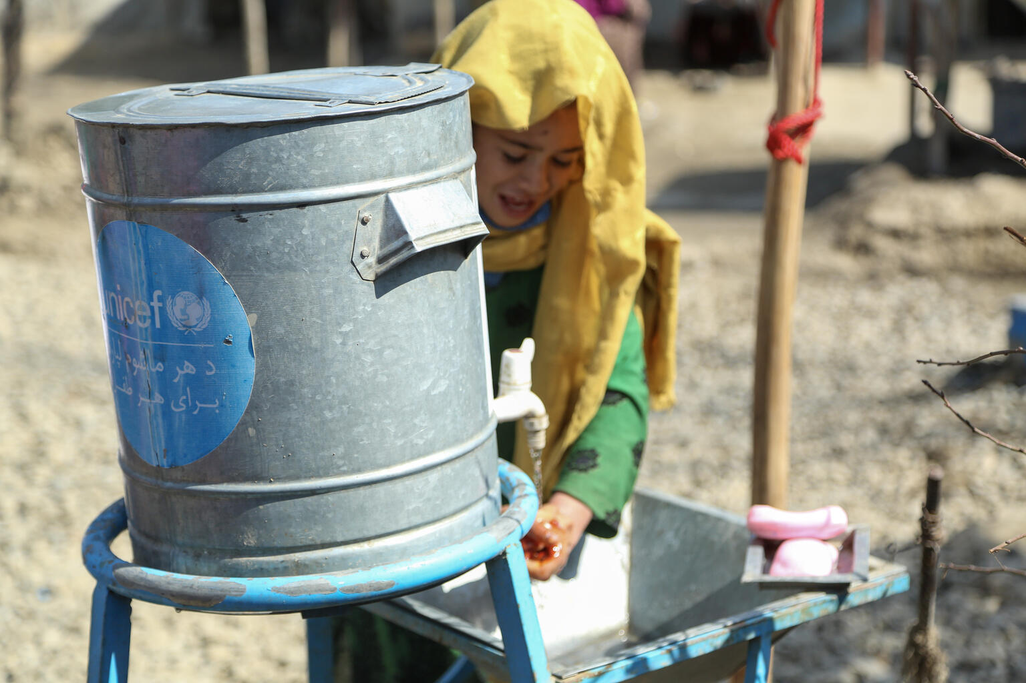
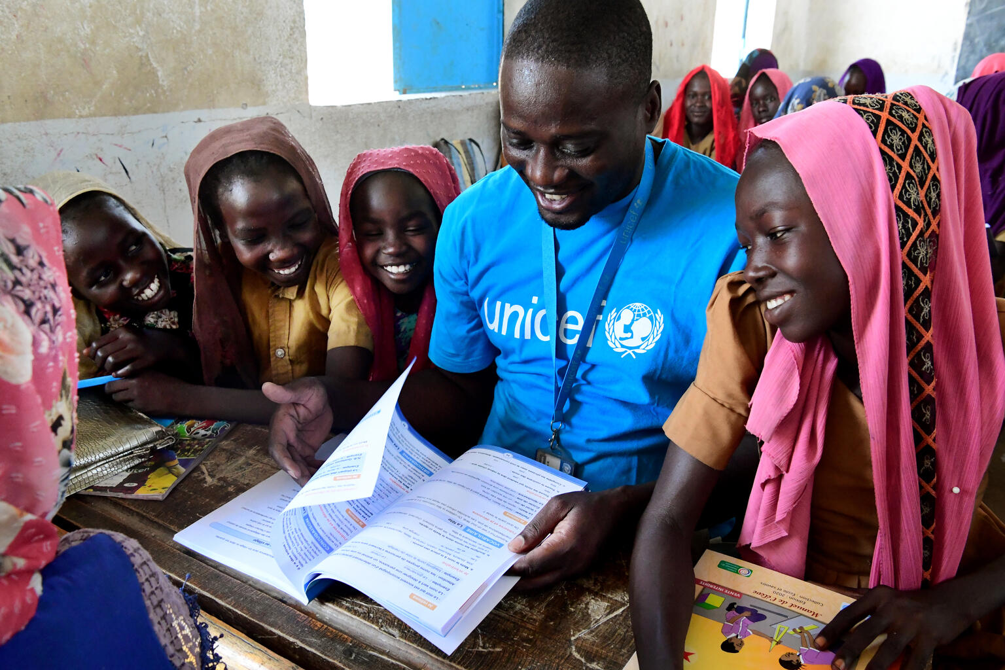
Guess the Article
These pictures provide a clue to this week’s article.
How do these pictures help you? Can you guess how they are linked together?
Write down your thoughts or discuss with someone in your class.
@UNICEF/ Tomislav Georgiev
@UNICEF/ Veronica Houser
@UNICEF/ Frank Dejongh

Slide 4
INTRODUCING ARTICLE 6
Steven Kidd, RRSA Professional Adviser, introduces Article 6
Article 6 (life, survival and development):
Every child has the right to life.
Governments must do all they can to
ensure that children survive and develop to
their full potential.
Click here to watch on YouTube

Slide 5
EXPLORING ARTICLE 6
What are all the things that you need to survive and to develop?

Slide 6
Did you think of these?
Good health – physical and mental
Education
Nutritious food
Clean water
Somewhere to live
People to look after you
A name and an identity so you can be registered for healthcare and education
Protection so you are safe from abuse and neglect
A good standard of living including water and sanitation facilities
Clean environment
Time and space to relax and play
Knowledge of your rights
Did you think of anything else?

Slide 7
Can you think of three things that you can do now that you couldn’t do when you were younger? Share your ideas with your friends. Perhaps you can create a timeline showing what you could do when you were different ages – remember though that everybody develops at different speeds.
The Very Hungry Caterpillar eats lots and lots of food to help him grow, not all of it very healthy! How do other animals change as they grow up? Draw a picture of what you might look like when you’re a grown up.
Article 6 talks about developing to your full potential and surviving; other words that are sometimes used are flourish and thrive. Look up the definitions of these words – do they all mean the same? How would you state Article 6 in your own words?
Write a poem or create a piece of art to show a child living their life to the fullest.

Slide 8
In your school you probably do lots about PSHE, Wellbeing, positive relationships and mental health. Work together to create a mind-map of all that you have done about these things so far this school year that links to Article 6. Think about what you could do to fill in any gaps.
Watch this clip of the book Can I Build Another Me and imagine yourselves as a tree. You can draw yourself as a tree. What kind of tree are you? What about your roots? Who, and what keeps you anchored into the ground? What do you need to grow? What has helped you grow so far? How do you hope you will grow? For more info and similar activities, have a look at the Imagine a Word resource developed by Dreamachine and UNICEF UK.
Do a research project to find out how UNICEF helps children to live and develop all around the world. This video about water for life might be a good place to start.
Have a look at all the rights in the CRC. How many other articles can you find that link to Article 6? Work in groups to create a list, then compare your answers.

Slide 9
‘Living and surviving is one thing – living and thriving is very different.’
Not having enough money to eat healthily or stay warm affects how well you can develop. Watch this video where students talk about how poverty affects them. It was made in a Rights Respecting School 10 years ago – did anything surprise you about the story and do you think that things have improved or got worse in the UK?
As a group or class create a list of the different things that might slow down a child’s survival and development or even limit their life. Use your research skills to find a current situation where, unfortunately, the things on your list are happening.
Very sadly, around the world nearly a million adolescents died in 2020. Use childmortality.org to explore adolescent mortality rates in different countries. Which is the safest or healthiest place for a teenager? Which is the least safe and healthy? Present your findings using one or more graphs.
Some people say that the right to life is obvious. Why do you think it was considered important enough to be an article in the CRC? How does it relate to all the other articles of the Convention?

Slide 10
UNICEF supports children’s right to life, survival and development around the world every day. Watch these two videos about its work - Help a Child and We won’t stop. Discuss your thoughts and reactions to the content. If you wish, use the ideas (especially the vocabulary) to write a report for your school newsletter or create an assembly about UNICEF’S work.
Accidents (unintentional injuries), homicide, suicide, cancer, and heart disease make up the five leading causes of death for 15 -24-year-olds. This poignant video from Papyrus UK encourages us to support suicide prevention and highlights their free helpline. What advice, help and support does your school offer for mental health, especially to those who are facing difficult or challenging situations? Are local and national organisations signposted? Design a leaflet about this for the new pupils joining your school later in the year.
The very idea of life in an extraordinary concept - look how much effort goes into search for life elsewhere in the universe! How can people show they value and appreciate life? Work alone or with a group to create a piece of art, drama, music or writing called ‘Celebrating Life’.
Conflict and crises greatly impact on children’s ability to enjoy Article 6. A lot of focus in the UK media is on the war in Ukraine, but this article in The New Humanitarian highlights eight other situations around the world where lives are threatened. Choose one of the examples to further research and compile a fact file.

Slide 11
REFLECTION
Use some of your mindfulness skills or a breathing exercise to be still and calm… then give some time to the thoughts and questions below...
Think about your development since you were a tiny baby…
Remember a moment when you learnt to do something for the first time…
How did it make you feel?
What did you do next?
What are you looking forward to learning and experiencing in the future?
Who can you share this with?
UNICEF UK/Dawe

Slide 12
MORE INFO…
RRSA WEBSITE
For more information or to download previous Article of the Week packs please visit the RRSA website by clicking the link below
CLICK HERE

Slide 13
Thank you
UNICEF UK/Dawe
Notes:
UNICEF UK/Dawe

