Slide 1
UNICEF/UN0609837

Slide 2
Slide 3 – Guess the articles
Slide 4 – Introducing Articles 9, 20 and 25
Slide 5 – Exploring Articles 9, 20 and 25
Slide 6 – Some possible answers
Slides 7&8 – Primary Activities
Slides 9&10 – Secondary Activities
Slide 11 – Reflection

Slide 3
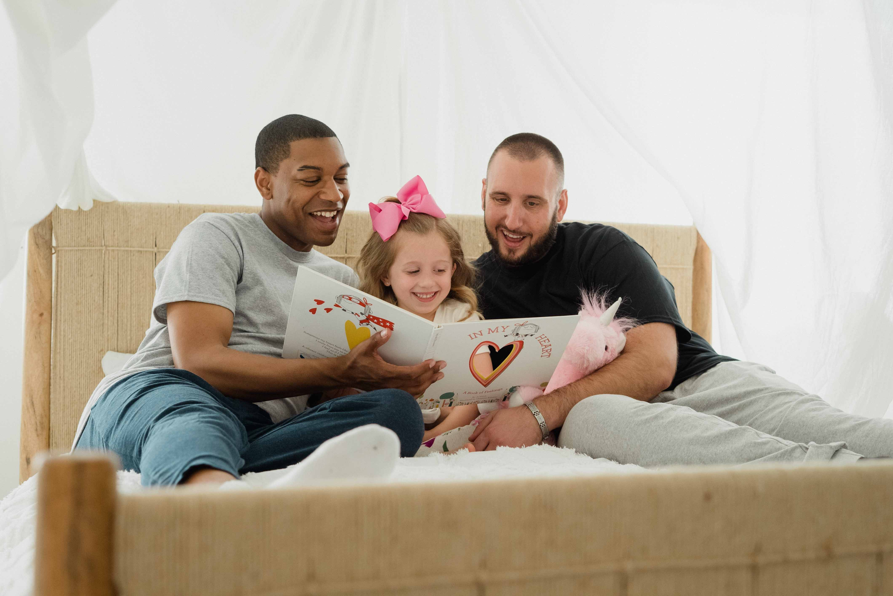
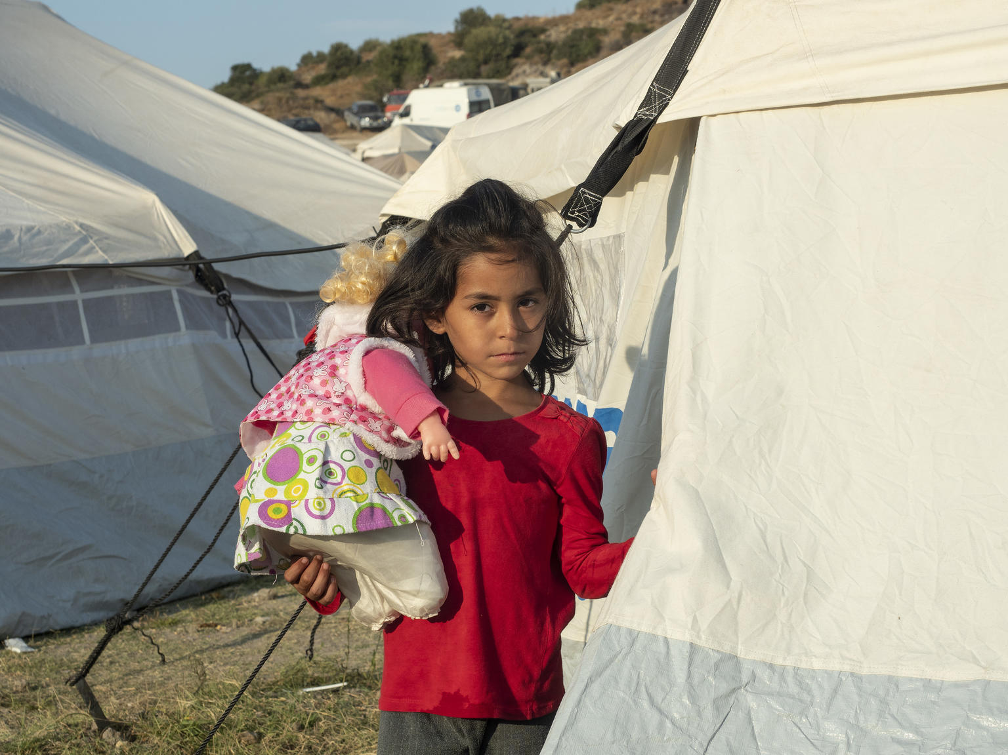
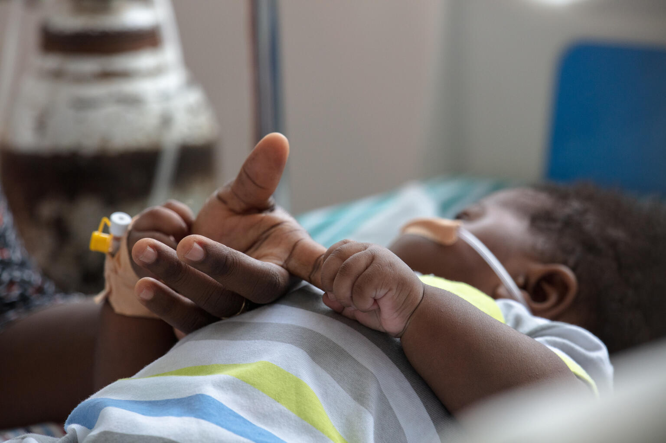
Guess the Articles
These pictures provide a clue to this week’s articles.
How do these pictures help you? Can you guess how they are linked together?
Write down your thoughts or discuss with someone in your class.
@Photo by Pexels
@UNICEF/ Enri Canaj/Magnum Photos
@UNICEF/ Francis Kokoroko

Slide 4
INTRODUCING ARTICLES 9, 20 & 25
Article 9 (separation from parents): Children must not be separated from their parents against their will unless it is in their best interests (for example, if a parent is hurting or neglecting a child). Children whose parents have separated have the right to stay in contact with both parents, unless this could cause them harm.
Article 20 (children unable to live with their family): If a child cannot be looked after by their immediate family, the government must give them special protection and assistance. This includes making sure the child is provided with alternative care that is continuous and respects the child’s culture, language and religion.
Article 25 (review of treatment in care): If a child has been placed away from home for the purpose of care or protection (for example, with a foster family or in hospital), they have the right to a regular review of their treatment, the way they are cared for and their wider circumstances.
Helen Trivers, RRSA Professional Adviser, introduces Articles 9, 20 and 25
Click here to watch on YouTube

Slide 5
EXPLORING ARTICLE 9, 20 & 25
Why might it not sometimes be possible for children to live with their parents?

Slide 6
Did you think of these?
Parents may be unwell and unable to care for them.
Parents may not be able to keep their children safe.
Parents may not be able to provide everything a child needs to be the best they can be.
Family situations may change, for example there may be a crisis.
Parents may live separately, even in different countries.
The child may need long term treatment or care.
Parents may be in prison.
Disasters or emergencies may cause a child to be separated from its family.
Did you think of other reasons?

Slide 7
Read The Blanket Bears by Samuel Langley-Swain about little bears who are being cared for by foster carers. What did their foster carers do to make the little bears feel safe and welcome? How were the bears involved in choosing their forever family? If you don’t have the book, watch this Story Time video.
Not all children live in the same kinds of families, there are families of many different types. Draw yourself with the people who look after you. Add details about who they are if you like.
All children have the right to be cared for and kept safe. Some children can’t stay at home and need to go somewhere safe to be cared for. This could be with another family member, or in foster care. Watch this video and listen to James’ story. How did this story make you feel? Talk about it in your class. How would you support James if he moved to your school?
Have you ever been away from your parents, carers or family, perhaps on a school trip or a sleepover with a friend? What did you miss the most? How did you keep in touch? Write some top tips for keeping in touch if people can’t be together.

Slide 8
You will have seen lots of sad stories about families separated by the conflict in Ukraine. Learn about the amazing work of UNICEF Blue Dot centres. Draw a picture or write about their work so other people can find out about the centres. Can you explain how the Blue Dot centres link to rights?
Lots of people will be familiar with Jacqueline Wilson’s books about Tracy Beaker who lived in a children’s home. Read this Newsround article about the 30th anniversary of the books and think about why the books are so popular. Does your library have books about children who don’t live with their parents?
Article 20 says that when a child is cared for away from their parents, their CULTURE, LANGUAGE AND RELIGION must still be respected. Discuss why this is important and look at what other rights connect to this.
Imagine you had to interview some adults for the role of foster carers. What sort of questions would you want to ask them and what answers would you hope to hear? Discuss this in groups then compare your ideas with others

Slide 9
All children have the right to be cared for and kept safe. Some children need alternative care arrangements. Watch this film from Barnardo's and listen to Abi’s diary as she explains how she felt moving into a new foster care home. How did this story make you feel? Talk about it in your class. Create a list of the qualities needed by foster carers.
Read the text of Articles 9, 20 and 25. Select five words or phrases which really stand out to you. Compare your list with others in your group, then discuss how these three articles are connected.
Lots of people will be familiar with Jacqueline Wilson’s books about Tracy Beaker who lived in a children’s home. Read this Newsround article about the 30th anniversary of the books and think about why they are so popular. Does your library have books about children who don’t live with their parents?
Article 20 says that when a child is cared for away from their parents, their CULTURE, LANGUAGE AND RELIGION must still be respected. Discuss why this is important and look at what other rights connect to this.

Slide 10
You will have seen lots of stories about families separated by the conflict in Ukraine. Learn about the amazing work of UNICEF Blue Dot centres. Draw a picture or write about their work so other people can find out about the centres. Can you explain how the Blue Dot centres link to rights?
This CNN report is about young people who have left Ukraine without their parents including a girl who wrote to the school in the area she was being sent to campaigning to continue her education. What inspires you about her story? Try to link the different parts of the story with her rights.
Imagine a new pupil is arriving in your school who has been separated from their parents, they do not know the local area and may be feeling anxious and worried. Put together a ‘Welcome pack’ of information detailing what there is to do in your local area, include practical details such as transport arrangements or information on support, groups or social activities they can join.
This pack is reaching your school during UK ‘Foster Care Fortnight’ – Do some research about this awareness raising campaign and find a way of sharing relevant information in your school community.

Slide 11
REFLECTION
Take some time and space to have a think….
Who shows you that they care about you?
What feelings do you have when you know you are cared for?
How do you show care to other people in your life?
Why does care matter?
Can you show your appreciation to those who care for you?
UNICEF UK/Dawe

Slide 12
MORE INFO…
RRSA WEBSITE
For more information or to download previous Article of the Week packs please visit the RRSA website by clicking the link below
CLICK HERE

Slide 13
Thank you
UNICEF UK/Dawe
Notes:
UNICEF UK/Dawe

