Slide 1
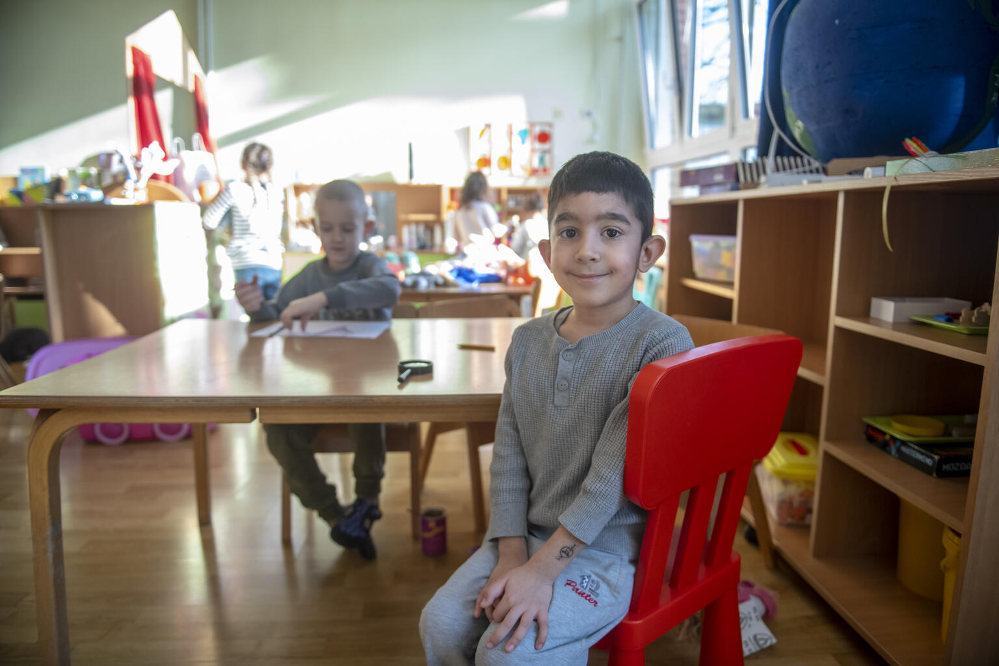
UNICEF/ UN0611650

Slide 2
Slide 3 – Introducing GRT History Month
Slide 4 – Introducing the articles
Slide 5 – Exploring GRT History Month question
Slide 6 – Exploring GRT History Month answers
Slides 7&8 – Primary Activities
Slides 9&10 – Secondary Activities
Slide 11 – Reflection

Slide 3
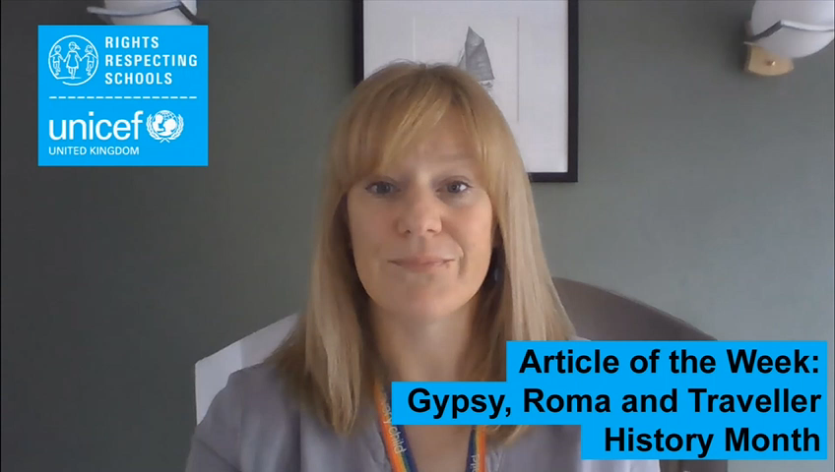

INTRODUCING GRT HISTORY MONTH
Kathy Allan, RRSA Professional Adviser, introduces Gypsy, Roma and Traveller History Month
Gypsy, Roma and Traveller History Month
Every June since 2008, people from across the UK have celebrated Gypsy, Roma and Traveller History Month. Through celebration, education and raising awareness, Gypsy, Roma and Traveller History Month helps tackle prejudice, challenge myths and amplify the voices of Gypsies, Roma and Travellers in wider society.
This year the theme for Gypsy, Roma and Traveller History Month is
'What Makes a Home?’
Click here to watch on YouTube

Slide 4



LINKED UNCRC ARTICLES
This week’s activities link to the following articles:
Article 2 (non-discrimination): The Convention applies to every child without discrimination, whatever their ethnicity, gender, religion, language, abilities or any other status, whatever they think or say, whatever their family background.
Article 8 (protection and preservation of identity):
Every child has the right to an identity. Governments must respect and protect that right, and prevent the child’s name, nationality or family relationships from being changed unlawfully.
Article 30 (children from minority or indigenous groups): Every child has the right to learn and use the language, customs and religion of their family, whether or not these are shared by the majority of the people in the country where they live.

Slide 5
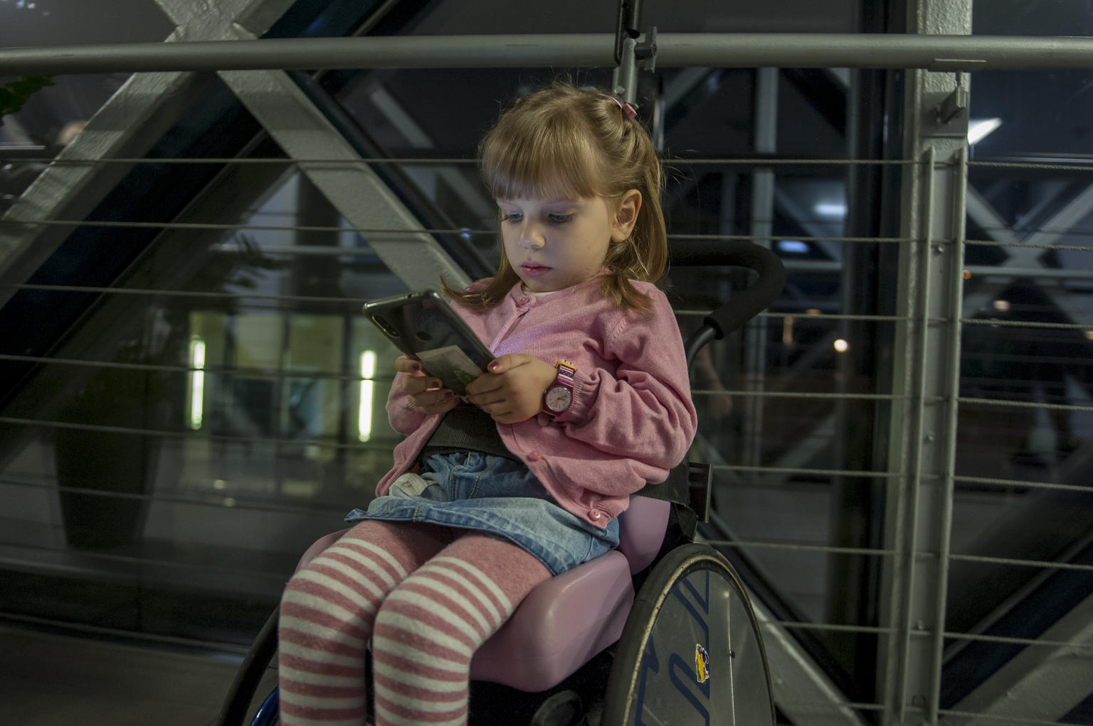
EXPLORING GRT HISTORY MONTH
This year’s theme for Gypsy, Roma and Traveller History Month is ‘What Makes a Home?’.
What do you think is needed for a place to feel like home?

Slide 6
How many of these did you get?
You feel safe there.
You know where everything is around you and locally.
The people there matter to you.
It’s where you feel you belong.
You feel comfortable there and can be yourself.
You can enjoy your right to relax and leisure.
It’s where you feel connected and have memories.
Did you have any other ideas?

Slide 7
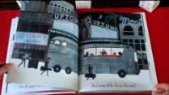
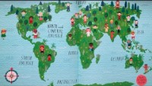
Create a piece of artwork, a poem, video or short story on the theme of ‘What Makes a Home?’. Check out this leaflet for more ideas and details on how to enter your work into a competition.
Discuss the idea of ‘home’. Perhaps start with the book Home by Carson Ellis (Read here). Draw a picture and create a display of the different homes lived in by the children in the class.
Children all over the world are very different, but they also have a lot in common. Put markers on a map of the world to show where you are from or where your parents or grandparents are from.
Watch this clip of Welcome to Our World by Moira Butterfield and celebrate the cultural backgrounds of all children in your class - What languages do you speak? What is your favourite family food?
Note: This activity is part of Global citizenship resources developed by Dreamachine and UNICEF UK. Find more here.
The CRC doesn’t mention a right to a home but Article 27 is all about a good standard of living. Look at the Convention and discuss which other articles link to the idea of having a home.

Slide 8

Watch this film about the history of Gypsy, Roma and Traveller people created by Travellers Times. Discuss how you think the film challenges negative stereotypical views about Gypsy, Roma or Traveller people. How could you use this film to promote inclusive attitudes and actions?
Choose one of these stories about different ideas of ‘home’ among the Gypsy Roma and Traveller community. Think about the life the person describes and what makes them proud of who they are. Share what you learn with your group.
Work in a group to create a mind-map to show how Articles 2, 8 & 30 link with everything you have been learning about Gypsy, Roma and Traveller people and communities.
Research famous individuals from Gypsy, Roma or Traveller people groups. What helped or hindered them accessing their rights as children and to gain the recognition that they have or had?

Slide 9

Explore these stories about different ideas of ‘home’ among the Gypsy Roma and Traveller community. Think about the life the person describes and what makes them proud of who they are. Share what you learn with your group.
As a class discuss the theme of this year’s Gypsy, Roma and Traveller History Month ‘What Makes a Home?’
What does home mean to you? Create a piece of artwork, a poem, video or short story on the theme of ‘What Makes a Home?’. Check out this leaflet for more ideas and details on how to enter your work into a competition.
Use the resources from this year’s Gypsy, Roma and Traveller History Month to create a display or a short assembly to raise awareness within your school community.
The CRC doesn’t mention a right to a home, but Article 27 is all about a good standard of living.
Look at the Convention and discuss which other articles link to the idea of having a home.

Slide 10
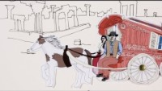
70% of Gypsy, Roma and Traveller children have faced discrimination at school.
How does this impact on their right to education? How does your school ensure that all children including those from a Gypsy, Roma and Traveller heritage are welcomed and accepted? How can children’s right to education be balanced with their cultural heritage and way of life?
Take a look at this timeline and watch this animation about key moments in the history of Gypsy Roma and Traveller communities. Make a note of five facts that interest you and share them with your class.
The comedian Jimmy Carr was recently criticised for making an offensive joke about Roma people. Were you aware that approximately 500,000 Roma and Sinti people were negatively impacted under the Nazi regime? Find out here about a campaign calling for Roma and Sinti genocide to be included in the national curriculum.
Discuss in class whether you agree with this campaign.
Work in a group to create a mind-map to show how Articles 2, 8 & 30 link with everything you have been learning about Gypsy, Roma and Traveller people and communities.

Slide 11
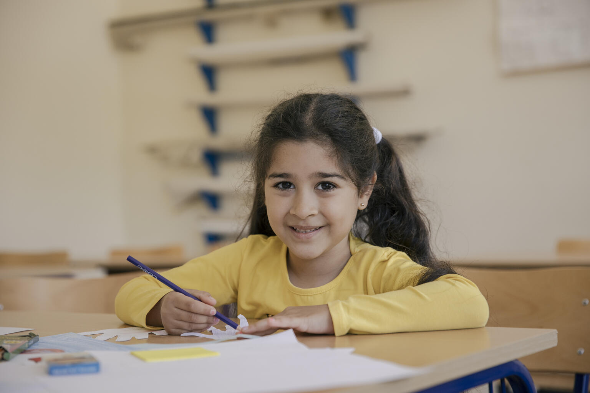
REFLECTION
Have a think about what you have learnt during GRT History Month.
What does home mean to you?
Think about a time when somebody made you feel ‘at home’.
What does it take to welcome others?
How can you be even more welcoming of people you meet?
How can your school community be even more welcoming of everyone?
@UNICEF/UN0482317

Slide 12
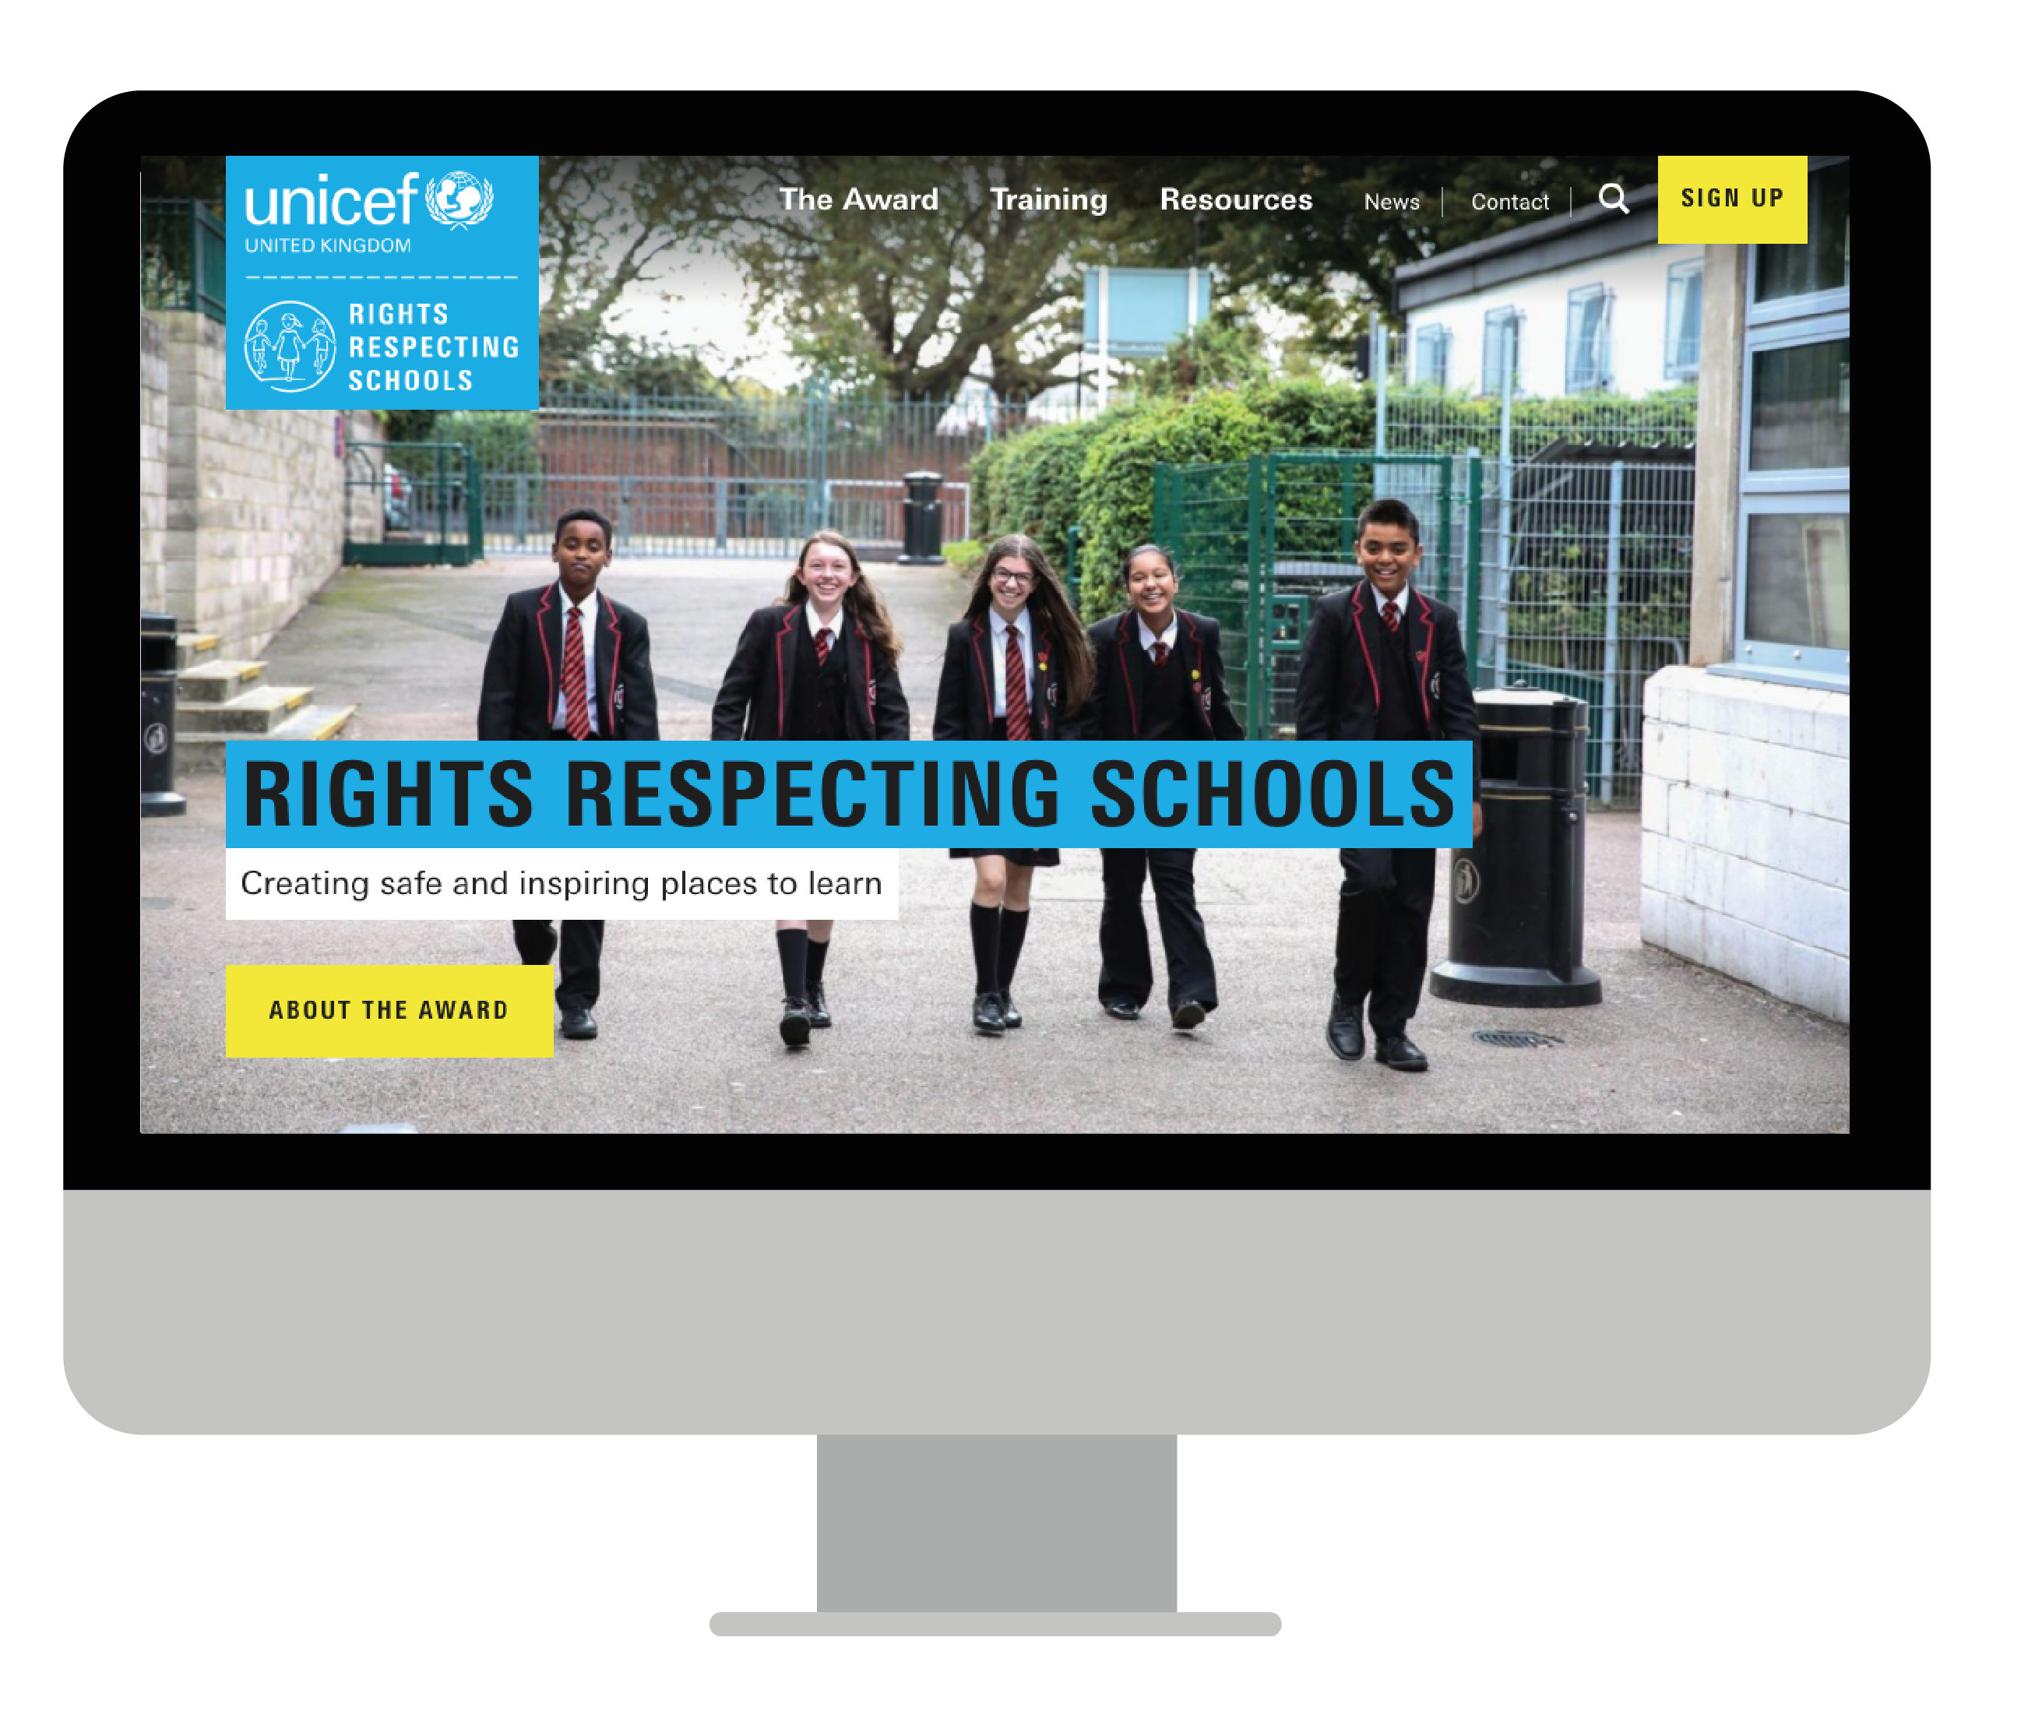
MORE INFO…
RRSA WEBSITE
For more information or to download previous Article of the Week packs please visit the RRSA website by clicking the link below
CLICK HERE

Slide 13
Thank you
UNICEF UK/Dawe
Notes:
UNICEF UK/Dawe

