Slide 1
© UNICEF/UN0647017

Slide 2
Slide 3 – Guess the article
Slide 4 – Introducing Articles 24&33
Slide 5 – OutRight 2022/23
Slide 6 – Exploring Articles 24&33
Slide 7 – Some possible answers
Slides 8&9 – Primary Activities
Slides 10&11 – Secondary Activities
Slide 12 – Reflection

Slide 3
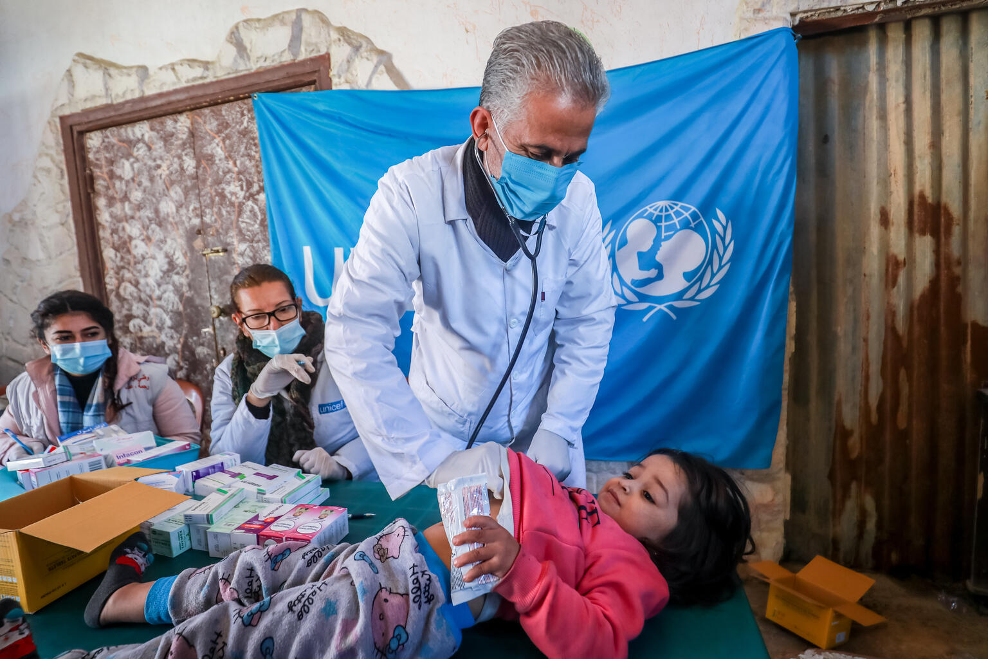
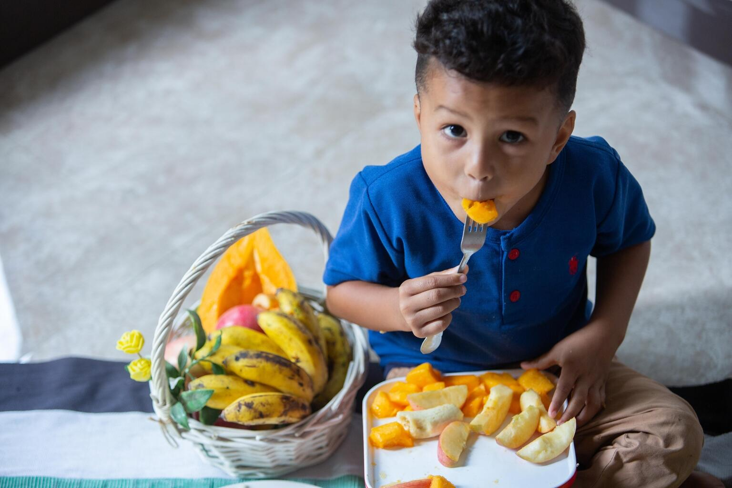
Guess the Articles
These pictures provide a clue to this week’s articles.
How do these pictures help you? Can you guess how they are linked together?
Write down your thoughts or discuss with someone in your class.
@UNICEF/ UN0585591
@UNICEF/ UN0517564
@Pexels

Slide 4
INTRODUCING ARTICLES 24 & 33
Article 24 (health and health services): Every child has the right to the best possible health. Governments must provide good quality health care, clean water, nutritious food, and a clean environment and education on health and well-being so that children can stay healthy.
Article 33 (drug abuse): Governments must protect children from the illegal use of drugs and from being involved in the production or distribution of drugs. States Parties shall take all appropriate measures, including legislative, administrative social and educational measures, to protect children from the illicit use of narcotic drugs and psychotropic substances as defined in the relevant international treaties, and to prevent the use of children in the illicit production and trafficking of such substances.
Grace Hunt, UNICEF UK Youth Campaigns Officer, introduces Articles 24 & 33
Click here to watch on YouTube

Slide 5
OUTRIGHT 2022/23
OutRight is UNICEF UK’s annual youth campaign. By signing up to this year’s campaign, you can learn about and campaign on all children’s right to the best possible health.
We all want to feel as well as possible, mentally and physically, but this isn’t possible for many children. Half of the world goes without access to the healthcare they need, so there are millions of children who can’t visit a nurse when they’re poorly or may miss out on vaccinations.
Through free learning activities, campaigning and live events, discover what we can do so that all children have their right to the best possible health fulfilled.
Sign up here.

Slide 6
EXPLORING ARTICLES 24 & 33
People use medicines, vaccines and drugs for lots of different positive reasons. What reasons can you think of?

Slide 7
Did you think of these?
To treat an illness
To protect them from infection and possible illness
To make sure they get the right vitamins
To help them sleep better
To feel relief from pain
To help treat serious mental ill-health
To protect them from allergies or allergic reaction.
Did you get any of these? What other answers did you have?

Slide 8
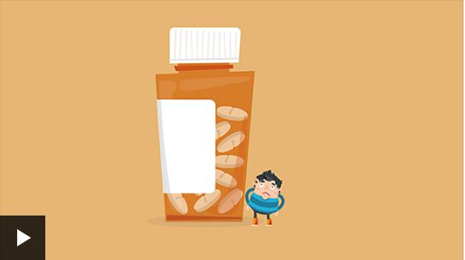
Think about the different ways you keep healthy. Create a poster to share in school or at home promoting the benefits of your favourite activity. Can you also link this to your rights?
Read or listen to Joe Wicks’ Burpee Bears. Talk about or write down the different things the bears did to help them to be healthy.
There are lots of people, things and actions that help us to keep healthy or get better when we are unwell or injured. Create a list of these and them make a display linked to Article 24. Here are a few ideas to get you started: doctor, dentist, inhaler, crutches...
In circle time or as a class talk about being safe and healthy. Discuss medicines and why taking some substances can be dangerous. Have a look with your class at this information from BBC Bitesize.

Slide 9
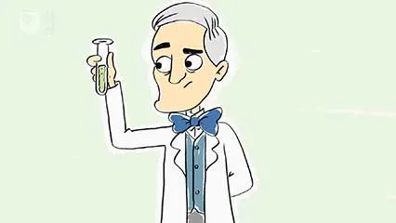
Alexander Fleming discovered penicillin in 1928. Read about him and watch the video in this profile. Research how penicillin and antibiotics are used today. Create a fact file to share the importance of antibiotics.
Discuss in groups what you can do if you are worried about someone’s health.
Who would you talk to?
Where can you go for support?
Smoking is illegal if you are under 18. There are many reasons for this. Smoking has also been banned in enclosed public spaces and in cars with children. Do you know the laws? Check out this website for further information and discuss what you have learnt.
In pairs think of five reasons why children might be tempted to use tobacco, alcohol or illegal drugs. Share your ideas within the class. Act out how you might persuade someone not to smoke or drink alcohol.

Slide 10
OutRight 2022/23 focuses on children’s right to the best possible health all around the world. Explore the Right to the Best Possible Health from UNICEF’s secondary assemblies programme. Use ideas from this to create your own form assembly.
Read about alcohol and tobacco on the Voices of Youth website. Create a fact file or a poster to share some of the facts on the website.
Why do you think some young people smoke, drink or take drugs? Discuss this with friends or your class. Can you run a campaign to raise awareness of the risks? Consider speaking to your school council or groups outside school to build support and encourage change.
Reflect on the different ways your school can help you to learn about keeping healthy and on opportunities to participate in activities, establishing healthy habits. Create a leaflet or policy for new pupils about Being Healthy in... (your school).

Slide 11
The NHS Youth Forum consists of 25 young people who have a passion for improving health services for young people. Watch this video. What are the most important health issues to you? What needs to change? What can you do to raise awareness/take action?
Discuss in class.
What would you do if you were worried about a friend who you thought might be taking illegal drugs? Talk about it in your class. This website might help you think about steps you could take to support a friend.
Over the years there have been lots of developments that help us keep healthy. Think about all the different elements of healthcare we have available in the UK and compare with those in another country. Share what you have learnt. How do children in the UK and the country you chose to explore get to experience Article 24 and 33?
Have a look at the articles of the Convention and highlight which other rights are linked to being healthy and protected from harmful drugs. Feedback your findings to your class.

Slide 12
REFLECTION
Give yourself some time out to reflect on your health and the harmful impact of illegal drugs.
How does your school help keep you healthy?
How do you encourage friends to make healthy choices?
In what different ways you value and appreciate your health and wellbeing?
UNICEF UK/Dawe

Slide 13
MORE INFO…
RRSA WEBSITE
For more information or to download previous Article of the Week packs please visit the RRSA website by clicking the link below
CLICK HERE

Slide 14
Thank you
UNICEF UK/Dawe
Notes:
UNICEF UK/Dawe

