Slide 1
UNICEF/ UN0599548

Slide 2
Slide 3 – Introducing World Refugee Day
Slide 4 – Introducing the articles
Slide 5 – Exploring World Refugee Day question
Slide 6 – Exploring World Refugee Day answers
Slides 7&8 – Primary Activities
Slides 9&10 – Secondary Activities
Slide 11 – Reflection

Slide 3
INTRODUCING WORLD REFUGEE DAY
Jenny Price, RRSA Professional Adviser, introduces World Refugee Day
World Refugee Day
World Refugee Day is an international day designated by the United Nations to honour refugees around the globe. It falls each year on June 20 and celebrates the strength and courage of people who have been forced to flee their home country to escape conflict or persecution. World Refugee Day is an occasion to build empathy and understanding for their plight and to recognize their resilience in rebuilding their lives.
This year, the focus will be on the right to seek safety. Every person on this planet has a right to seek safety - whoever they are, wherever they come from and whenever they are forced to flee.
Click here to watch on YouTube

Slide 4
LINKED UNCRC ARTICLES
This week’s activities link to the following articles:
Article 22 (refugee children)
If a child is seeking refuge or has refugee status, governments must provide them with appropriate protection and assistance to help them enjoy all the rights in the Convention. Governments must help refugee children who are separated from their parents to be reunited with them.
Article 10 (family reunification)
Governments must respond quickly and sympathetically if a child or their parents apply to live together in the same country. If a child’s parents live apart in different countries, the child has a right to visit and keep in contact with both of them.

Slide 5
EXPLORING WORLD REFUGEE DAY
What events may lead to children and their families becoming refugees?

Slide 6
How many of these did you get?
Natural disaster e.g. flood, hurricane, earthquake, tsunami, volcanic activity, snow storm, bushfire and others
Drought, famine – lack of food and water
War and conflict
Climate change – changes in weather affect access to food, water and education
Did you have any other ideas?
Discrimination: racism, religious beliefs; gender; homophobia; nationality (xenophobia); political beliefs
Civil unrest in a country making people feel unsafe
Poverty or loss of income
Family disputes or problems

Slide 7
There are many rights related to being kept safe and protected from harm. Do you have a special place where you feel really safe? Maybe at home or a grandparent’s home, or somewhere else? Draw a picture of where you feel safe.
Watch this video explaining what a refugee is. Can you create your own animation or a simple PowerPoint presentation to help younger children in your school understand who are refugees?
If you had to flee your home suddenly, what would you take with you? Draw or list what you would take and remember that you might have to carry it a long way. Compare your list with other people in your class.
Watch and listen to My Name is Not Refugee or Help them Feel at Home. Use the themes of the stories to open up a simple exploration of what it is to be a refugee.

Slide 8
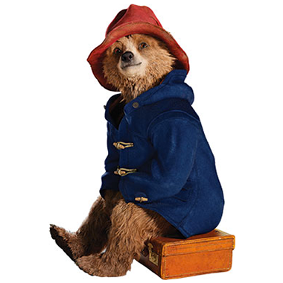
Imagine a new refugee family is arriving in your neighbourhood. Write a letter to welcome them. Tell them everything they need to know about - places to visit, who can help and perhaps a bit about yourself too.
Paddington was a refugee. Read some of his story or watch the Paddington film and then discuss how you think Paddington felt when he was in the lifeboat after leaving Aunt Lucy in Peru or how he felt being at the train station on his own. How do you think he felt when he met the Brown family?
Article 22 is about governments supporting refugee children to enjoy all of their rights and to make sure they are reunited with their parents – what do you think the Government should be doing to support refugee children who arrive in the UK? Draw a mind map or write a list of everything you think they will need to be kept safe and feel welcomed.
Do some research to find out the meaning of the following terms:
Refugee – Asylum seeker – Immigrant – Economic migrant
Create a display to show what you have found out.

Slide 9
Use this information from UNICEF to find out about how and why some people become refugees and how UNICEF supports them.
Create a display or a piece of drama or music to raise awareness in your school.
Explore the wording of articles 22 and 10. Discuss and share what stands out for you. How could you raise awareness of these articles in your school and locally?
Have a look at this list of stories about refugees. Choose one you would like to read and perhaps write a short book review to share with others.
Discuss with your school librarian ways of including more books from the perspective of refugees in your school library.
Read this blog from Voices of Youth, UNICEF’s community for and by young people.
How can you support refugees in your school and community?

Slide 10
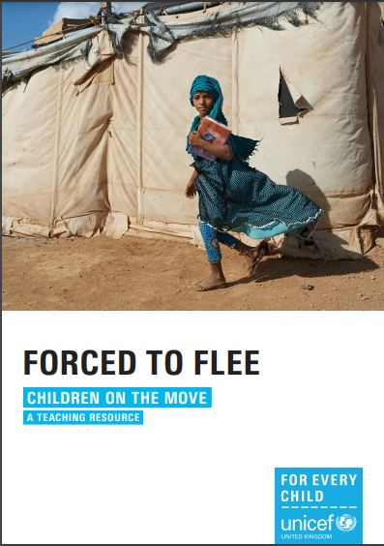
The Refugee Convention defines a refugee in 51 words. In pairs, come up with your own definition of a refugee, using no more than 51 words.
Once the definitions have been drafted, compare your choice of words with each other’s, and with the actual text of the 1951 Refugee Convention.
Download the UNICEF UK resource Forced to Flee. Work with a group to plan a lesson or an assembly to mark the World Refugee Day in your school. You might like to start with getting people to understand and use the accurate terminology on page 4.
In small groups think about the practical obstacles refugees may face, including dangers within their home country, methods of travel, food and shelter, language differences, weather, border controls and caring for sick and vulnerable family members, including children. Which children’s rights might be under threat?
Can you think of suggestion on how they may be protected?
Simple Acts are everyday actions we can all do to stand with refugees and make new connections in our communities. Have a look at the list here and choose which simple act you will do to show support. Or can you come up with your own?

Slide 11
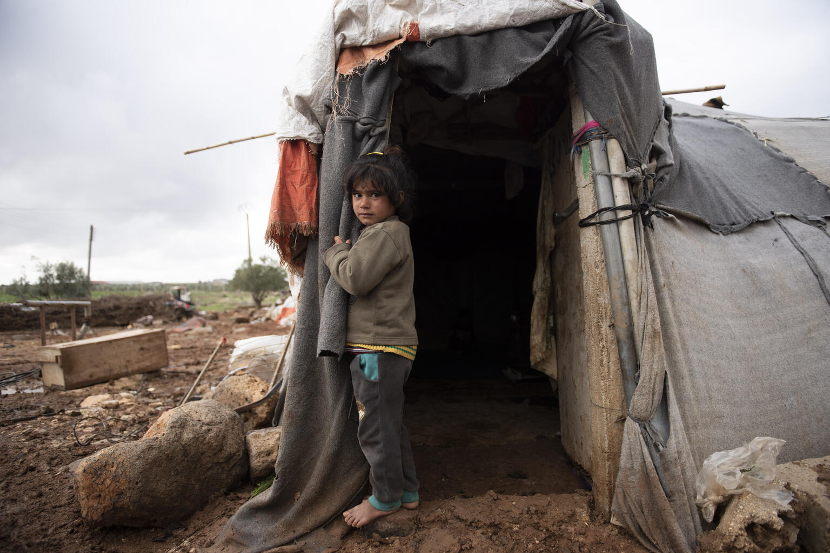
REFLECTION
The theme of this year’s World Refugee Day is the right to seek safety.
Spend a few minutes thinking about what makes you feel safe.
How can we learn more about the lives of other people whose experiences may be very different to ours?
How can all children, including refugees be helped to feel safe?
@UNICEF/UN0430189

Slide 12
MORE INFO…
RRSA WEBSITE
For more information or to download previous Article of the Week packs please visit the RRSA website by clicking the link below
CLICK HERE

Slide 13
Thank you
UNICEF UK/Dawe
Notes:
UNICEF UK/Dawe

