Slide 1
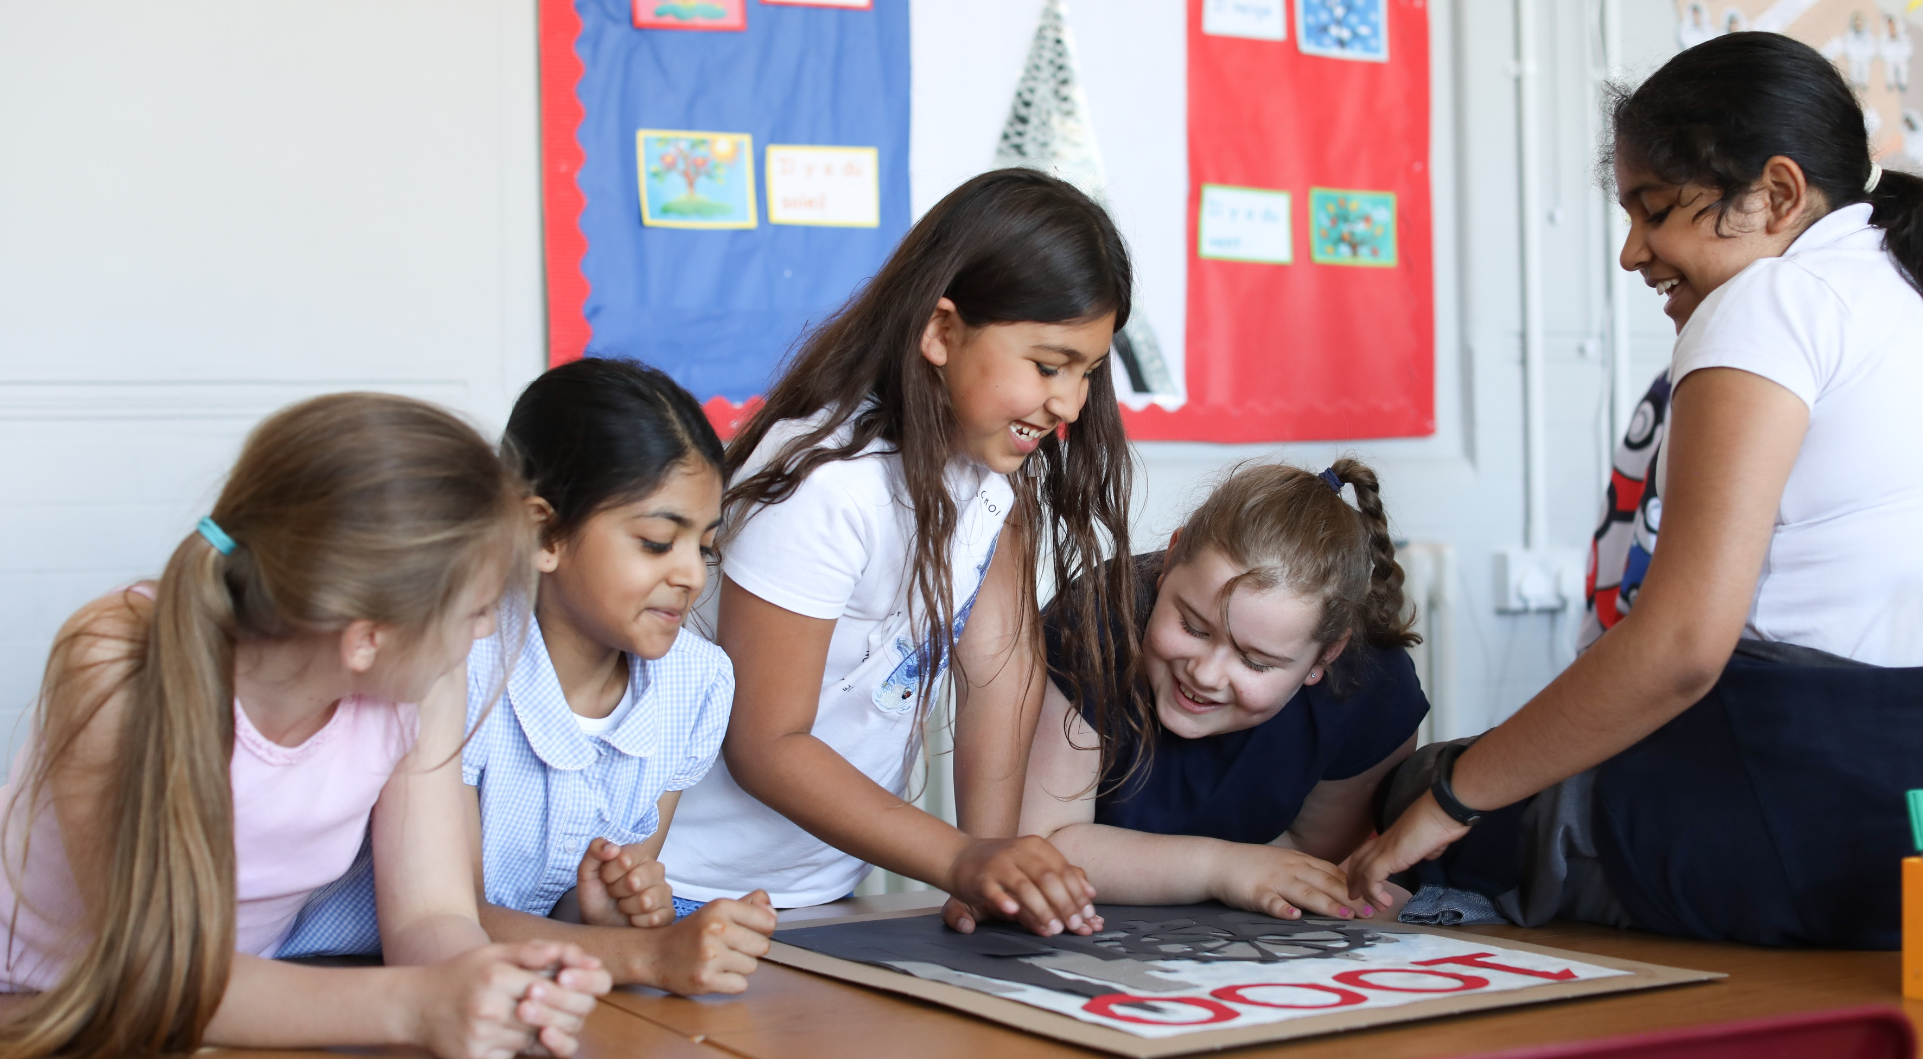


  WELCOME
  TO OUTRIGHT
© UNICEF/Dawe
United Kingdom Committee for UNICEF (UNICEF UK), Registered Charity No. 1072612 (England & Wales), SC043677 (Scotland).

Slide 2
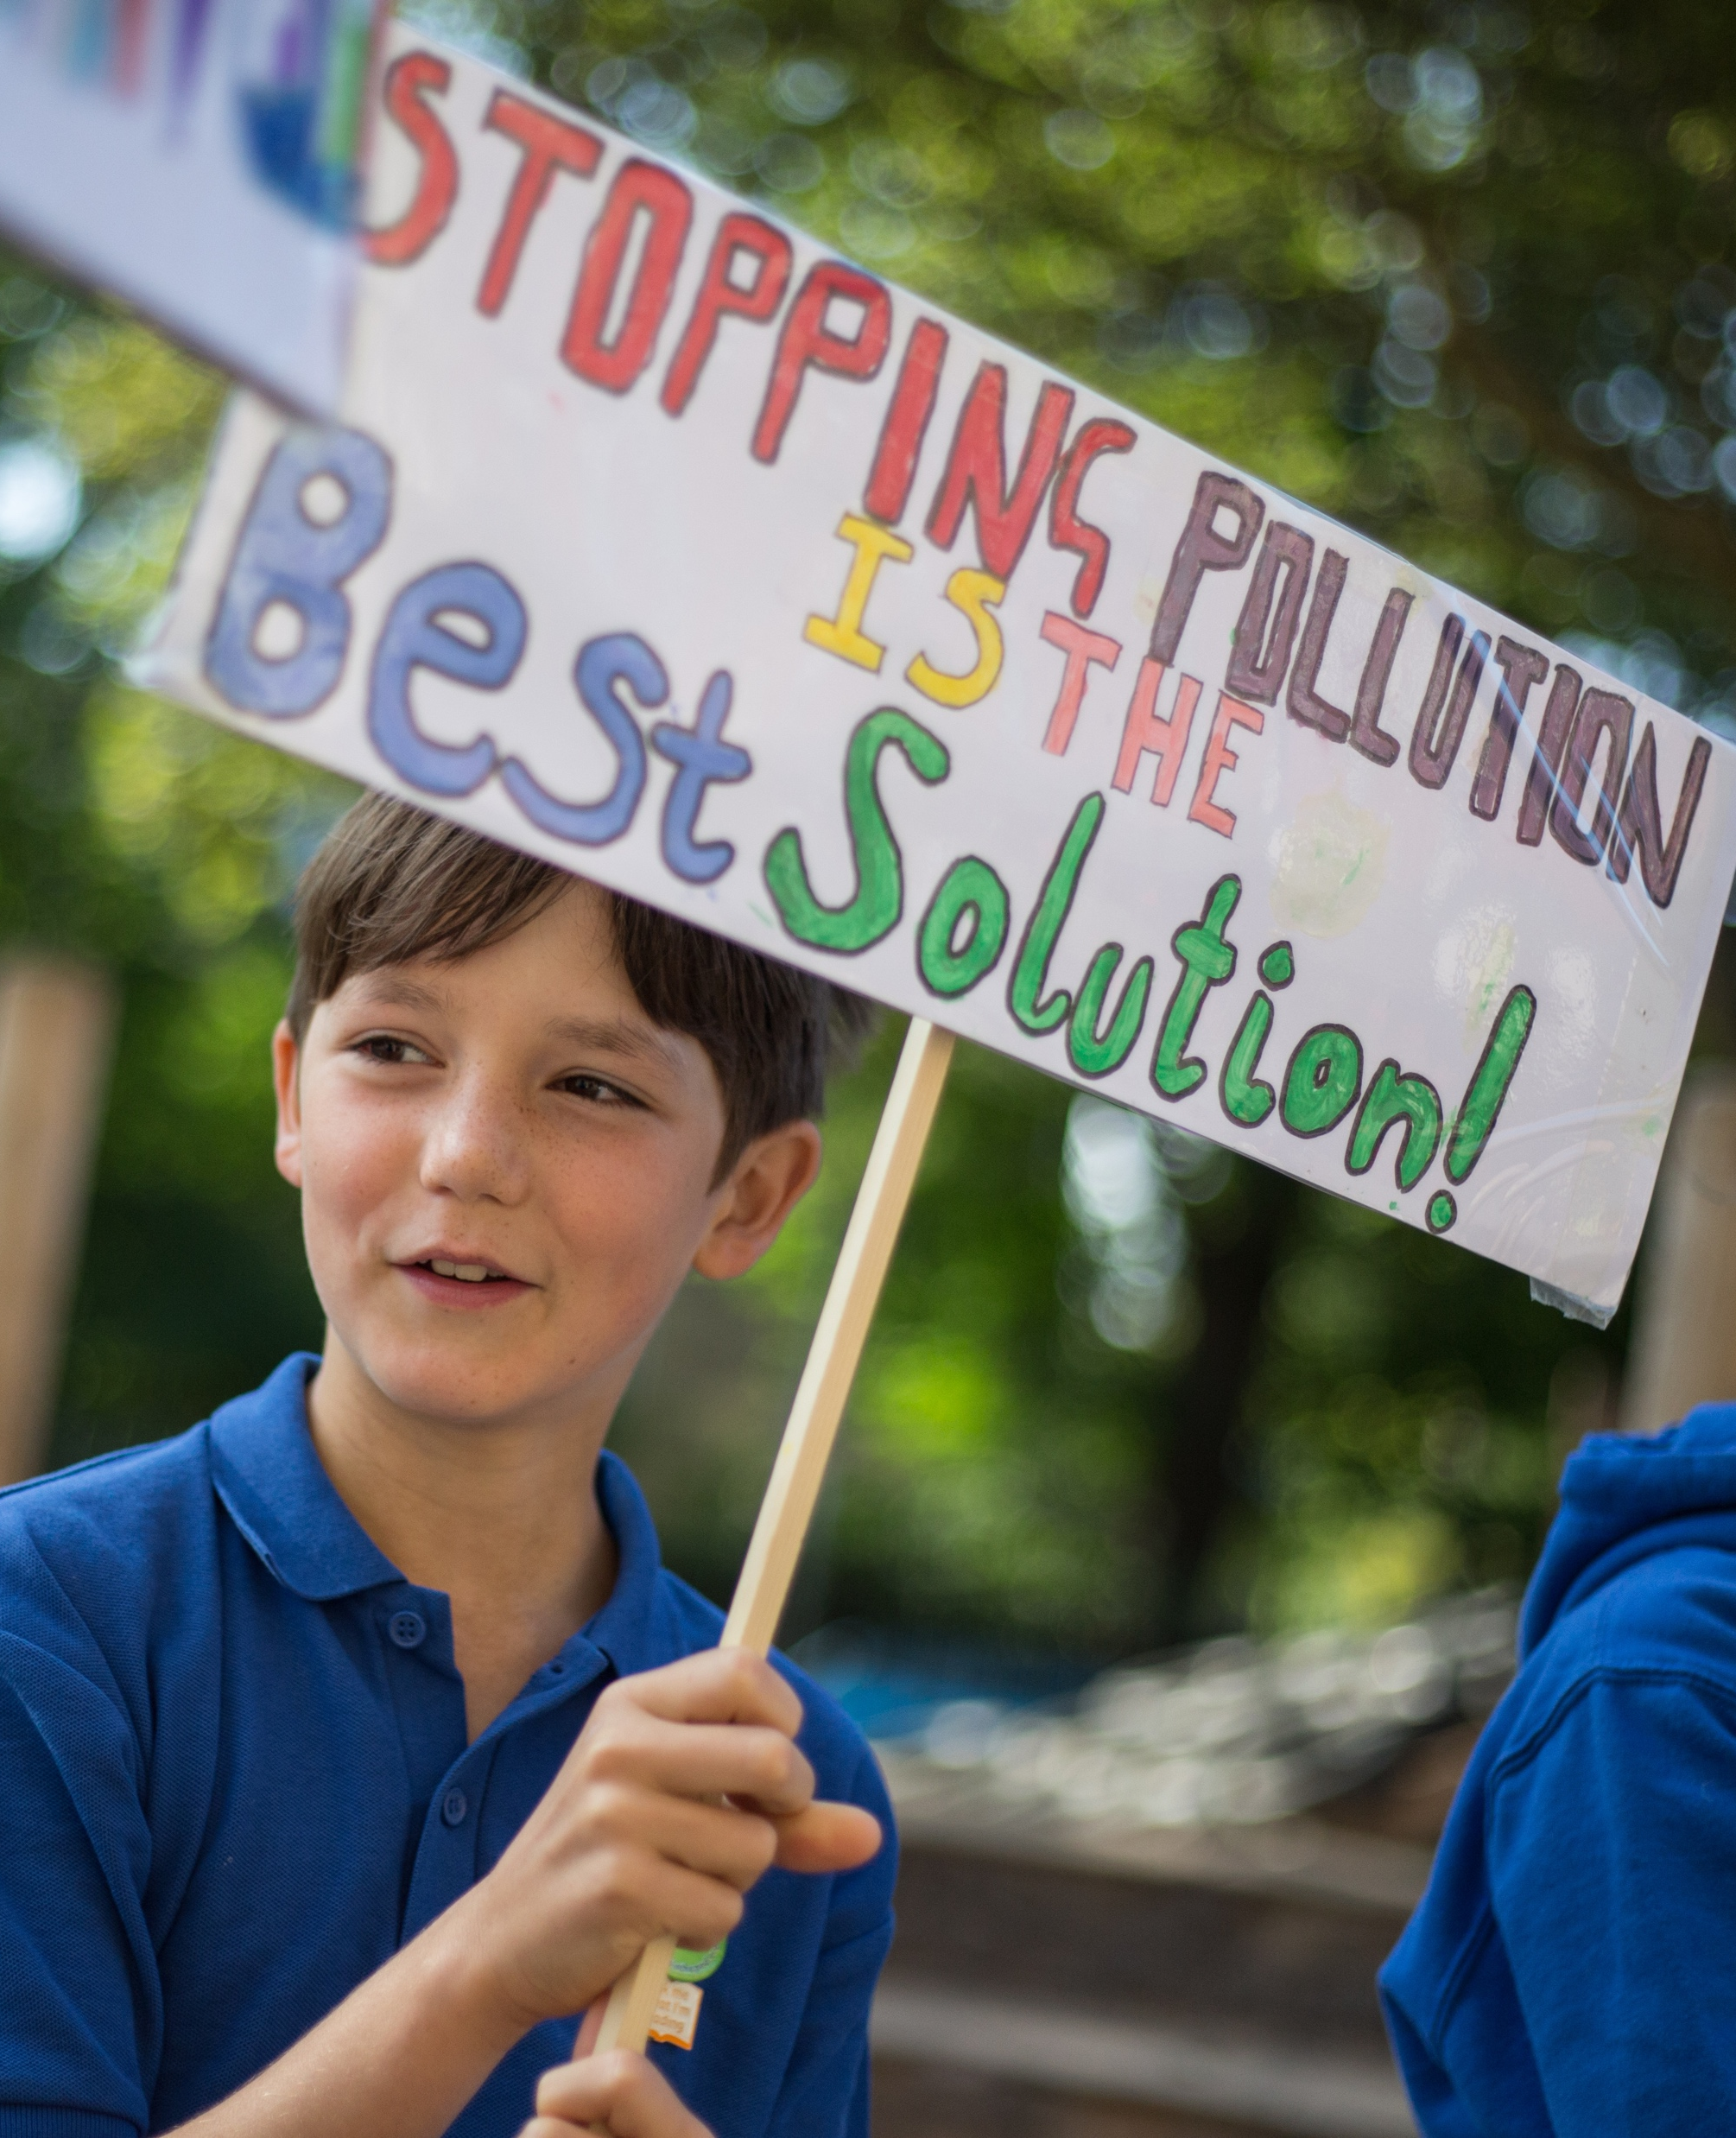

WHAT IS OUTRIGHT?
OutRight is a youth campaign run by UNICEF UK that helps children and young people to speak out about children’s rights across the world.
It’s a campaign by children, for children.
© UNICEF/Sutton-Hibbert
© UNICEF/Dawe

Slide 3
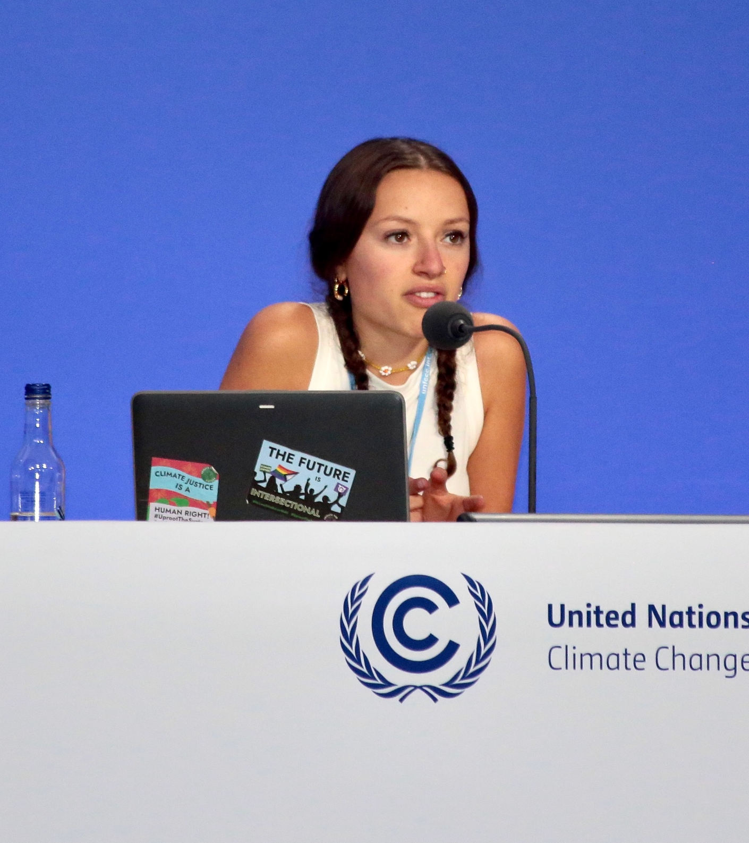
MAKE YOUR VOICE
© UNICEF/Elwyn-Jones
HEARD!
OutRight will help children like you to stand up for the rights of children in the UK and around the world, with the support of our campaign champion, Paddington Bear.
This year, OutRight is all about all children’s right to the best possible health.
© UNICEF/Diarassouba

Slide 4

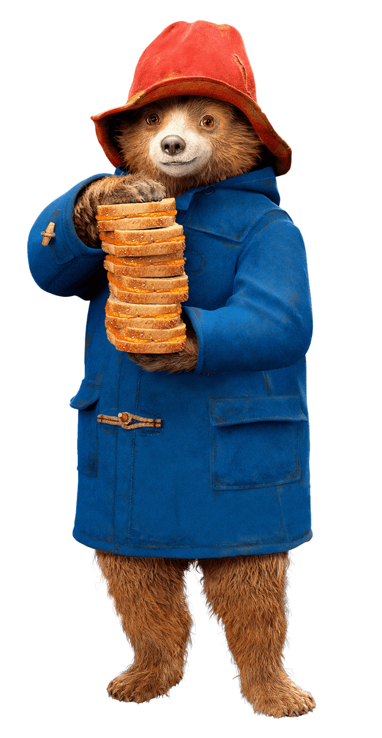

Paddington’s kindness and openness to different cultures makes him a great champion for children.
Like UNICEF UK, he wants you to use your voices to make the world a better place.
Notes:
Paddington knows the pandemic has been hard on everyone.
Can you think of any things you weren’t able to do because of the pandemic? In some parts of the world children weren’t able to see a doctor when they needed to.
Paddington knows how important it is to be healthy, so, as we get back to a more ‘normal’ way of life, hand in paw with Paddington, we’ll learn about what needs to be done to make sure all children have the best possible health.

Slide 5
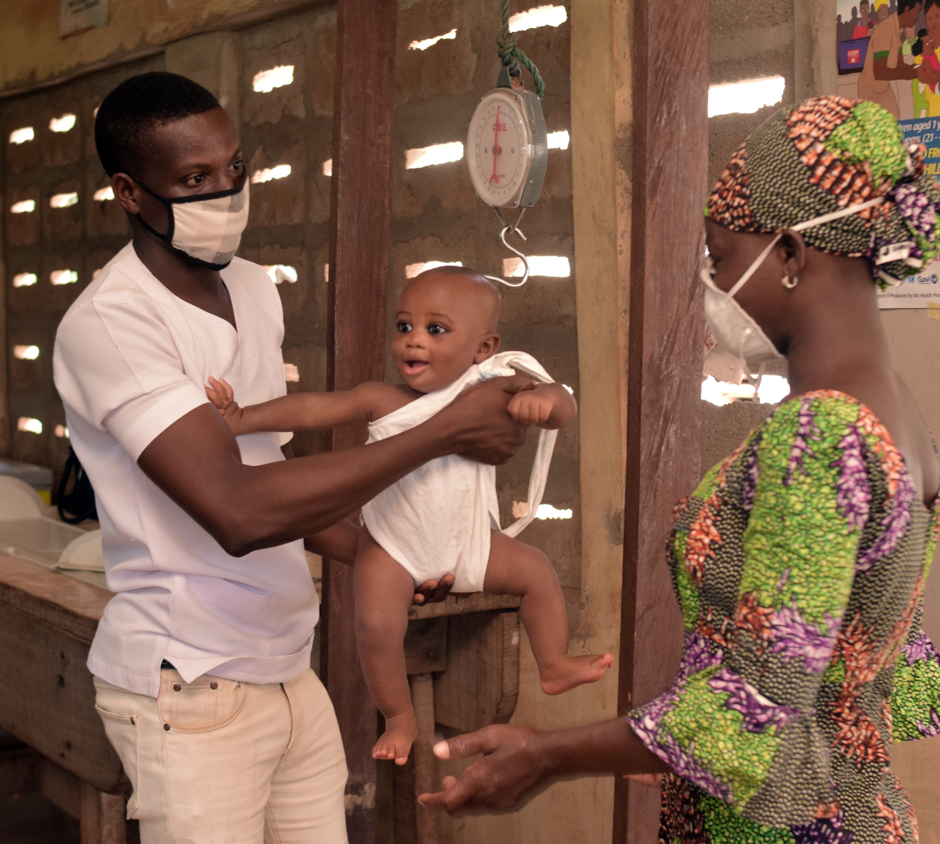
WHY IS IT IMPORTANT TO BE HEALTHY?
We all want to stay healthy and feel well.
We’ll all feel ill sometimes, too. But it’s important that, when we do, we can get help to get better.
That means we need a good health system, with:
- nurses, doctors, dentists, opticians…
- hospitals and clinics…
- medicines, vaccines, bandages, crutches…
If children don’t have these things, they might miss out on school, and playing outside with friends – things they have the right to be able to do!
© UNICEF/Dejongh

Slide 6
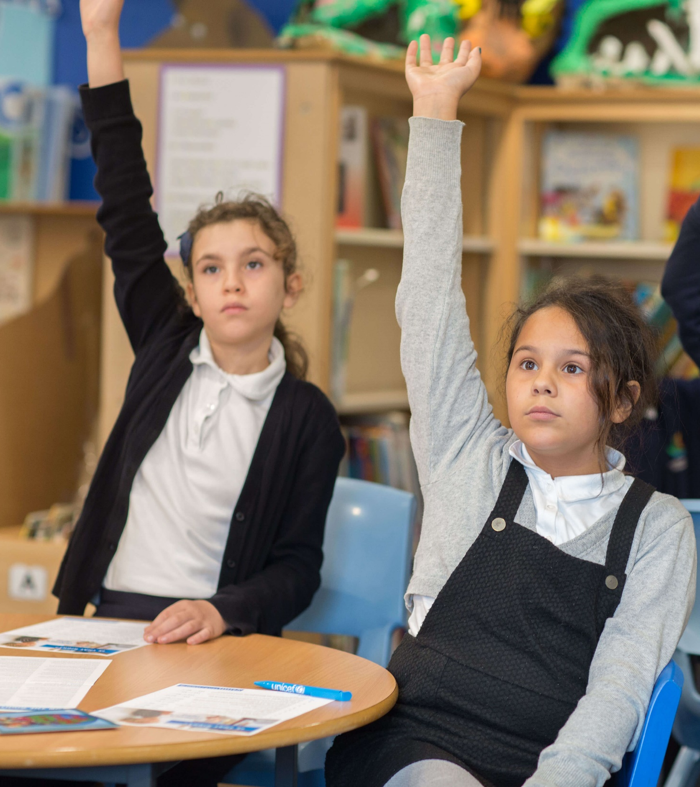

TAKING PART IN OUTRIGHT
We will:
Learn about all children’s right to the best possible health
Learn how the pandemic has affected this
Speak out and take action, and hear about other children and young people who are doing the same
© UNICEF/Dawe

Slide 7
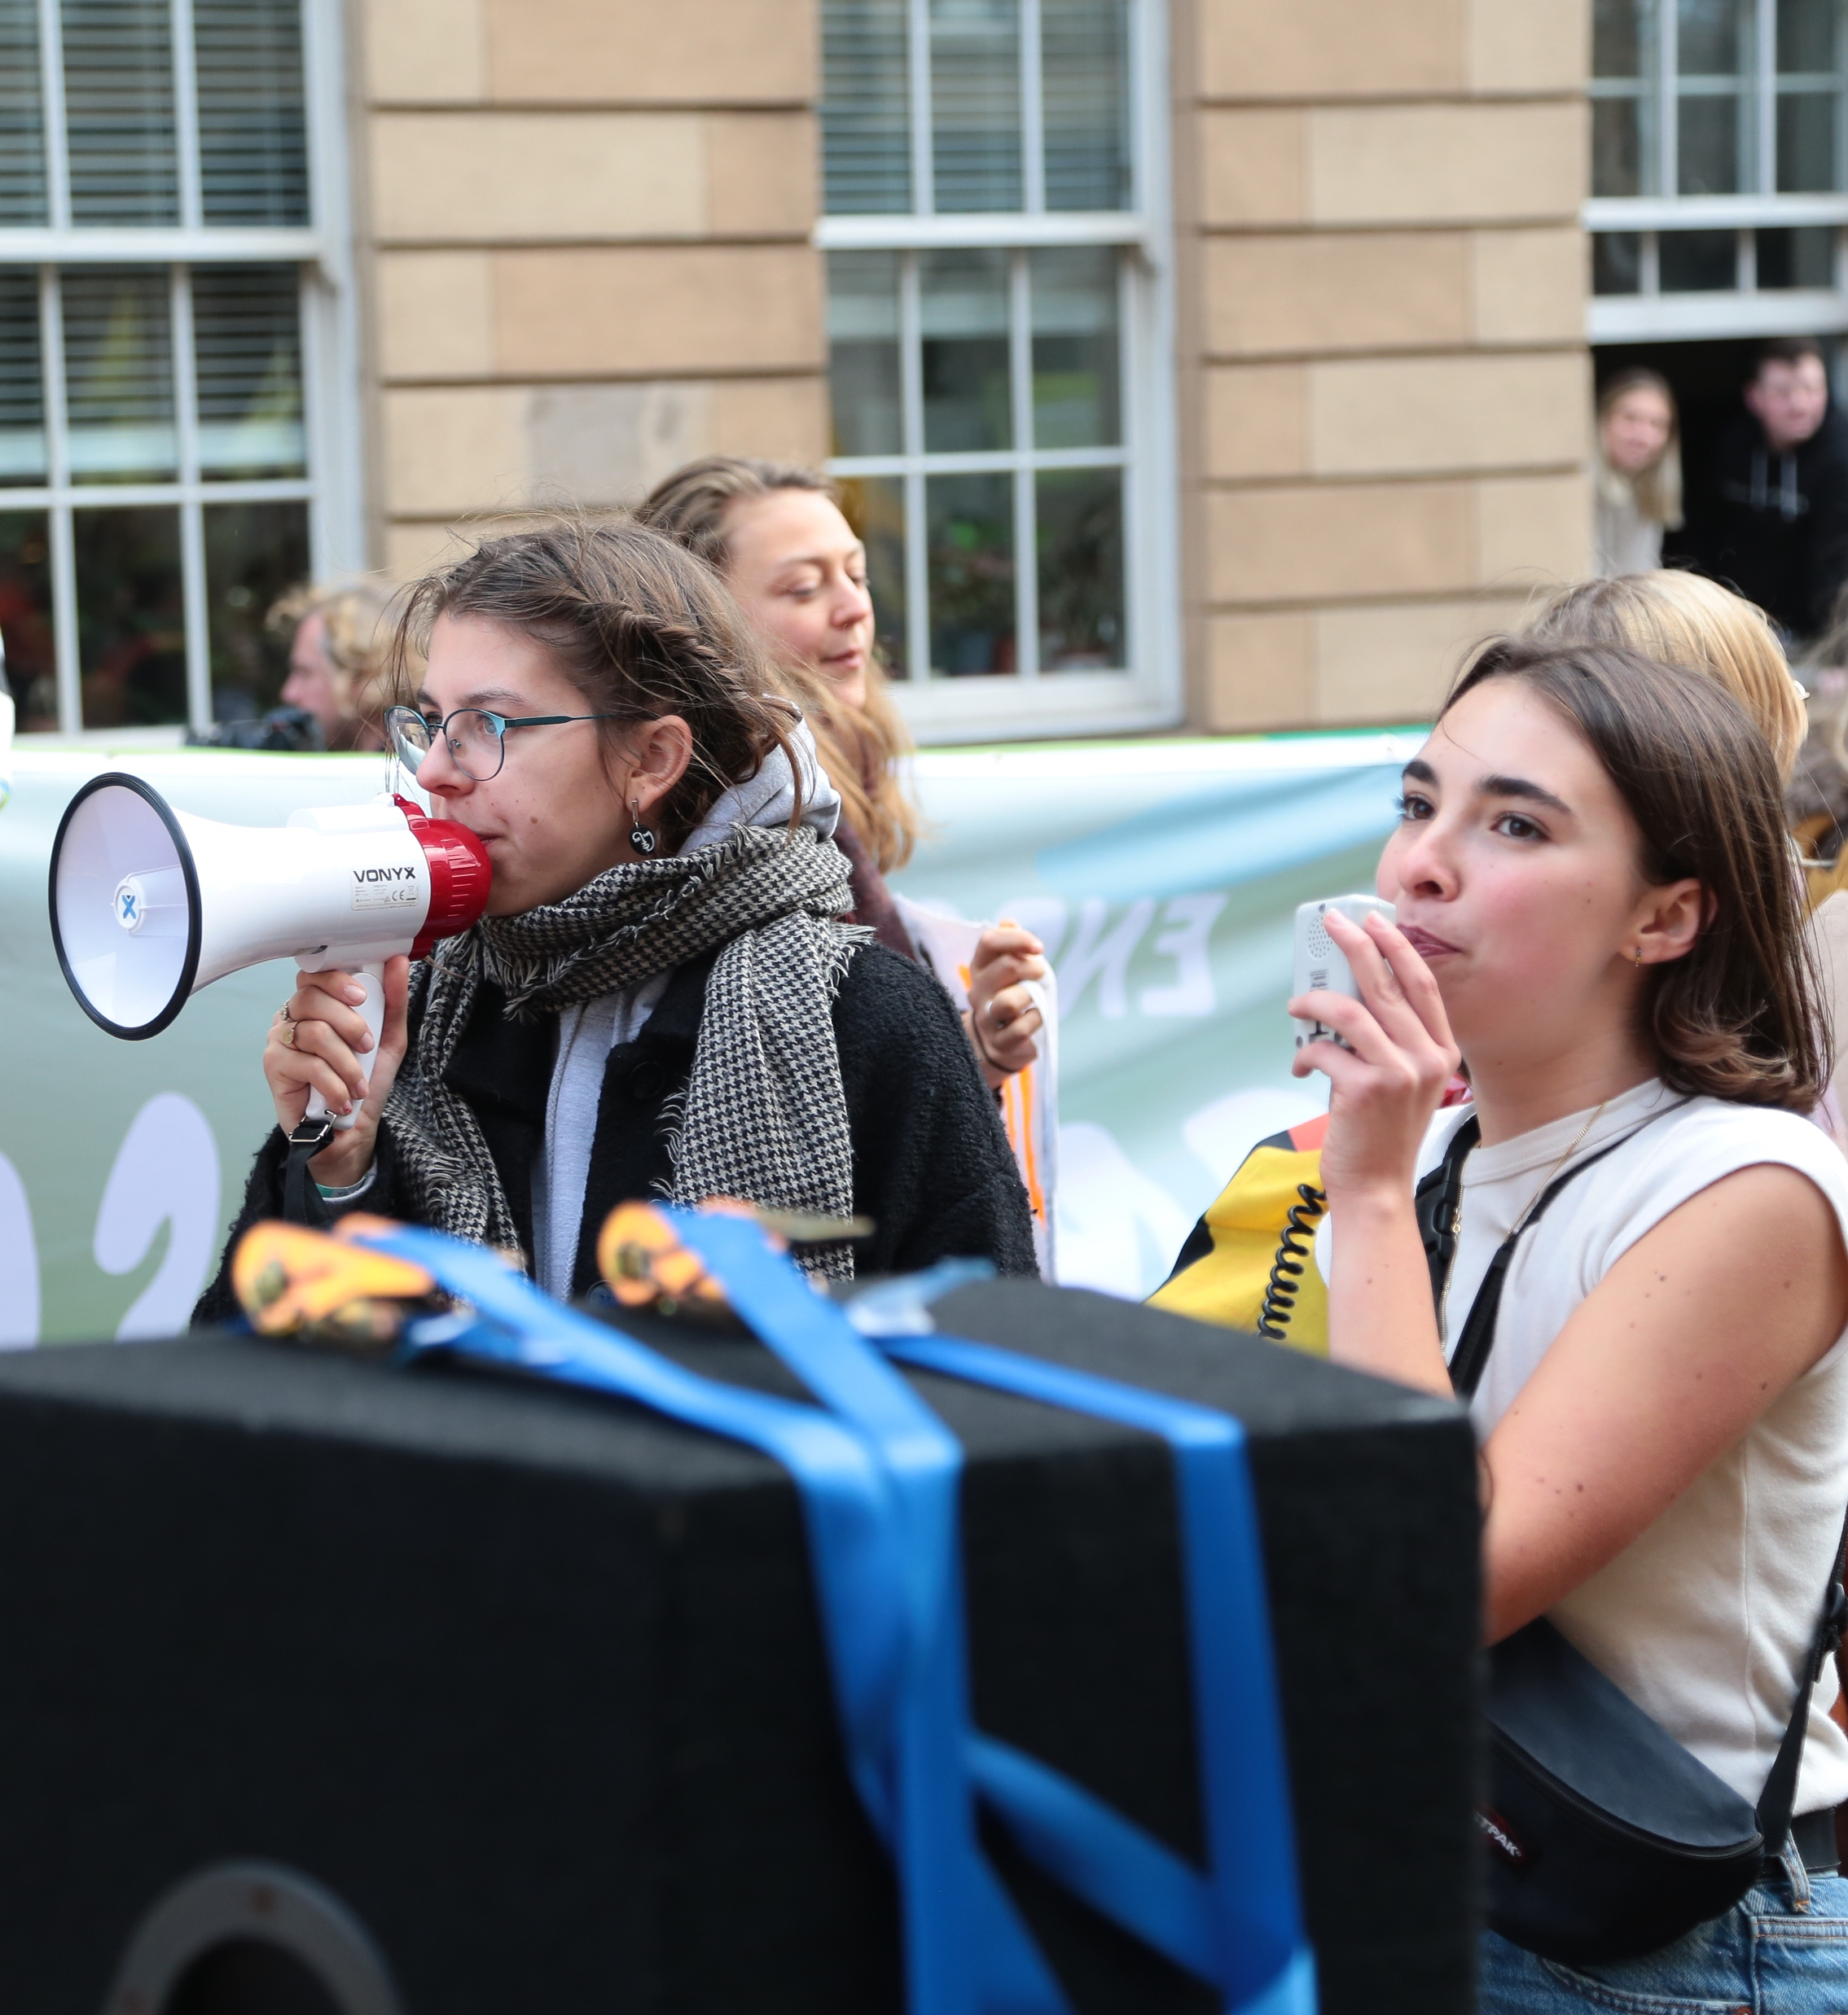
WHAT IS
© UNICEF/Elwyn-Jones
CAMPAIGNING?
Campaigning is about taking specific and organised actions (like taking part in OutRight!) to bring about positive change on an issue, and influence those in power to act.
Going to a march, writing to your
MP or local councillor, or signing a petition are all ways we can campaign for change.
© UNICEF/Nesbitt

Slide 8
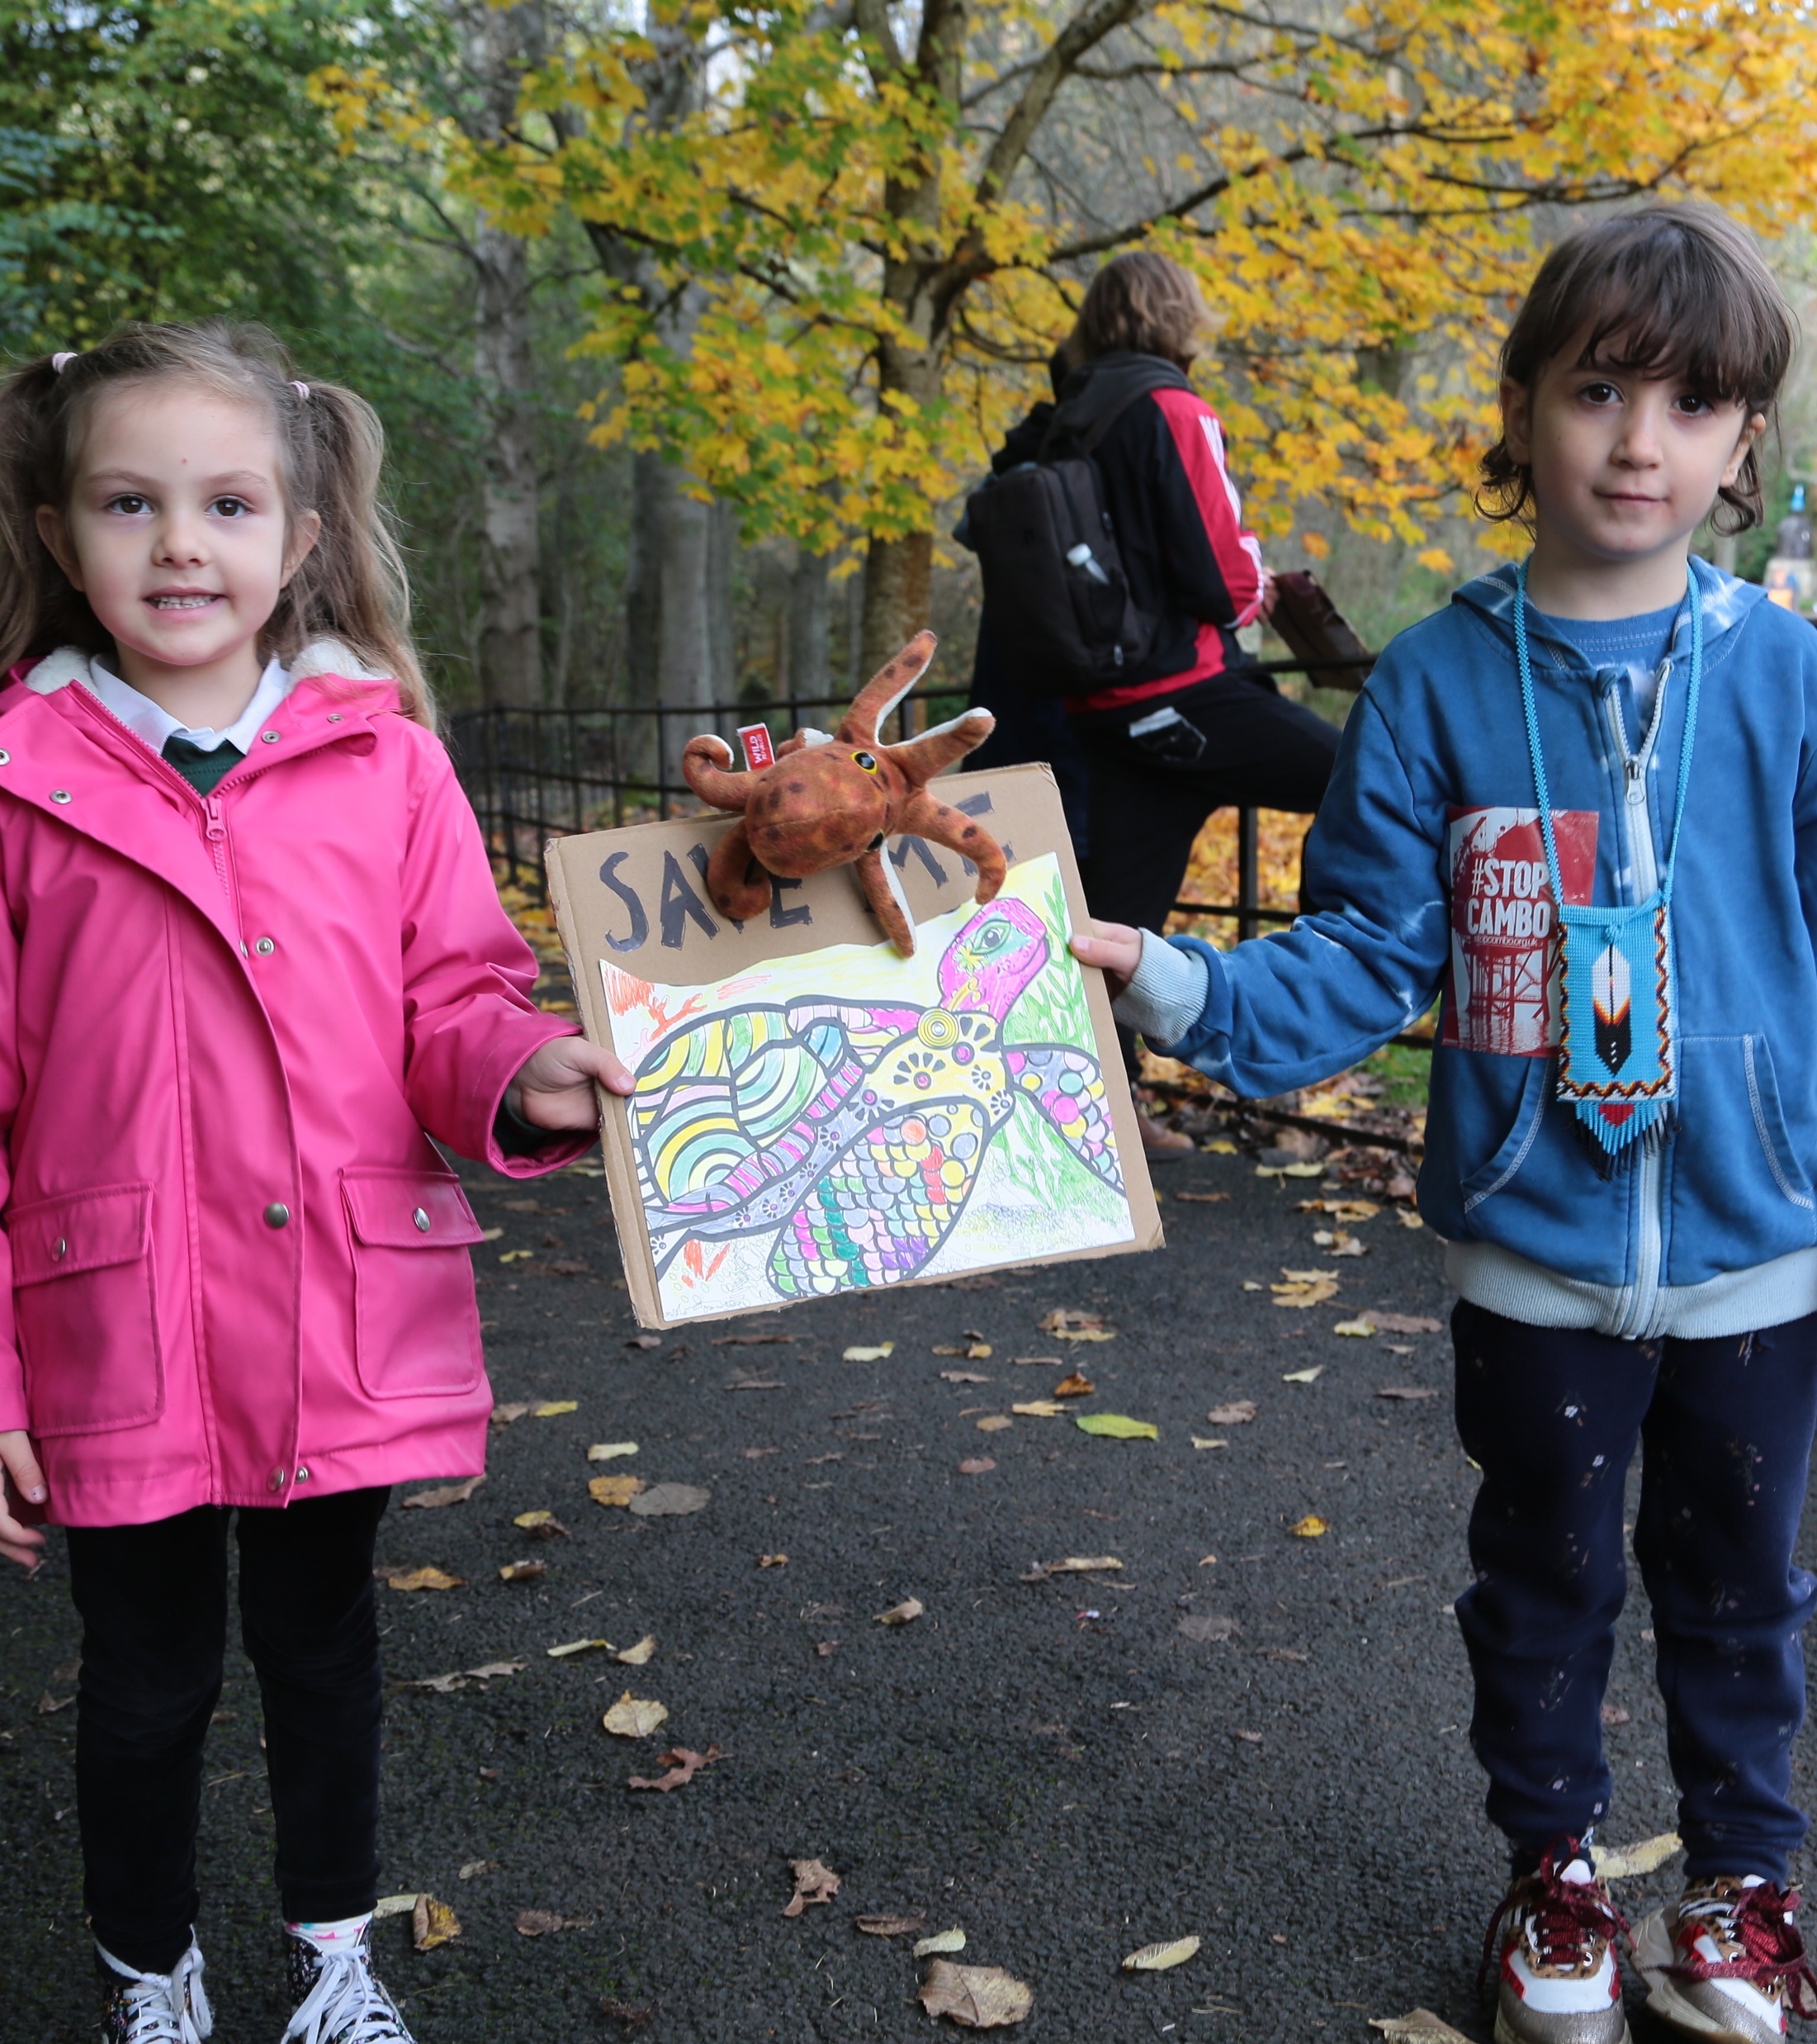
WHY
CAMPAIGN?
Children like you have an important role to play in campaigning to create change. Your voices matter and can make a difference!
UN Convention on the Rights of the Child: Article 12
Every child has the right to say what they think in all matters affecting them, and to have their views taken seriously.
© UNICEF/Elwyn-Jones
© UNICEF/Nesbitt
Notes:
Article 12 is a very important part of the UN Convention on the Rights of the Child because it's all about respecting children's views: every child has the right to express their views, feelings and wishes in all matters affecting them, and to have their views considered and taken seriously. This right applies at all times, for example during immigration proceedings, housing decisions or the child’s day-to-day home life.
It's important that children know they have the right to talk about the different situations and experiences that affect them. By getting involved in this campaign, children and young people can show those in power just how much they know and care about their rights.
Campaigning is one way children can use their voices and make sure their views are respected. Campaigning on issues that affect children can make a real difference to children and young people in the UK and around the world.

Slide 9


  MAKE YOUR VOICE HEARD
Join our World Children’s Day live event! You can share how your campaign is going and hear what others are doing.
Calling all reporters! Take a look at our guide to getting local journalists involved in your campaign.
Get ready to take action for stronger health systems: we'll share campaign actions you can take during your OutRight journey.
Don't forget to tag us on Twitter:
@UNICEFUK_Action
Notes:
As you work through the learning activities, your class or group should develop a better understanding of health, healthcare systems, and how these relate to children’s rights.
We hope you all feel inspired to use your voices – there are lots of ways to speak out and advocate for children’s rights throughout this campaign.
As part of OutRight we always provide campaign ‘advocacy actions’ that outline ways in which children can put their views to decision-makers and advocate for their ideas.
So keep an eye out for those on your OutRight journey, but we know you’ll come up with lots of ideas of your own! So you’ll also get resources and more information about sharing the work your class or group has been doing, as well as involving local media to raise awareness of any action you’re taking around strengthening health systems and protecting children's right to the best possible health.

Slide 10
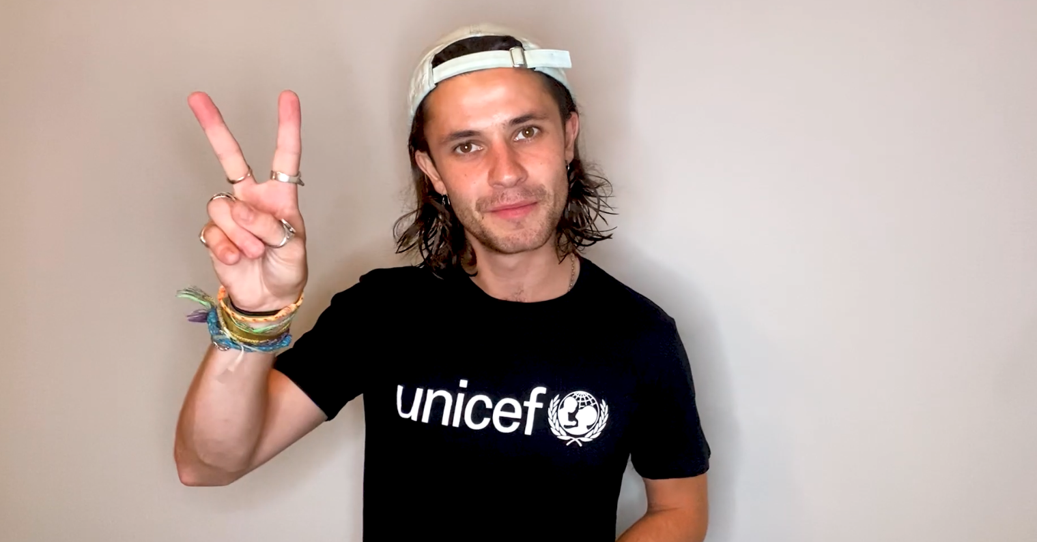
A MESSAGE FROM CEL SPELLMAN
Actor and UNICEF UK
High Profile Supporter
Cel Spellman has this message for you about
taking part in OutRight…
Click to play video
Cel video link
Notes:
Cel is a champion for youth voice and, like UNICEF UK, wants you to use your voices to make the world a better place.
The welcome message from Cel Spellman is available here: INSERT NEW LINK HERE

Slide 11
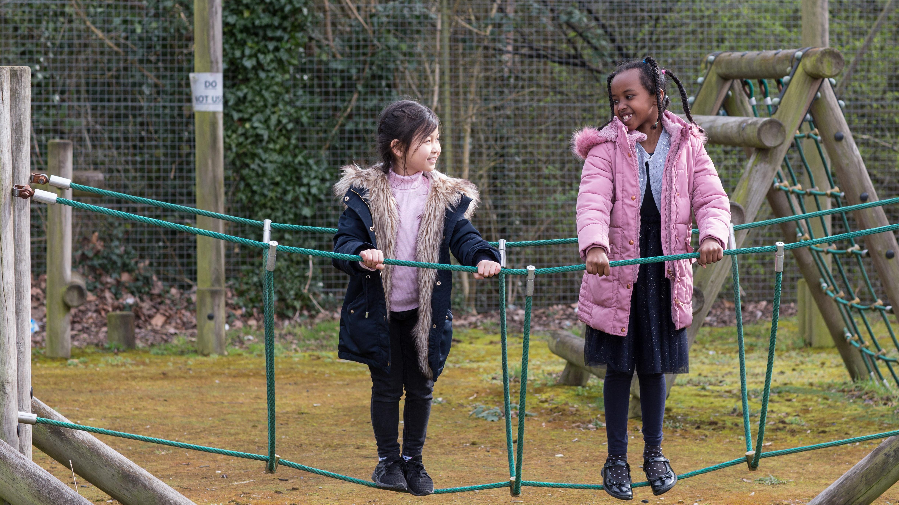

  THANK YOU
Thank you so much for taking part in OutRight this year and for making your voice heard.
We look forward to hearing what you get up to!
© UNICEF/Dawe

