Slide 1
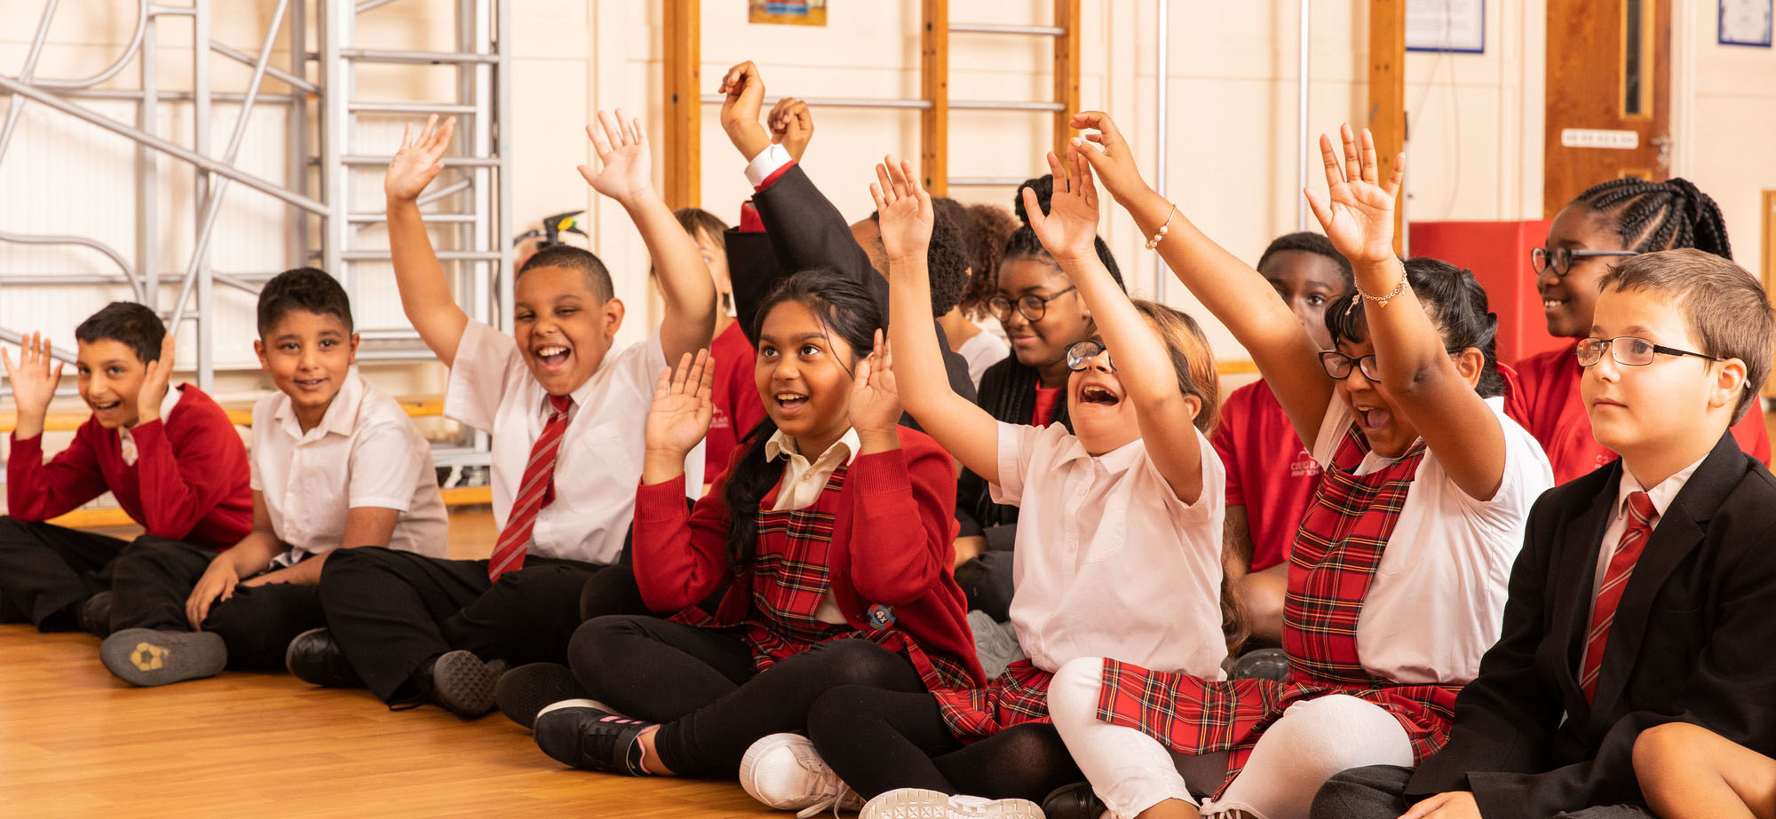

Activity 1
Do you know your rights?
@UNICEF/Dawe
UNICEF UK, registered charity England & Wales (1072612) Scotland (SC043677).

Slide 2
Explore the
UN Convention on the Rights
of the Child
Notes:
Introduce the child rights matching/memory game.
Ask the children to shuffle the cards and lay them all face down on the table. They should take turns, turning any two cards face up on each go. If the cards match, they read the right out loud to their group then keep those two cards and take another turn.
If the cards don't match, they return face down in the same location and the next player takes their turn. The game is finished when all the matches have been made.

Slide 3
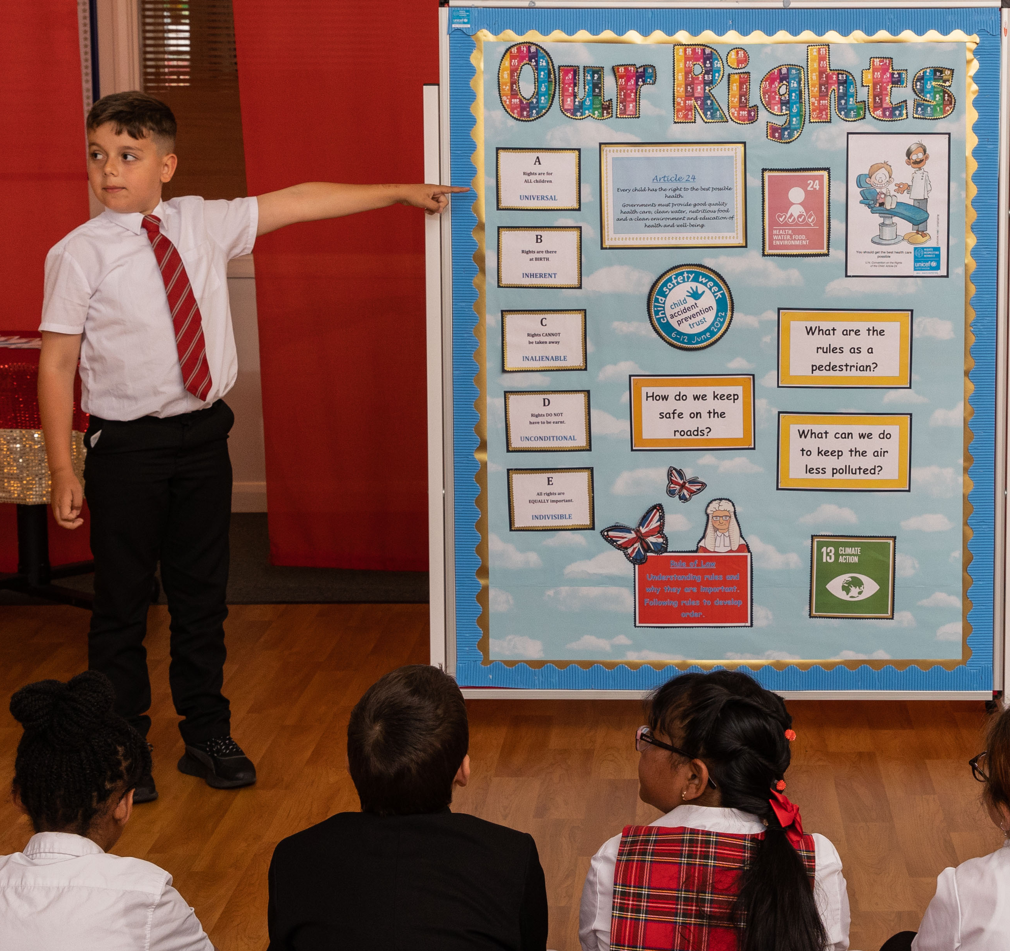
@UNICEF/Dawe
Which articles link to a child’s right to the best possible health?
Notes:
NOTE: The answer is on the next slide – so don't click through until you're ready to reveal it!
Ask everyone to turn all the pairs face up on the table. Explain that, of all of these rights that children have, the right being explored in this year’s OutRight sessions is our right to the best possible health, and the health systems that support it.
Ask everyone to look at the cards, and to pick out which articles they think are important for a child’s right to health to be realised. In turn, ask each group to share one article they’ve picked, and explain why they think it’s connected to health.
Prompt children to explore articles 2, 3, 6, 12, 13, 23, and 24 if they don’t identify them on their own.

Slide 4
A child’s right to the best possible health, and the health systems that support it
Notes:
These are the key articles from the CRC that we're looking at in OutRight this year:
Article 2: No discrimination
Article 3: Best interests of the child
Article 6: Life, survival, and development
Article 12: Respect for children’s views
Article 13: Sharing thoughts freely
Article 23: Children with disabilities
Article 24: Health, water, food, environment
Note: When talking about children’s right to the best possible health, this doesn’t mean that children have the right to not be ill – any one of us can get ill and some illnesses can't be prevented. But it does mean that children have the right to be protected against preventable illness and get the care they need to help them live with any unpreventable illness they get as best they can.

