Slide 1
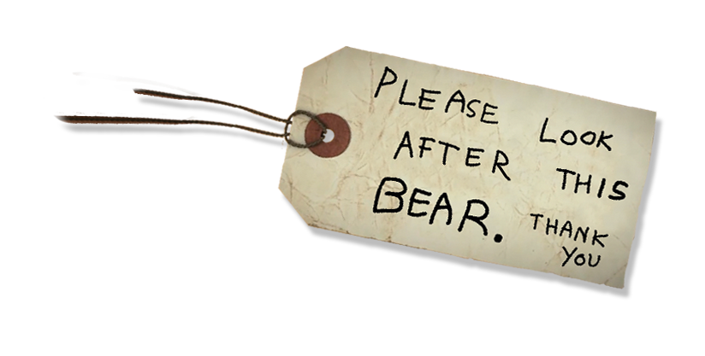
Activity 2
A right to healthcare –
and the systems that support it
© P&Co Ltd/SC 2022
UNICEF UK, registered charity England & Wales (1072612) Scotland (SC043677).
Notes:
In this activity we’re looking at health systems. While we have our own families, carers, and friends who look after us, having good health systems is also important so that children are cared for and can experience their right to the best possible health. By learning about health systems in OutRight, and how we can help make them better for children around the world, we’re looking out for one another.

Slide 2
What is
health?
© P&Co Ltd/SC 2022
Notes:
Health is “a state of complete physical, mental, and social wellbeing and not merely the absence of disease” according to the World Health Organization (WHO)

Slide 3
What is
a health system?
© P&Co Ltd/SC 2022
Notes:
Health systems are made up of the people, organisations and resources that look after everyone's health.
- Doctors, midwives, dentists, community health workers, psychiatrists and occupational therapists.
- The places they work, like hospitals, clinics, GP surgeries and more.
- The equipment they use, and the medicines they prescribe for us.
These are all part of health systems.
As well as all this, campaigns (using things like posters, leaflets and TV ads) are important too. They encourage us to make healthy lifestyle choices, give us information we can trust about healthcare services and how to seek help when we need it.

Slide 4
Medication
Immunisation
Epidemic
Health system
Disability
Doctor
Prevention
Medicine
Health
Healthcare
Nurse
Clinic
Pandemic
Wellbeing
Nutrition
Public health
Community health worker
Mental health
UNCRC
Child rights
Advocate
Primary care
Diagnosis
GP
Hospital
Right to health
NHS
Health equity
Vaccination
© P&Co Ltd/SC 2022
Notes:
Definitions of BINGO words children might not know:
Advocate – someone who promotes or defends another person’s rights, needs, and interests.
Community health worker – a person who works to help link people to the healthcare information and services they need.
Diagnosis – the process of identifying a disease, condition, or injury from its signs and symptoms.
Epidemic – an outbreak of a disease that quickly infects a large number of people in a community, population or region.
Health equity – the idea that everyone has a fair and just opportunity to be as healthy as possible.
Healthcare – preserving mental and physical health by preventing or treating illnesses through services.
Mental health is something that everyone has – just like physical health. Sometimes we feel well, and sometimes we don’t.
Mental health refers to how we think, feel and behave, and this changes. When our mental health is good, we might enjoy being around other people and feel able to take on challenges and new experiences. But when our mental health is not so good, we can find it much harder to cope.
NHS – National Health Service is the name of the health system in the UK.
Nutrition – eating a healthy and balanced diet that promotes growth and wellbeing.
Pandemic – an outbreak of a disease (like an epidemic, but more broad) that is quickly spread over a wide area like multiple countries or continents. For example, COVID-19.
Prevention – keeping something from happening. E.g., immunisations as prevention for getting sick.
Primary care – basic healthcare.
Public health – the health of a population as a whole. Public health authorities usually manage hygiene and disease prevention.
CRC – United Nations Convention on the Rights of the Child is a list of all rights children everywhere have.
Wellbeing – wellness. Being comfortable and healthy.

Slide 5
Let’s play
bingo!
© P&Co Ltd/SC 2022

Slide 6
© P&Co Ltd/SC 2022
Notes:
Now that you know more about health systems and health coverage, how do you think these articles relate to ensuring a child’s right to the best possible health?

