Slide 1
Activity 2
A right to healthcare – and the systems that support it
UNICEF UK, registered charity England & Wales (1072612) Scotland (SC043677).
Notes:
In this activity we’re looking at health systems. While we have our own families, carers, and friends who look after us, having good health systems is also important so that children and young people are cared for and can experience their right to the best possible health. By learning about health systems and how we can strengthen them, we can advocate for the best possible care for children in the UK and around the world.

Slide 2
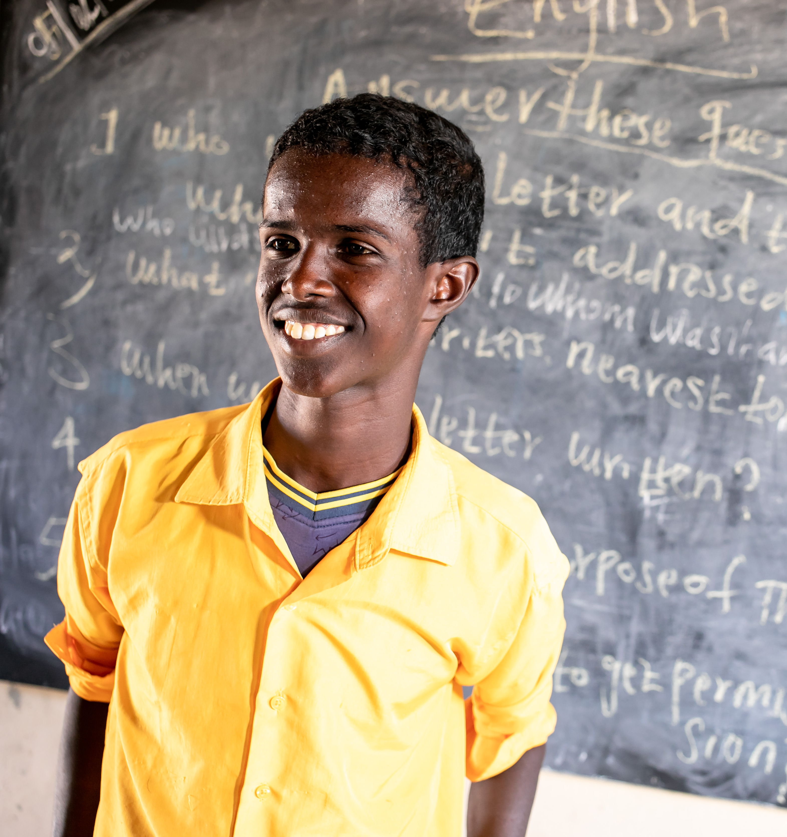
What is health?
© UNICEF/Dejongh
Notes:
Health is “a state of complete physical, mental, and social wellbeing and not merely the absence of disease” according to the World Health Organization (WHO).

Slide 3
What is a health system?
Health workers
Hospitals, clinics and so on
Equipment and medicines
Good information-sharing
Notes:
Health systems are made up of the people, organisations and resources that look after everyone's health. Health workers like doctors, midwives, dentists, community health workers, psychiatrists and occupational therapists.
The places they work, like hospitals, clinics, GP surgeries and more. The equipment these professionals use, and the medicines they prescribe for us.
Alongside all this, information is important to health systems too. Campaigns (using things like posters, leaflets and TV ads) encourage us to make healthy lifestyle choices, provide us with accurate and reliable information about healthcare services, and seek help when we need it.

Slide 4
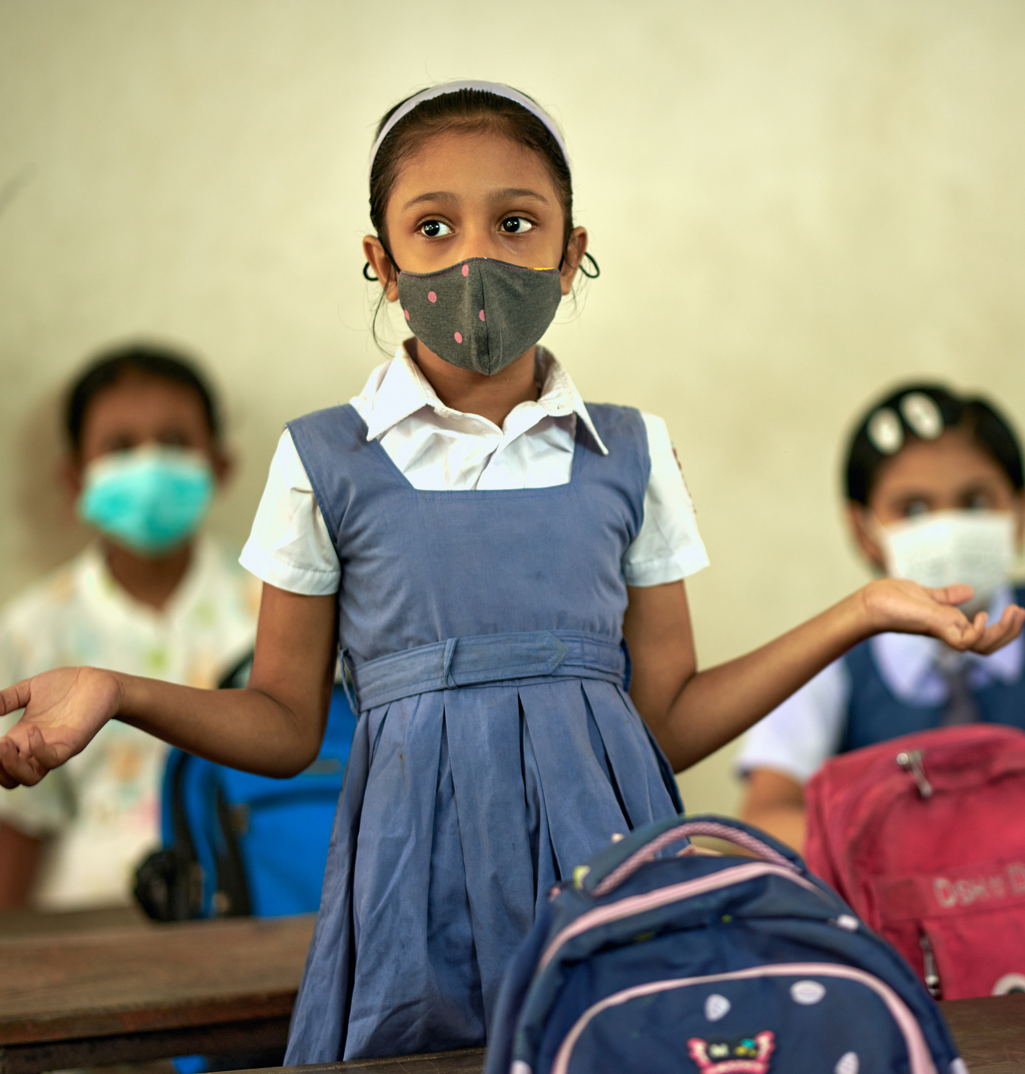
What is Universal Health Coverage?
© UNICEF/Sujan
Notes:
Universal Health Coverage means having safe, timely, affordable healthcare available for all people, everywhere (including children) no matter who they are or what their situation (e.g. wealth, gender, age, geography, ethnicity, disability status, etc.)

Slide 5
Communicable disease
Life expectancy
Antibiotics
Hygiene
Under five
Child mortality
Cancer
Epidemic
Medication
Immunisation
Convention on the Rights of the Child
Health system
Disability
Doctor
NCDs
Prevention
Health
Medicine
Nurse
Clinic
Pandemic
Healthcare
Wellbeing
Nutrition
Diabetes
Public health
Community health worker
Mental health
United Nation's Convention on the Rights of the Child
Advocate
Diagnosis
GP
Hospital
Primary care
Right to health
NHS
Vaccination
Malaria
Health equity
Heart disease
Ebola
Prenatal care
Reproductive health
Universal Health Coverage
Child rights
Polio
Notes:
Definitions of BINGO words young people might not know:
Advocate – someone who promotes or defends another person’s rights, needs, and interests.
Antibiotics – a type of medicine that fights a bacterial infection.
Child mortality – the probability of a child not living until their fifth birthday (you can read more here about how these figures are calculated and recorded).
Communicable disease – diseases that can spread from person to person. E.g. influenza, COVID-19, measles, etc.
Community health worker – a person who works to help link people to the healthcare information and services they need.
CRC – the United Nations Convention on the Rights of the Child is a list of all rights children everywhere have.
Diagnosis – the process of identifying a disease, condition, or injury from its signs and symptoms.
Ebola – a contagious and life-threatening disease caused by a viral infection that originated in sub-Saharan Africa.
Epidemic – an outbreak of a disease that quickly infects a large number of people in a community, population or region.
Health equity – the idea that everyone has a fair and just opportunity to be as healthy as possible.
Healthcare – preserving mental and physical health by preventing or treating illnesses through services.
Heart disease – a type of non-communicable disease that affects the heart or blood vessels.
Life expectancy – the number of years a person is expected to live.
Malaria – a disease, common in some places in Asia, Africa, Central and South America, caused by a parasite carried by mosquitos.
Mental health - how we think, feel and behave. Our mental health can change. Mental health and physical health are closely linked, and both are essential for our overall health and wellbeing.
NCDs – Non-Communicable Diseases. Conditions that are not caused by infection but have long-term health consequences and need long-term medical treatment and care. Heart disease, cancer, and diabetes are examples of NCDs.
NHS – The National Health Service is the name of the health system in the UK.
Nutrition – the energy and goodness you get from what you eat and drink. Being able to get nutritious food, and eating a healthy and balanced diet, promotes growth and wellbeing.
Pandemic – an outbreak of a disease (like an epidemic, but bigger) that is quickly spread over a wide area like multiple countries or continents. For example, COVID-19.
Polio – a highly infectious virus that mostly affects children under age five. The Polio virus has mostly been eradicated throughout the world thanks to vaccination.
Prenatal care – healthcare given to pregnant people to keep both them and their baby healthy.
Prevention – keeping something from happening, e.g. immunisations as prevention for getting sick.
Primary care – basic healthcare, like a GP or dentist.
Public health – the health of a population as a whole. Usually regulated by a government to manage hygiene and disease prevention.
Reproductive health – sexual and reproductive health is a state of complete physical, mental, and social wellbeing in all matters relating to the reproductive system.
Under 5 – the age at which children around the world are most vulnerable to (likely to die from) infectious diseases like malaria, pneumonia and diarrhoea. Children under five especially at risk in places without strong health systems.
Wellbeing – wellness. Being comfortable and healthy.

Slide 6
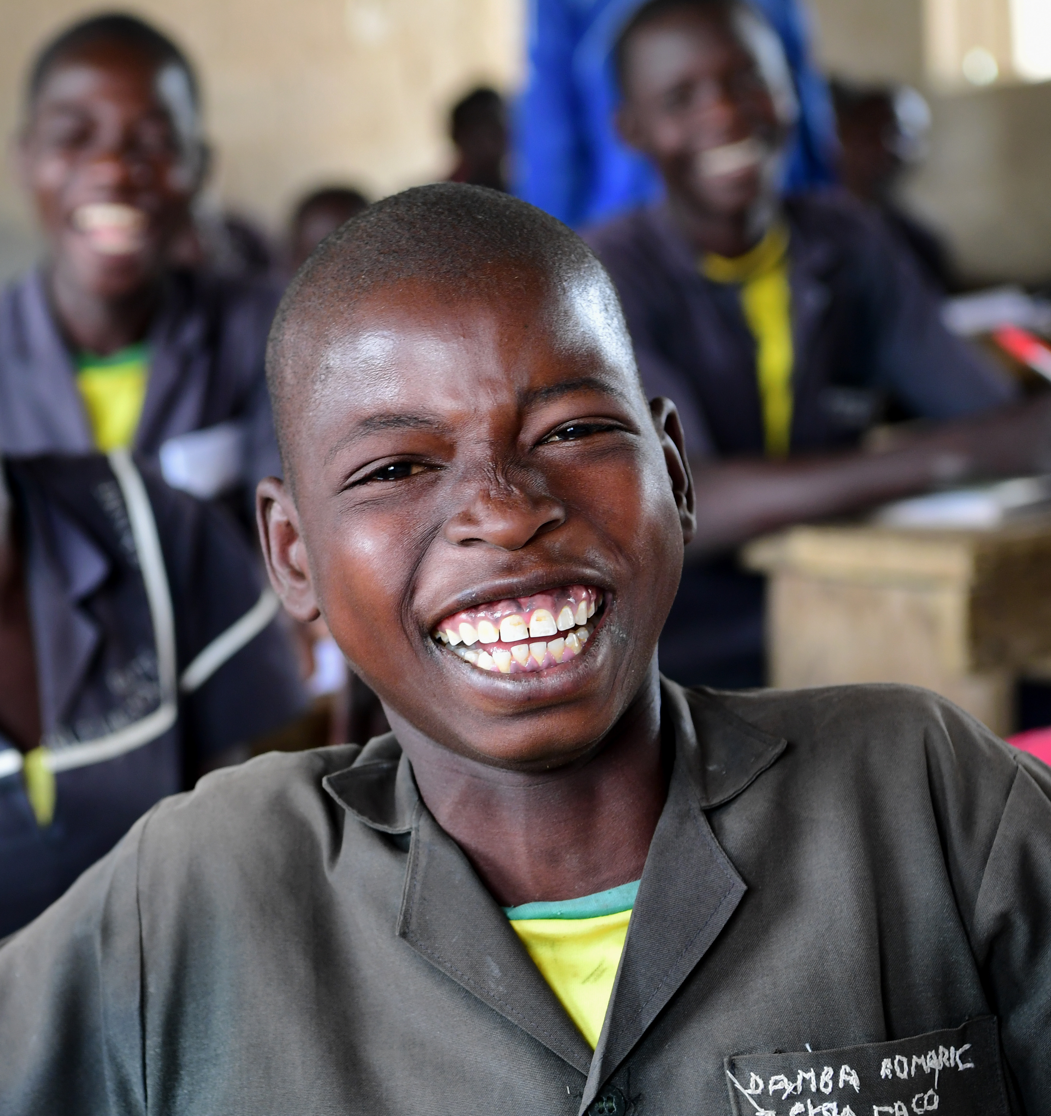
Let's play Health Systems Bingo!
© UNICEF/Dejongh

Slide 7
Notes:
Ask: “Now that you know more about health systems and universal health coverage, how do you think these articles relate to ensuring a child’s right to the best possible health?”

