Slide 1
ARTICLE OF THE WEEK

Slide 2
INSTRUCTIONS
Slide 3: Guess the article
Slide 4: Introducing Article 12
Slide 5: Exploring Article 12
Slide 6: Some possible answers
Slide 7, 8 & 9: Primary activities
Slide 10, 11 & 12: Secondary activities
Slide 13: Reflection

Slide 3
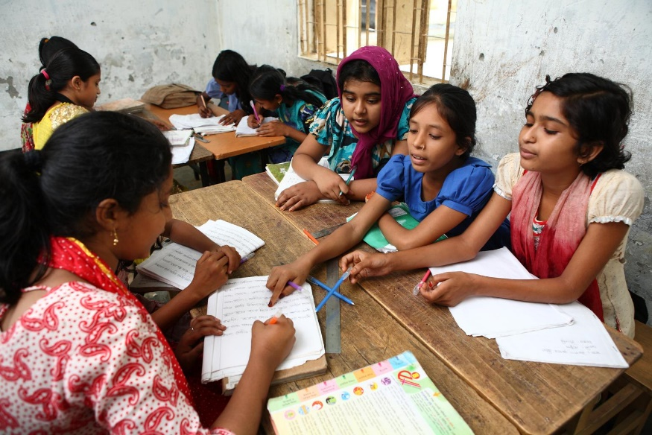
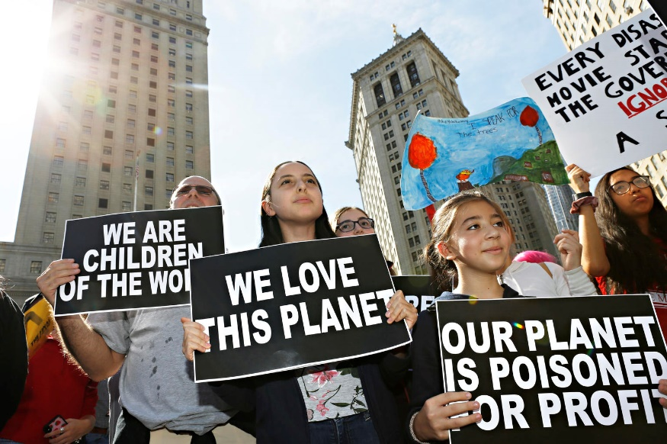
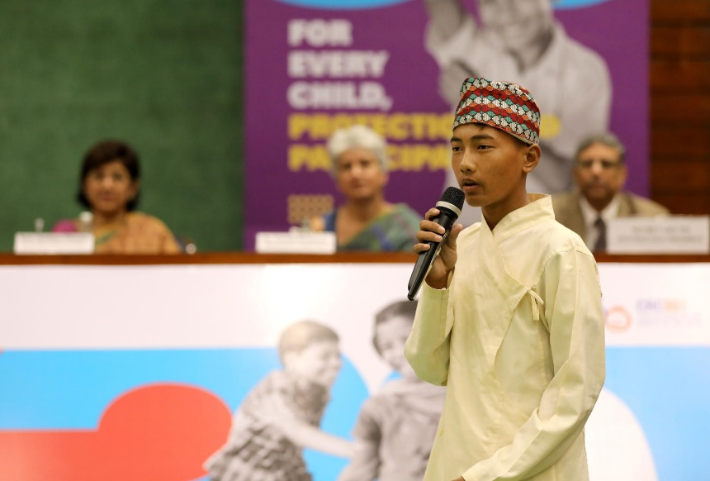
GUESS THE ARTICLE
@UNICEF/Kiron
@ UNICEF/ Chalasani
@UNICEF/Altaf Ahmad
These pictures provide a clue to this week’s articles.
How do these pictures help you? Can you guess how they are linked together?
Write down your thoughts or discuss with someone in your class.

Slide 4
INTRODUCING ARTICLE 12
Steven Kidd, RRSA Professional Adviser, introduces Article 12
Article 12 – respect for the views of the child
Every child has the right to express their views, feelings and wishes in all matters affecting them, and to have their views considered and taken seriously. This right applies at all times, for example during immigration proceedings, housing decisions or the child’s day-to-day home life.
Click here to watch on YouTube

Slide 5
EXPLORING ARTICLE 12
Why should you be able to share your views and opinions on matters that affect you?
Have a think and write down some answers.

Slide 6
EXPLORING ARTICLE 12
Did you think of these?
Being involved in decisions makes you feel like a part of it, you have ownership.
Relationships between children and adults improve when there’s communication.
School is there to help children to learn, so it is important to put children at the centre.
Children have some great ideas that adults might never think of.
It helps to prepare you for adulthood.
Children and young people feel valued.
Involving young people means there are more people to make a difference.
We all have different views and experiences, so including everyone means we get lots of perspectives.
It can help you to learn about politics and democracy.
It is your right to be involved in decisions which affect you!
What else did you think of?

Slide 7
PRIMARY ACTIVITIES
You do not need to complete every activity but if you have time, you can try to complete more than one.
For the youngest children: Talk about choosing at nursery/school – snack choices, who to play with etc. Discuss why is it important for children to have the opportunity to make choices. This story may help discussion about choices.
What decisions do you make in your house? What about in school? Do you think you should have more of a say? Write down your reasons why and try to persuade the grown-ups.
Think about what your face looks like when you like something, when you don’t like something, or when you are scared or excited. Can you tell how someone else is feeling by looking at their facial expressions? How can we ‘hear’ people even when they don’t speak so that we can respect their views?
Have you ever used Two Stars and a Wish to give feedback? It’s really simple, you think about two things that were really good (stars) and one that you’d like to change (wish). Thinking about your last week at school, what would be your Two Stars and a Wish feedback? If you can, share this with your class.

Slide 8
PRIMARY ACTIVITIES 2
You do not need to complete every activity but if you have time, you can try to complete more than one.
What do the words ‘opinion’ and ‘viewpoint’ mean? Discuss as a class how your teachers listen to your opinions in different ways every day.
Have you heard of the UN Global Goals? Watch this video to show how the voice and participation of children and young people can make a difference. Can you think of one thing you could do to make the world a better place and promise to do it? Perhaps you could get other people to sign your pledge, too.
People don’t only share their opinions and thoughts through talking. Write a list of as many ways as you can think of through which people share their thoughts and opinions. Now pick one from your list and use it to share your opinion with the class.
Listen to this story, Everyone Gets A Say, then discuss with your class why it’s important to listen to a lot of people’s ideas.

Slide 9
PRIMARY ACTIVITIES 3
You do not need to complete every activity but if you have time, you can try to complete more than one.
Watch this video clip of a pupil council meeting where they’re talking about homework. Is it the same or different from meetings in your school? What advice would you give to your class representatives?
Many schools have worry boxes or “tell me” boxes so that children can share their thoughts in writing. One school has a box labelled, “I wish my teacher knew...” so that children can share any thoughts, ideas, worries or news. Design a class box so that children in your class can share their views through writing.
Watch this video about children’s rights. Can you draw the page in the storybook where Viz, Leepa and Zooko explain what Article 12 is all about? (It’s at 6 mins)

Slide 10
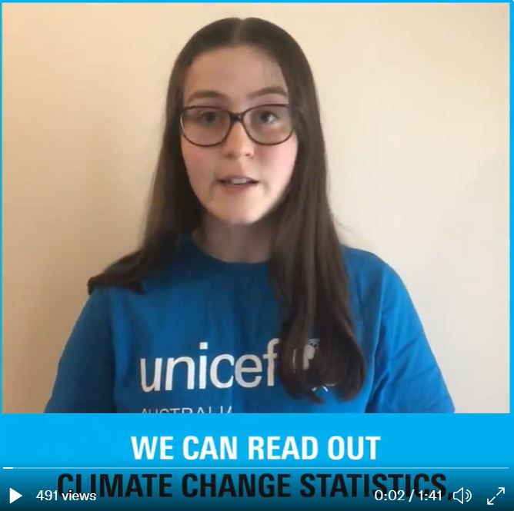
SECONDARY ACTIVITIES
You do not need to complete every activity but if you have time, you can try to complete more than one.
How can you tell how someone is feeling? List all of the ways people communicate their views and opinions. Share your list with your class. Discuss the importance of non-verbal communication. What can you do to make sure everyone is listened to and able to participate in decision-making?
Watch this video (2020) showing young people from the UK and Australia expressing their views on climate change. What do you feel passionate about? Visit the UNICEF Voices of Youth home page and find out more about how your voice can join with young people all over the world.
Part of Article 12 says: “Every child has the right to express their views, feelings and wishes in all matters affecting them, and to have their views considered and taken seriously.” Discuss the meaning of this and write a guide for adults helping them to show different ways that your views have been respected even when the decision doesn’t go your way!
The UK Youth Parliament’s Make Your Mark survey gives 11–18-year-olds in the UK the chance to have a say on the biggest issues – did you take part? Can you create your own survey to identify the issues most important to pupils in your school?

Slide 11
SECONDARY ACTIVITIES 2
You do not need to complete every activity but if you have time, you can try to complete more than one.
In this video, young poet and activist Amanda Gorman explains how poetry is her way of expressing her views and opinions. How do you express yourself? Write a poem, draw a picture, compose a song or find another way to share your opinion.
Using a top news story on the BBC website as inspiration, run a class debate on one of the issues reported. How will you make sure that everyone is able to fully participate?
Imagine that for one day only, you have been made the headteacher of your school. What changes will you make? Are there things which you could change to uphold the rights of pupils in the school? Explore your ideas using role play or ‘hot seating’, taking it in turns to be the headteacher.
What do you know about your pupil council or other leadership groups? How is your school making sure that a diverse range of voices is heard? What are the groups achieving? Raise awareness of their work with a promotional poster or video.

Slide 12
SECONDARY ACTIVITIES 3
You do not need to complete every activity but if you have time, you can try to complete more than one.
If you were to stand for election to your School Council or Pupil Parliament next year, what would you say in your speech or manifesto? Start drafting it now!
Check out UNICEF UK’s Advocacy Toolkit. It’s full of great advice on how to make a difference. What are you passionate about? Using the toolkit to help, come up with an idea of how you can take action.
Watch this video about the UN Global Goals. Why do you think the Global Goals for Sustainable Development are important? How could your school community take action to support one or more of the Goals?

Slide 13
REFLECTION
Give yourself some time and try to find a space where you can be quiet and think…
How does it feel when you know you are being listened to and your views are respected?
When has your voice and your views made a difference?
If adults are not creating a space for your views to be heard, how can you respectfully claim this right? Who could help you?
Are there more things you could speak up about in your own life or in the wider world? How might you do this - on your own or with friends?

Slide 14
MORE INFO
RRSA WEBSITE
For more information or to download previous Article of the Week packs please visit the RRSA website by clicking on the link below.
CLICK HERE

Slide 15
THANK YOU

