Slide 1
ARTICLE OF THE WEEK
Notes:
Children reading in the German Version of the Convention on the Rights of the Child. The photo was produced in the context of the campaign of the German Committee for UNICEF "Children's Rights into the Basic Law / Kinderrechte ins Grundgesetz".

Slide 2
INSTRUCTIONS
Slide 3: Guess the article
Slide 4: Introducing articles 1, 4 & 41
Slide 5: Exploring articles 1, 4 & 41
Slide 6: Some possible answers
Slide 7, 8 & 9: Primary activities
Slide 10, 11 & 12: Secondary activities
Slide 13: Reflection

Slide 3
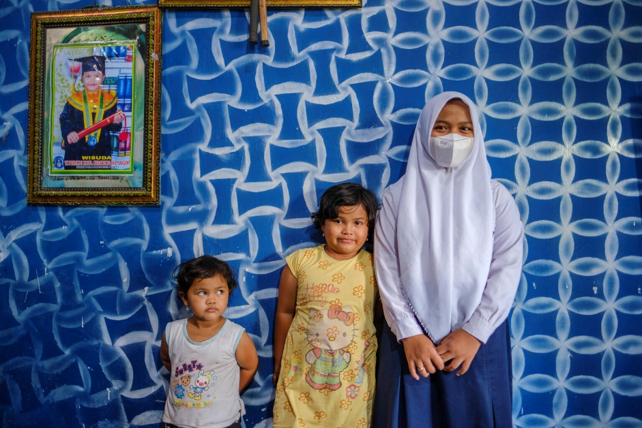
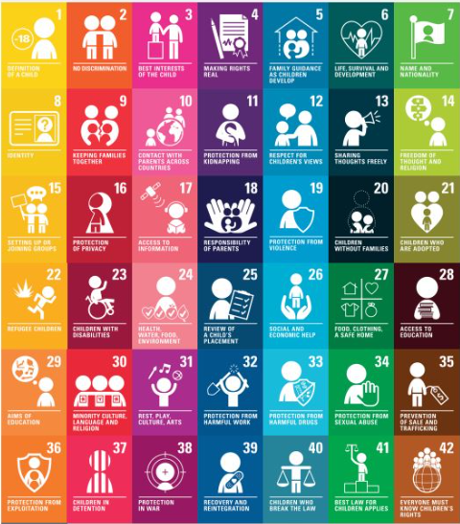
GUESS THE ARTICLE
@UNICEF/Ose
@Pexels
These pictures provide a clue to this week’s articles.
How do these pictures help you? Can you guess how they are linked together?
Write down your thoughts or discuss with someone in your class.

Slide 4
MAKING RIGHTS HAPPEN
Making Rights Happen: Articles 1, 4 and 41
Helen Trivers, RRSA Professional Adviser, introduces articles 1, 4 & 41
The Convention on the Rights of the Child brings together a range of rights that all children aged under 18 are entitled to, no matter who they are or where they are born. These rights ensure that all children are given the support they need to develop and reach their potential and are protected from harm. Governments across the world have signed up to the CRC and have promised to make the rights within the CRC a reality for children in their country and a number of articles specifically mention what governments must do to make rights happen.
Article 1 makes clear that everyone under the age of 18 has all the rights in the Convention.
Article 4 states that governments must do all they can to make sure every child can enjoy their rights by creating systems and passing laws that promote and protect children’s rights.
Article 41 states that if a country has laws and standards that go further than the present Convention, then the country must keep these laws.
This Article of the Week will support you to explore these rights in more detail and consider what must be done to make rights happen for all children.
Click here to watch on YouTube

Slide 5
EXPLORING ARTICLES 1, 4 & 41
How do children get to enjoy their rights in the UK? What does Government do to make this happen?
Have a think and write down some answers.

Slide 6
EXPLORING ARTICLES 1, 4 & 41
Did you think of these?
Every child must be registered with a name at birth.
There are parks and play areas provided.
We have education and health care systems.
Some people’s job is to protect children.
The school curriculum includes learning about the CRC (in some parts of the UK).
Children are given protection when they need it.
Most schools have ways of listening to children’s views and opinions.
There are Children’s Commissioners whose job it is to make sure children are listened to.
Social care services and the police work to keep all children protected.
In Scotland, the CRC is being incorporated into law.
Many schools are UNICEF UK Rights Respecting Schools and children learn about their rights.
There are laws which include some rights from the CRC, such as equalities legislation and the Children Act.
What else did you think of?

Slide 7
PRIMARY ACTIVITIES
You do not need to complete every activity but if you have time, you can try to complete more than one.
All children are special and important, and governments have to do all they can to make sure that each child enjoys their rights. Read the book Every Child a Song by Nicola Davies and Marc Martin and discuss what makes each child in your class special. Why not create a whole school display based on the book?
Childhood is a special time. Discuss as a class and write a list of things that makes being a child special. Create a display of your pictures showing ‘The Best of Childhood’.
Under the CRC, children are rights holders; governments and adults are duty bearers who are responsible for making sure children’s rights are met. As a class, talk about who the duty bearers are in your school and write cards to thank them for making sure that children’s rights are enjoyed in your school.
Do you know five key words related to rights? They are universal, unconditional, inherent, inalienable and indivisible! If this is new to your school, have a look at this presentation on our website and see how many of the five you can remember! Make a short video to explain the words to your teachers and to other children in your school.

Slide 8
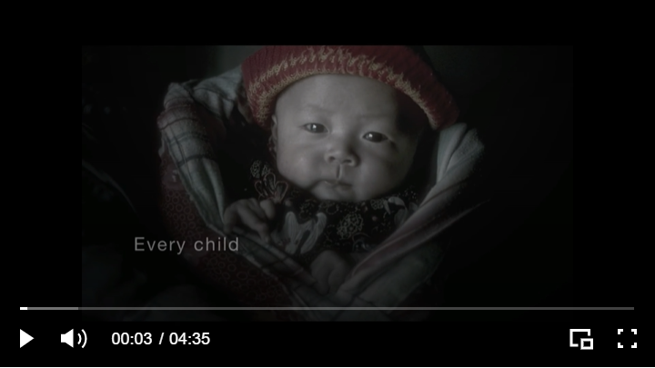
PRIMARY ACTIVITIES 2
You do not need to complete every activity but if you have time, you can try to complete more than one.
Each country of the UK has a children’s commissioner whose job it is to promote children’s rights and make sure that children are being supported. Find out more about the Children’s Commissioner in your part of the UK. Why not write a letter to them to explain why you think children’s rights are important?
Your local MP/MSP/MLA/MS can have influence on the Government. Why not send them a postcard with a message to explain why you think their role in supporting and protecting children's rights is so important? You could even invite them into your school to talk about what they do to support and protect children’s rights.
It’s the job of the government to make the Convention known but lots of children like to share knowledge of their rights. Watch this example from Glade Primary School and see if it inspires you to be creative in explaining you rights to others.
Look at the CRC summary document on our website and discuss things which might stop children from enjoying their rights around the word. Are any children in your school unable to enjoy any of their rights as fully as they should?

Slide 9
PRIMARY ACTIVITIES 3
You do not need to complete every activity but if you have time, you can try to complete more than one.
Find out about some of the laws that are linked to and help to uphold children’s rights. You might explore the Equalities Act or the Children Act which are UK wide laws.
Article 41 says that if a country has laws and standards that are better or stronger than the Convention, then the country must keep these laws. Do some research about the history of education laws in the UK to see how children’s right to an education improved enormously in our part of the world, even before the CRC was adopted by the United Nations in 1989.
Watch this video about the history of the Universal Declaration of Human Rights. Discuss why you think the United Nations decided to create a special convention just for children.

Slide 10
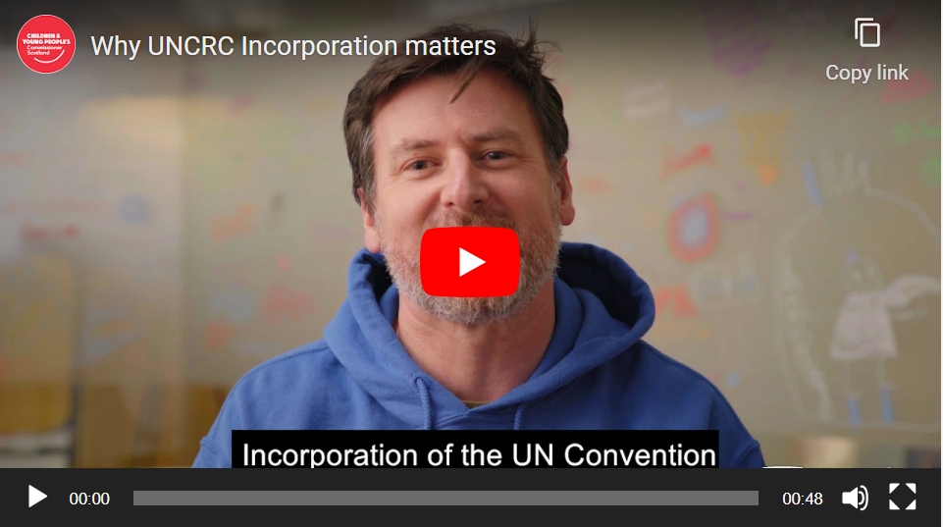
SECONDARY ACTIVITIES
You do not need to complete every activity but if you have time, you can try to complete more than one.
How do you feel about being referred to as a child? Look at the wording of Article 1. Have you been addressed by some of these alternative terms:
‘Adolescents’ ‘Young people’ ‘Youth’ Young adults’ Youngsters’?
Discuss as a class what advice you would give to adults about how they refer to your age group.
Talk to your family or carers about their childhood. What was different when they were growing up? How has the Convention impacted children’s lives? Draw, write or produce a resource to show a comparison of a young person’s experience then and now.
Look at the this infographic produced by the government in England showing how the UK government respects children’s rights. Does it feel accurate to you? Is there anything missing? Work with your classmates to create a version of this document to show what your school does to uphold your rights.
The Scottish Government in the process of incorporating the CRC into their law. Watch this video from the Children and Young People’s Commissioner Scotland to see why it’s so important. If you are not in Scotland, you could debate with your class whether you think the CRC should be incorporated into law in your country. If you think it should, you could contact your MLA/SM/MP to ask whether this has been discussed.

Slide 11
SECONDARY ACTIVITIES 2
You do not need to complete every activity but if you have time, you can try to complete more than one.
Article 41 of the CRC says that if governments have higher standards or stronger laws than the CRC asks for, they must keep these standards. Look at the Convention and try to identify any rights which, in the UK, are promoted or protected more strongly than the Convention expects.
Find out which countries or territories haven’t ratified the CRC. Compose and send a letter to their ambassadors or representatives in the UK explaining the importance of every child around the world having their government committed to the CRC.
Identify places in your school or community where rights are realised or where they may not be fully accessed by all. At your school you might include a route that takes in your school playground (Article 31), a garden or green space (Articles 24 & 31) or the lunch area (Article 24). Further afield, you could walk to a religious building (Article 14) or a youth club (Article 15). Make a poster to reflect the relevant articles of the CRC and put them up around school or in the wider community. Use the school’s social media or the local press to raise awareness of children’s rights locally.
Develop an assembly to ensure your whole school understands the nature of rights being universal, unconditional, inherent, indivisible and inalienable. Use UNICEF UK’s ABCDE of Rights resource to help you.

Slide 12
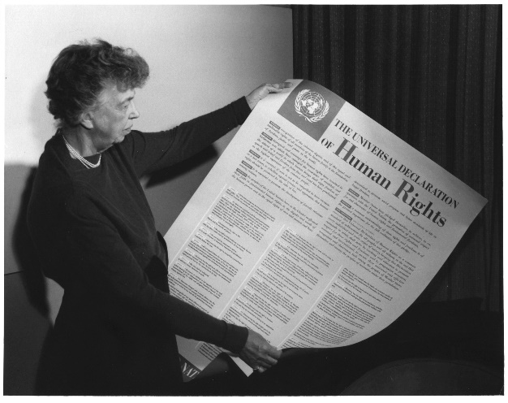
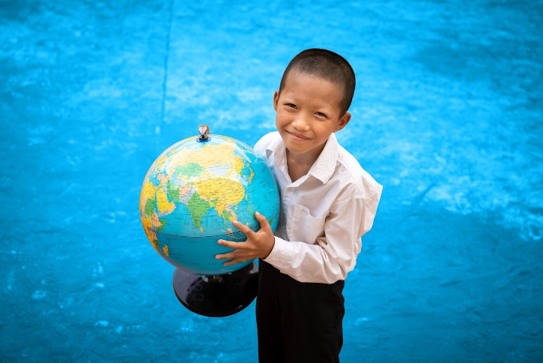
SECONDARY ACTIVITIES 3
You do not need to complete every activity but if you have time, you can try to complete more than one.
In 1948 the Universal Declaration of Human Rights was the world’s first global rights treaty. Many others have been agreed since then. The CRC is one of these. Find out about other human rights treaties that have been developed to protect specific groups of people and share what you find out with your class.
Produce a stop-frame animation exploring the history of the Convention. What has the impact on children’s lives been and why are rights important? What are the key things that children around the world need to survive in the future?
@UNICEF/Raab

Slide 13
REFLECTION
Give yourself some time and try to find a space where you can be quiet and think…
As you sit quietly think about your rights and why they matter. This acronym may help:
R is for really important. Why do rights matter for every child?
I is for international. Remember - every child in the world is born with these rights.
G is for governments, grown-ups, guardians. How do they help you to get your rights?
H is for hopeful. Because of the CRC the world is becoming a better place for children.
T is for together. You are connected with every other child and young person as you have the same rights.
S is for sharing. How can we tell others what we know about rights?

Slide 14
MORE INFO
RRSA WEBSITE
For more information or to download previous Article of the Week packs please visit the RRSA website by clicking on the link below.
CLICK HERE

Slide 15
THANK YOU

