Slide 1
ARTICLE OF THE WEEK
Notes:
Image: 'Beads for peace' ("Perlen für den Frieden") was the motto of Emilia, Svea and Yolanda. Over a longer period of time, the three girls made beaded jewelry together and individually at home. On March 18, 2022, the girls gave away their self-made beaded jewelry and sorted-out toys at the marketplace in Warendorf in exchange for a donation to UNICEF. Later, their younger siblings joined them and supported them in their action.

Slide 2
INSTRUCTIONS
Slide 3: Introducing International Day of Peace
Slide 4: Linked UNCRC articles
Slide 5: Exploring International Day of Peace
Slide 6: Some possible answers
Slide 7, 8 & 9: Primary activities
Slide 10, 11 & 12: Secondary activities
Slide 13: Reflection

Slide 3
INTRODUCING INTERNATIONAL DAY OF PEACE
International Day of Peace
Jenny Price, RRSA Professional Adviser, introduces International Day of Peace
The International Day of Peace (“Peace Day”) is observed around the world each year on 21st September. Established in 1981 by unanimous United Nations resolution at the General Assembly, it has been declared as a day devoted to “commemorating and strengthening the ideals of peace both within and among all nations and peoples.”
Peace Day provides a globally shared date for all humanity to commit to peace above all differences and to contribute to building a culture of peace.
Each year there is a particular focus with resources and ideas on how to get involved: https://internationaldayofpeace.org/
Peace, human rights and the Sustainable Development Goals (SDGs) are all closely connected because building a peaceful world needs all people everywhere to have their rights protected and respected, to have the resources they need and to live and thrive in a clean, safe environment. For this to happen, we need stable, caring governments making decisions and working together to ensure the safety of people and the planet.
Click here to watch on YouTube

Slide 4
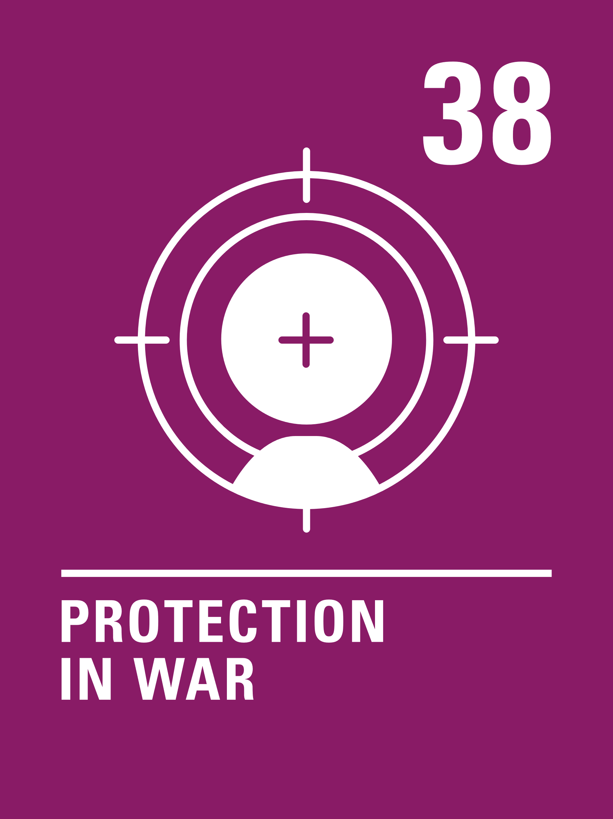
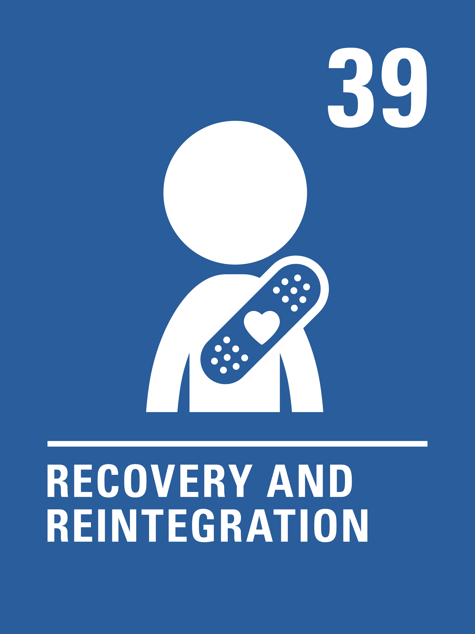
LINKED UNCRC ARTICLES
Many articles of the CRC relate to this week’s theme but the activities link, in particular, to the following articles:
Article 38 (war and armed conflicts)
Governments must not allow children under the age of 15 to take part in war or join the armed forces. Governments must do everything they can to protect and care for children affected by war and armed conflict.
Article 39 (recovery from trauma and reintegration)
Children who have experienced neglect, abuse, exploitation, torture or who are victims of war must receive special support to help them recover their health, dignity, self-respect and social life.

Slide 5
EXPLORING INTERNATIONAL DAY OF PEACE
What does peace mean to you?
Have a think and write down some answers.

Slide 6
EXPLORING INTERNATIONAL DAY OF PEACE
Did you think of these?
Feeling calm, quiet, still
Feeling safe wherever you are (in school, at home, in your community)
Knowing you can trust the people around you
Living in harmony with others
Being the person you want to be without fear
Supporting others who need help
Living in a world without conflict or violence
Living in a world where people respect and value each other
No discrimination
A just and fair government you can trust
Living in an inclusive community without racism or hate
Acting in a way that helps others to feel calm and happy
What else did you think of?

Slide 7
PRIMARY ACTIVITIES
You do not need to complete every activity but if you have time, you can try to complete more than one.
Listen to the story This is Our House by Michael Rosen. At the beginning of the story George didn’t know how to play and share with other children which made them upset. What did he learn? How do you make sure you include everyone in your class so that it is a safe and peaceful place? Could you add anything to your class/school charter to show this?
Use your existing strategies for wellbeing and being calm such as mindfulness or peer massage to lead into a discussion about how it feels to be peaceful. Create a piece of art or a simple dance to represent what peace feels like.
Explore the International Day of Peace website to find out what the International Day of Peace is all about. Work in groups to agree how you can observe the day in your school or your community. Can you create your own message of peace to share?
Create a Peace Path using an activity from the World’s Largest Lesson to make a path that is safe and peaceful for children or animals to use.

Slide 8
PRIMARY ACTIVITIES 2
You do not need to complete every activity but if you have time, you can try to complete more than one.
Design or build a ‘peace corner’ in your classroom where you can go to reflect and sort out any problems. Get creative - you might like to create some peace puppets so that you can act out different solutions to problems.
Do you think you are a good peacemaker? Can you think of a time when you helped to solve a disagreement between two people? What did you do? What did you say? How does Article 12 and respecting each other’s opinion help when solving a problem? Write a top 10 list of things to say to help promote peace in the classroom or on the playground.
Research the theme of this year’s International Day of Peace and use the information you find to prepare an assembly to share and promote Peace Day.
UN Sustainable Development Goal 16 is Promoting Peace, Justice and Strong Institutions. What do you think a government needs to do to help create a peaceful society? What does the government do in your country to help create peace in your community?

Slide 9
PRIMARY ACTIVITIES 3
You do not need to complete every activity but if you have time, you can try to complete more than one.
Articles 38 and 39 of the CRC are all about the effect of war on children. Have you read any story books that show what living through war might be like for a child? Discuss the possible impact of war on children - what other rights might be affected?
What makes a peaceful classroom? How could this transfer globally to make a peaceful society? What are the similarities? Could you add some ideas to a class/school charter?
Do a simple survey in your class to collect people’s ideas about what they understand by ‘peace’. Discuss examples of peace and conflict around the world and then work with a partner to create a piece of art or music to represent a positive vision or message of peace.
What other rights from the CRC do you think link to the International Day of Peace? Create a wall display to show this for others in your school.

Slide 10
SECONDARY ACTIVITIES
You do not need to complete every activity but if you have time, you can try to complete more than one.
Do a simple survey in your class to collect people’s ideas about what they understand by ‘peace’. Discuss examples of peace and conflict around the world and then work with a partner to create a piece of art or music to represent a positive vision or message of peace.
Watch Poems for Peace and listen to children and young people living in conflict using poetry to call for peace. While you watch, pick out a line or a phrase that really sticks in your mind. Use it to help you create a poem of your own about peace.
Research the theme of this year’s Peace Day and share what you find out in a class. Use the information you have found to prepare an assembly or create a display to share the message across your year group or school.
Explore the UN Sustainable Development Goal 16 and ‘The Power of Peace’ using the World’s Largest Lesson activities such as discussing ‘What are some peaceful ways of dealing with conflict?’.

Slide 11
SECONDARY ACTIVITIES 2
You do not need to complete every activity but if you have time, you can try to complete more than one.
Part of UNICEF’s work is to protect children affected by war (Article 39). Find out how UNICEF creates safe spaces – Blue Dots Hubs - for children here. How could you help raise awareness of this work that UNICEF is doing?
UN Sustainable Development Goal 16 is Promoting Peace, Justice and Strong Institutions. What do you think a government needs to do to help create a peaceful society? What does the government do in your country to help create peace in your community? Find out about one other country - compare and contrast to your own. What are the similarities and what are the differences?
The video ‘My name is Younis - I am a child, not a solider’ shows how poverty led one child in Sudan to be caught up in conflict at a young age. While you watch it think about which rights were denied to Younis, then read articles 38 and 39 again. Discuss what role organisations like UNICEF have in working with young people like Younis to turn lives around. What do you think governments should be doing?
Voices of Youth are exhibiting #IllustrationsForPeace. Use the art to inspire your own creation - art, music, poetry or dance. Display the work in your school to promote peace.

Slide 12
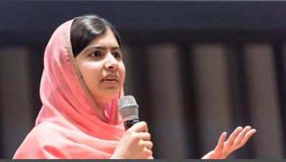
SECONDARY ACTIVITIES 3
You do not need to complete every activity but if you have time, you can try to complete more than one.
What other rights from the CRC do you think link to the International Day of Peace – create a wall display to show this for others in your school.
The United Nations says: ‘Conflict is the greatest threat to children’s rights and magnifies all other threats. Peace remains their best protection.’ In pairs, think about which rights you think might be denied for children living in areas of conflict? Use the CRC summary to help you and then create a mind map to share your ideas.
Messengers of Peace volunteer their own time, talent and passion to help focus worldwide attention on the work of the United Nations. Find out about Messengers of Peace on UN website If you had messengers of peace in your school, what would the message be? Write a job description for them, including the skills, knowledge and values that they would need to have. Could this link to your school's anti-bullying policy?

Slide 13
REFLECTION
Take five minutes to sit peacefully, be still and quiet… to consider all that you could do for yourself.
How does it feel to be at peace with yourself, and in your community?
Being at peace within yourself is important. What one thing could you do to bring greater peace into your own life?
…and to the people around you?

Slide 14
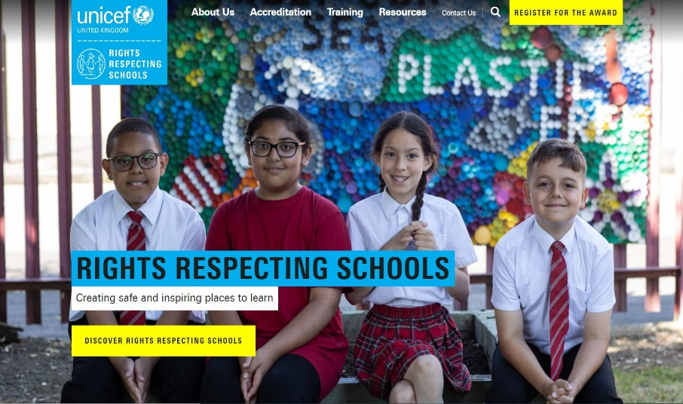
MORE INFO
RRSA WEBSITE
For more information or to download previous Article of the Week packs please visit the RRSA website by clicking on the link below.
CLICK HERE

Slide 15
THANK YOU

