Slide 1



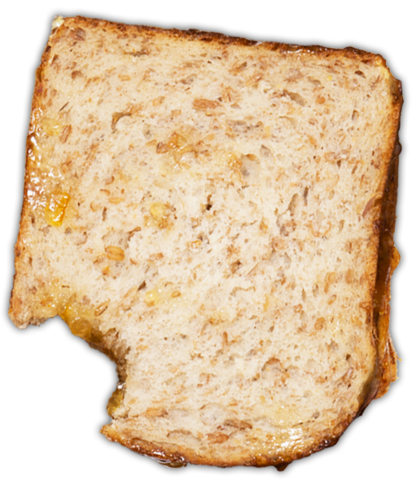
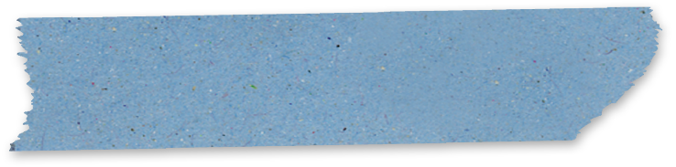



Activity 3
Exploring our community's
health system
© P&Co Ltd/SC 2022
UNICEF UK, registered charity England & Wales (1072612) Scotland (SC043677).
Notes:
Time to put our explorer hats on...!

Slide 2





What does the health system in our community look like?
© P&Co Ltd/SC 2022
Notes:
Warm-up: Can you think of a time when you or someone you know needed to use the healthcare system in your community? (Tip: don't get distracted thinking about marmalade...!)

Slide 3



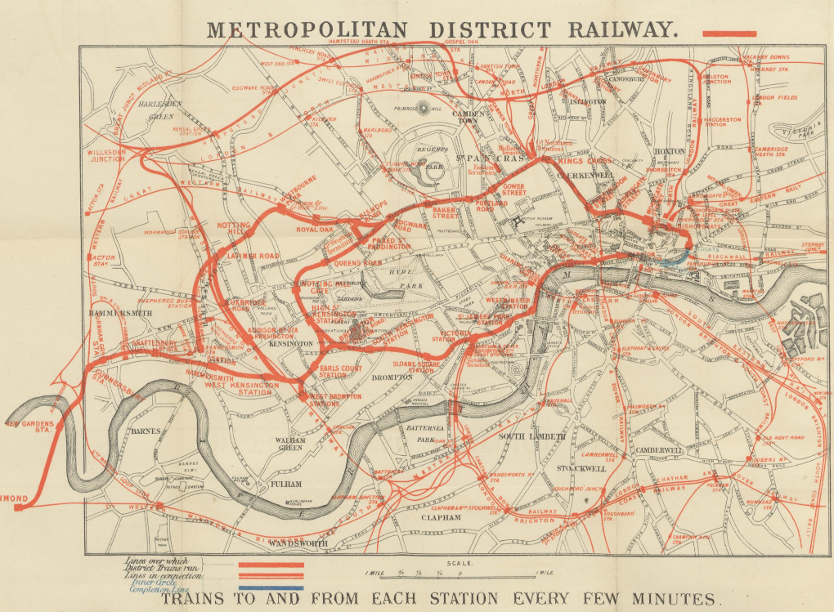



Put on your explorer’s hat: Planning our community health system expedition
© P&Co Ltd/SC 2022
Notes:
Looking at your own map, ask the group to think about how they think the health system works in their community.
Where are the places they go to or might go to for healthcare? Who are the providers of health services they know of? Where are they located? Ask the group to think about the map they've made. Are there any key places that are missing?
Prompt children to think about what they pass when they’re on their way to school, the shops, or the park. Where’s the hospital? The doctor? The local clinic? The dentist? The chemist?
Ask children to add any missing locations to their map. Circle each of these locations on the map, or mark them with a small red + which is an international sign for healthcare.
Use this completed map to plan your community walk.

