Slide 1
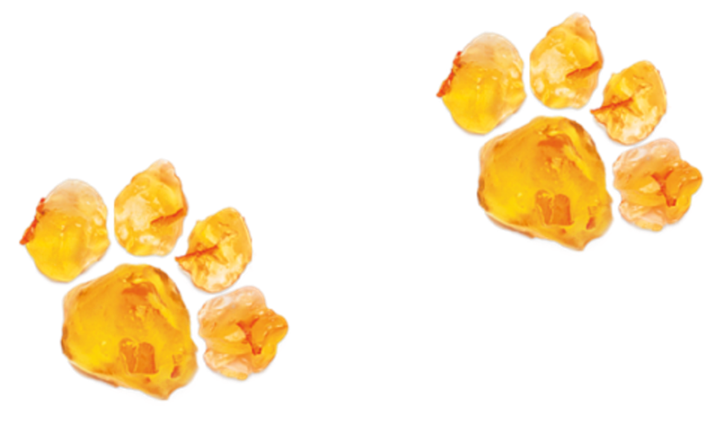
Activity 4
Obstacles to good health
© P&Co Ltd/SC 2022
UNICEF UK, registered charity England & Wales (1072612) Scotland (SC043677).

Slide 2
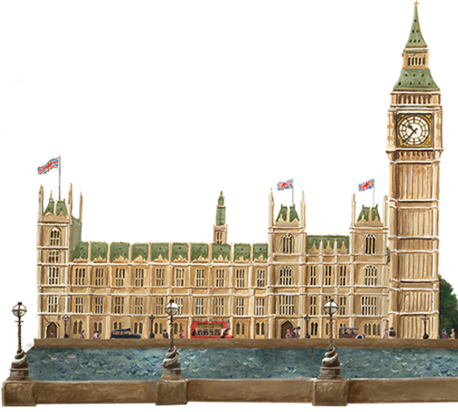
Warm-up
"The sun is out, deep breath in, a spring in my step."
© P&Co Ltd/SC 2022
Notes:
In many places around the world, including here in the UK, weak parts of health systems and other obstacles prevent children from having access to the care they need. This means that children’s right to the best possible health is at risk.
In this activity we’ll explore why health systems sometimes don’t work the way that they should, and how this puts children’s rights and futures at risk.

Slide 3
Risks
and
obstacles
© P&Co Ltd/SC 2022
Notes:
Mr Brown could imagine lots of risks and obstacles that might be involved in looking after a bear in his home!
What risks and obstacles can you imagine children might face when they need help to keep them healthy...?

Slide 4
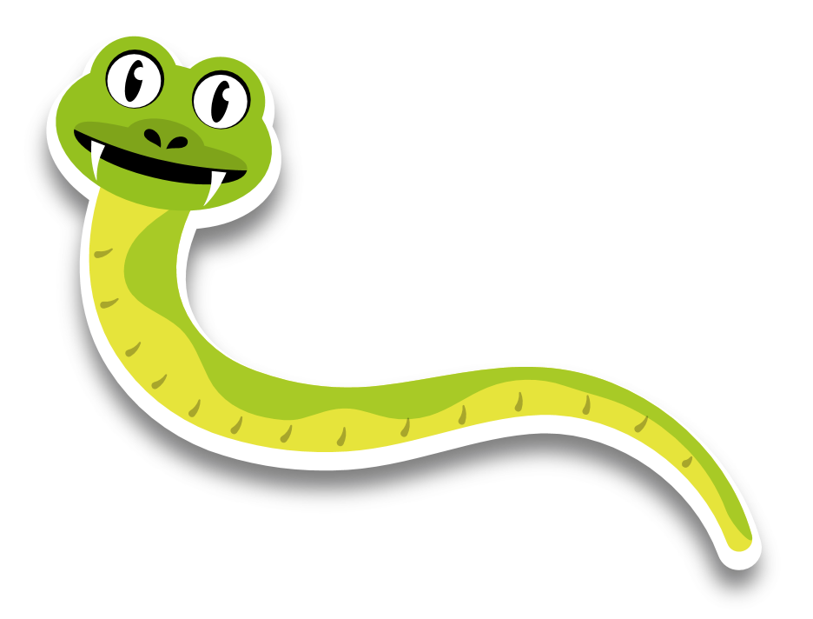
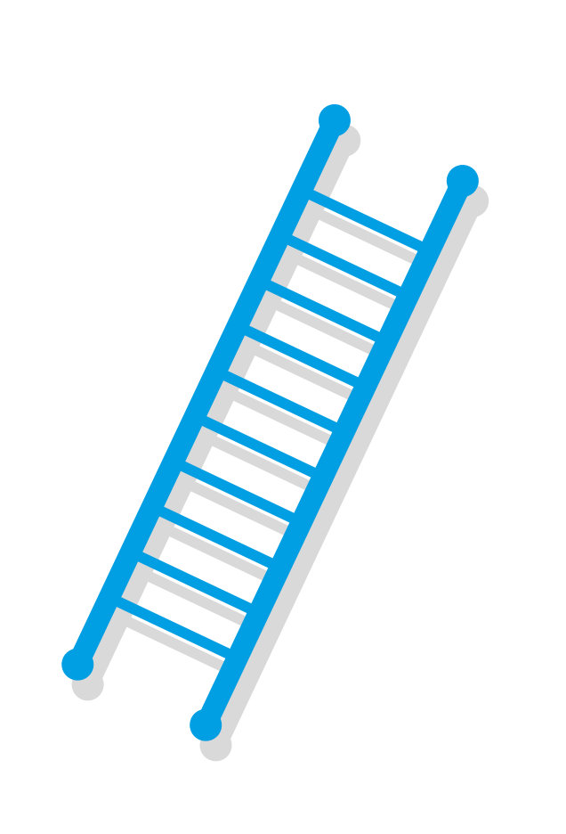
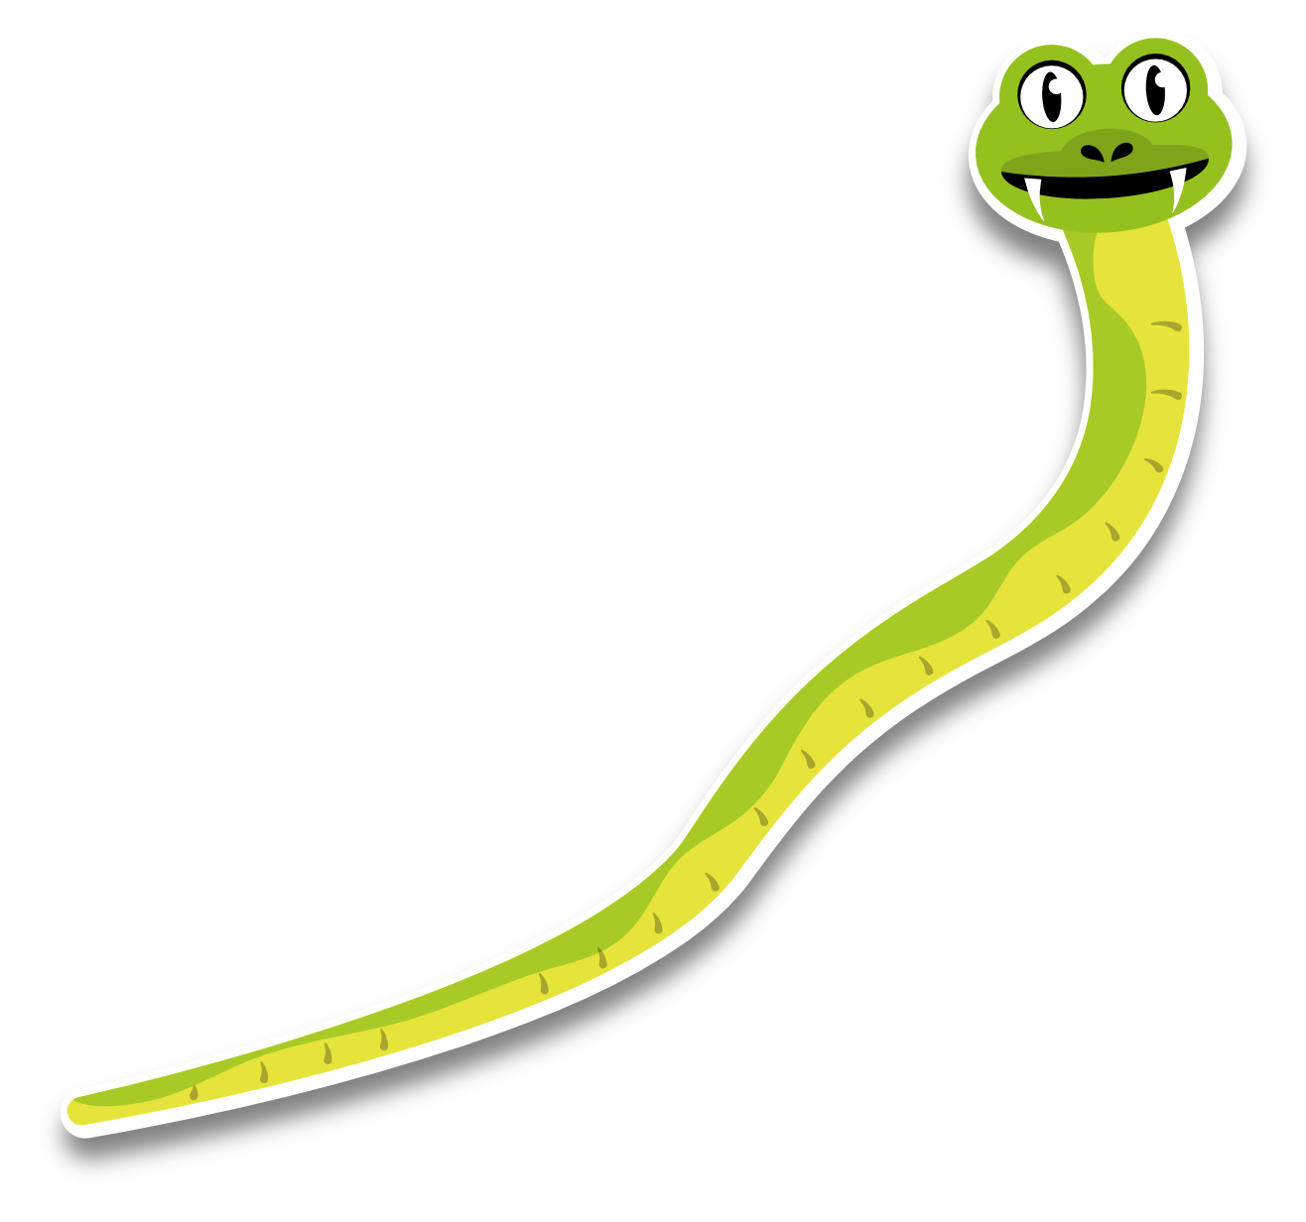
Decorate your game board
Add obstacles at the top of the snakes
Add strengthening solutions to the bottom of the ladders
Roll the dice and play!
Snakes
and
Ladders
© P&Co Ltd/SC 2022
Notes:
Invite the children into a creative activity to make and play their own health systems version of a snakes and ladders game.
Encourage children to choose some of the health system strengthening solutions to sit at the bottom of the ladders, and some of the obstacles and risks to place at the top of the snakes.
After playing the game, ask children to share what they learned about the challenges towards reaching accessible health care for all and why efforts to strengthen health systems are very important to help achieve this.

