Slide 1
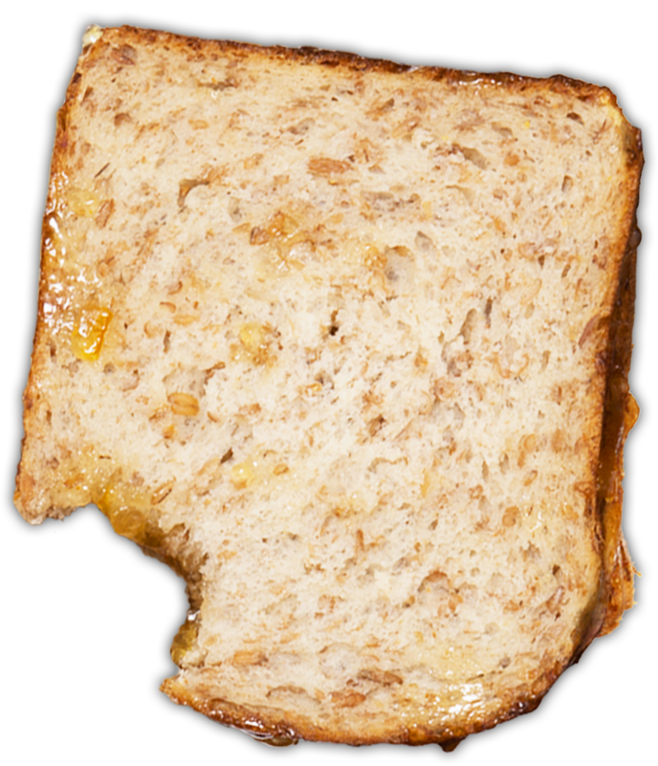
Activity 5
A right to the best possible health...
and the systems that support it
© P&Co Ltd/SC 2022
UNICEF UK, registered charity England & Wales (1072612) Scotland (SC043677).
Notes:
In the last session we explored some of the obstacles that keep people, including children, from accessing healthcare they need. Sometimes these obstacles are physical barriers – for example, in some places there may be no clinic or hospital to go to. At other times, people can be excluded from getting the care they need just because of who they are. This is called discrimination.
In this activity we'll look at the UNCRC articles that say discrimination shouldn't be allowed to get in the way of children's rights.

Slide 2
© P&Co Ltd/SC 2022

Slide 3
Article 2: All children have all these rights, no matter who they are, where they live, what language they speak, what their religion is, what they think, what they look like, if they are a boy or girl, if they have a disability, if they are rich or poor, and no matter who their parents or families are or what their parents or families believe or do. No child should be treated unfairly for any reason.
Notes:
Discrimination means treating someone differently because of how they look, where they come from, what gender they are, what language they speak, what their religion is, who they love, the colour of their skin or the ethnic group they come from, or if they experience any different abilities. Children are sometimes also treated differently because of who their parents are or even where their parents came from.
Article 2 of the CRC tells us that all children should have their rights respected without discrimination.

Slide 4
Article 23: Every child with a disability should enjoy the best possible life in society. Governments should remove all obstacles for children with disabilities to become independent and to participate actively in the community.
Notes:
While Article 2 says that children with a disability should not be discriminated against, Article 23 talks more about this specifically. In the next activity we will explore what discrimination looks like in health systems, and what we can do to help all children be able to experience their rights.

Slide 5
How do you think health systems could change, or be stronger, to make sure everyone gets the care they need?
© P&Co Ltd/SC 2022

Slide 6
Health equity means that everyone has a fair chance to be as healthy as possible.
Notes:
'Health equity' means that everyone has a fair and just opportunity to be as healthy as possible (definition: Robert Wood Johnson Foundation).
Everyone has the same right to be as healthy as possible, but some children who face discrimination or disability might need more access to healthcare in order to be in, and stay in, good health.
By comparison, equality means that everyone gets the same treatment.

