Slide 1
Activity 3
Exploring our community’s health system
UNICEF UK, registered charity England & Wales (1072612) Scotland (SC043677).
Notes:
Invite young people to think quietly about a time when they needed some kind of healthcare: prompt questions are provided in the facilitator notes.

Slide 2
What does the health system in our community look like?
Notes:
Can you think of a time when you or someone you know needed to use the healthcare system in your community?
Ask young people to think about how they think the health system works in their community.
Where are the places they go to or might go to for healthcare? Who are the providers of health services they know of?
Beyond healthcare providers, encourage young people to think about all the parts of the health system and the infrastructure that supports it – government that supports healthcare, supply chains that hospitals and chemists rely on for medicines, testing facilities, universities for training healthcare workers and research, for example.

Slide 3
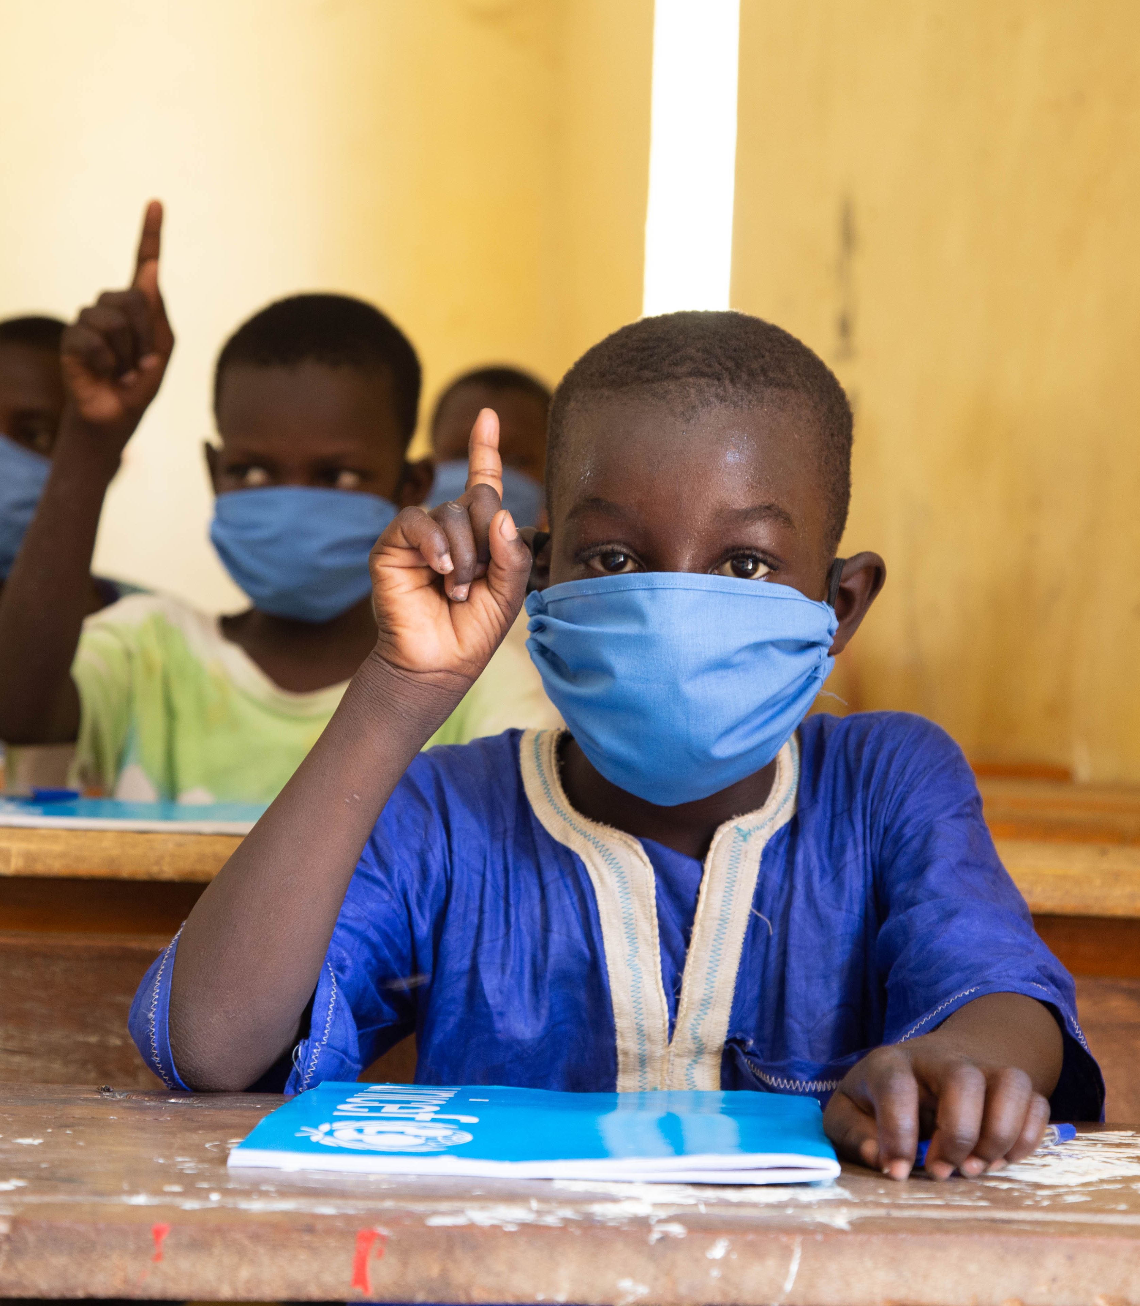
Was there anything that surprised you about mapping the health system in your own community?
What are the strengths of your community’s health system?
What did you notice that could be made better to strengthen your own community health system?
© UNICEF/Pouget
Notes:
Next, you could encourage young people to take or create their own health system quiz.

