Slide 1
Activity 4
Obstacles to good health
UNICEF UK, registered charity England & Wales (1072612) Scotland (SC043677).

Slide 2
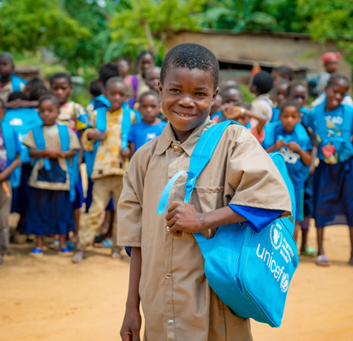
Warm up
© UNICEF/Ziavoula
Notes:
Can you think of a time when you’ve faced an obstacle? What feelings have you had when you couldn’t do something that you needed to do?”
Feeling frustration or anger is normal when we have to face an obstacle.

Slide 3
Obstacles and risks
Notes:
Building on the information from the video and the completed heath system mapping work from starter activity 2, consider two questions in small groups – some focussed on the risks and others on the obstacles:
1) What are some of the obstacles that prevent young people from getting the healthcare that they need (or accessing health systems)?
2) What might be some risks to children and young people if they can’t access health systems because of these obstacles?
Think creatively about not only addressing the problem, but finding a solution for each one of the obstacles – what actions would strengthen health systems? Sometimes we have to look for the problems (risks and obstacles) so we know where to start to look for the solutions to make things better.
Press the play button on the slide, or use this link: https://www.youtube.com/watch?v=JON4SBQLM9I

Slide 4
Health Uncovered with Cel Spellman
Notes:
How can taboos around discussing (the selected podcast topic) openly, whether due to personal beliefs or cultural beliefs in some cases, be an obstacle for people, especially children and adolescents, to having the best possible health?

