Slide 1
Activity 5
Discrimination as a barrier to healthcare (articles 2 & 23)
UNICEF UK, registered charity England & Wales (1072612) Scotland (SC043677).

Slide 2
People with disabilities share their experiences of accessing health services.
Notes:
View one of the WHO videos as an introduction to learn about how people with disabilities are excluded from health systems:
https://www.youtube.com/watch?v=p9OTHFWvG88 or https://www.youtube.com/watch?v=TKzgi5jmgQM

Slide 3
3
Three facts you learned.
2
Two things you want to remember or tell someone else about.
1
One question you still have or would like answered.
Notes:
Following the video, invite young people to reflect on the content using a 3, 2, 1 debrief:
• Three facts that they’ve learned from this video.
• Two things they want to remember or will tell someone else about.
• One question they still have or would like answered about the topic.

Slide 4
Article 2: All children have all these rights, no matter who they are,
where they live,
what language they speak,
what their religion is,
what they think,
what they look like,
if they are a boy or girl,
if they have a disability,
if they are rich or poor, and no matter who their parents or families are or what their parents or families believe or do. No child should be treated unfairly for any reason.
Notes:
In this session we'll be exploring the barriers people face, and thinking about ways in which health systems could change to be fairer, more inclusive and equitable, and therefore stronger.

Slide 5
Article 23: Every child with a disability should enjoy the best possible life in society. Governments should remove all obstacles for children with disabilities to become independent and to participate actively in the community.
Notes:
In this session we'll be exploring the barriers people face, and thinking about ways in which health systems could change to be fairer, more inclusive and equitable, and therefore stronger.

Slide 6
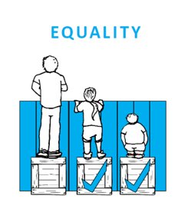
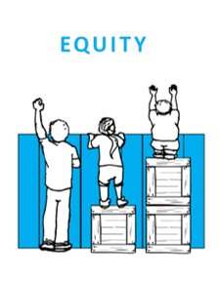
Health equity means that everyone has a fair and just opportunity to be as healthy as possible.
Notes:
Health Equity means that everyone has a fair and just opportunity to be as healthy as possible. [definition Robert Wood Johnson Foundation]
By comparison, equality means that everyone gets the same treatment.
While all children and young people have the same right to be healthy, and to stay in good health, some who face discrimination or have a disability might need more access to healthcare. For example, a child who lives in a country where the health system is not strong may need extra support to be able to get the care they need, which is why organisations like UNICEF work to support healthcare for children in their countries. Likewise, a child with a non-preventable health condition or disability may need to visit a health facility more often or need more types of healthcare.

Slide 7
Article 2
Article 23
Article 24
Discrimination
Health equity
A child in the best possible health
A strong health system
Signs of discrimination
Inequality example
A risk
A strengthening idea
A rights-respecting story
Decorate the 12 sides of your Bloom Ball
Notes:
To better understand the idea of health equity, we’re going to create a Bloom Ball – a paper ball made by joining up 12 pentagon shapes cut out in a circle.
There are 12 questions to answer – one for each pentagon shape.
Write or illustrate CRC Article 2.
Write or illustrate CRC Article 23.
Write or illustrate CRC Article 24.
What does “Discrimination” mean?
What does “Health Equity” mean?
Describe a child who has their right to the best possible health realised.
Describe what a strong health system looks like.
What might be signs of discrimination in a health system?
What are some examples of equity gaps (or inequities) in health systems?
What are the risks when a health system is not equitable?
How could health systems be strengthened to make them more equitable?
Create a scenario or story in which a child who might likely face discrimination gains access to the best possible healthcare because of a strong and equitable health system.
Once all the pages are designed, we'll cut out the 12 circles, and fold the tabs of the circle along the lines of the pentagon inside. We'll then glue the tabs of the 12 pentagons together to form a ball. Then we'll hang our decorated balls up and decorate the room.

