Slide 1
ARTICLE OF THE WEEK
© UNICEF/Dubourthoumieu
Notes:
A teenager accused of theft, accompanied by a social worker and a lawyer, is heard at the children's court in Kisangani, Tshopo province, in the Democratic Republic of Congo, on November 4, 2021. UNICEF supports the operation of the court to ensure respect for children's rights through training and support for lawyers assisting children, mediation committees and data collection.
© UNICEF/Dubourthoumieu

Slide 2
Slide 3: Guess the article
Slide 4: Introducing Articles 37 & 40
Slide 5: Exploring Articles 37 & 40
Slide 6: Some possible answers
Slide 7, 8 & 9: Primary activities
Slide 10, 11 & 12: Secondary activities
Slide 13: Reflection

Slide 3
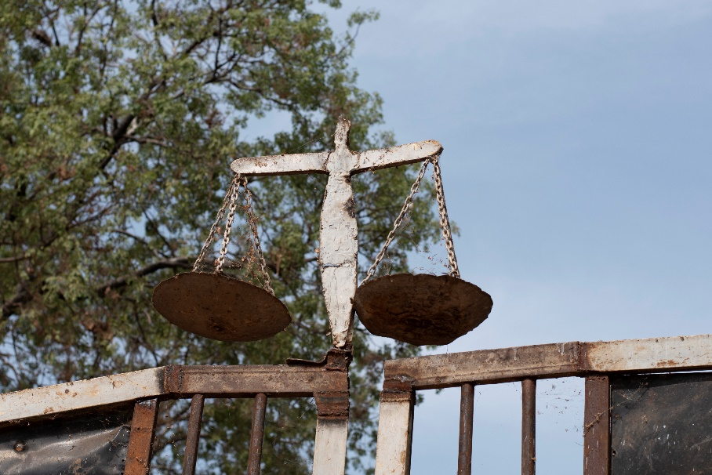
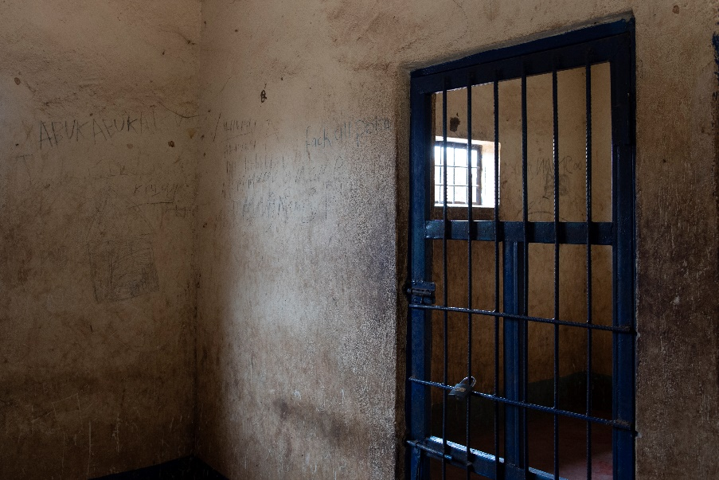
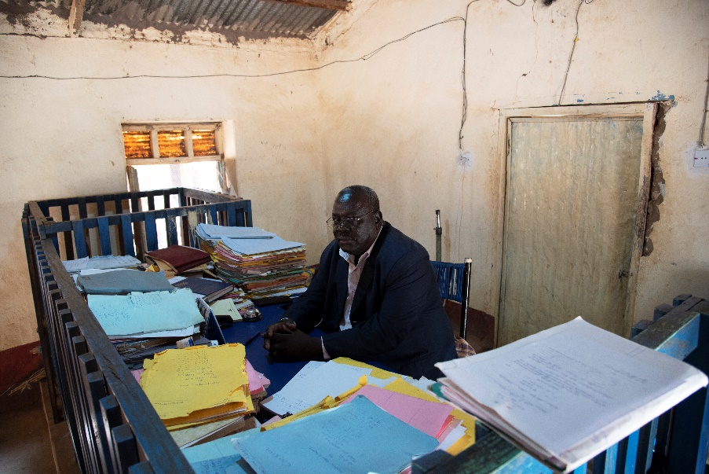
GUESS THE ARTICLE
© UNICEF/Ryeng
© UNICEF/Ryeng
© UNICEF/Ryeng
These pictures provide a clue to this week’s articles.
How do these pictures help you? Can you guess how they are linked together?
Write down your thoughts or discuss with someone in your class.
Notes:
REPLACE IMAGES

Slide 4
ARTICLES 37 & 40
Article 37 (inhumane treatment and detention)
Children must not be tortured, sentenced to the death penalty or suffer other cruel or degrading treatment or punishment.
Article 40 (juvenile justice)
A child accused or guilty of breaking the law must be treated with dignity and respect.

Slide 5
EXPLORING ARTICLES 37&40
Children who are accused or found guilty of breaking the law should be treated with dignity and respect.
How might this happen and what might it include?

Slide 6
EXPLORING ARTICLES 37 & 40
DID YOU THINK OF THESE?
They should be treated with fairness.
They have the right to be listened to.
Their views need to be respected.
The police, lawyers and courts should still treat them as a child.
They should be kept safe.
They should be treated with respect even if they need to be punished.
They should still have access to their rights.
If they are guilty, they need a chance to learn and change their lives.
Did you get anything else?

Slide 7
PRIMARY ACTIVITIES
You do not need to complete every activity but if you have time, you can try to complete more than one.
Watch this video of the book by Julia Donaldson about The Detective Dog, trying to solve a crime. What was the crime and how was it solved? Who was affected?
Use circle time to discuss ways to express your views if you have done something wrong or had something wrong done to you. What are the different ways you can resolve disagreements and hurtful behaviours?
If your school has class/school charters based on children’s rights, have a discussion about how this approach works compared to having rules. Explore how rights respecting charters can help everyone to get along better.
Watch the telling of the story book ‘What if Everybody Did That?’
Use the story to open up an exploration with the youngest children about why we have rules and laws.

Slide 8
PRIMARY ACTIVITIES 2
You do not need to complete every activity but if you have time, you can try to complete more than one.
What is crime? What happens if you commit a crime?
Find out more here about how duty bearers can help children who commit crimes here.
Work in a group to design a leaflet to remind police officers about some of the rights that all children and young people have in the CRC. If you have a school police officer or CPSO, share your work with them.
Think about any books you have read in which a child has broken the law or experiences a crime happening to them. Discuss how they were treated.
Were there any of their rights affected? Gather everyone’s ideas and create a display about this.
The age of criminal responsibility varies country to country. Research the age of criminal responsibility in different countries and present your findings in a creative way such as a graph or infographic. Share your opinions on this? Do you agree? What would you change and why?

Slide 9
PRIMARY ACTIVITIES 3
You do not need to complete every activity but if you have time, you can try to complete more than one.
Article 40 says a child accused of breaking the law must be treated with dignity and respect. Discuss your school’s behaviour and/or relationships policy to see how it ensures all children are treated with dignity and respect. If you have any questions or concerns you could share them with your School Council or arrange to meet your Headteacher to discuss them.
Look at activities from the National Archive about children being imprisoned in Victorian times. The CRC didn’t exist then but imagine it did, discuss experiences of children from a rights point of view.
Imagine a child aged about 11 or 12* had committed a very serious crime and a court decided that they should be placed in special secure care away from family and friends for a year or two. Look at the CRC and discuss in a group how things could be organised to make sure that child could still access their rights.
* The age of criminal responsibility is different across the UK.
Find out about the Sustainable Development Goal (SDG) 16 related to Peace and Justice. How can you and your school help to achieve this global goal? Create a campaign to let others know.

Slide 10
SECONDARY ACTIVITIES
You do not need to complete every activity but if you have time, you can try to complete more than one.
There is much advice and guidance to support young people in understanding the law and their rights. Discuss this in PSHE. Have a look at this website from a charity and this from the Crown Prosecution Service and then share five facts with your class.
The minimum age at which a child can be convicted of a crime is sometimes called the age of criminal responsibility. This varies around the world and within the UK. Do some research about what the minimum age is in different countries. Have a class debate for and against raising the age of criminal responsibility to 16. Here’s an article and information from the NSPCC and the UK government to begin your research.
Article 40 states that a child accused of breaking the law must be treated with dignity and respect. Discuss your school’s behaviour and/or relationships policy to see how it makes sure that all children are treated with dignity and respect, aligned to your rights. If you have any questions or concerns you could share them with your School Council or arrange to meet your Headteacher to discuss them?
What is crime? What happens if you commit a crime? Find out more here.

Slide 11
SECONDARY ACTIVITIES 2
You do not need to complete every activity but if you have time, you can try to complete more than one.
Article 40 says that children who have been through the criminal justice system should be helped to ‘reintegrate into society’. Imagine a friend or relative of yours had been in a youth offenders centre or secure care. How would you and your school community help them to reintegrate? Have a look at this website to find out about support already available.
What is criminal exploitation? Find out about gang behaviour here.
Have you heard of ‘restorative approaches’? Does your school use them? Find out more here and then discuss as a class how such approaches could be used alongside children’s and young people’s rights in and out of school. Could this support the review and development of a new behaviour/relationships policy in your school?
When anyone is found guilty of serious offenses most people agree that there should be consequences, even prison or secure care. Apart from this being a ‘punishment’ why else should it happen? This article may help your discussion.

Slide 12
SECONDARY ACTIVITIES 3
You do not need to complete every activity but if you have time, you can try to complete more than one.
Just like many other areas of life, there is evidence of racial discrimination in the Criminal Justice System. Read this report from the campaign organisation Justice. Can you see how many articles of the Convention you can link to their recommendations?
Read the Executive Summary of A Rights-Based Analysis of Youth Justice in the UK that was recently produced by the UK Committee for UNICEF (UNICEF UK). Look at the recommendations for your part of the UK. If you agree with the recommendations write a letter to a local politician to ask for change.
Just for Kids Law is a charity to support children and the law. Find out about youth advocacy – what does this involve?

Slide 13
REFLECTION
Take a few minutes to be still and quiet and have some time to yourself:
Article 40 says that even when children have done something wrong, they must be treated with dignity and respect.
Think about why this is so important:
How does it feel to be respected?
How you show respect for others and uphold their dignity as a person?

Slide 14
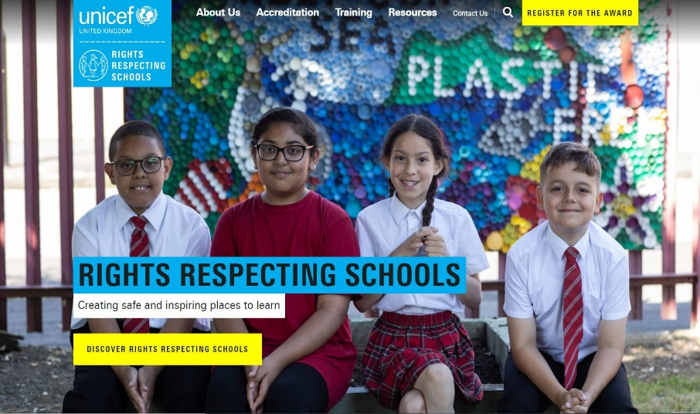
MORE INFO
RRSA WEBSITE
For more information or to download previous Article of the Week packs please visit the RRSA website by clicking on the link below.
CLICK HERE

