Slide 1
ARTICLE OF THE WEEK
Notes:
Ilda Sofia Vasquez and Brandon Vasquez, both 10 years old play outside while their parents participate in a workshop supported by UNICEF about online security and positive parenting practices in Nikajkim Comunity, Utatlan, Solola Guatemala.

Slide 2
INSTRUCTIONS
Slide 3: Guess the article
Slide 4: Introducing Article 16
Slide 5: Exploring Article 16
Slide 6: Some possible answers
Slide 7, 8 & 9: Primary activities
Slide 10, 11 & 12: Secondary activities
Slide 13: Reflection

Slide 3
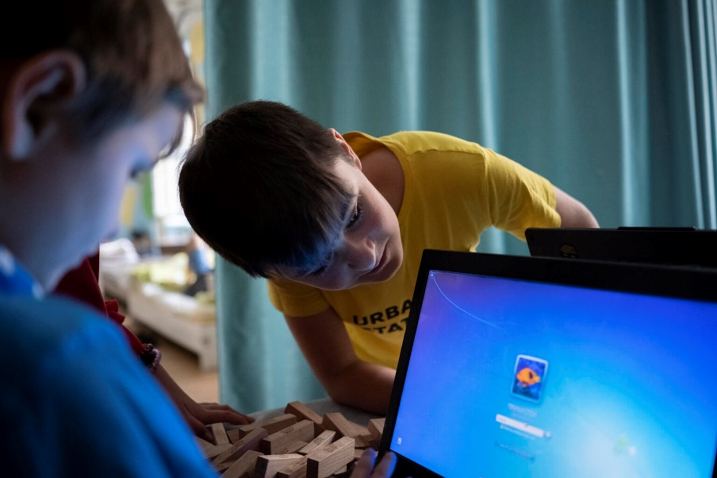
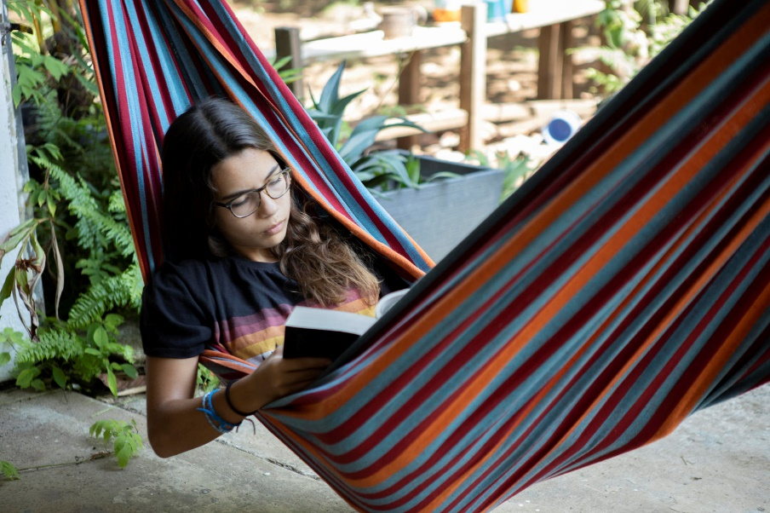
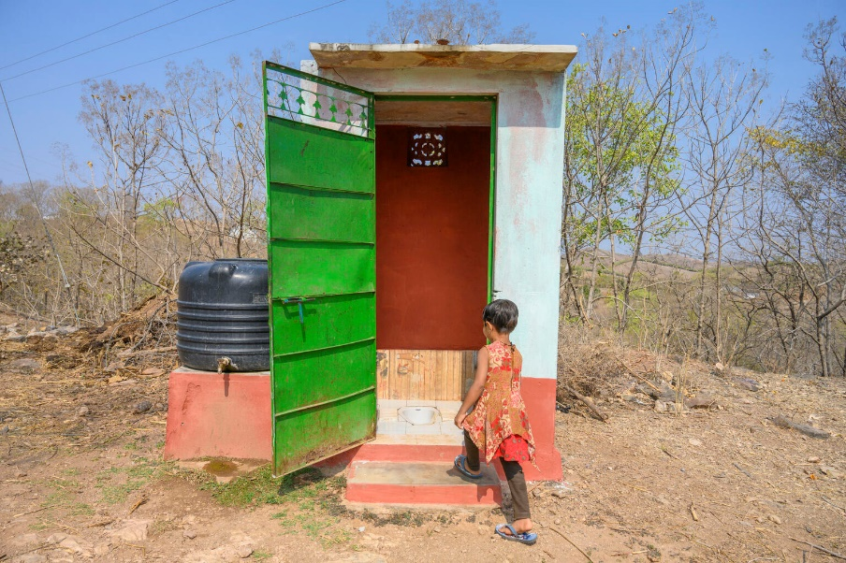
GUESS THE ARTICLE
@UNICEF/Gilbertson - Highway Child
@UNICEF/Schverdfinger
@UNICEF/Panjwani
These pictures provide a clue to this week’s articles.
How do these pictures help you? Can you guess how they are linked together?
Write down your thoughts or discuss with someone in your class.

Slide 4
ARTICLE 16
Isobel Mitchell, RRSA Professional Adviser,
introduces Article 16
Article 16 (right to privacy)
Every child has the right to privacy. The law should protect the child’s private, family and home life, including protecting children from unlawful attacks that harm their reputation.
Click here to watch on YouTube

Slide 5
EXPLORING ARTICLE 16
Why is privacy important to you?
Have a think and write down some answers.

Slide 6
EXPLORING ARTICLE 16
Did you think of these?
Not everyone should know everything about me.
It helps me to have personal space.
It helps to keep me safe online and in the real world.
Children are at risk of being harmed if the wrong people know too much about them.
Things about identity, location, health and personal life, are private to me.
I should be able to record my thoughts and feelings without others looking at them.
People might judge me or make assumptions about me.
People might not understand me for who I am.
I should be able to choose the right time to share and with whom.
What else did you think of?

Slide 7
PRIMARY ACTIVITIES
You do not need to complete every activity but if you have time, you can try to complete more than one.
For the youngest children, find a way to open up a conversation to deepen their understanding of privacy. Read a traditional fairy tale such as Goldilocks and the Three Bears or Cinderella – think about how the right to privacy was affected by what happens in the stories, for example, how would the three bears feel about a stranger coming into their house when they were not there?
Can you design a special box to keep all your secret and special things in? How would people know it belonged to you and know not to look in it without asking? You might use your design to decorate a shoe box or other empty box.
Watch this telling of the book 'Some Secrets Should Never be Kept' by Jayneen Sanders and use as class discussion.
*Teachers - this story contains sensitive subjects so please watch it first before sharing with the class.
What do we do to keep things safe and private? Listen to this story, ‘Password Please?’, and then discuss with your class the lessons you have learnt from the story.

Slide 8
PRIMARY ACTIVITIES 2
You do not need to complete every activity but if you have time, you can try to complete more than one.
Talking about the right to privacy might make you think about personal space. Discuss with your teacher and class what personal space means and how we respect each other’s personal space. This ‘social story’ in symbol format may help the discussion. Create a set of top tips or design a poster to remind everyone about personal space.
Watch this video about privacy online. Use this as a starting point for a class discussion.
You want to have a private conversation with an adult at school. How does your school help that to happen - which rooms can you have private conversations in and when is a good time? Discuss in your class and agree whether the school can do more to improve your right to privacy. You might ask your headteacher to follow up any suggestions.
You have the right to privacy. Think about a two-year-old, a 10-year-old and a 16-year-old. What are the similarities and differences in the types of privacy that should be respected at these ages?

Slide 9
PRIMARY ACTIVITIES 3
You do not need to complete every activity but if you have time, you can try to complete more than one.
Look at a summary of the CRC. In a group, discuss how right to privacy might connect with other articles. How does privacy link to a person’s dignity?
Have you looked at the PANTS resources from the NSPCC in your school? What can you remember about this? Discuss how these link to your right to privacy.
Did you know there is a ‘Children’s Code’ which companies should follow to keep children safe and respect their right to privacy online? It came into law in September 2021. See the Newsround article about this and talk with your class and teacher about it.
Think about why privacy is important to you. Have a go at showing your reasons in way that works for you. It could be a list, a piece of creative writing or a picture.

Slide 10
SECONDARY ACTIVITIES
You do not need to complete every activity but if you have time, you can try to complete more than one.
Have you ever discussed privacy settings on devices at home? Read this article from the e-safety organisation Internet Matters. Have a discussion in class (and at home too) about the value of safe settings and parental controls.
You want to have a private conversation with an adult at school. How does your school help that to happen - which rooms can you have private conversations in and when is a good time? Discuss in your class and agree whether the school can do more to improve your right to privacy. You might ask your headteacher to follow up any suggestions.
Look at a summary of the CRC. In a group, discuss how right to privacy might connect with other articles. How does privacy link to a person’s dignity?
Watch this film about how information shared on social media is used by others. What kind of information might you regularly share on social media? Your location? Posts you have ‘liked’? A photo of you and friends? Items you have bought?
Discuss the risks of sharing this information in relation to a) your right to privacy b) Your right to be protected from harm and c) Your future life.
Think of three top tips you would give to someone new to social media to protect them from harm, now and in the future.

Slide 11
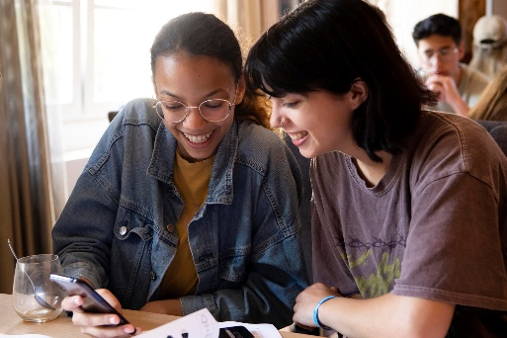
SECONDARY ACTIVITIES 2
You do not need to complete every activity but if you have time, you can try to complete more than one.
‘The Age Appropriate Design Code’ requires companies that run social media platforms such as Instagram and Snapchat to improve their privacy settings for under 18s. Research this code on BBC and The Guardian. What do you think of it? Does it go far enough or too far? Would it be easy for under 18s to get around it?
Not everyone has a bedroom of their own or a space that is private. What advice would you give someone about how they can still enjoy a sense of privacy and personal space in other ways – walking outdoors for example?
Children and young people have a right to privacy and yet it’s important that parents and carers monitor their use of the internet to help keep them safe and protected. Write a page for a parenting guide about how to respect a child’s right to privacy as that child grows into an adolescent. Ensure that this is balanced with an adult’s responsibility for keeping them safe. Try and find time to have this conversation with the adults in your family.
Create a short presentation about how the right to privacy is respected in school. This presentation could be shared in PSHE or in an assembly. Is there a way of sharing ideas to improve everyone’s privacy?

Slide 12
SECONDARY ACTIVITIES 3
You do not need to complete every activity but if you have time, you can try to complete more than one.
Think about why privacy is important to you. Think about a two-year-old, a 10-year-old and a 16-year-old. What are the similarities and differences in the types of privacy that should be respected at these ages? Write a letter to your six-year-old self explaining why the right to privacy is important.
“I have the right to keep my phone calls, social media and emails private.” Work with your peers to create a drama scenario in which a teenager is talking with their parent about their right to privacy. How might the parent respond? Try to see the debate from both sides.
Why is privacy important to us as people? How does it feel when your privacy is invaded? Why is it sometimes hard to respect another person’s privacy? Discuss these questions in a group, then work together to find a creative way to collate and feedback your ideas.
Imagine this scenario (or make up one of your own): A celebrity includes their child in a ‘reality’ television show. Discuss in groups what you think about this. What impact might this have on the child?

Slide 13
REFLECTION
Give yourself some time and space – a moment of privacy! Have a think about the following questions:
Why is your privacy important to you?
What do you do to respect other people’s right to privacy?
What other rights are connected to the right to privacy?

Slide 14
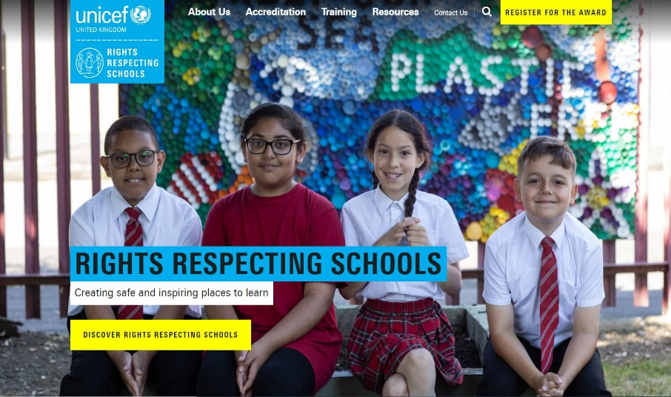
MORE INFO
RRSA WEBSITE
For more information or to download previous Article of the Week packs please visit the RRSA website by clicking on the link below.
CLICK HERE

Slide 15
THANK YOU

