Slide 1
ARTICLE OF THE WEEK
Photo by Elina Sazonova from Pexels

Slide 2
INSTRUCTIONS
Slide 3: Introducing Remembrance – Article 38
Slide 4 & 5: Exploring Remembrance - Question and Answers
Slide 6, 7 & 8: Primary activities
Slide 9, 10 & 11: Secondary activities
Slide 12: Reflection

Slide 3
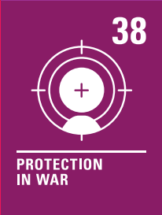
REMEMBRANCE &
ARTICLE 38
Remembrance & Article 38
Remembrance unites people of all faiths, cultures and backgrounds in honouring those who defend our democratic freedom and way of life.
The UK has a long tradition of marking Armistice Day, calling to mind the moment when fighting ceased at the end of the First World War, at 11.00am on the 11th November 1918.
Kathy Allan, RRSA Professional Adviser,
introduces Remembrance, Article 38
Article 38
Governments must not allow children under the age of 15 to take part in war or join the armed forces. Governments must do everything they can to protect and care for children affected by war and armed conflicts.
Click here to watch on YouTube

Slide 4
EXPLORING REMEMBRANCE
Why is it important to remember and commemorate those who have fought in wars?
How does this link to Article 38 of the Convention?
Have a think and write down some answers.

Slide 5
EXPLORING REMEMBRANCE
Did you think of these?
Children have a right to be protected during war.
It’s important to remember and acknowledge those who have fought to keep children safe and to show thanks.
Children have a right to life. During wars, some people lose their own lives to protect the lives of children and their communities. It is important to remember their sacrifice.
If we forget about wars that have protected our way of life, we might make the same mistakes again.
Children under 15 should not take part in war.
It is important to think about how we can achieve a more peaceful future.
It is important to consider ways to avoid war to resolve conflict.
Remembrance unites people of all faiths cultures and backgrounds.
Did you think of any other reasons?

Slide 6
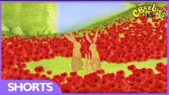
PRIMARY ACTIVITIES
You do not need to complete every activity but if you have time, you can try to complete more than one.
UNICEF was created in 1946 to help protect and support children after World War II. Find out more about UNICEF’s history and how we have supported children, including those affected by wars, ever since. Create your own timeline of interesting facts about UNICEF, the Convention and war. These pages might help to start you off: UNICEF - history of child rights, and UNICEF history.
There are many children in the world today who are affected by war. War Child is a charity that works to protect the rights of children in five countries where there is conflict. Find out more about their work here. What could you do to advocate for the rights of children affected by war?
.
Fighting and wars can be complicated.
Read or listen to the story Tusk Tusk by David McKee. Why do you think peace is important? What would you say to the small ear and large ear elephants towards the end of the story?
Poppies are used as symbols during Remembrance Day events. Watch this short CBeebies animation and discuss what the film is about. Discuss how the rabbit is feeling during the war. If the rabbit was a child, what rights are affected?

Slide 7
PRIMARY ACTIVITIES 2
You do not need to complete every activity but if you have time, you can try to complete more than one.
Through history children have often been forced to fight in wars. UNICEF rescues children who are forced to fight. Watch this video about the recent war in South Sudan. Discuss in class why using children to fight in wars is wrong.
A growing number of children and young people joining schools in the UK are refugees fleeing from countries at war. How can schools support such pupils and help them to feel welcome? What role could fellow students play in this?
In this short film, you’ll see the girls lay a poppy wreath at a memorial, which is a traditional part of Remembrance Day events. Why not try making your own remembrance wreath from recycled materials? Where might you put it?
If someone is worried about conflict at home or around the world,
who can they tell?
Talk about the different people that you can talk to if you have a worry or don’t feel safe.

Slide 8
PRIMARY ACTIVITIES 3
You do not need to complete every activity but if you have time, you can try to complete more than one.
How do you commemorate Remembrance Day in your school? Learn more about the importance of the day here and develop your own activity to help everyone in school to reflect and remember.
Is there a war memorial near you? If it’s close enough, you could visit it, otherwise your teacher might be able to show it on screen. Could you make your own version with classroom materials or maybe draw a picture of it?
Many organisation are involved in Remembrance Day. Do some research about how the day is marked across the UK and share what you find with others in your school, perhaps as part of a remembrance assembly.

Slide 9
SECONDARY ACTIVITIES
You do not need to complete every activity but if you have time, you can try to complete more than one.
Remembrance Day was originally called Armistice Day - find out why it was changed? Would you change what happens on Remembrance Day? Should it be a day for taking action and not just remembering? You can find more information here.
UNICEF was created in 1946 to help protect children after World War II. Find out more about UNICEF’s history and how we have supported children, including those affected by wars, ever since. Create your own timeline of interesting facts about UNICEF, the Convention and war. These pages might help to start you off: UNICEF - history of child rights and UNICEF history.
Write a report on the history of a nearby war memorial, like this one about the Cenotaph.
Watch this powerful message from a former child soldier. What do you think are the main points Ishmael is making? Do his words challenge or inspire you? If so, create a piece of art, drama or writing in response.

Slide 10
SECONDARY ACTIVITIES 2
You do not need to complete every activity but if you have time, you can try to complete more than one.
It’s easy to think that only men are involved in war, but that’s not the case - find out more about Noor Inayat-Khan and these other courageous women on The Commonwealth War Graves Commission website. Find a way of sharing what you discover.
Where is there conflict in the world right now? Why do you think we hear more about some conflicts on the news than others? Create a display that highlights the current the conflicts you have researched.
UNICEF said, “Children bear no responsibility for war. Yet they suffer its consequences for life.” Watch this hard-hitting, animated poem, strongly opposing children under 18 being recruited as soldiers. Look at the questions and other information on the website and have a discussion in class about the issues raised. Can you write your own poem to express your thoughts, particularly on how children's rights are affected?*
*We recommend this activity for upper secondary years with staff supervision and support.
Find out about the targets of the UN Global Goal 16 (Peace & Justice) and discuss in groups how you can contribute to achieving these targets. Small changes can have big impact. Write an action plan outlining who will do what and when.

Slide 11
SECONDARY ACTIVITIES 3
You do not need to complete every activity but if you have time, you can try to complete more than one.
A growing number of children and young people joining schools in the UK are refugees fleeing from countries at war.
How can schools support such pupils and help them to feel welcome? What role can you as pupils play in this?
The rights within the Convention are indivisible – a child should have all of their rights, all the time. Look at the Convention and try to identify how many other rights might be affected when a child or young person’s life is disrupted by armed conflict or war.
In recent years different types of poppy have emerged and wearing (or not wearing) a particular poppy can cause controversy. This Guardian article explains the general argument but do some research of your own, or have a class discussion about the points raised.
Back in 2016, the men’s national football teams of England and Scotland were set to be punished by FIFA for featuring the poppy emblem on their shirts, as reported by Newsround at the time. FIFA has since lifted the ban.
Do you think they made the right decision?

Slide 12
REFLECTION
Give yourself some time and space and have a think about the following questions:
Do you have a safe, quiet space in your school to help you reflect and think?
Or maybe you have space at home or in the local community?
Think about where this is and how it makes you feel.
Use this space to consider those who have lost their lives in war and conflict helping to bring freedom and a better life for others.
Reflect on how these people’s sacrifice has supported you to access your rights?

Slide 13
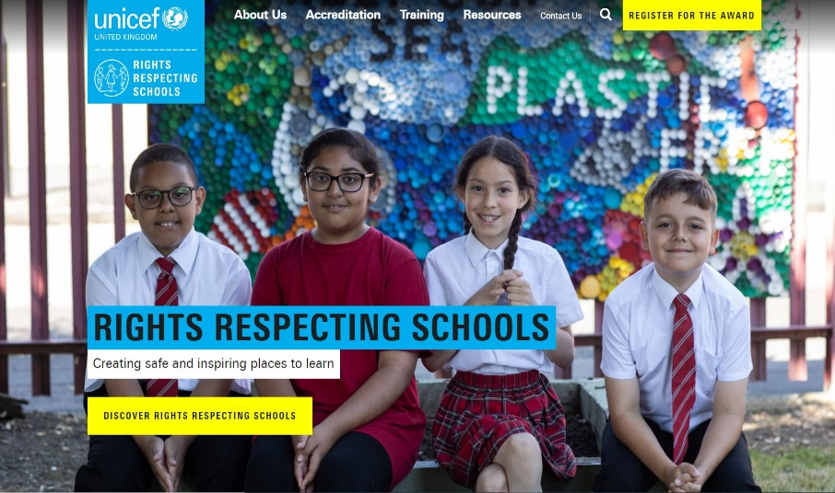
MORE INFO
RRSA WEBSITE
For more information or to download previous Article of the Week packs please visit the RRSA website by clicking on the link below.
CLICK HERE

Slide 14
THANK YOU

