Slide 1
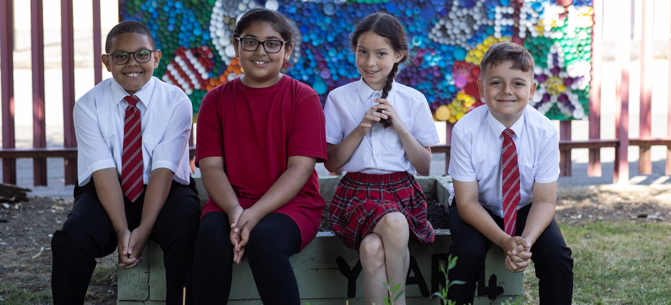
Activity 6
A right to healthcare and the systems that support it
©UNICEF/Dawe
UNICEF UK, registered charity England & Wales (1072612) Scotland (SC043677).

Slide 2
What was it like getting healthcare during the COVID-19 pandemic?
What do you think the world learned from the pandemic that could improve healthcare systems, so they're stronger for the future?
Time to think...
Notes:
More prompts if they help: Did you ever need to see a doctor, optician or physiotherapist but weren’t able to? Did you miss any vaccinations? What about your family?

Slide 3
Healthcare systems around the world

Slide 4
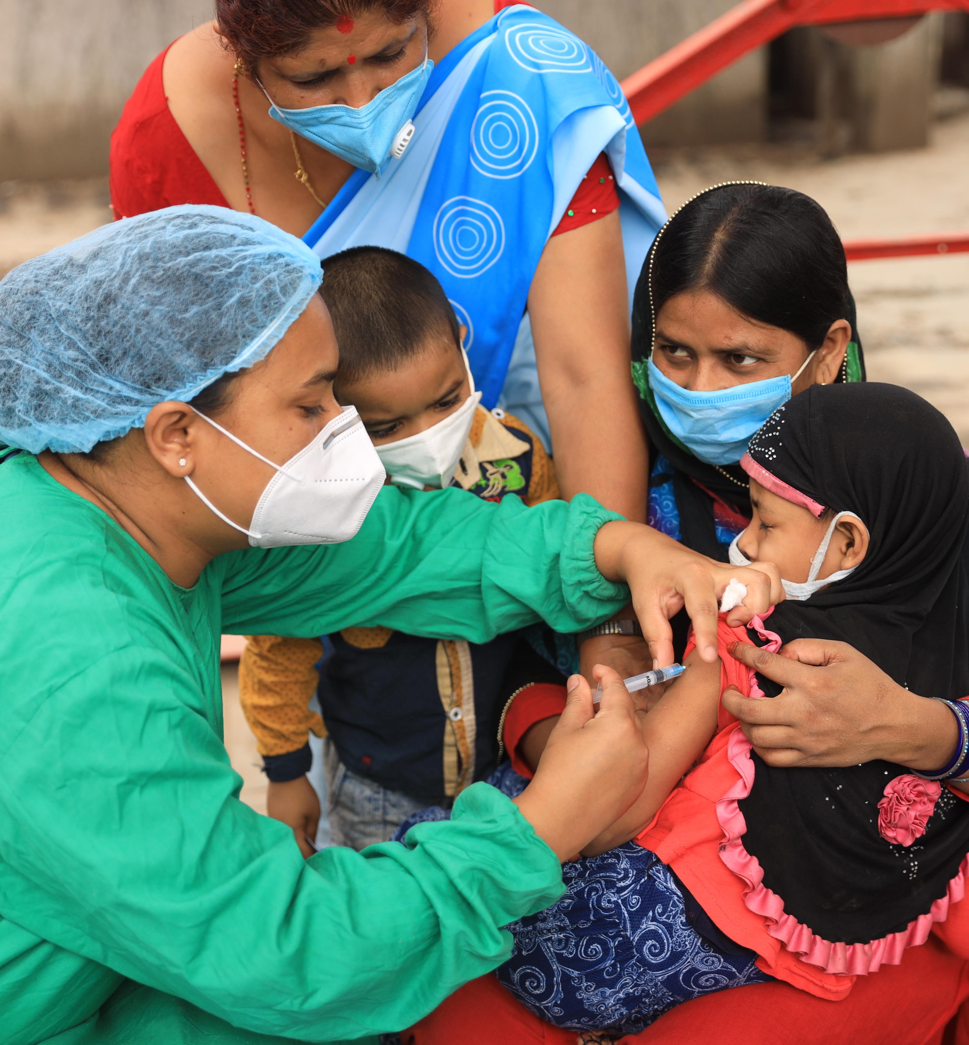
Getting our vaccinations – for the best possible health
©UNICEF Nepal/2020/LPNgakhusi
Notes:
The COVID-19 pandemic around the world has overwhelmed health systems and interrupted routine immunisation services that prevent childhood diseases like measles.
In Nepal, the national measles vaccine campaign was stopped in 2020 because of the COVID-19.
UNICEF, alongside WHO (The World Health Organisation), helped support the government of Nepal to design a way that they could carefully complete the vaccine campaign during the pandemic so children wouldn’t be at risk of the measles, which is a preventable disease.
In this picture, Farinda (aged four) is held by her mother while she gets the measles-rubella (MR) vaccine at an immunisation centre in Kathmandu, Nepal.
Health systems must be stronger so children don’t lose out on their right to the best possible health when a crisis happens like the COVID-19 pandemic.

Slide 5
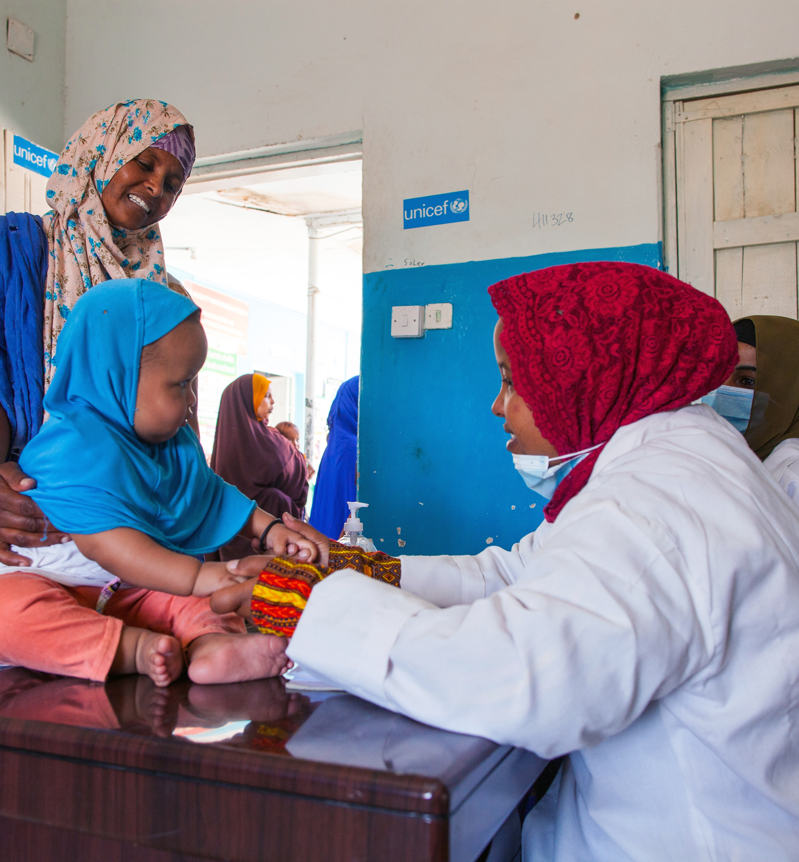
Better nutrition – for the best possible health
©UNICEF
Notes:
In Somalia there is a severe drought and almost 5 million children aren’t able to get the nutritious food they need to stay healthy. [Source: UNICEF]
Health services in the country are unavailable or unreachable, making newborn babies and young children especially vulnerable to harm.
Simple, and low-cost community health clinics provide a basis for improving the health of young children. Health workers at the clinic diagnose and treat common childhood illnesses; vaccinate children against measles, meningitis and other diseases; provide nutrition counselling and treatment; and distribute hygiene kits to families. They also teach community members about important health practices.
Dr Zahara Mohmud attends to a malnourished baby at the UK Government and UNICEF-supported health centre in Hargeisa, Somaliland.
Health systems must be stronger, so children don’t lose out on their right to the best possible health when crises like drought come.

Slide 6
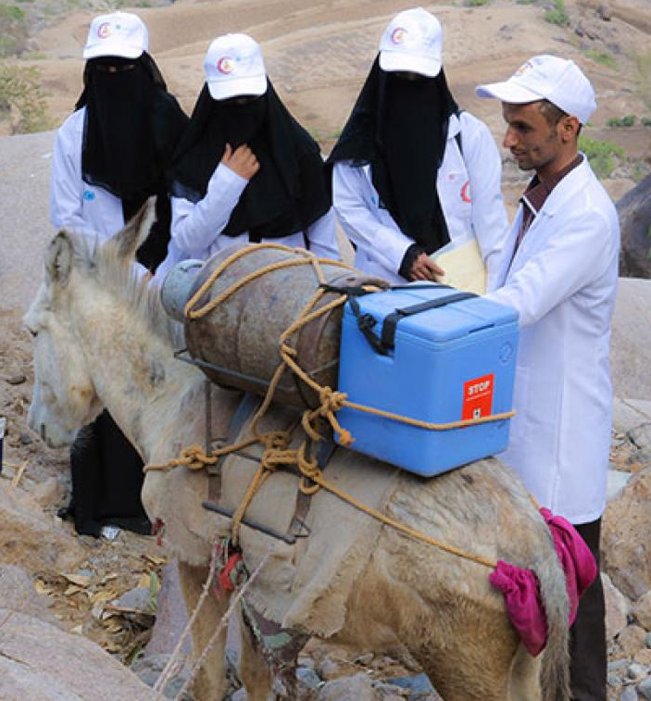
Getting the medicines and vaccines we need – for the best possible health
@UNICEF/Al-Zikri
Notes:
In Yemen there has been a war going on for many years which has affected the country’s health system terribly.
Over half of all medical facilities in Yemen are closed because of possible dangers, and it’s hard for people to travel to get healthcare because the roads are blocked, there are fuel shortages, and many people live in remote areas.
Because the health system isn’t strong, it’s hard for children to access immunisations and basic healthcare.
In this picture, you see a team of health workers who are traveling by foot to reach a mountain community to deliver vaccines and vitamins to help keep children in the best possible health. The fifth member of the team is a donkey. The donkey carries a gas cylinder, which powers a generator to keep the vaccines cold on the journey up and over the mountain.
Health systems must be stronger, so children don’t lose out on their right to the best possible health when conflict arises.

Slide 7
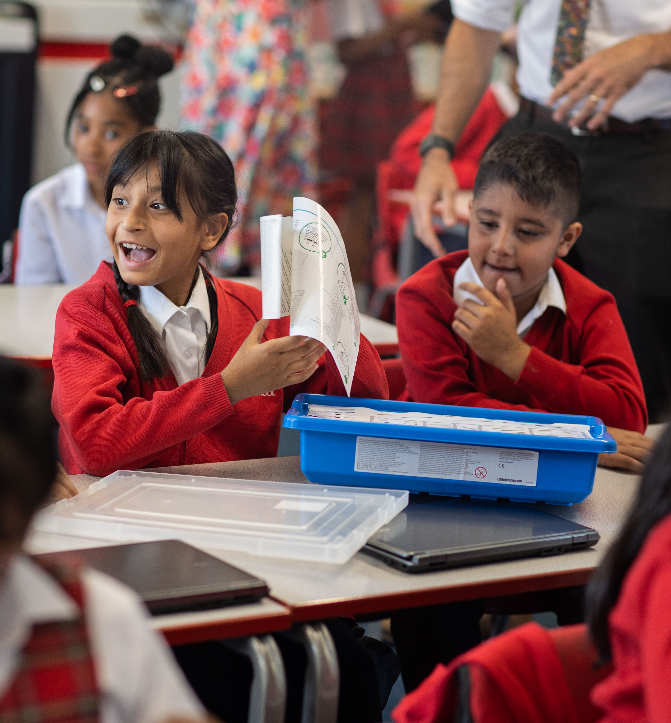
How could the health system in this country be strengthened?
How should the UK help children in other countries to realise their right to the best possible health?
©UNICEF/Dawe
Notes:
In each of these stories, UNICEF is working here to help fill needs where there are gaps in the health system so that children’s rights are realised, but it shouldn’t have to be this way. Every child has the right to have access to a strong healthcare system that supports them to achieve their best possible health.
Work in small groups to consider these questions, thinking about your chosen country. Then rewrite the story so it has a stronger health system and a rights-respecting ending, sharing with the rest of the wider group.

