Slide 1
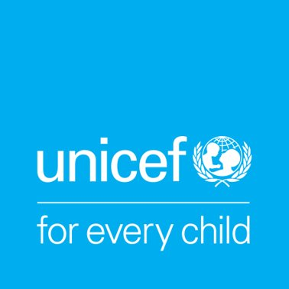
Activity 6
What happens when health systems fail
UNICEF UK, registered charity England & Wales (1072612) Scotland (SC043677).
Notes:
Health systems and access to these systems can look very different in countries around the world. While some countries like the UK have a healthcare system like the NHS, intended to give everyone in the UK access to the care they need, about half of the world’s population goes without regular, affordable, reliable access to healthcare. In these places, children are being denied their right to the best possible health.
Prompts to get the group thinking:
Did you ever need to see a doctor but weren’t able to access one? Did you miss any vaccinations? What about your family?

Slide 2
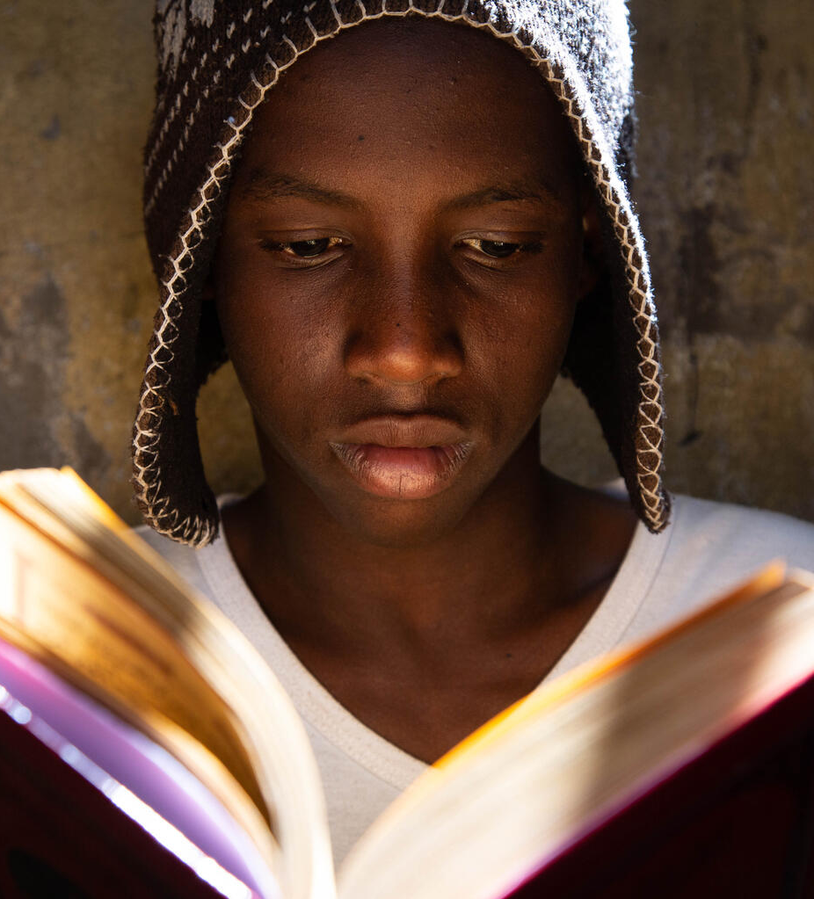
Reflection time
What was your experience like with getting healthcare during the COVID-19 pandemic?
What do you think the world has learned from the COVID-19 pandemic that has the power to improve and strengthen healthcare systems for the future?
© UNICEF/Pouget
Notes:
At the end of the warm-up time, consider repeating the breathing exercise from activity 4 if talking about COVID brings up emotions for any young people in the group.

Slide 3
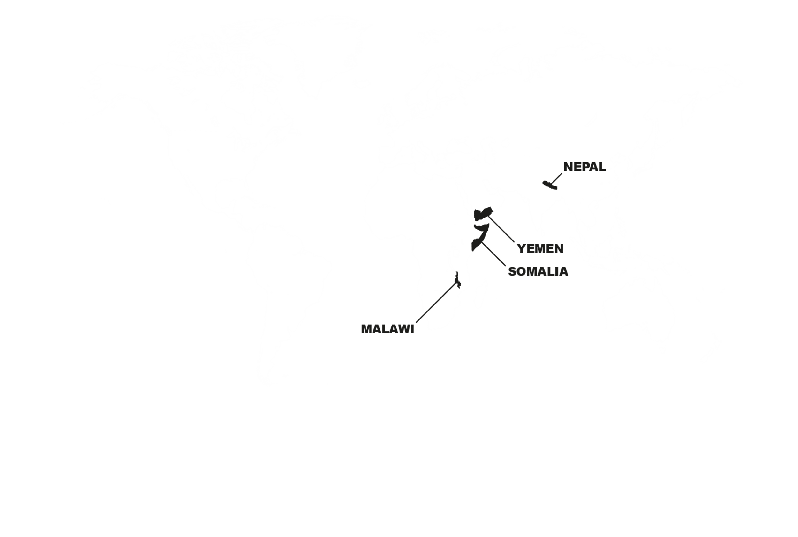
Healthcare systems around the world
Notes:
In this activity we’ll think beyond the UK to consider what healthcare and health systems look like in some other places in the world.

Slide 4
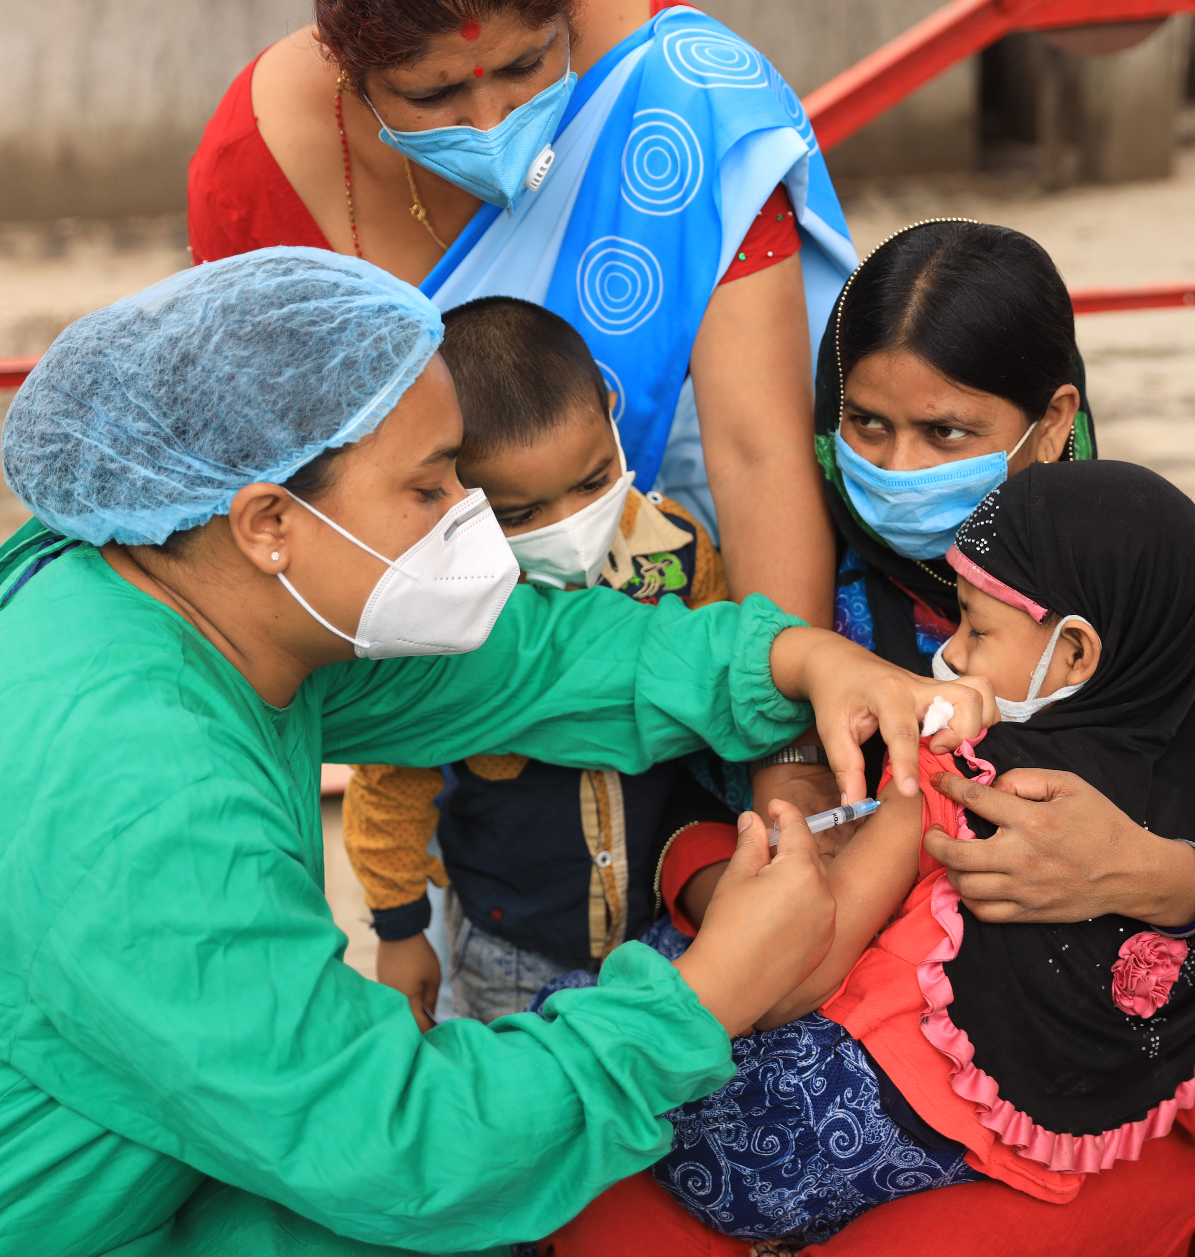
Getting our vaccinations – for the best possible health
©UNICEF/Ngakhusi
Notes:
The COVID-19 pandemic around the world has overwhelmed health systems and interrupted routine immunisation services in many countries that prevent childhood diseases like measles.
In Nepal, the national measles vaccine campaign was stopped in 2020 because of COVID-19.
UNICEF, alongside WHO, helped support the government of Nepal to design a way that they could carefully complete the vaccine campaign during the pandemic, so children wouldn’t be at risk of the measles, which is a preventable disease.
In this picture, Farinda (age 4) is held by her mother while she gets the measles-rubella (MR) vaccine at an immunisation centre in Kathmandu, Nepal.
Health systems must be stronger so children don’t lose out on their right to the best possible health when a crisis happens like the COVID-19 pandemic.
Read more here: https://www.unicef.org/nepal/stories/path-full-immunization

Slide 5
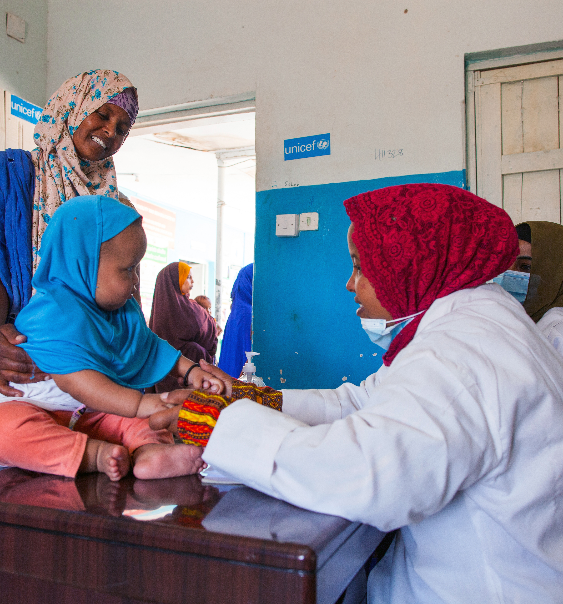
Better nutrition – for the best possible health
© UNICEF
Notes:
In Somalia there is a severe drought. UNICEF figures suggest almost five million children aren’t able to get the nutritious food they need to stay healthy.
Health services in the country are not available or are difficult to reach, making newborn babies and young children especially vulnerable.
Simple and low-cost community health clinics provide a basis for improving the health of young children. Health workers at the clinic diagnose and treat common childhood illnesses; vaccinate children against measles, meningitis and other diseases; provide nutrition counselling and treatment; and distribute hygiene kits to families. They also teach community members about important health practices.
Dr Zahara Mohmud attends to a malnourished baby at the UK Government and UNICEF-supported health centre in Hargeisa, Somaliland.
Health systems must be stronger, so children don’t lose out on their right to the best possible health when crises like drought come.
Read more here: https://www.unicef.org/somalia/nutrition

Slide 6
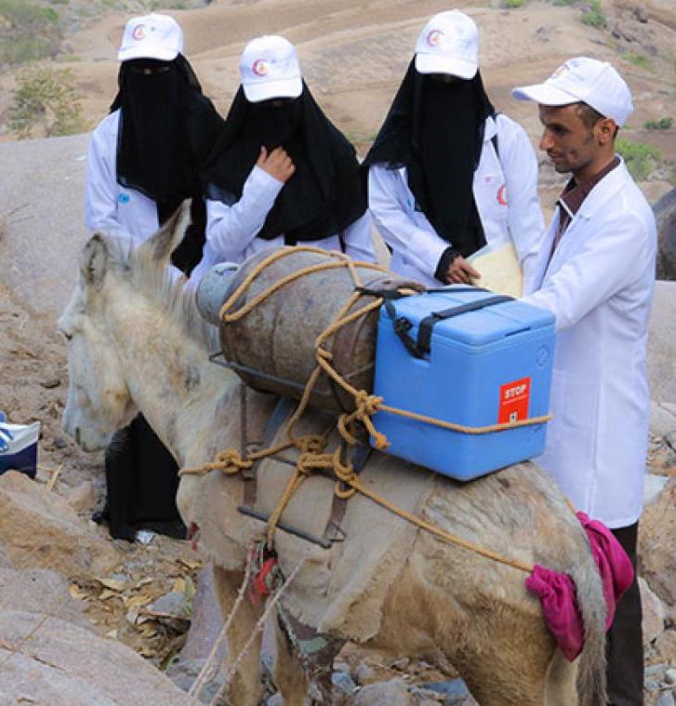
Getting the medicines and vaccines we need – for the best possible health
© UNICEF/Al-Zikri
Notes:
In Yemen there has been a war going on for many years, which has affected the country’s health system terribly.
Over half of all medical facilities in Yemen are closed because of the risk of danger, and it’s hard for people to travel to get healthcare because the roads are blocked, there are fuel shortages, and many people live in remote areas.
Because the health system isn’t strong, it’s hard for children to get immunisations and basic healthcare.
In this picture, you see a team of health workers who are traveling by foot to reach a mountain community to deliver vaccines and vitamins to help keep children in the best possible health. The fifth member of the team is a donkey. The donkey carries a gas cylinder which powers a generator to keep the vaccines cold on the journey up and over the mountain.
Health systems must be stronger, so children don’t lose out on their right to the best possible health when conflict arises.
Read more here: https://www.unicef.org/yemen/stories/polio-immunization-campaign-critical-moment-protect-yemens-children

Slide 7
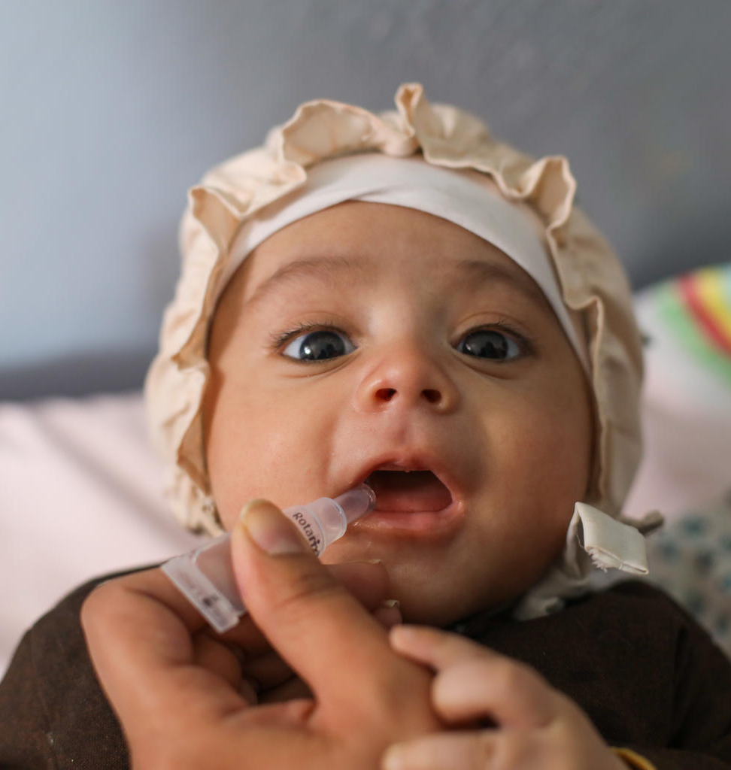
Strengthening health systems to keep eradicated diseases from returning
© UNICEF/Fazel
Notes:
Extraordinary advances have been made to eradicate the wild polio virus, and the number of children paralysed by polio has decreased by 99% since 1988.
Because of gaps in immunisations, cases of polio are once again emerging, and this threatens the advances that have been made over the past three decades.
Africa was declared free of wild polio in 2020 after Nigeria reached zero wild polio cases. But now some cases of wild polio are emerging on the continent again.
In late 2020, a case of wild polio was detected in Lilongwe, Malawi. This was the first case of wild polio in Africa in five years, and the first case in Malawi in more than 30 years.
Together with Mozambique, Tanzania and Zambia (and potentially Zimbabwe), Malawi is trying to vaccinate around 20 million children in the region to prevent a mass outbreak.
Read more here: https://www.unicef.org/malawi/stories/polio-vaccination-leaves-no-child-behind and https://www.unicef.org/malawi/stories/preserving-every-drop-polio-vaccine

Slide 8
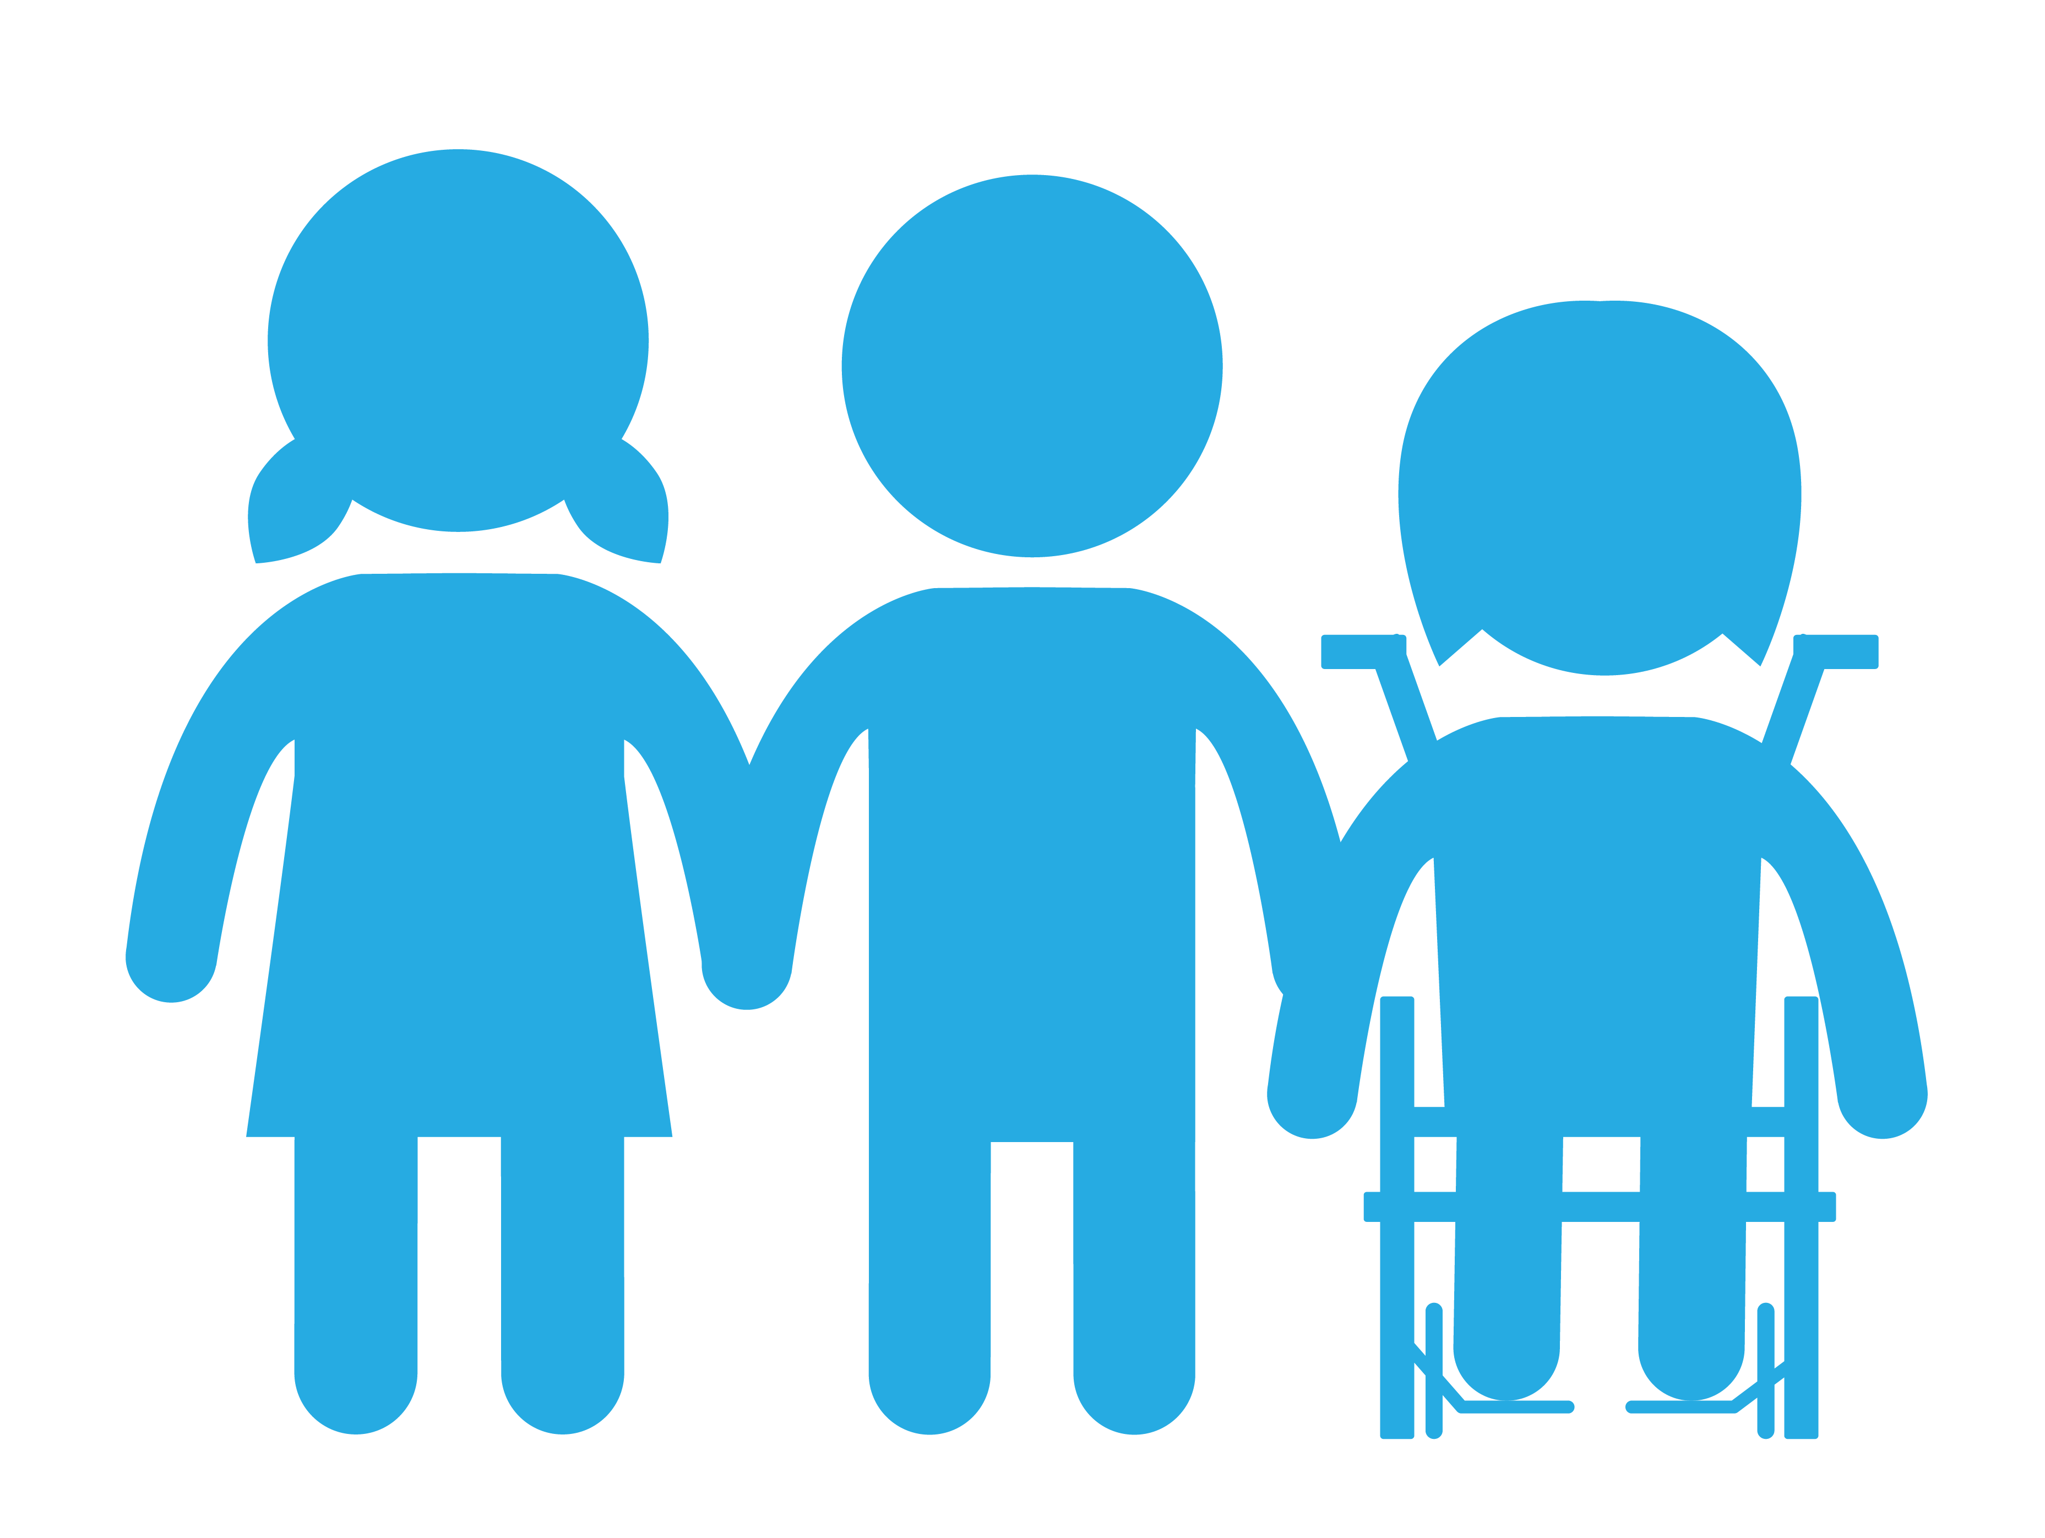
How are the health systems in these countries different from the health system in my community?
What are the obstacles or challenges these children face that affect their rights?
Notes:
Add your reflections to your journal. You can also ask yourselves:
How could the health system in each of these countries be strengthened?
How should the UK help these countries so children there can realise their right to the best possible health?

