Slide 1
1
Outright World Children's Day event
Notes:
Hello and welcome everyone to the OutRight World Children's Day event. It's so great to have you all here! So why are we all here today? World Children's Day and OutRight are all about children and young people being able to talk about the issues that matter to them and to be heard and taken seriously. Through OutRight you've been learning about your rights and why they matter, and you've been focussing on the UNCRC articles that relate to health. One of those is Article 24, which says that our healthcare should be as good as possible. Today we are celebrating children and young people, like all of you, who care about children's right to the best possible health. We all know that this is such as important topic - when children can be prescribed medicines they need, see a dentist regularly, visit a physiotherapist if they have an injury, or spend time with a speech therapist then they are going to feel better, they're more able to attend school, spend time with their friends and family and be as healthy as possible! We have some special guests joining us today to help us celebrate.
We know some of you won’t have had a chance to get stuck in yet to the OutRight campaign just yet - that’s okay: this is a chance to get a taste of what it's all about. Let's get started! What's happening today?

Slide 2
2
Today's event
Meet our guests
Healthcare advocate conversation
OutRight in action
Health systems game
Notes:
So we're beginning today with a conversation between our two special guests. We'll then get to see some of your work so far for OutRight, we've got stories and pictures from across the UK to show you! We'll then finish up with an interactive game about health systems for us all to get involved in, that means every child, young person, teacher and facilitator out there!

Slide 3
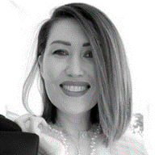
Today's guests
3
Arushi
Youth Advisory Board Member at UNICEF UK
Svetlana
Health Specialist at UNICEF UK

Slide 4
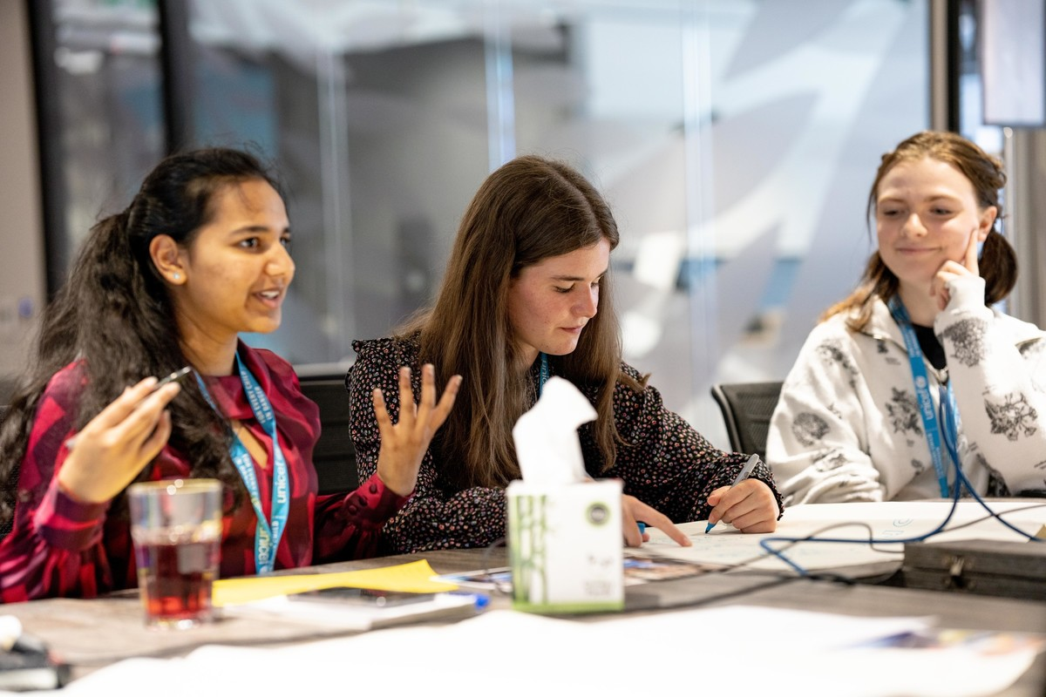
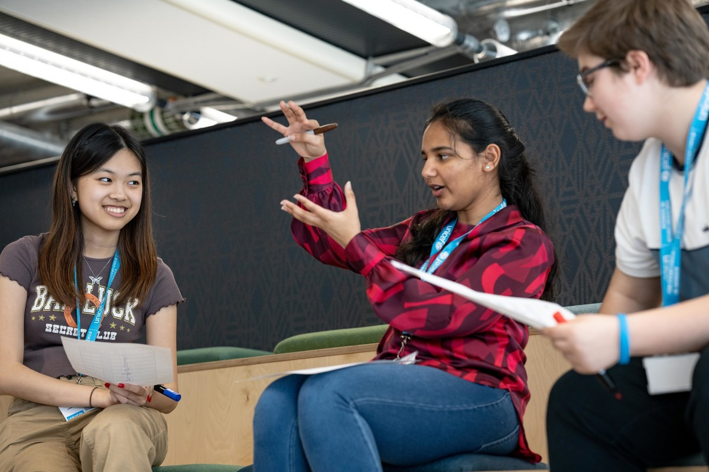
UNICEF UK Youth Advisory Board
4
Jamie, Arushi and Arthur
Arushi, Poppy and Lauren

Slide 5
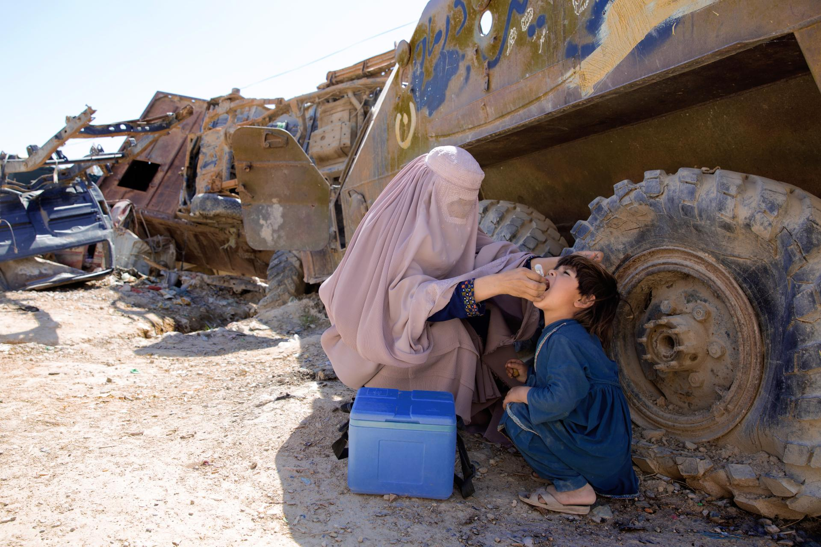
UNICEF'S HEALTH WORK - Afghanistan
5

Slide 6
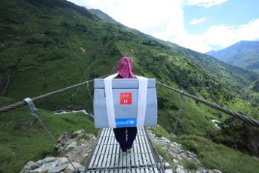
UNICEF'S HEALTH WORK - Nepal
6

Slide 7
7
A message from Cel Spellman

Slide 8
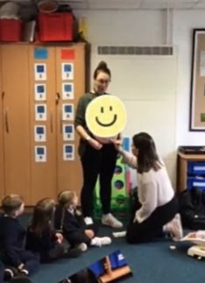
8
OUTRIGHT IN ACTION!
Barley Fields Primary School
Notes:
Now, let's look at what children and young people across the UK have been doing in their OutRight campaigns. There's 1000s of you out there, and it's always great to learn from each other, so here we go!
Up first we have Barley Fields Primary School, in Stockton. So that the class could learn about healthcare works and what they do, one of their students taking part in OutRight invited their mum to visit the class and talk about her work fitting cochlear implants. A cochlear implant is a small electronic device that helps people hear. It picks up sounds with a microphone. It then processes the sound and transmits it to the internal part of the implant in your ear. The class asked some really good questions, like "how do you know if babies can hear?" and "is it only old people who need hearing aids?" . They also got to practice fitting cochlear implants, on a teddy bear. Another student's mother joined the class too, to talk about her work as a midwife supporting people whilst they're pregnant, during birth, and after childbirth. The class got to try out a piece of medical equipment, called a doppler, on one of their teachers who is pregnant, so everyone could hear the baby's heartbeat.

Slide 9
9
Leith Primary School
Notes:
We also heard from P1 at Leith Primary School, in Edinburgh, who had a special visit from Doctor Millar who told them all about his job as a GP. They asked lots of questions & learnt about the equipment he keeps in his doctor's bag.

Slide 10
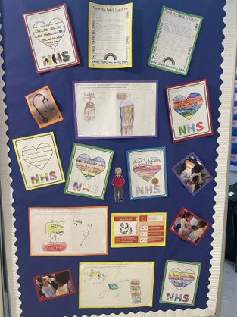
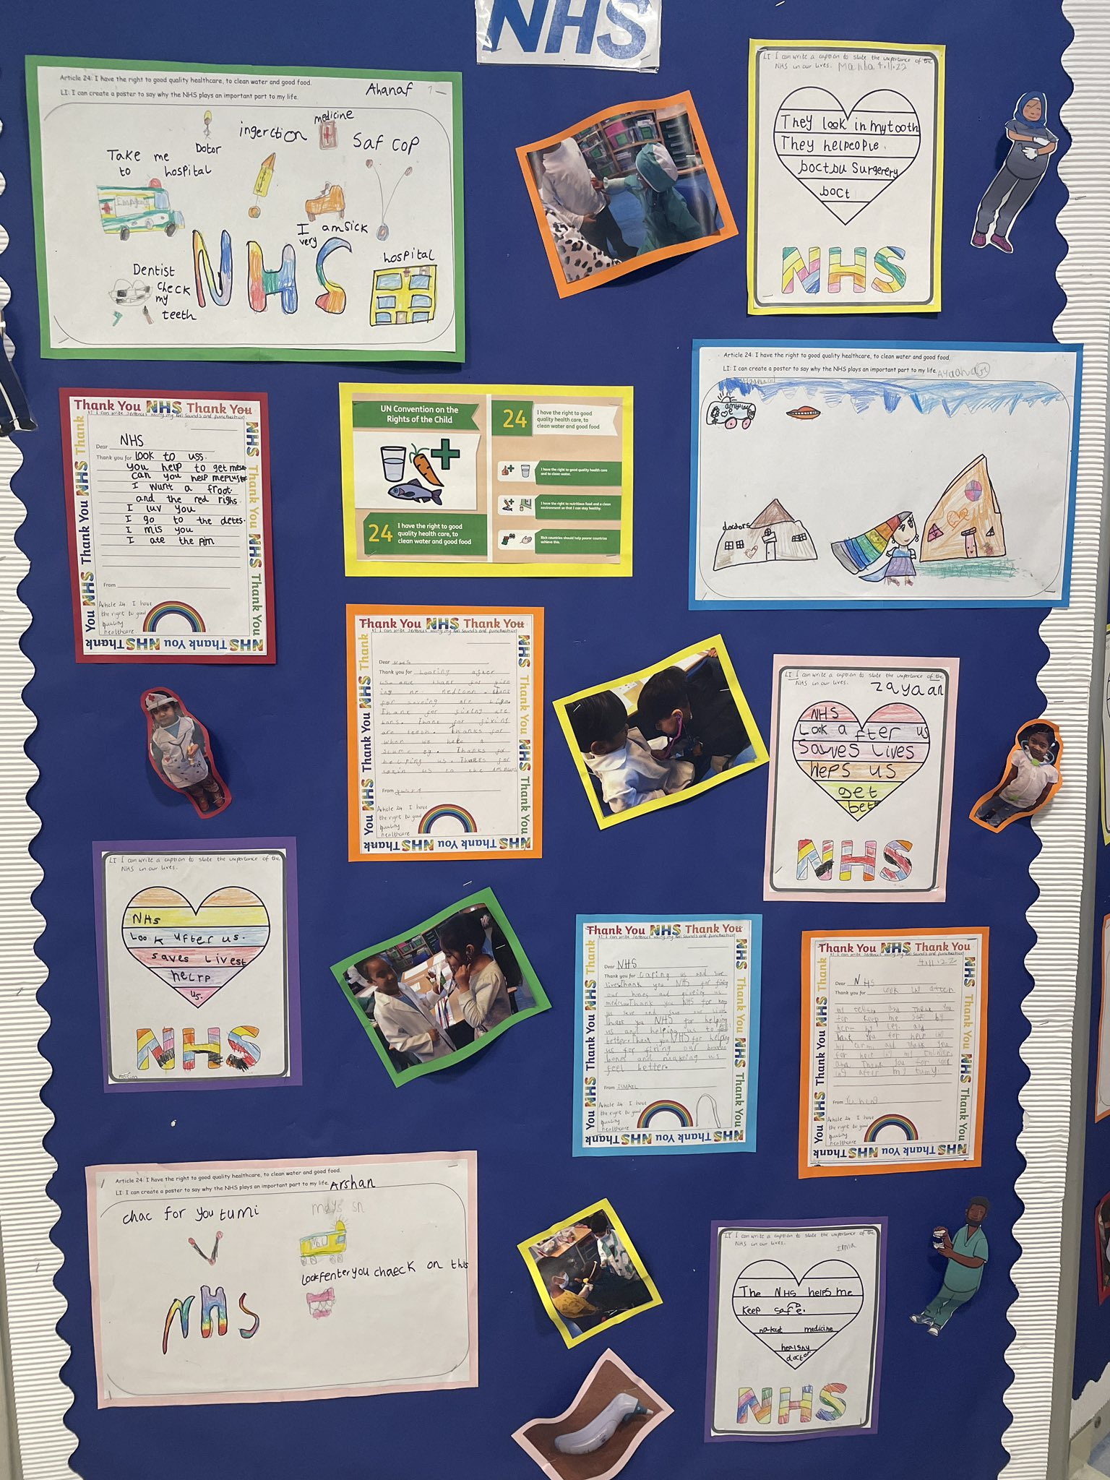
Y1 at Bonner Primary School
10
Notes:
Y1 at Bonner Primary School in London learnt about the NHS and Article 23 of the UNCRC which says that if you have a disability, you have the right to special care and education, which includes your healthcare. They also dressed up as healthcare workers and got to explore some of the medical equipment that they use to help us all be as healthy as possible, like a stethoscope which helps us hear whats going on inside our bodies, like in our heart and lungs.

Slide 11
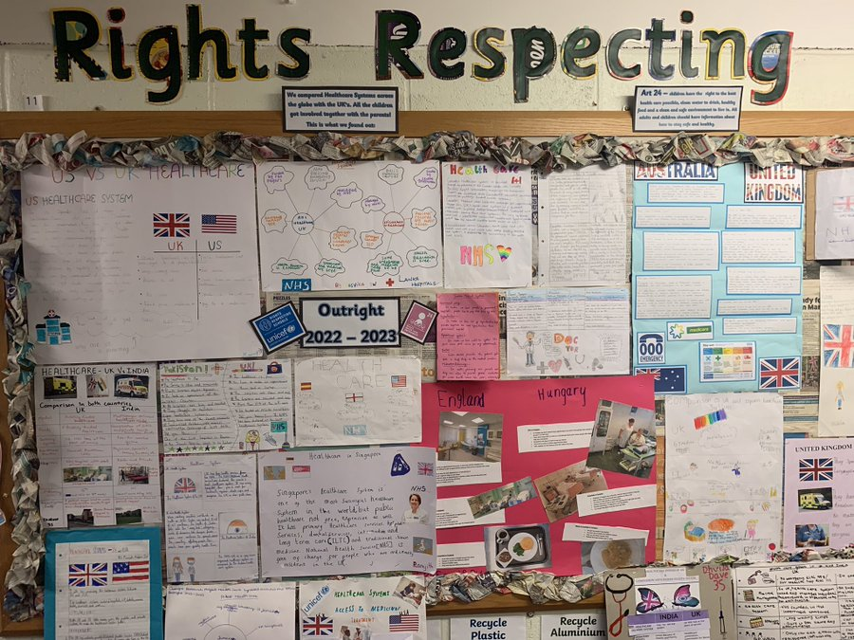
SS Peter & Paul's Catholic Primary School
11
Notes:
At SS Peter and Paul's Catholic Primary School in Ilford, London The children have shared their work from their whole-school homework for Outright. This allowed children to explore healthcare systems in various countries, like in Hungary, America and Australia.

Slide 12
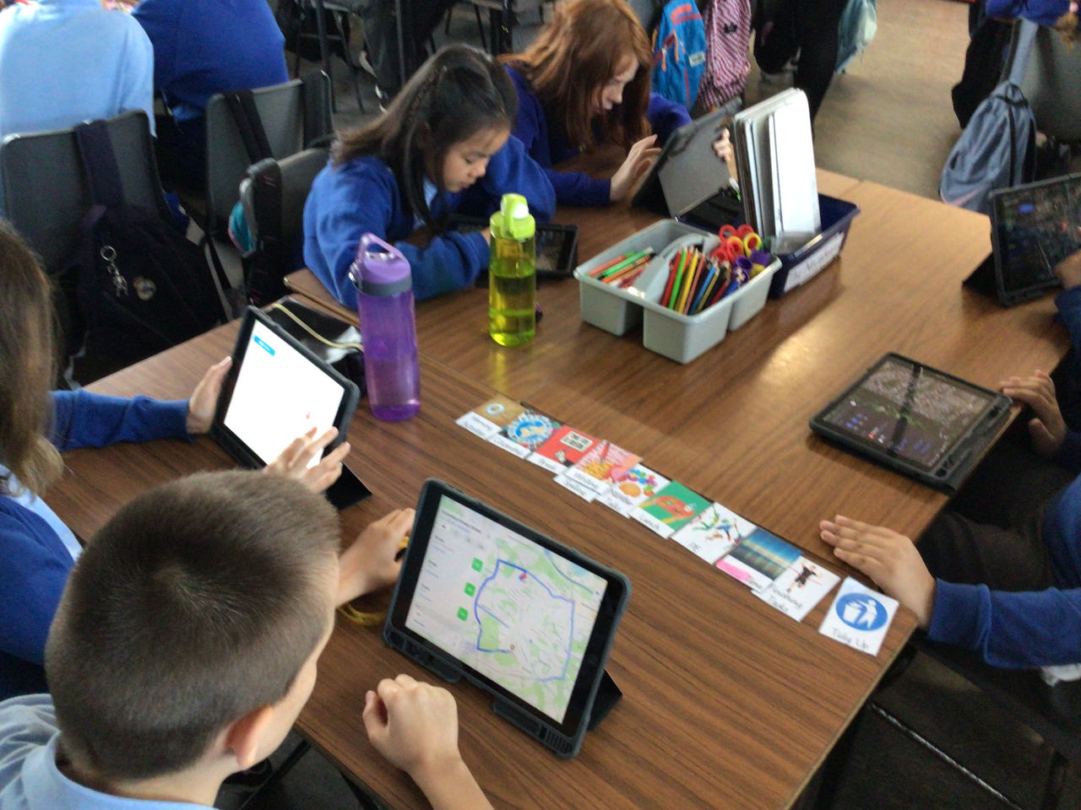
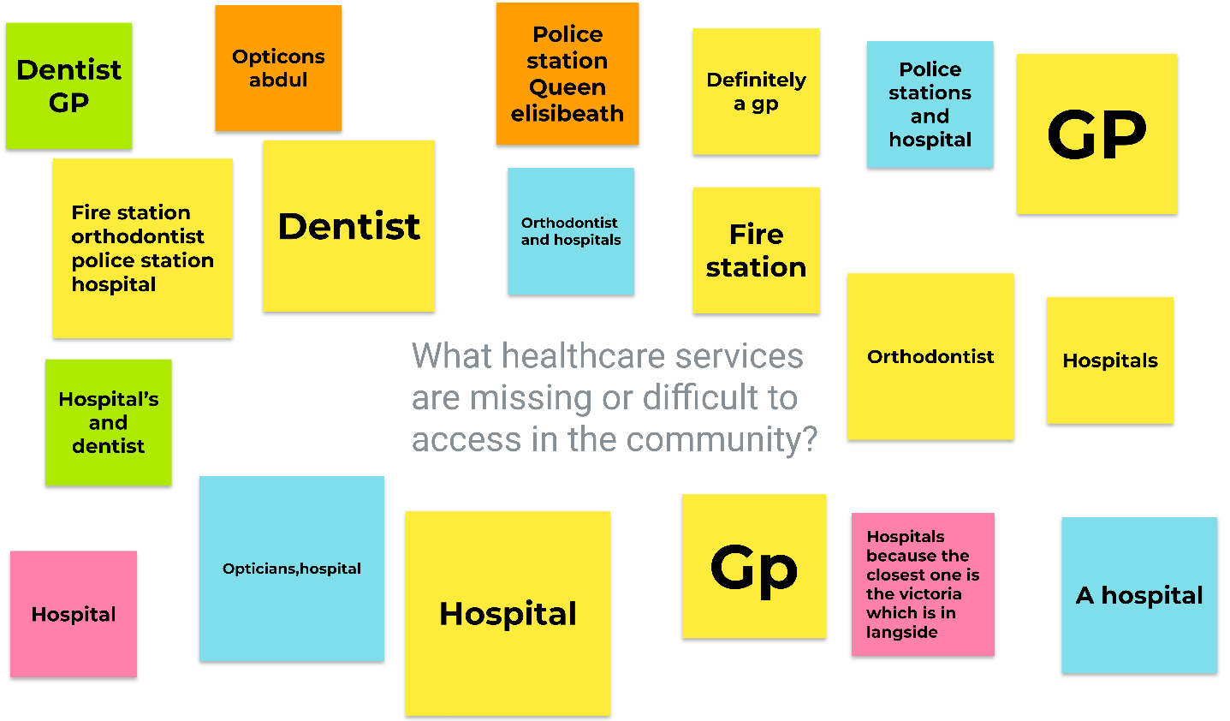
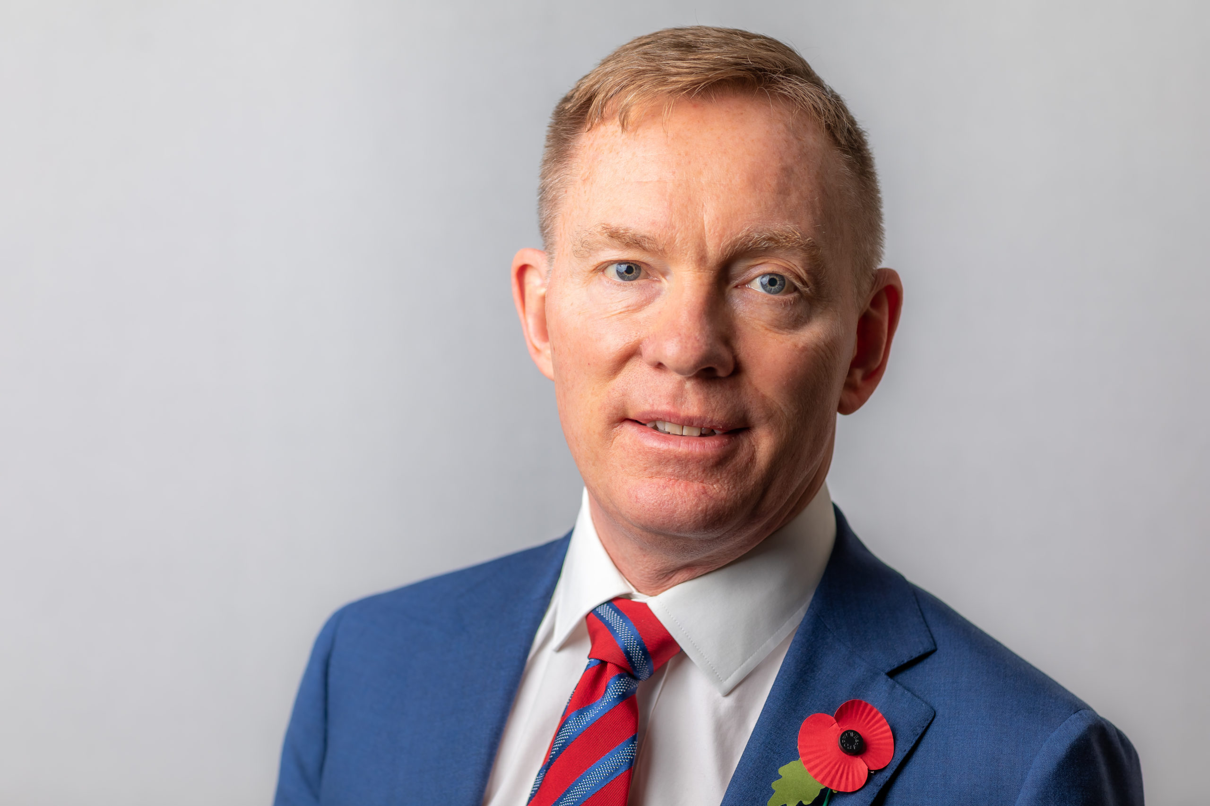
Croftfoot Primary School
12
Trealaw Primary School
Notes:
P7B at Croftfoot Primary School used the Maps app to explore the health services that are available in their local area. They then used Jamboard to identify any healthcare services that they felt needed to be improved in our community. We know it's important that healthcare is easy to get to, for example it being in our local area, so this is a great activity to get thinking about that! And last, but absolutely not least we have Trealaw Primary School in Tonypandy. They got in contact to tell us that they have their local Member of Parliament, Chris Bryant, visiting today! We can't wait to hear how your meeting goes, meeting and speaking to the people who make important decsions about healthcare and the services children can get, is a great way to speak out about children's rights. Trealaw Primary School kicked off their Outright Campaign with an in-depth discussion about the health care in their area. Lots of issues arose & many more questions.

Slide 13
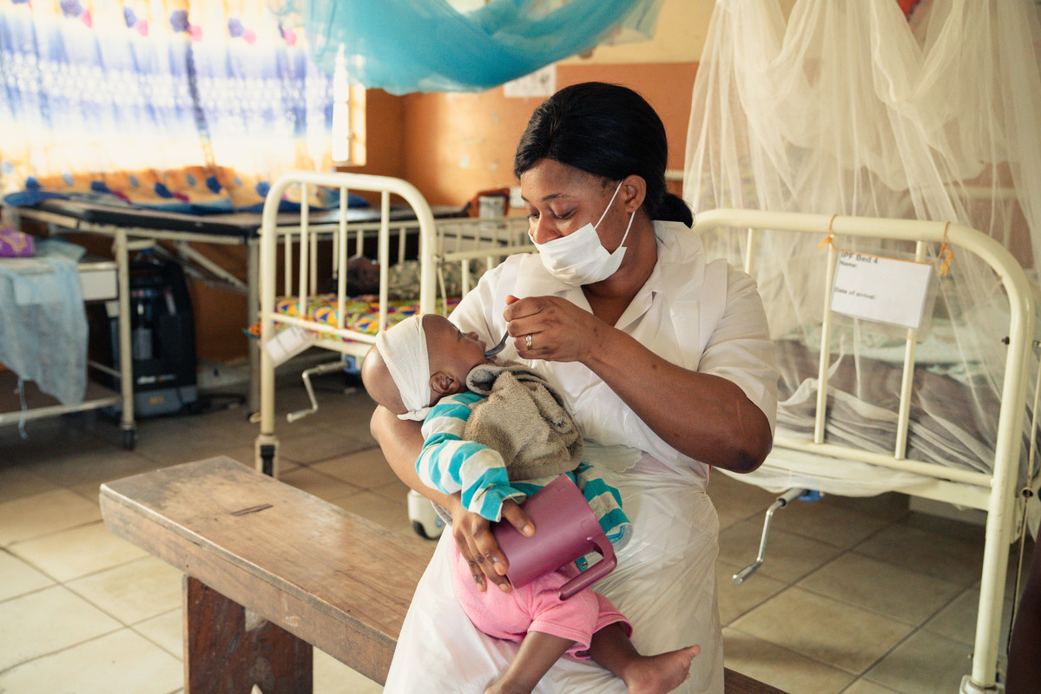
Health systems game
13
Moyamba, Sierra Leone
Notes:
We're now going to play a game. We'll be thinking about what health systems are, and what they are made of! As a reminder and to get us ready, let's think about what a health system is. A health care system is an organization of people, institutions, and resources that delivers health care services to meet the health needs of target populations. So, what does that mean? For instance, when we talk about our healthcare system that includes nurses, therapists, all the equipment they use (like stethoscopes and dopplers), surgeons, antibiotics, the bed you may stay in in hospital, ambulances and much more! Lots of things need to work properly too so that health systems can function, for example we need roads and vans to deliver medicines to the doctors office, we need universities to train dentists, and we need fridges to store some kinds of vaccines that must be kept cold. So with that in mind, I'm going to show you a picture and you've got to point of what bits of a health system that you can see.
Here is the picture, showing a nurse and a patient in Sierra Leone. What bits of a healthcare system can you see? I'm going to go quiet for a couple of minutes whilst you have a think - put your hand up if you spot something and share with your group. I'll then come back and reveal the answers. You have 2 minutes!

Slide 14
What did you spot?
14
Moyamba, Sierra Leone
Notes:
Hello! I'm back, so what can we see here? This scene shows a nurse feeding a young child theraputic food, this is from January this year. Nurses themselves are part of health systems, a really essential one! The uniforms she is wearing is also part of the health system. Did you spot the equipment she is using? That's all part of it too, like the food and her mask. Behind them, the beds and nets hanging over them are some of the resources too that mean we can get the healthcare we all need. OK, we have one more of these. Again, I'm going to show you a picture. This one is from Goma, in the Democratic Republic of Congo. I'll disappear for a couple of minutes whilst you all have a think about what parts of the health system you can identify. I'll be back at x time.

Slide 15
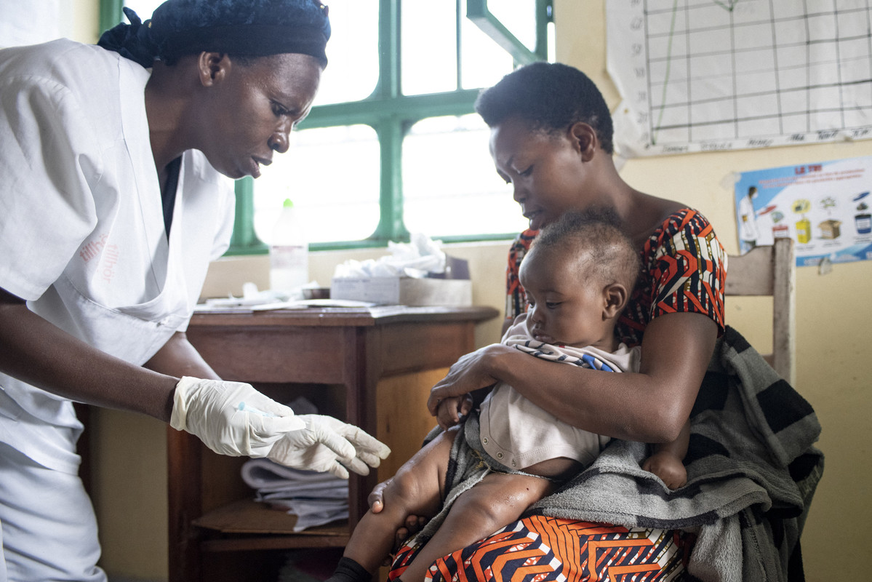
Health systems game
15
Goma, Democratic Republic of Congo

Slide 16
HOW MANY DID YOU SPOT?
16
Goma, Democratic Republic of Congo
Notes:
I'm back again, what did you spot? Here's a few things I saw - the healthcare workers uniform, like her gloves, she is also holding a syringe to give the baby a vaccine. On the table behind them is some more medical equipment, and a poster behind the woman sitting in the chair. It shows what to put in which bin - posters like this, which tell healthcare workers and patients how to stay safe and be healthy, much like ones you see on the walls of a doctors office, are all part of the health care system too!

Slide 17
What can we not see?
17
Goma, Democratic Republic of Congo
Notes:
We know that health systems are big, and are made up of lots of parts that work together, from medicines to the trained staff who give them to us. Something else we can think about is what can we not see in those pictures, that is still really important for those scenes to happen. For instance, how does the nurse know how to give a vaccines to a baby? It's because she was taught at university who she learnt about healthcare. Have a discussion with you group afterwards. Here are some hints to think about... how did the equipment get there? Where do medicines come from? How to midwives, surgeons and counsellors know how to help us when we dont feel well? This will get you thinking about all of the things that make up a health system, and make sure they're working smoothly, so that all children can achieve their right to the best possible health.

Slide 18
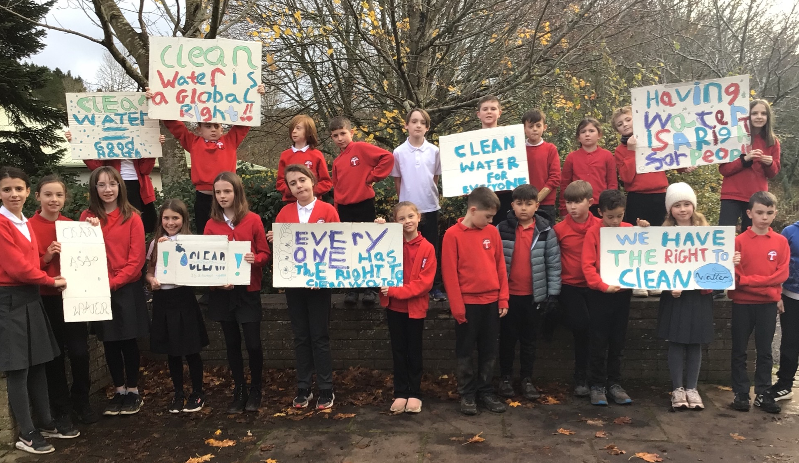
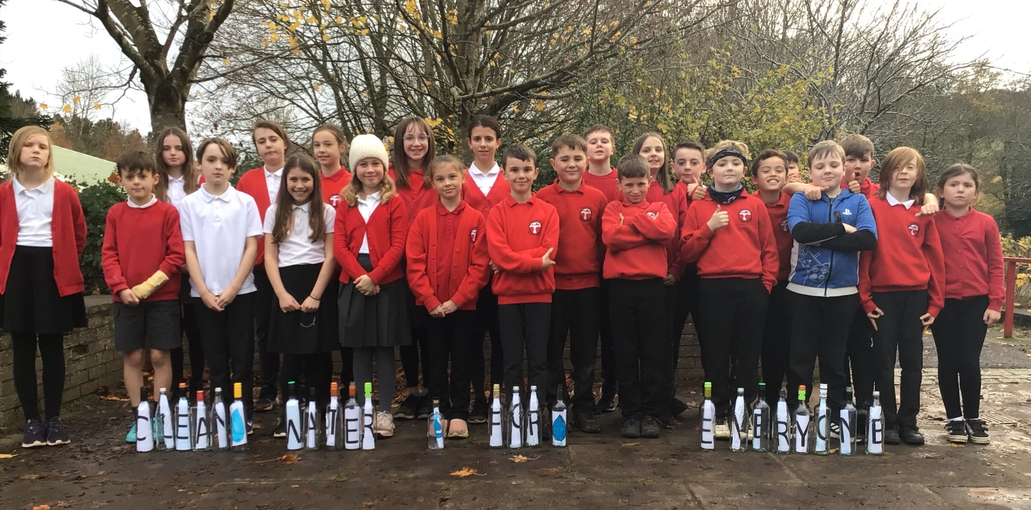
18
Thank you and goodbye!
Notes:
So, that brings us to the end of today's event, I hope you're going away feeling motivated to start or continue working on your OutRight campaign. In the coming weeks we'll be emailing your teachers and facilitators another activity, through which you'll be able to speak out about what you've been doing to learn about children's right to the best possible health to decision makers in the UK Government. Thank you for all the work you've done so far for it, and today for coming along and joining in. Thanks you to all the teachers, youth group leaders and facilitators who make OutRight possible, bringing it to life.

