Slide 1
ARTICLE OF THE WEEK
Notes:
These boys are training to become monks. In September 2012, the monastery opened a school, expanding the education of young apprentice monks to include secular as well as religious studies. UNICEF/Sokol

Slide 2
INSTRUCTIONS
Slide 3: Guess the article
Slide 4: Introducing Article 14
Slide 5: Exploring Article 14
Slide 6: Some possible answers
Slides 7, 8 & 9: Primary activities
Slides 10, 11 & 12: Secondary activities
Slide x: Reflection

Slide 3
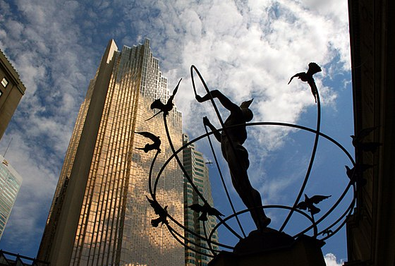
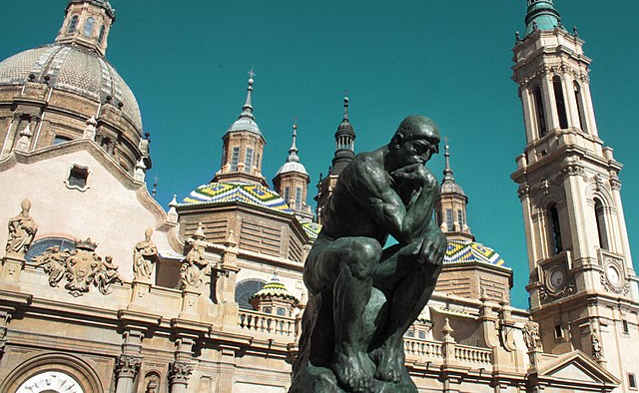
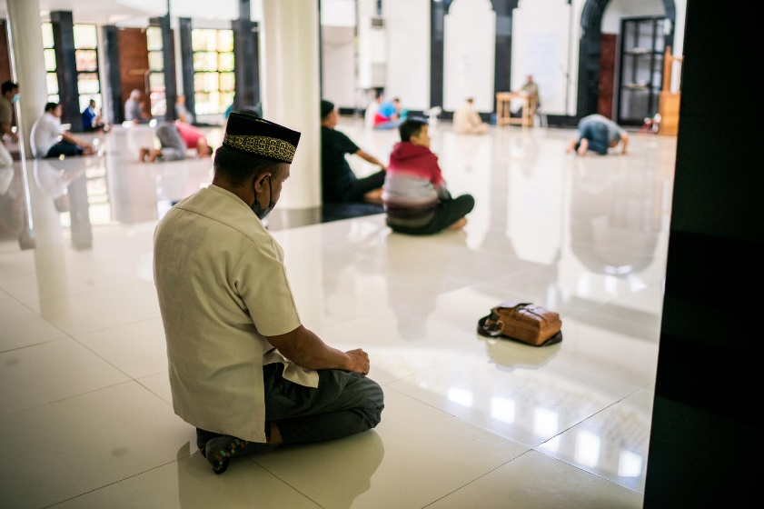
GUESS THE ARTICLE
@Wikicommons
@Wikicommons
@UNICEF/Pirozzi
These pictures provide a clue to this week’s articles.
How do these pictures help you? Can you guess how they are linked together?
Write down your thoughts or discuss with someone in your class.
Notes:
Monument to Multiculturalism by Francesco Perillie "This monument, a tribute to multiculturalism, was presented to the city of Toronto on the occasion of its sesquicentennial by the national congress of Italian Canadians on behalf of the Italian Canadian Community.“ Wikicommons
2. A statue of The Thinker in aragoza, España. @Wikicommons
3. A religious leader, sits in worship at Mutilan Mosque.. UNICEF/SanDiago

Slide 4
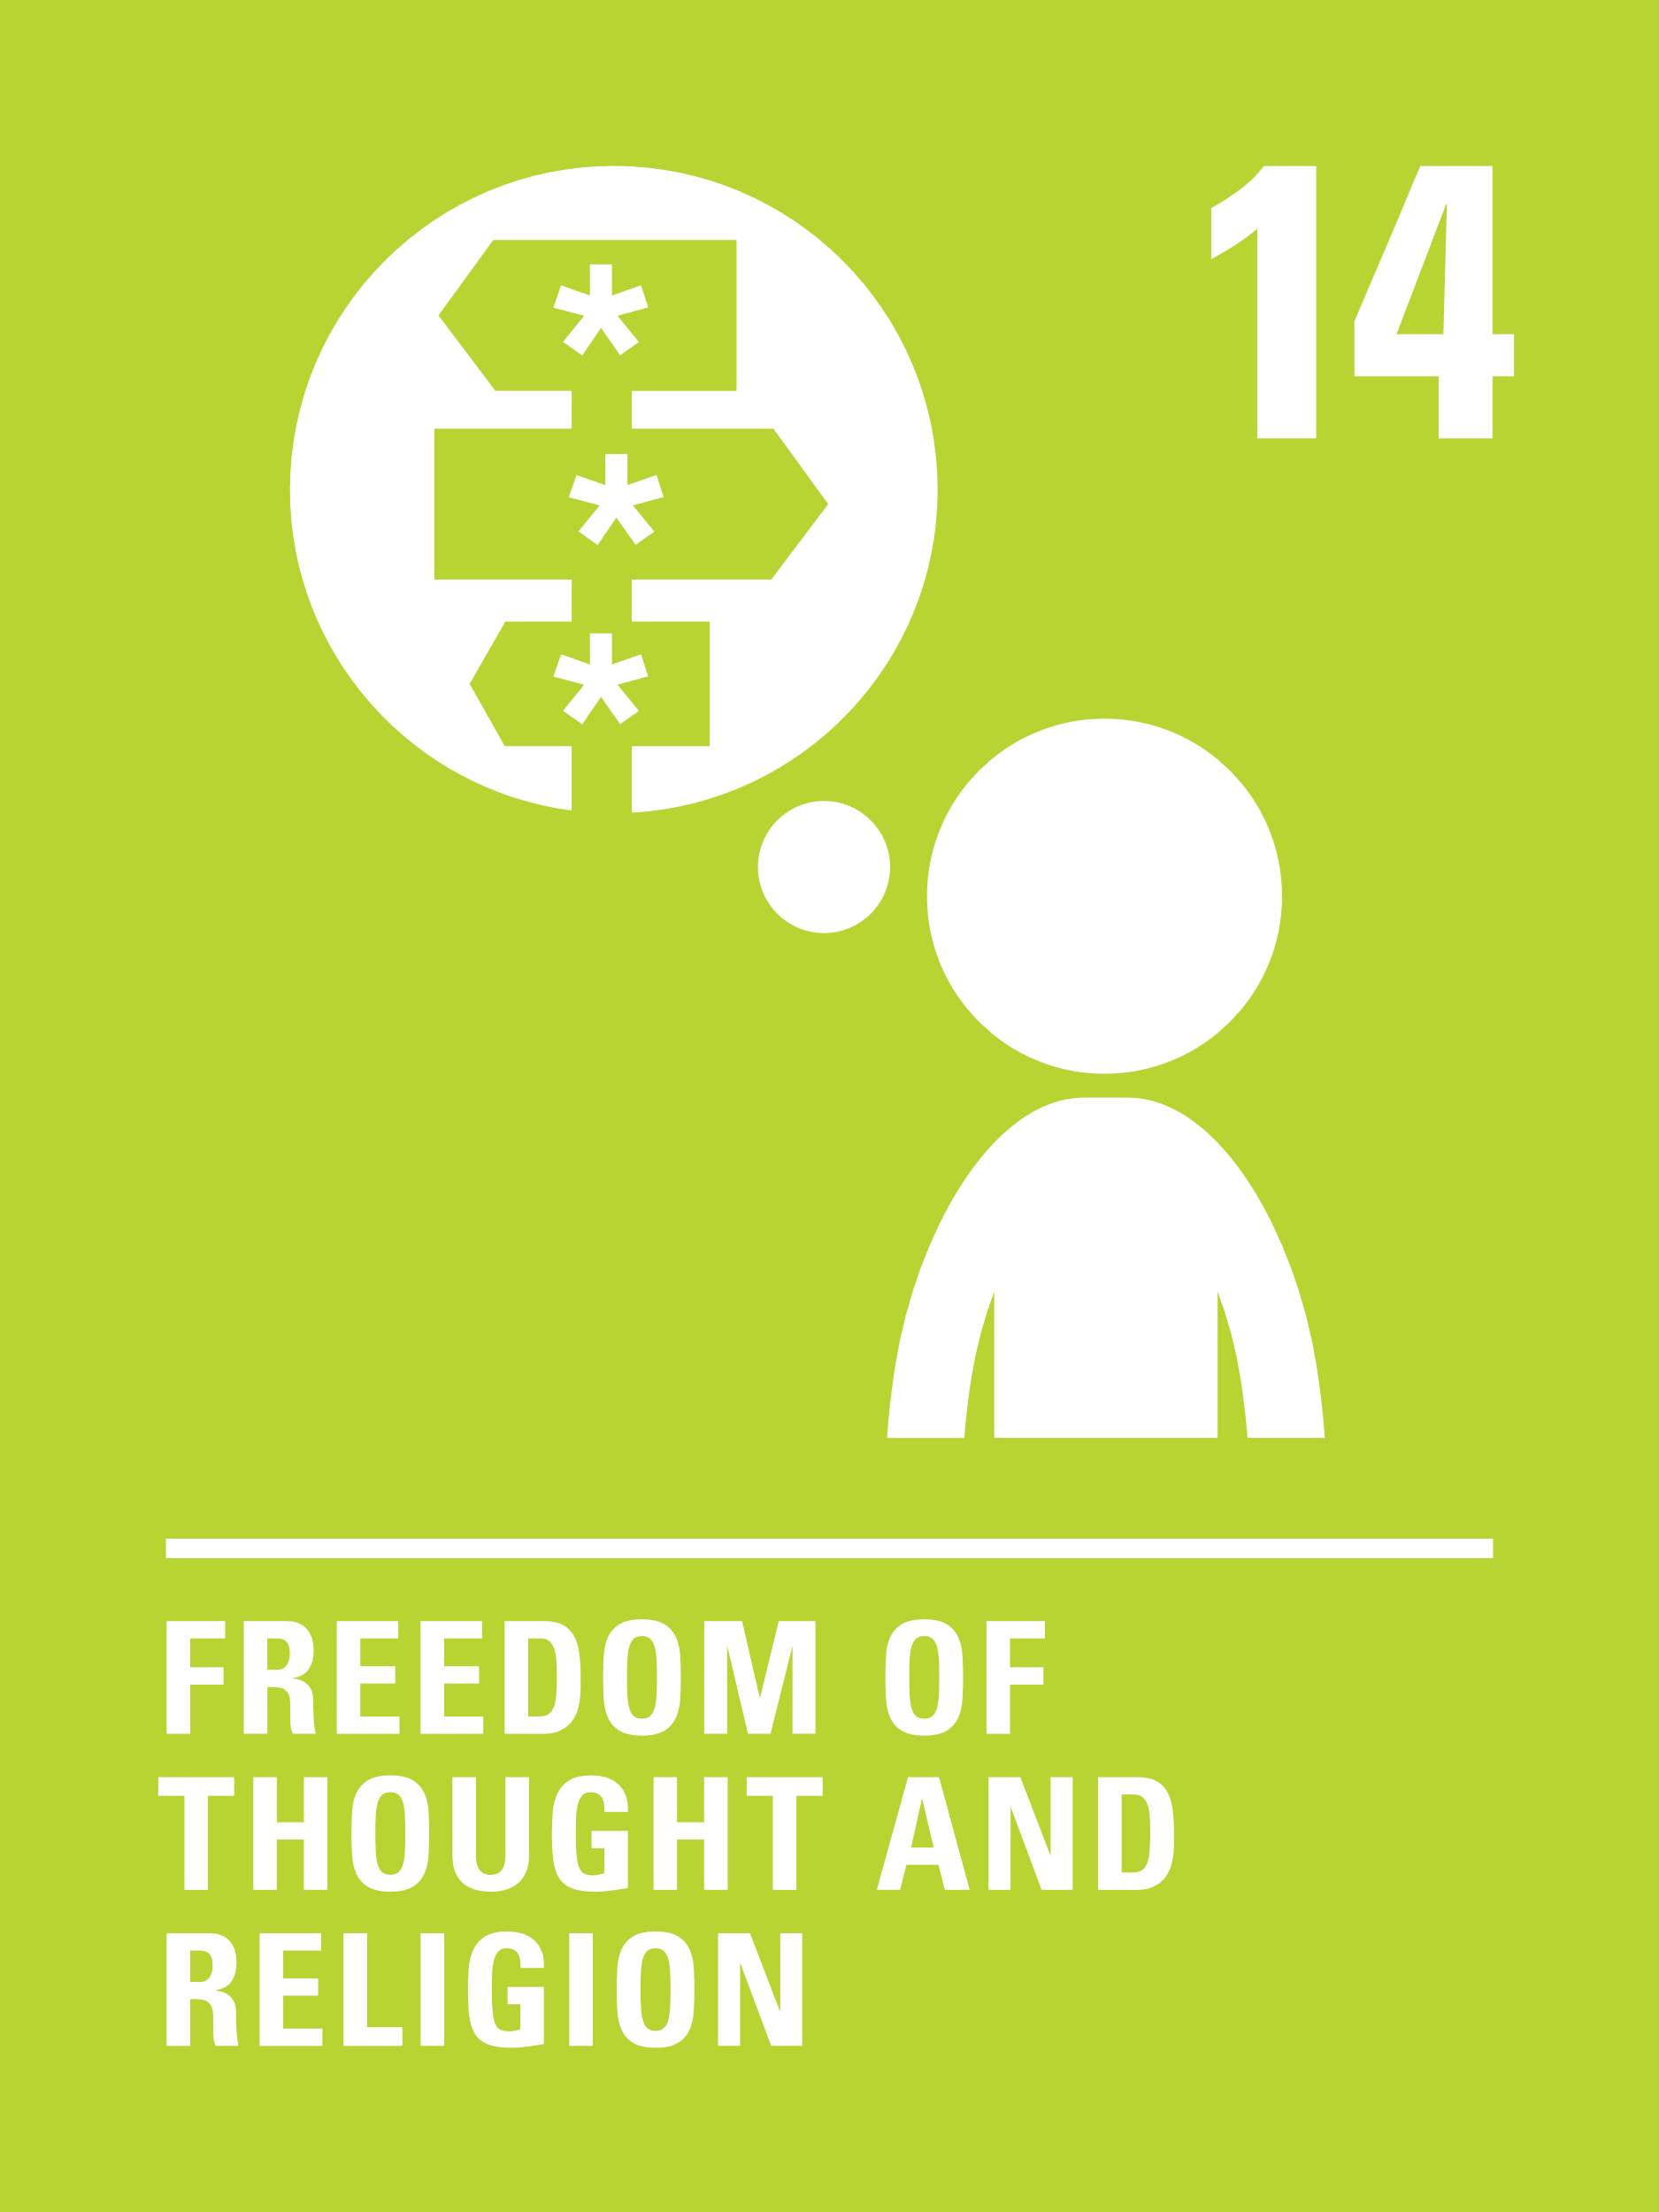
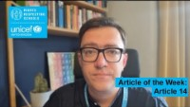
ARTICLE 14
Article 14 (freedom of thought, belief and religion)
Steven Kidd, Professional Adviser, introduces
Article 14
Every child has the right to think and believe what they choose and also to practise their religion, as long as they are not stopping other people from enjoying their rights. Governments must respect the rights and responsibilities of parents to guide their child as they grow up.
Click here to watch on YouTube

Slide 5
EXPLORING ARTICLES 14
Give yourself one minute to think of as many answers as you can to the question below.
Who or what influences the way you think about the world and shapes your thoughts and beliefs?

Slide 6
EXPLORING ARTICLE 14
Did you think of these?
Your cultural background and heritage
Friends
Family
TV
School
Where you live
Your religion
Your health
Social media
Personal life experiences
Your family history
Politicians
Celebrities
Education
What else did you think of?

Slide 7
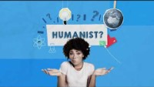
PRIMARY ACTIVITIES
You do not need to complete every activity but if you have time, you can try to complete more than one.
With the youngest children discuss the differences between facts (things that are always true) opinions (a person’s choice such as likes and dislike) and beliefs (things that affect how we act and live – could include religion) use RE learning or a story book to frame this, or use the following statements:
“Animals need water to live” “My favourite colour is green” “God wants everyone to be kind.”
.
Do you always agree with members of your family about important topics? What kind of things might you have a different opinion about? Make a list and compare with a friend!
Not everyone follows a particular faith or believes in religion. What or who do you think helps to guide people if they don’t have a faith? You might like to watch this video about humanism to help you think about these questions.
List as many religions as you can think of. Do you know what symbols are linked with these religions? Have a go at drawing them if you can and perhaps create a display for your classroom or corridor.

Slide 8
PRIMARY ACTIVITIES 2
You do not need to complete every activity but if you have time, you can try to complete more than one.
November and December are important months for many religions. Can you think of some festivals and events that take place at this time? See how many you can think of. You could write a sentence, draw a picture, or write a story about a child celebrating a festival or special day.
What sort of things do your parents and carers help you to make decisions about? Think back to when you were a baby or a toddler, what decisions are you able to make now that you couldn’t then? What decisions do you think it’s appropriate for children to make at 15 compared to aged 10?
Many religious stories help us to understand the importance of being kind and respectful and of looking after each other. Can you create your own story and characters to illustrate these important values?
What opportunities are there for children at your school to practise and share their different religions and beliefs? Could you do more?

Slide 9
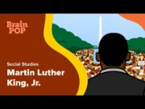
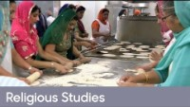
PRIMARY ACTIVITIES 3
You do not need to complete every activity but if you have time, you can try to complete more than one.
This video about Dr Martin Luther King Jr explains how his religion and beliefs shaped his work for civil rights. Research and write about another inspirational figure who had strong beliefs – do you agree with them? Share your thoughts about this in a class discussion.
Try drawing a picture to represent Article 14 and then compare it with the icon from this set of images.
In this video, 11 year-old Simran shows you a Gurdwara, the Sikh place of worship. Religions often have a special place where people come together to worship. What others can you find out about?
Choose one of your beliefs or opinions - something that you feel strongly about and create a presentation to share your views with others.

Slide 10

SECONDARY ACTIVITIES
You do not need to complete every activity but if you have time, you can try to complete more than one.
If there was a lesson called ‘Thought, Belief and Religion’ as part of the curriculum, what might it include? Map out topics that could be explored for both primary and secondary students.
The right to freedom of conscience is also part of Article 14. This is a person’s right to choose not to do something because of their moral or religious reasons. This might include becoming a vegan or vegetarian or refusing to sign up to the armed services. Research the ethical reasons behind veganism or vegetarianism, this could include interviewing adults, students at school or family.
Watch this short video about a group of Year 7s talking about religion. if you were being interviewed for this programme what would you say? Compare your ideas with other students in your class.
Watch the first minute and a half of this video ‘If the world were a village of 100 people’ to find out the percentage of people practicing major religions. You might like to first estimate with a partner how many people you think would be Muslim, Jewish, Hindu, Christian, Sikh and then compare with the video. What influenced your thinking?

Slide 11

SECONDARY ACTIVITIES 2
You do not need to complete every activity but if you have time, you can try to complete more than one.
Do you know what an echo chamber is? Watch this video and think about how you can make sure you hear lots of different perspectives before you form an opinion.
When was the last time you changed your opinion on something important? Who or what made you change your mind? If you are comfortable to do so, share this with your class.
Article 14 says that parents and carers should provide guidance for their children as they grow up. At what age do you feel children and young people are old enough to make decisions about religion and other beliefs?
Imagine someone you know has been excluded from a club because of their beliefs. You have been asked to speak on their behalf at the School Council. Write an argument defending them, using Article 14 to help you.

Slide 12
SECONDARY ACTIVITIES 3
You do not need to complete every activity but if you have time, you can try to complete more than one.
For some people, humanism is a belief and provides answers to questions about the way to live your life in the same way that religion does for others. Explore what it means to be a humanist and create a leaflet to show what you have found out (this video might help).
How do you respond when someone expresses a view different to your own? ‘Respectfully disagreeing’ with someone’s thoughts or beliefs is an important skill. Work with a partner to write some guidelines about the language to use and attitudes to take when having a discussion with someone with different views. Use these guidelines to host a debate on an issue important to you.
Do you think it’s important to learn about different religions at school? Talk about this with a friend and share your thoughts. What opportunities are there for children at your school to practice and share their different religions and beliefs?
When learning about wars in school you might have heard about people refusing to fight because it goes against their beliefs. They are called conscientious objectors. Do some research to find out more about them.

Slide 13
REFLECTION
Give yourself some time and space… to think about and reflect on what Article 14 means to you….
Article 14 is all about your thoughts and beliefs. These are very personal things and help to define who you are.
What things do you feel most strongly about that make you the person you are?
What more can you do to help other people around you to enjoy this right?

Slide 14
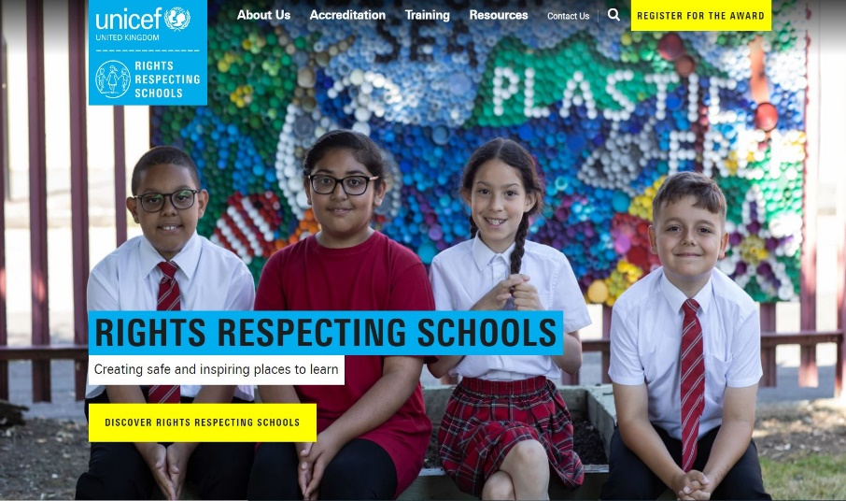
MORE INFO
RRSA WEBSITE
For more information or to download previous Article of the Week packs please visit the RRSA website by clicking on the link below.
CLICK HERE

Slide 15
THANK YOU

