Slide 1
ARTICLE OF THE WEEK

Slide 2
INSTRUCTIONS
Slide 3: Introducing LGBT+ History Month
Slide 4: Linked Articles – Articles 2, 13 & 17
Slide 5 & 6: Exploring LGBT+ History Month - Question and Answers
Slide 7, 8 & 9 : Primary activities
Slide 10, 11 & 12: Secondary activities
Slide 13: Reflection

Slide 3
INTRODUCING
LGBT+ HISTORY MONTH
LGBT+ History Month takes place in February each year.
LGBT+ History Month is all about promoting fairness, equality and diversity and raising awareness of LGBT+ people and culture, now and in the past. It aims to give voice to LGBT+ experiences, celebrate achievements and highlight the challenges people still face today. It is also about helping everyone to learn more about LGBT+ culture and history.
The theme for this year, along with more information about the month, can be found here.
Isobel Mitchel, RRSA Professional Adviser,
introduces LGBT+ History Month
Click here to watch on YouTube

Slide 4
LINKED ARTICLES
Many articles are relevant to explore when celebrating LGBT+ History Month but this pack focusses on following:
Article 2: (non-discrimination) The Convention applies to every child without discrimination, whatever their ethnicity, gender, religion, language, abilities or any other status, whatever they think or say, whatever their family background.
Article 13: (freedom of expression) Every child must be free to express their thoughts and opinions and to access all kinds of information if it is within the law.
Article 17 - access to reliable information Every child has the right to reliable information from a variety of sources, and governments should encourage the media to provide information that children can understand. Governments must help protect children from materials that could harm them.
And remember, at the heart of the UN Convention on the Rights of the Child are the values of dignity, equality and non-discrimination.

Slide 5
EXPLORING LGBT+ HISTORY MONTH
Why is it important to listen to, learn from and celebrate people’s differences in school and in our community?
Have a think and write down some answers.

Slide 6
EXPLORING LGBT+ HISTORY MONTH
It helps to remind us that we are all unique and should all be treated with dignity.
It reminds us that everyone has different experiences and everyone has the right to be listened to and express their opinions.
When our differences are celebrated, we feel valued as people and our health and wellbeing improves.
It helps all people to feel welcome in school.
It reminds us that not all families or relationships look the same.
It helps us to be open and respectful to new ideas about identity.
We are all learning all of the time and by listening to others we continue to grow and learn.
So that we can speak up and challenge unfair comments or actions.
To help ensure that all children and young people’s opinions are taken into account when making decisions about them.
Did you think of any other reasons?

Slide 7
PRIMARY ACTIVITIES
You do not need to complete every activity but if you have time, you can try to complete more than one.
Read the story Elmer the Elephant, you can also watch it here. Elmer didn’t feel that he wanted to be the same as the other elephants. Think of ways that we can celebrate our differences like the elephants do on ‘Elmer Day’ – talk about your ideas with an adult.
It is important to be proud of who we are. Make a ‘Proud To Be Me’ fact sheet or poster. You might want to include your favourite foods, colours, activities, or places you like to go. Think about what things you've included that make you unique and proud to be you.
We keep using the word ‘different’. In circle time talk about what the word means. What’s its opposite? What would it be like if we were all the same? Work in pairs and find three things that are the same (or very similar) about you both and three differences. Feedback some of your examples to the whole class.
Watch the video of the story And Tango Makes Three. There are many different types of families. For example, some children may live with a mum and a dad, just a mum, two dads or live with other carers who look after them. Draw pictures of your family. Talk with a friend about why your family is special to you. Finish the sentence with ‘I love my family because...

Slide 8
PRIMARY ACTIVITIES 2
You do not need to complete every activity but if you have time, you can try to complete more than one.
Being happy and proud about who we are as people is important. Read ‘The Flamingo Who Didn’t Want To Be Pink’? By Nicola Stone. Watch this animated version of the story made by Y4 children at William Tyndale School – a gold Rights Respecting school. Discuss in class the best things each person likes about being themselves.
Listen to the story Julian is a Mermaid’ read by the author Jessica Love. What did you think of the story? Was there anything that surprised you? How did Julian’s Abuela (Nana) react to him dressing as a mermaid? What did you think of her reaction? How can we help everyone to feel happy being themselves at school? Which rights does the story connect to?
Watch this story about the history of the Pride Flag. The Pride Flag is a symbol of inclusion and diversity. Look up these two words and think about the link with rights such as Article 2 –
non-discrimination. Write a poem about all these ideas called Rainbows and Rights or design a rights respecting inclusive flag, explaining what each colour and symbol means to you.
We often hear the phrase, “Treat others as you would like to be treated.” What do you think about this idea? Are there times, when perhaps we should treat people as they would like to be treated? Can we really know what it is like to be in someone else’s shoes when our experiences are often so very different? You might like to discuss this in circle time.

Slide 9
PRIMARY ACTIVITIES 3
You do not need to complete every activity but if you have time, you can try to complete more than one.
Do some research and create a fact file on an inspirational LGBT+ figure that you know. It may be someone famous, a figure in history or somebody you know. What do their actions show us about equality, dignity and rights? Share your research with your class.
Watch this video Love Has No Labels. Discuss with a friend, conversation partner, or a group in your class about how it made you feel.
There are many different types of families. For example, some children may live with a mum and a dad, just a mum, two dads or live with other carers who look after them. Fold a sheet of A4 paper into 8 boxes. Draw and label a different type of family in each box. How many types of family can you think of? Can you think of any rights connected with this activity?
Watch this trailer for the film Happily Ever After based on the story ‘King and ‘King’.
How was this story different and similar to stories you have seen or read before. Discuss with a friend why it’s important to read stories that explore the diversity of people that exist in our world.

Slide 10
SECONDARY ACTIVITIES
You do not need to complete every activity but if you have time, you can try to complete more than one.
What do you understand it means to be an LGBT+ ally? Many people understand an LBGT+ ally to be someone who believes in equality and fair treatment in society for people who identify as LGBT+ and who stands ‘with’ rather than ‘for’ the LGBT+ community. Educating yourself about LGBT+ history is one way to start being an ally. Can you think of other things you can do?
We often hear the phrase, “Treat others as you would like to be treated.” What do you think about this idea? Are there times, when perhaps we should treat people as they would like to be treated? Can we really know what it is like to be in someone else’s shoes when our experiences are often so very different? Discuss this with a friend or suggest it as a theme for tutor time.
A global movement is improving awareness and respect for the rights of LGBT+ people. However, some countries have anti LGBT+ laws and criminalise forms of gender expression and same sex relationships. You might be interested to read different equality global news stories highlighted by Amnesty International.
Watch this video Love Has No Labels. Discuss with a friend, talk partner, or class group about how it made you feel. Think creatively, and see if you can come up with ways of challenging perceptions about difference and promoting diversity in your school.

Slide 11
SECONDARY ACTIVITIES 2
You do not need to complete every activity but if you have time, you can try to complete more than one.
The Black Flamingo is a verse novel by Dean Atta about a black, gay teenager. Watch this YouTube clip by Dean. Why do you think it is important for people to feel included and valued? Discuss the clip in light of Articles 2, 13 and 17. Discuss in class how each of us might work towards preventing discrimination from happening. You may also like to watch this video of Dean Atta reading more of his novel.
There are many organisations you can reach out to if you feel the need to talk about your gender identity such as Switch Board. Create a database of organisations that can be displayed in your school for pupils who may need their support.
There are many terms associated with the LBGT+ community and we are all on a journey of learning. Therefore, having access to reliable information (Article 17) is important. The organisation Stonewall has produced a Glossary of terms that might be helpful. Give yourself some time to quietly read and then discuss with a friend or learning partner.
Each year LGBT+ History Month has a theme. Look up this year’s theme and explore why it was chosen. Find a way of sharing what you have found out with others in your school – perhaps by creating a special display or producing an assembly.

Slide 12
SECONDARY ACTIVITIES 3
You do not need to complete every activity but if you have time, you can try to complete more than one.
Do you have a LGBT+ support group in your school? If so, how does it champion Articles 2, 13 and 17? Is there more it could do to raise awareness of LGBT+ issues in school? If you don’t have a group, would it be helpful to start one? Who would you approach? What might be its logo?
Watch this video about visual artists from the LGBT+ community How does this video relate to Articles 2 and 13 and help to promote understanding about the importance of freedom of expression?
.
You might be interested in learning more about symbols used to represent different members of the LBGT+ community. Have a look at the symbols here. How do symbols help to champion LGBT+ issues and to help create communities.
Choose one or more individuals from this wall chart (you will need to download it) and do some research to create a fact sheet or poster outlining their contribution to LGBT+ history. Does their story make you think of any articles from the CRC? Find a way to share this with others in school.

Slide 13
REFLECTION
Give yourself some time and space ... to relax... to be quiet...to think...
Have you heard the phrase ‘be your true self’? What does it mean to you?
Where and when do you feel comfortable and free to be yourself?
How can we support others to be their true selves?
How can we speak up and speak out when another person’s identity is not being respected?

Slide 14
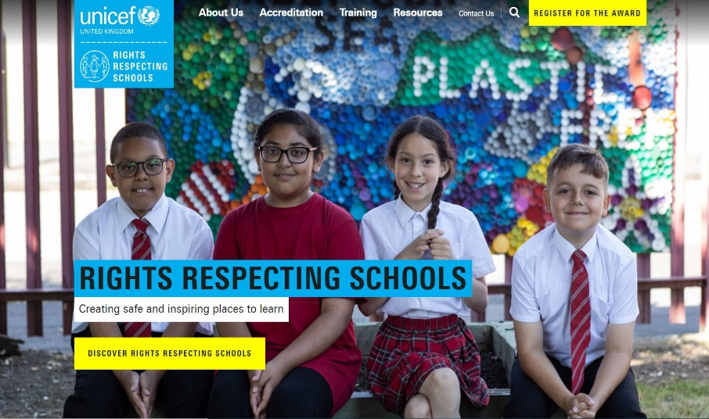
MORE INFO
RRSA WEBSITE
For more information or to download previous Article of the Week packs please visit the RRSA website by clicking on the link below.
CLICK HERE

