Slide 1
ARTICLE OF THE WEEK
UNICEF/Bulghadaryan
Notes:
A girl with a drawing of the Armenian flag on her cheek photographed during an crafts class outside of the learning center established by UNICEF Armenia and Red Cross in Talin town.

Slide 2
INSTRUCTIONS
Slide 3: Introducing Articles 7 & 8
Slide 4 & 5: Exploring Article 7 & 8 - Question and Answers
Slide 6, 7 & 8 : Primary activities
Slide 9, 10 & 11: Secondary activities
Slide 12: Reflection

Slide 3
ARTICLES 7 & 8
Article 7 & 8
Article 7 – birth registration, name, nationality, care
Every child has the right to be registered at birth, to have a name and nationality, and, as far as possible, to know and be cared for by their parents.
Article 8 – Protection and Preservation of Identity
Every child has the right to an identity. Governments must respect and protect that right, and prevent the child’s name, nationality or family relationships from being changed unlawfully.
Kathy Allan, RRSA Professional Adviser,
introduces Articles 7 & 8
Click here to watch on YouTube

Slide 4
EXPLORING ARTICLES 7 & 8
List as many things as you can think of that help to make you a unique and wonderful person!
Have a think and write down some answers.

Slide 5
EXPLORING ARTICLES 7 & 8
Appearance
Talents
Nationality
Life story
Name
Religion
Gender
Sexual orientation
Family
Interests
Ethnicity
Skills
Medical conditions
Age
Opportunities
Experiences
Did you think of any other reasons?

Slide 6
PRIMARY ACTIVITIES
You do not need to complete every activity but if you have time, you can try to complete more than one.
Our names are very important to us. Discuss why names matter and the right to a name, then play a name game in a circle. You could use a name song, such as this one, for very young children or play the ‘My name, your name’ clapping game with older children.
Being able to write your own name is a really important skill. Spend some time practising this. Create a class display of everyone’s names and link this to Article 7.
Look at a map of the world or a globe. How many different countries you can see? People have the right to belong to a country - this is called their nationality. What nationalities are represented in your class or group?
It is important to try to pronounce people’s names correctly to respect the right to a name and identity. Read ‘Your Name is a Song’ by Jamilah Thompkins-Bigelow or watch this video. Turn your name into a song or write it phonetically to show how it is pronounced.

Slide 7
PRIMARY ACTIVITIES 2
You do not need to complete every activity but if you have time, you can try to complete more than one.
Read ‘Alma and How She Got Her Name’. Find out the story of your name and then share this with your class.
Identity is what makes you unique. How would you describe your identity to somebody who does not know you? Try using a mixture of words and pictures.
What is your nationality? Do you know what the national flag looks like? Look at other flags, pick a favourite and find out which country it belongs to. Talk to your class about how you celebrate your nationality. Perhaps through days like Burns’ Night, St George’s Day or Chinese New Year?
Have you ever been to a naming ceremony, like a Christening or a Namkaran? Find out about naming ceremonies in different faiths or cultures. What are the similarities and differences?

Slide 8
PRIMARY ACTIVITIES 3
You do not need to complete every activity but if you have time, you can try to complete more than one.
You might have learnt about protecting your identity as part of online safety. Why is it important not to share information about your name, date of birth, location or other details that might identify you? Design a poster to remind people about this.
Why do you think it is important to be registered at birth? Discuss as a class and try to think about what other rights might be impacted if someone is not registered.
Even when people’s identities are different, we can always find characteristics in common. And even when we have similar identities, we will have something that makes us individual. Talk to someone you wouldn’t normally work with. Find one thing you have in common and one thing you don’t. Create a class display to show these similarities and differences.
What makes you proud about your identity, name and nationality? Imagine if the government decided to ignore individual identity and just give everyone a number. Then write a letter to protest about this, explaining your opinions and feelings.

Slide 9
SECONDARY ACTIVITIES
You do not need to complete every activity but if you have time, you can try to complete more than one.
In some countries people have to carry ‘identity cards’. In the UK many people have passports as proof of their identity. Find out what information is included on a passport, how you get one and what a passport helps you to do.
Ask your family why you have the name you have. Is the name you are called the same or different to your official name? Does your name have a meaning? Research the most popular names in the UK. What were the most popular names in the year you were born?
Learn more about identity theft. Why is this important to know about and how can you protect yourself when you are online? Make some suggestions about how your school could do more to promote awareness of this, linked to rights.
Watch the first few minutes of this TED Talk about identity. Discuss with your friends or in class some of the reasons why we should value our legal identity and not take it for granted.

Slide 10
SECONDARY ACTIVITIES 2
You do not need to complete every activity but if you have time, you can try to complete more than one.
Watch this video from the #nonamecampaign run by UNICEF and the African Union. As a class, discuss how the right to a name and identity link with other rights in the CRC.
What is your nationality? Do you know the flag that represents your nationality? Create a display of the flags that represent all of the nationalities in your class or school to celebrate your diversity.
Think of as many words as you can that describe your identify. Using the website www.wordle.net create an image that can be shared and displayed in your school.
Create a piece of art, a poem, a song, or dance to say something about your identity, such as the things you like, you as a person, what you enjoy and where you are from. Express yourself!

Slide 11
SECONDARY ACTIVITIES 3
You do not need to complete every activity but if you have time, you can try to complete more than one.
Even when people’s identities are different, we can always find characteristics in common. When we have similar identities, we will have something that makes us individual. Talk to someone you wouldn’t normally work with. Find one thing you don’t have in common and one thing you do.
Have you ever watched the BBC programme ‘Who Do You Think You Are?’ It’s a documentary series where celebrities investigate their family history. They usually discover relatives with very surprising life stories, and this is often quite moving. Speak to some of your relatives and write up some of your family stories.
Watch this video (1) to learn about the impact not having a nationality has on children. Find out what is being done across the world to support children’s right to a nationality and watch this video (2).
What could you do to take action on this issue?
1.
Why is it important to celebrate features of people’s identity, such as their ethnicity, language, religion, sexual orientation amongst others? What more could be done in our society, in your school, or by you as an individual to protect and celebrate these aspects of people’s identity?
2.

Slide 12
REFLECTION
Take a few quiet moments on your own to think about your identity and your personal thoughts about who you are. How you would answer the following questions
Our right to a name, a nationality and an identity is something special and should be valued.
Think about what makes you who you are.
What are you proud of about yourself?
How can you respect and appreciate other people’s identity?
How might you share this with them?
How does respecting different identities make for a better world?

Slide 13
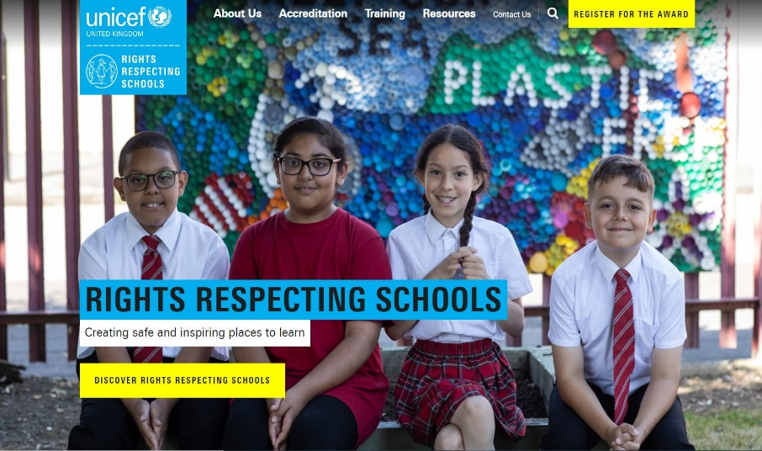
MORE INFO
RRSA WEBSITE
For more information or to download previous Article of the Week packs please visit the RRSA website by clicking on the link below.
CLICK HERE

