Slide 1
ARTICLE OF THE WEEK
© UNICEF/UN0583266

Slide 2
INSTRUCTIONS
Slide 3: Safer Internet Day
Slide 4: Linked articles
Slide 5 & 6: Exploring Safer Internet Day – questions and answers
Slide 7, 8 & 9 : Primary activities
Slide 10, 11 & 12: Secondary activities
Slide 13: Reflection

Slide 3
Safer Internet Day is marked on 7 February every year.
We all have a right to feel safe and secure and that means safe online as well as in the real world. Safer Internet Day is an annual event that promotes the safe, responsible and positive use of the internet.
There are a large number of articles that link with being online. This week’s activities have a particular focus on Article 19, the right to protection from harm, Article 17, the right to reliable information and Article 34, protection from exploitation.
The internet can be a great place but needs to be used carefully. Please use these activities to start the conversation about internet issues that matter to you, what changes you would like to see and how we can make it a more positive and rights respecting place!
Your school can register its support for Safer Internet Day here. If you share things you have done, please mention your links to children’s rights.
SAFER INTERNET DAY
Jilly Hillier, RRSA Professional Adviser,
introduces Safer Internet Day
Click here to watch on YouTube

Slide 4
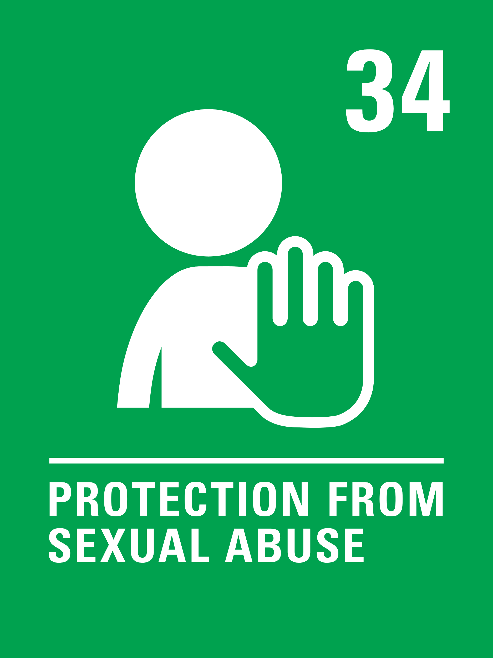
LINKED ARTICLES
This week’s activities link to the following articles:
Article 17, Access to information from the media - Every child has the right to reliable information from a variety of sources and governments should encourage the media to provide information that children can understand. Governments must help protect children from materials that could harm them.
Article 19, Protection from violence, abuse and neglect - Governments must do all they can to ensure that children are protected from all forms of violence, abuse, neglect and bad treatment by their parents or anyone else who looks after them.
Article 34, Sexual exploitation - Governments must protect children from forms of sexual abuse and exploitation.

Slide 5
EXPLORING SAFER INTERNET DAY
This week there are TWO questions to think about!
1. What do you feel are some of the great things about the internet and life online?
2. What don’t you like about the internet and life online?
Note your ideas down or discuss them in a group and then compare your thoughts with the next.

Slide 6
EXPLORING SAFER INTERNET DAY
Great things …
You can find out lots of information quickly and easily.
You can connect with your friends even if you can’t meet face-to-face.
Learning is possible even if you haven’t got books at home or access to a library.
There are lots of fun games and activities to do online.
You can keep in touch with family and friends who live far away.
It can increase equality and democracy because more people can have their voices heard.
You can shop and bank online which is good for people who are busy, not near the shops or have mobility issues.
You can visit places remotely that you can’t get to in person.
It helps you find places in the car and people you want to contact with.
I don’t like it when …
People don’t respect each other and make unkind comments.
Children use it to bully other children.
People’s right to privacy is not always respected.
Some information is not reliable and there is a lot of fake news.
People are sometimes tricked out of money and savings.
Companies and businesses are hacked and your information can be shared without your consent.
I spend too much time online instead of doing other things.
People make fun of others because they don’t have the latest technology.
Did you think of any other reasons?

Slide 7
PRIMARY ACTIVITIES
You do not need to complete every activity but if you have time, you can try to complete more than one.
Read ‘Digiduck’s Big Decision’ - there is an online version which would work on your class screen. Discuss the lessons from the story about friendship and respect online.
You can also explore other resources from this series.
Have a discussion and perhaps create a display about safe play and friendship in the playground and safe play and friendship online.
Smartie the Penguin is a downloadable story to share with younger children about how to stay safe online and the importance of talking to an adult if they are worried about something they see.
Draw a picture of your favourite online game or character.
Discuss the sort of helpful message they might give to you and other children.
You could add these to the pictures as speech bubbles.

Slide 8
PRIMARY ACTIVITIES 2
You do not need to complete every activity but if you have time, you can try to complete more than one.
Your right to be safe and protected is always important, including when you use computers, phones and the internet. Can you think of three top tips for staying safe online? Use thinkuknow.co.uk to help. Discuss this with adults in your house or share with your class.
In Circle Time talk about any worries you might have about the internet. Decide on some conversation guidelines that include listening respectfully and being supportive.
As part of your discussions decide on three things you will do as a group to address your worries.
The NSPCC have teamed up with Ambitious About Autism to help children think about chatting safely online. Have a look at this PowerPoint and choose five key things that could go on an information leaflet or display about online safety…
which rights could you link your points to?
You might know more about the internet than the adults who care for you. Think about talking through this leaflet with them so together you can sate safe online.

Slide 9
PRIMARY ACTIVITIES 3
You do not need to complete every activity but if you have time, you can try to complete more than one.
Do you know how to spot fake news? The information we get from social media is not always accurate or true. Watch this Newsround video and learn how BBC reporters make sure the information they report is reliable. Make your own video to highlight the importance of checking your facts when writing a news report.
Talk about how things might go wrong with friendships online.
Try to make up some examples and then work out ways of resolving or sorting out these difficulties. Remember some situations might require adult help.
Work as class to design an advice guide to share your ideas.
Watch this video in which two children talk about some important rights that protect children from exploitation. See how many rights you can remember that the children talk about. Discuss how the rights mentioned link with life online.
Watch this video about safe and respectful relationships online. Talk about the lessons you learned from watching it. Could you make your own class version of the video or act out your own version for an assembly? The children in the video don’t mention their rights but you could!

Slide 10
SECONDARY ACTIVITIES
You do not need to complete every activity but if you have time, you can try to complete more than one.
Each year there is a theme for Safer Internet Day. Find out about this year’s and do some research around it. Most organisations don’t naturally make links to rights but you can!
Present this year’s message about internet safety for your year group or school, with lots of links to the articles of the CRC.
Create leaflets, posters or a page on your school’s website signposting all pupils to charities and organisations who can help people experiencing things that worry or upset them online.
Evidence shows that many young people want their parents or carers to use the various filters and controls available on home Wi-Fi and devices.
Discuss why you think this is the case. What advice would you give to your peers about having a family conversation about this?
Have a go at this quiz about cyberbullying.
Find ways to raise awareness in your school about the issues it raises.

Slide 11
SECONDARY ACTIVITIES 2
You do not need to complete every activity but if you have time, you can try to complete more than one.
The media sometimes talks about violence, controlling language and behaviours and other abuse, particularly towards women. Such attitudes are often promoted online, through content on social media platforms like TikTok or WhatsApp. Use this video as the starting point for class discussion about abuse online. How does your knowledge of rights inform this discussion?
Article 34 is about protection from all forms of sexual abuse and exploitation. You might have heard of online grooming. Watch this video by Childline and think about how you can raise awareness of what young people need to look out for to stay safe online. Discuss how grooming can be used in other harmful ways too.
Watch this video from a previous Safer Internet Day. The students are talking about ‘top tips’ to support positive and respectful relationships online. Work with friends to create your own ‘top tips’. Try to mention some relevant rights. Make a poster to display where children can easily see it and ask to share it on your school’s website.
Do you know how to spot fake news? The information we get from the internet or on social media is not always accurate or true. Do some research on ‘fake news’, link it to your knowledge of the CRC and present your findings to your class in form time or a PSHE lesson.

Slide 12
SECONDARY ACTIVITIES 3
You do not need to complete every activity but if you have time, you can try to complete more than one.
The Online Safety Bill sets out the government’s commitment to make the UK a safer place to be online while defending free expression. Do you think big tech companies like Facebook and YouTube do enough to protect young people? What kind of changes would you and your friends like to see?
Find initial information about the Online Safety Bill here.
Have a discussion about dignity and respect (looking up definitions may help you). How do these ideas relate to online play, gaming and social media? Work together to create a ‘top tips’ guide to promote respect for others online. Try to include positive messaging about respecting ‘no’ from another person and the idea of consent.
How many times a day do you use the internet? Discuss with a group if you think this is healthy? Research shows using the internet or being on electronic devices interrupts sleep patterns. Why do you think this is?
Have a look at the Safer Internet Day website. Explore some of the key messages. How could you promote their advice in school? Could the parental guidance be shared via a newsletter or on your school’s website?

Slide 13
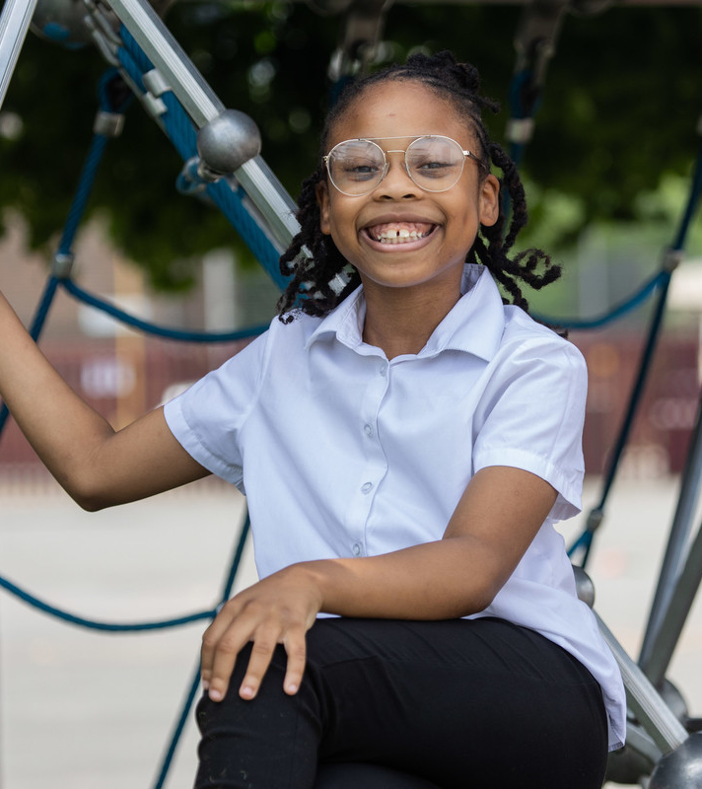
REFLECTION
Create some quiet time and find a safe and comfortable space.
Thinking about our lives online:
How can we make sure that the internet is a good place to talk?
What changes need to be made and who would you talk to if you had concerns about your own online life or someone else’s?
© UNICEF/Dawe

Slide 14
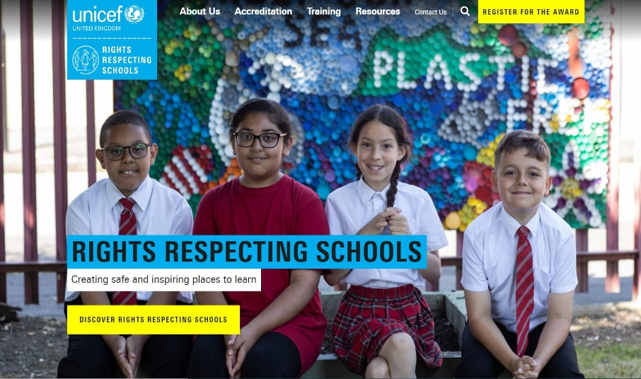
MORE INFO
RRSA WEBSITE
For more information or to download previous Article of the Week packs please visit the RRSA website by clicking on the link below.
CLICK HERE

