Slide 1
ARTICLE OF THE WEEK
UNICEF/Dawe

Slide 2
INSTRUCTIONS
Slide 3: Introducing Articles 13
Slide 4 & 5: Exploring Article 13 - Question and Answers
Slide 6, 7 & 8 : Primary activities
Slide 9, 10 & 11: Secondary activities
Slide 12: Reflection

Slide 3
ARTICLES 13
Article 13
Article 13 (freedom of expression)
Sharing Thoughts Freely
Every child must be free to express their thoughts and opinions and to access all kinds of information, as long as it is within the law.
Gerry McMurtrie, RRSA Senior Professional Adviser,
introduces Article 13
Click here to watch on YouTube

Slide 4
EXPLORING ARTICLE 13
Why do you think it’s important that children and young people are able to express their thoughts, ideas and opinions freely?
Have a think and write down some answers.

Slide 5
EXPLORING ARTICLE 13
Our views matter.
Free expression helps good conversation and discussion.
Many thoughts and ideas can lead to a better world.
Children have some great ideas that adults might never think of.
It helps to prepare you for adulthood.
Adults have this right so children should have it too,
It helps children and young people to feel valued.
Involving young people means there are more people to make a difference.
We all have different views and experiences, so including everyone means we get lots of perspectives.
It can help you to learn about politics and democracy.
We have rights!
Did you think of any other reasons?

Slide 6
PRIMARY ACTIVITIES
You do not need to complete every activity but if you have time, you can try to complete more than one.
Listen to this story, Everyone Gets a Say then discuss why it’s important to listen to lot of peoples ideas.
What can teachers do to make it easier for you to share your views? Draw a picture of a teacher and around them write all your ideas about how they can respect your right to express your thoughts and opinions.
What do the words ‘opinion’ and ‘viewpoint’ mean? Discuss as a class how your teachers listen to your opinions in different ways every day.
In circle time, ask children to share their favourite toy, or game, or story. Explore why there are so many different answers… that this is not just OK but actually a good thing. Talk about how it feels when people have different opinions to ours. This Peppy Pals video may help.

Slide 7
PRIMARY ACTIVITIES 2
You do not need to complete every activity but if you have time, you can try to complete more than one.
Watch this video clip of a pupil council meeting where they’re talking about homework. Have a discussion in your class about one aspect of school life. How can you encourage the sharing of as many different views as possible?
How do you like to express yourself?
Create some art, write a story, poetry or make up a song or dance, or draw a poster to show what it’s like to be you!
How can we make sure every child enjoys Article 13 and that everyone is included?
Can you think of different ways adults help particular individuals and groups of children to express themselves.
What resources might some children need?
You have the right to express yourself. Can you find out about groups in school or your community that you can join to help you express yourself?

Slide 8
PRIMARY ACTIVITIES 3
You do not need to complete every activity but if you have time, you can try to complete more than one.
Can you think of a someone famous who uses their freedom of expression to be heard? Watch this video of Greta Thunberg addressing adults at COP26 for inspiration. Is there anything that you feel very strongly about? How do you express your thoughts about this issue? How could you share your views in school?
Do you remember looking at Article 12 about children’s views being taken as seriously as those of adults? Can you explain to your friends or teachers how Articles 12 and 13 support each other?
Do you know the story of Malala Yousafzai? Malala continues to use her right to share her thoughts freely to change the world, even though people tried to stop her doing so. How might people like Malala and Greta Thunberg inspire other young people to express their opinions? Are there qualities they show, that you would like to develop? Explore these questions in a piece of writing or by discussing in groups.
You have the right to access information as long as it is within the law. Why are there age limits on who can access things, like films or social media? Watch this video and talk to your class about how you stay safe online.

Slide 9
SECONDARY ACTIVITIES
You do not need to complete every activity but if you have time, you can try to complete more than one.
How would you define the words viewpoint, opinion and thoughts? Look them up to check and then discuss how this information relates to Article 13.
How does your school enable everyone to express their thoughts and opinions. Think about individual lessons as well as wider school life.
Do opportunities for this apply equally to all young people?
Work with classmates to design a survey to explore this further. Share what you find with school leaders and the School Council.
You have the right to express yourself and look for information to help you to develop and share your opinions.
How do you do this in your life?
Even if you’re too young to vote, there are people elected to represent you, including Councillors and members of parliaments or national assemblies. Find details of one of your elected representatives and contact them to share your views on an issue that matters to you.

Slide 10
SECONDARY ACTIVITIES 2
You do not need to complete every activity but if you have time, you can try to complete more than one.
Watch this video about differing opinions within friendships. What did you hear that you agreed with? Discuss how you deal with different viewpoints in your friendship groups.
Using a top news story from a trusted organisation’s website as inspiration, run a class debate on one of the issues reported.
How will you be sure to include a range of opinions?
Are there some views that you hold very strongly now that differ significantly from what you previously thought? Tell this as a story called ‘I’ve changed my mind’ or share with a group in class how the change happened.
It is a crime to harass someone because of their race, gender, sexuality, disability, or religious beliefs. Article 13 is also a human right. It is important that while expressing yourself, you do not stop others from enjoying their rights. Talk about why this is important or research the impact of hate speech on the rights of others.

Slide 11
SECONDARY ACTIVITIES 3
You do not need to complete every activity but if you have time, you can try to complete more than one.
Watch this video from Amnesty International and then use their website to find out about how freedom of expression is not always allowed in a number of countries.
You may have seen young poet and activist Amanda Gorman perform her poem The Hill We Climb at the inauguration of US President Joe Biden. In this video, she explains how poetry is her way of expressing her views and opinions. How do you express yourself? Write a poem, draw a picture, compose a song or find another way to share how you feel.
Watch this video of Greta Thunberg addressing adults at COP26 for inspiration. Investigate some other activists or campaigners. What are the skills and strategies they use to strengthen the communication of their views. Discuss such techniques in an English lesson.
One way to express your opinions is to campaign for change. UNICEF UK’s Youth Advocacy Toolkit is designed to help young people to identify an issue and to express their views about it, to bring about change. Have a look and perhaps have a go.

Slide 12
REFLECTION
Watch this short story (it may seem to be aimed at younger children but there is a message for everyone!)
Then….
Spend a few minutes thinking about these questions…
What ideas do you have to make things better? In your life? At home? At school?
Do you think it’s important to listen to get ideas from lots of different people?
How can your school encourage people to share their ideas and show that they’re listening?

Slide 13
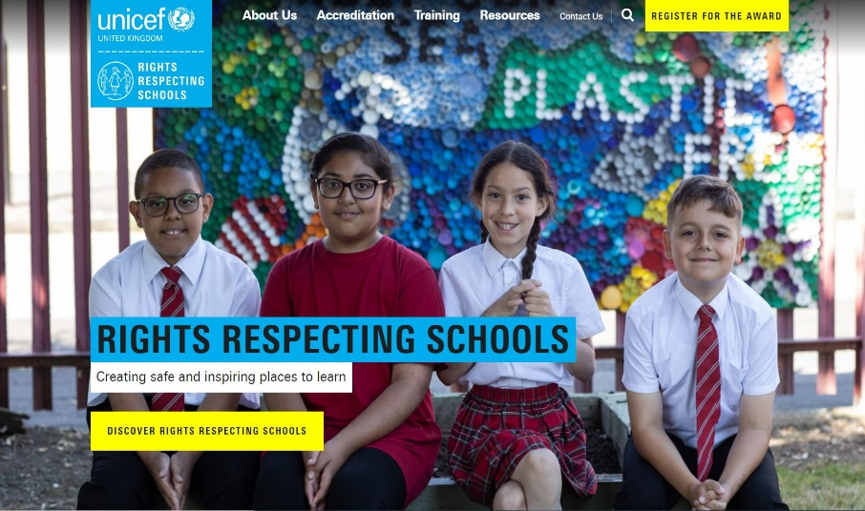
MORE INFO
RRSA WEBSITE
For more information or to download previous Article of the Week packs please visit the RRSA website by clicking on the link below.
CLICK HERE

